Slide 1
Evaluating the Impacts of NASA- SPoRT Daily Greenness Vegetation Fraction on Land Surface Model and Numerical Weather Forecasts
Jordan Bell
NASA SPoRT Summer Intern 2011

Slide 2
Outline
Background
Goals of Project
Methodology
Analysis of Land Surface Model Results
Severe weather case study: 17 July 2010
Conclusions

Slide 3
Background
NASA SPoRT produces a real time Greenness Vegetation Fraction (GVF) using MODIS data aboard NASA polar-orbiting satellites
GVF is percent coverage of healthy vegetation
Operational models currently use a ~20 year old static GVF dataset
SPoRT/MODIS GVF data provides advantages
Response to anomalies (urbanization, extreme temp/moist.)
Better resolution (~15x higher)

Slide 4
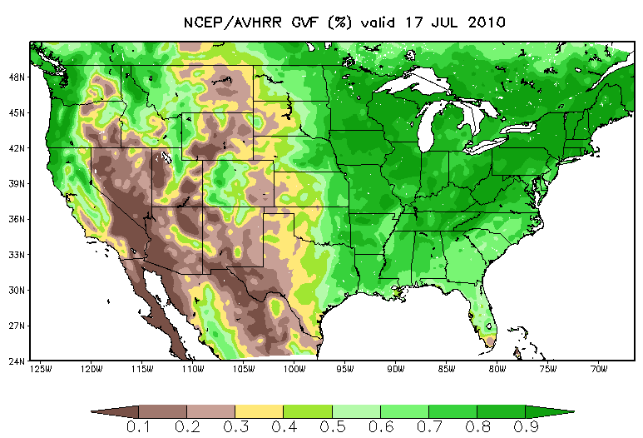
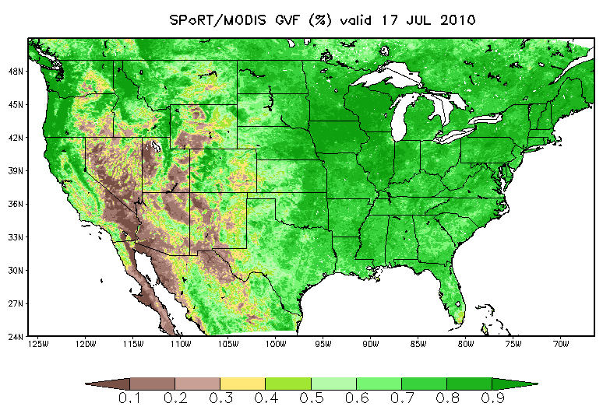
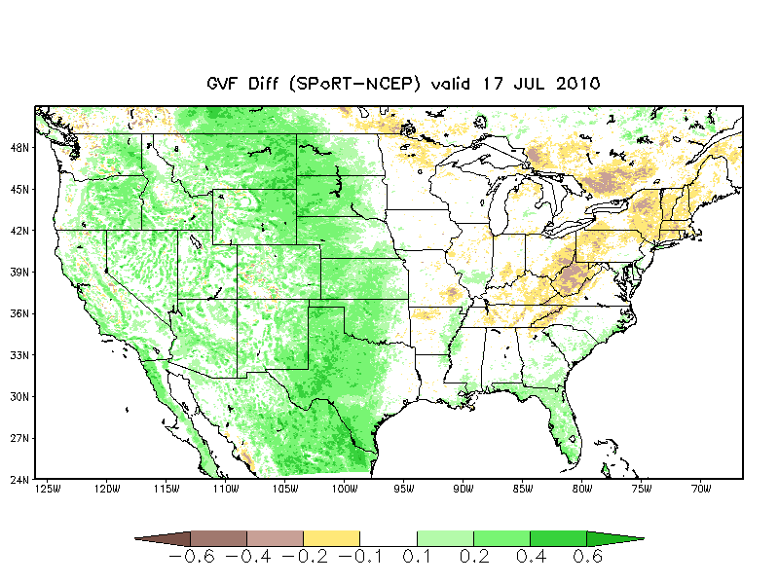
GVF Comparison: 17 July 2010
Improved resolution
Ability to resolve vegetation variation in complex terrain
Greener in Western U.S.
Nearly 20-40% over High Plains
High Plains rainfall well above average in previous 3 months
NW
NE
SW
SE
Notes:
The above slide shows the two data sets that were used for this project. The upper left picture is the NCEP climatology, the above right is the real time SPoRT GVF product. And the bottom image shows the difference between the two images. The are just east of the Rocky Mountains is 20%-40% greener than climatology. In this portion of the country, some of these areas experienced nearly 600% their normal rainfall.

Slide 5
Goals of Project
Compare SPoRT/MODIS to NCEP climo GVF
2010 warm season (1 June – 31 Oct); Continental US
NASA Land Information System (LIS) used to quantify impacts on the Noah land surface model
Examine impacts of SPoRT GVF on NWP using the Weather Research and Forecasting (WRF) model
17 July 2010 Upper Midwest severe weather event
36-hour CONUS forecast at 4-km resolution

Slide 6
Methodology
Offline LIS run:
→Noah Land Surface Model
→Atmospheric analyses from GFS Data Assim. System
Notes:
Talk about LIS:
LIS is a land surface modeling and data assimilation system that can run various land surface models.
We chose the Noah land surface model because it is used operationally in NCEP models.
LIS can be run in an offline, or spin-up mode, where the land surface model is run apart from NWP models.
OR LIS can be run coupled to the WRF model (e.g. 17 July WRF forecast case study)

Slide 7
GVF Quadrant Comparison: SPoRT vs. NCEP; 1 June to 31 October
SPoRT GVFs:
Consistently higher in western U.S.
Have more day-to-day variation
NE: Slightly lower in mid-summer, then higher in early Fall
SE: Closest to NCEP
Warmer than normal temperatures out East in Fall 2010

Slide 8
Land Surface Model Stats: NW Quadrant
Higher SPoRT-GVFs lead to:
Higher latent heat fluxes due to increased evapo-transpiration
Lower sensible heat flux initially
More rapid drying of soil moisture
By late Summer/Fall:
Both latent and sensible heat flux increase
This is due to drier soils that cause more rapid surface heating
GVF Diff, Peak Heating
(SPoRT – NCEP)
Sensible Heat Flux Diff
Soil Moisture Diff
Latent Heat Flux Diff
Notes:
Remember to transition to the 17 July case study with an introduction statement.
Now that we have examined the NW Quadrant, where the GVF’s are higher, lets examine a case where the higher GVF values on the eastern edge of the NW quadrant play a role in a severe weather outbreak.

Slide 9
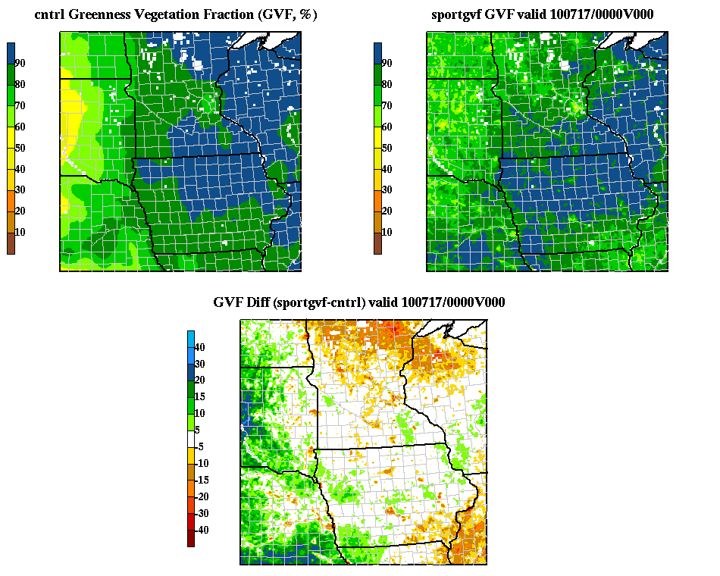
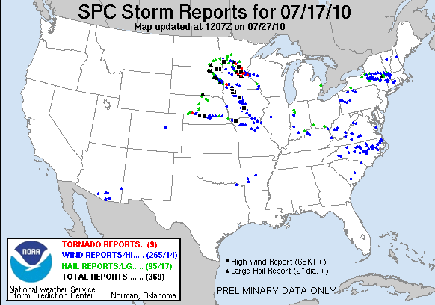
17 July 2010 Case Study
MSP
OMA
DSM
Urban areas can be resolved much better by the SPoRT GVF.
Higher GVFs prevail from NE to ND.

Slide 10
WRF Run 21-h fcst: 2-m Temp
Higher SPoRT GVFs in the western portion of the focus area lead to lower forecast 2-m temperatures

Slide 11
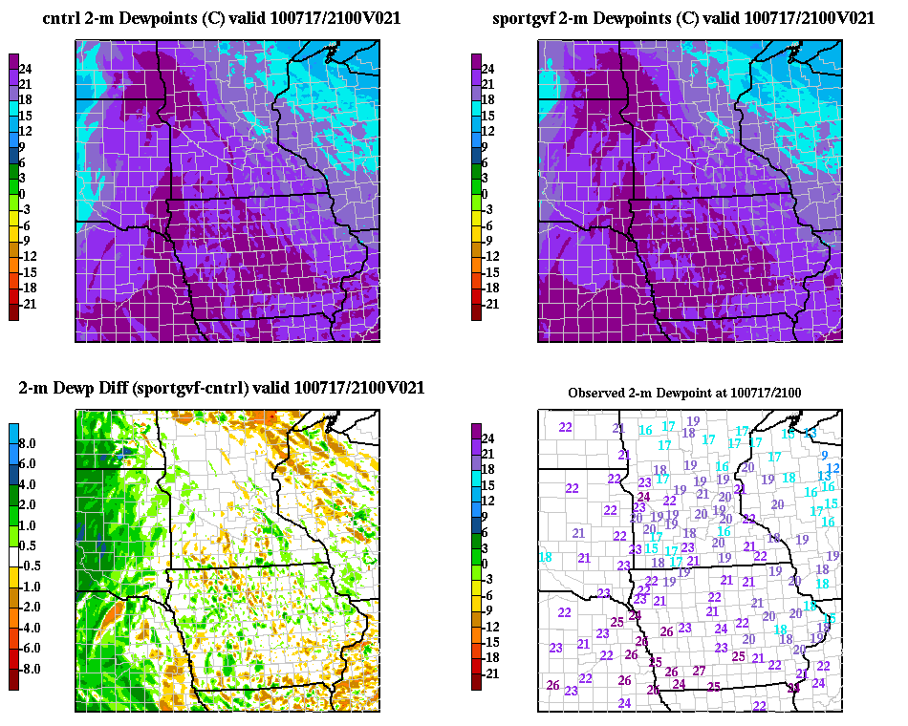
WRF Run 21-h fcst: 2-m Dewp/CAPE
Higher GVF values lead to higher 2-m dewpoints
Net result is increase in CAPE up to 1000 J kg⁻¹

Slide 12
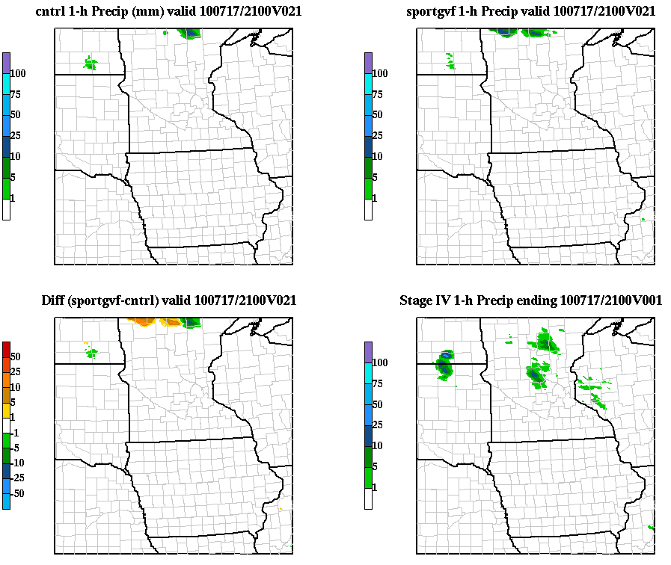
Forecast 1-h precip: 21-36 h forecasts
Notes:
On this slide I think it would be best to just have animation gif of the precip graphics on a loop. I will discuss

Slide 13
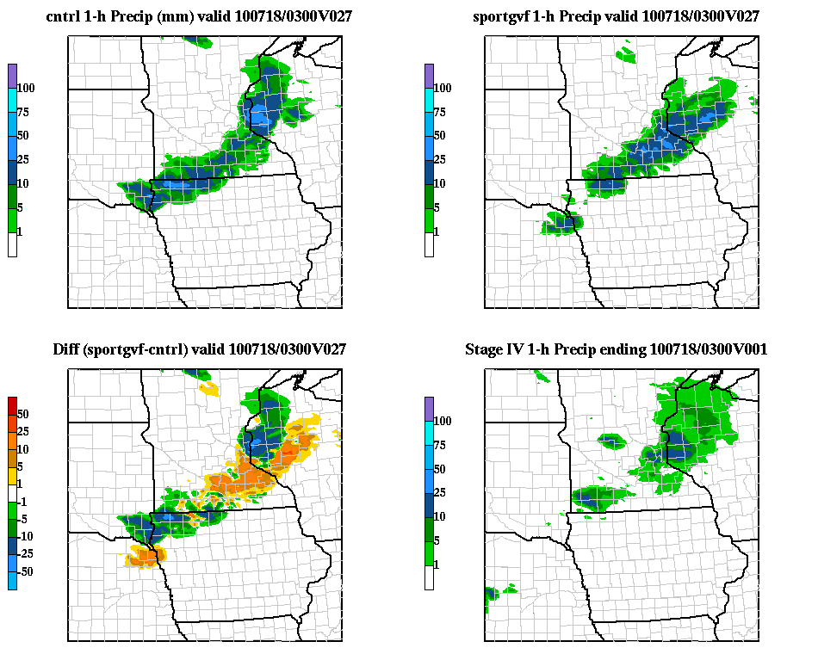
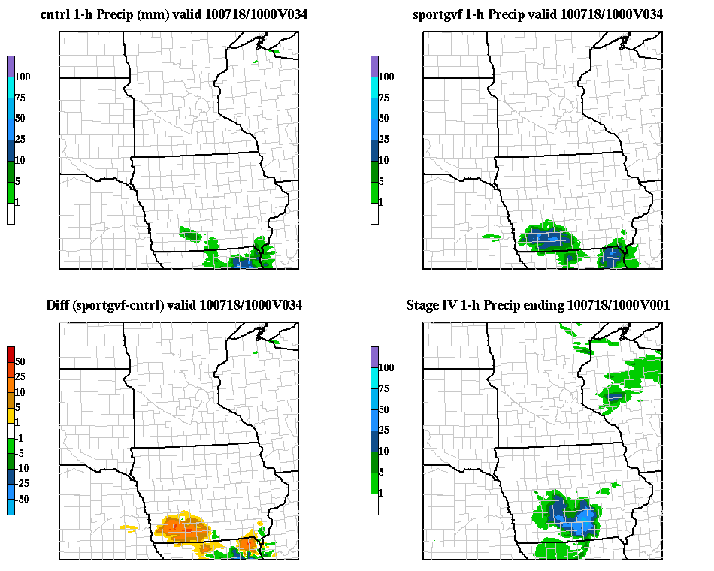
Forecast 1-h precip: 27/34 h forecasts
Both model runs close on placement
Variation in intensity
SPoRT suggests more discrete convective mode, similar to obs.
NCEP takes convection through domain faster
SPoRT run is still closer on intensity and placement
Notes:
highlight discrete convective mode at 27 h.
highlight improved evolution of precip features by 34 h.

Slide 14
Summary and Conclusions
Higher SPoRT GVFs in the western U.S. and Mexico
Greater moisture transport into the atmosphere
More rapid soil drying in the Noah land surface model
Model run using SPoRT GVFs showed some improvement on the 17 July severe weather case
Because the vegetation patterns of the U.S. have changed since the NCEP dataset was derived, further exploration should be done to see if a real time dataset would enhance the accuracy of forecast models

