Slide 1


Session 2:
Situational Awareness
Overview
Sixth Meeting of the Science Advisory Committee
28 February – 1 March 2012
National Space Science and Technology Center, Huntsville, AL
transitioning unique NASA data and research technologies to operations

Slide 2
Situational Awareness: Introduction
What is this?
  Near real-time and short-term observations to support end users
  Supports severe weather applications, diagnosing model initial conditions, assessing current conditions, and others
Core capabilities
  Remote sensing applications and observational analyses
    MODIS, total lightning, AIRS, GOES, VIIRS, passive microwave
  Proven paradigm of transition, training, and assessment
  Put products in end user’s decision support system
    Started with AWIPS I
    Developing plug-ins to utilize all SPoRT data in AWIPS II
    Demo to follow
transitioning unique NASA data and research technologies to operations

Slide 3
Situational Awareness: Relevance
Address multiple NWS forecast concerns
  Convective initiation, lightning safety, severe weather warnings
  Improving decision support in end user’s decision support systems
  Fog, smoke, and fire monitoring
  Snow cover monitoring
  Sea surface and Great Lakes temperatures
  Obs in data poor regions (Alaska, WindSat, passive microwave)
  Supporting the “Ice Desk” in Alaska
  Air mass, microphysics, and dust observations with RGBs
  Tornado damage track assessment
  Improved near-shore fog and precipitation forecasting
  SPoRT Product Status web page
transitioning unique NASA data and research technologies to operations

Slide 4
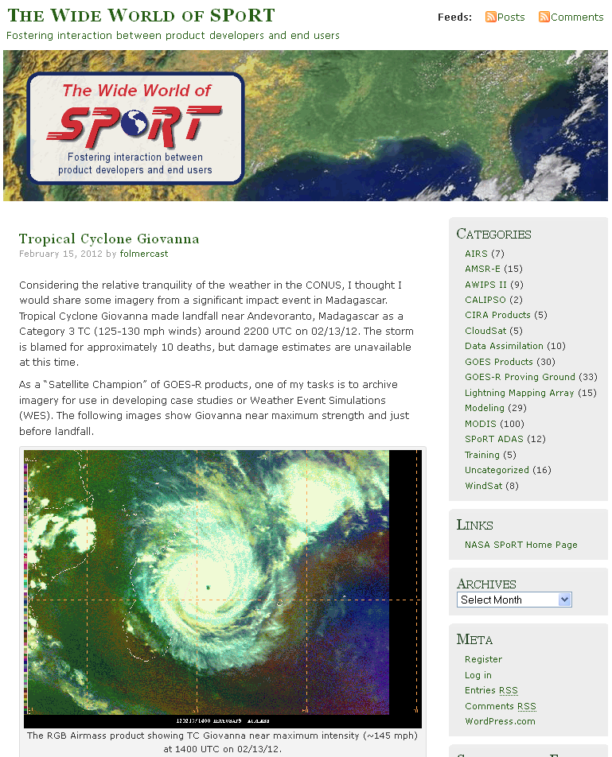
Situational Awareness: Relevance
Success of transitions improved by:
  Training
    Web modules
    Site visits, coordination calls
    Workshops
    Science sharing
  Assessments
    Web surveys
    SPoRT blog
    Intensive survey periods
    Site visits, coordination calls
    Conference and journal articles
  Listening to the end user!!
transitioning unique NASA data and research technologies to operations

Slide 5
Situational Awareness: Accomplishments
“…provide information on the link of NASA data to future NOAA data sets.” – 2009 SAC
  SPoRT addressing this with several projects
  MODIS to VIIRS and the Advanced Baseline Imager
  Ground-based total lightning to the Geostationary Lightning Mapper
“Ensure objectives, targeted end-users, and deliverables are identified both for the project plan and for future SAC reviews” – 2009 SAC
  Bi-weekly products meeting
  Working with WFO partners to develop focused, project oriented calls
transitioning unique NASA data and research technologies to operations
Notes:
What other testbeds are we working with?

Slide 6
Situational Awareness: Speakers
PRESENTATIONS
NASA data and products (Smith)
Other experimental and research products (Smith)
Total lightning (Stano)
Examples from Albuquerque, WFO (Guyer)
Product training (Fuell)
Product assessment (Fuell)
Future focus of activities (Stano)
Open discussion
transitioning unique NASA data and research technologies to operations

