Slide 1
Hyperspectral IR Data Assimilation
Science Advisory Committee Meeting
26 – 28 August, 2014
National Space Science and Technology Center, Huntsville, AL

Slide 2
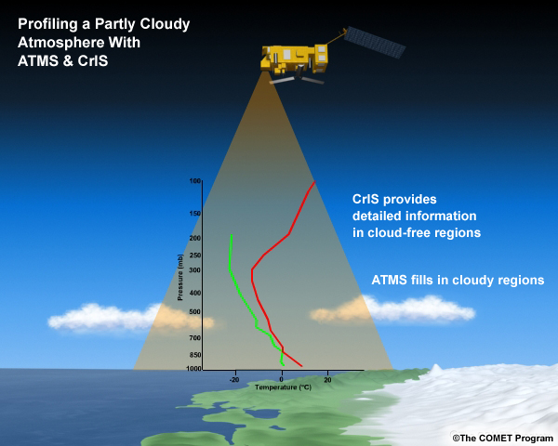
Introduction
1
SPoRT assimilates AIRS, CrIS, and IASI profiles into regional models to demonstrate their impact on NWP and address specific forecast issues
Atmospheric rivers
Stratospheric intrusions and non-convective winds
SPoRT is working to improve hyperspectral IR profile assimilation
Development of a GSI module to assimilate profiles with specific error characteristics
Apply bias correction to profiles
SPoRT is working to improve hyperspectral IR radiance assimilation
Satellite cloud top pressure (CTP) comparison
Example CrIS/ATMS profile
@COMET Program 2012

Slide 3
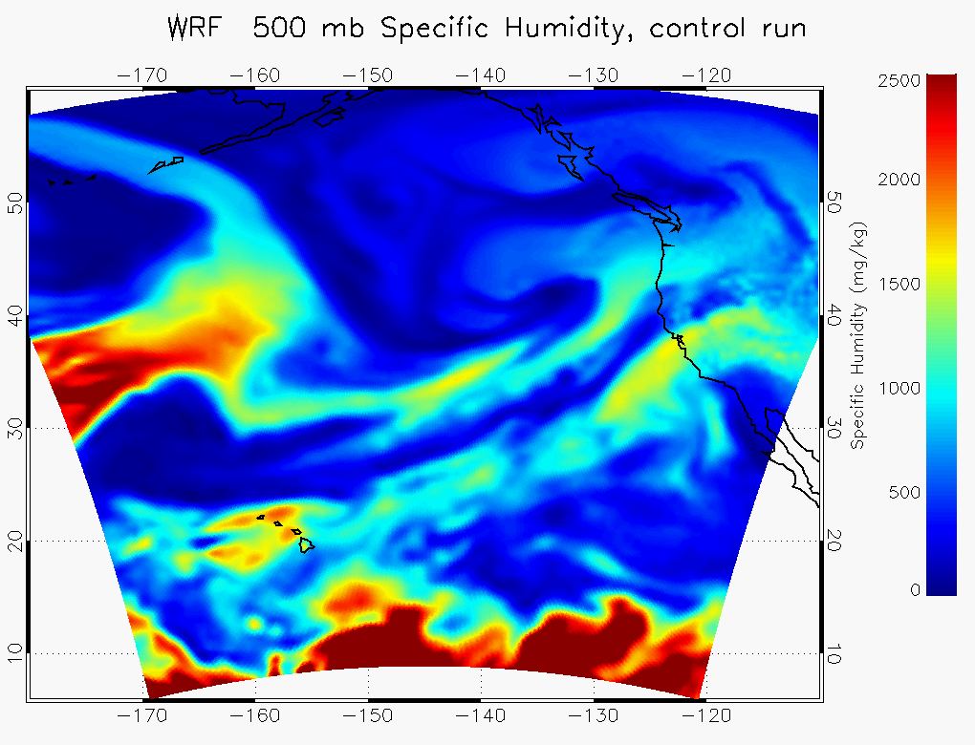
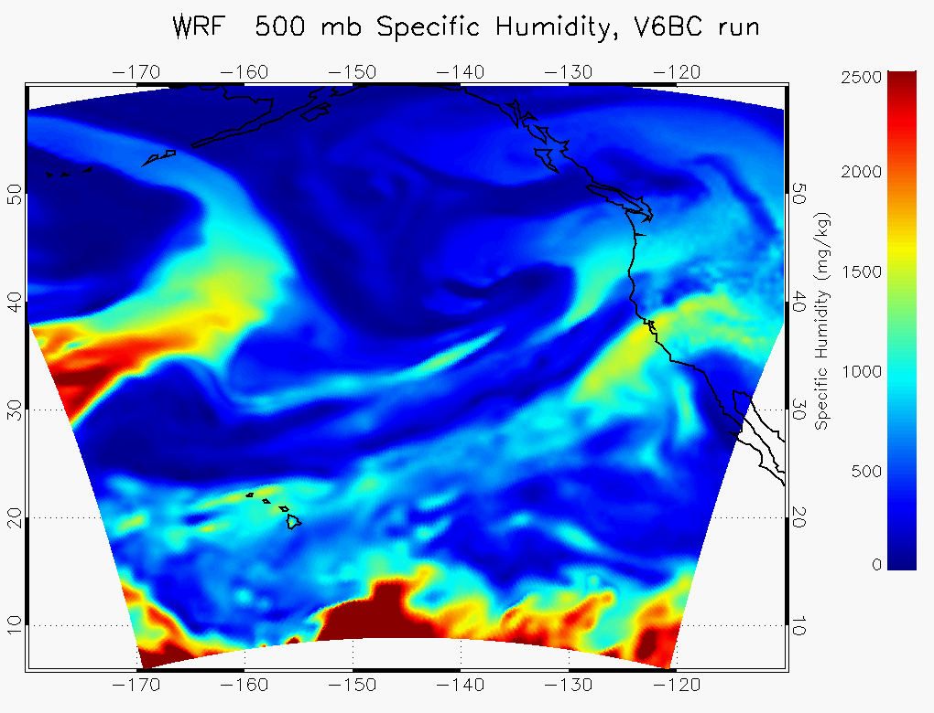
Atmospheric Rivers
2
Problem: Forecasting heavy precipitation associated with atmospheric rivers and anticipating severe flooding is a challenge for West Coast WFOs and WPC/OPC
Goal: improve WRF atmospheric river forecasts by assimilating AIRS profiles (above the cloud) where radiances are rejected
Preliminary collaboration with HMT
Future opportunities:
Validate rainfall forecasts from AIRS profile assimilation
Similar studies could be done with CrIS
Atmos River narrower after AIRS assimilation

Slide 4
Stratospheric intrusions and non-convective wind forecasts
3
Problem: cyclogenesis, stratospheric intrusions, and non-convective winds are critical forecast challenges for WPC/OPC and model representation needs improvement
Goal: improve model representation of stratospheric intrusions and near-surface winds by assimilating AIRS, CrIS, and IASI t, q profiles
First project using CrIS profiles
Stratospheric intrusion
Non-convective wind

Slide 5
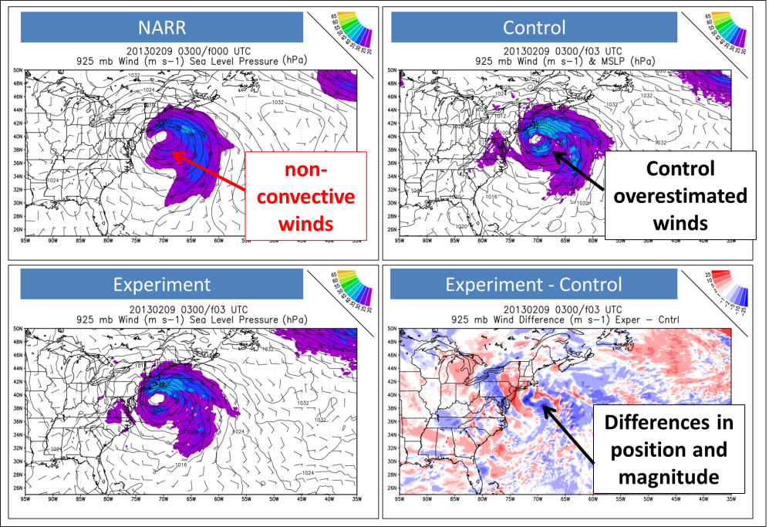
Stratospheric intrusions and non-convective wind forecasts
4
Results show modeling low-level stability is more important to near surface wind forecast than correctly modeling the stratospheric intrusion
Experiment
NARR
Modeling low-level stability could be improved by:
developing a GSI Module to assimilate profiles with more appropriate error values
Control
Control
Experiment

Slide 6
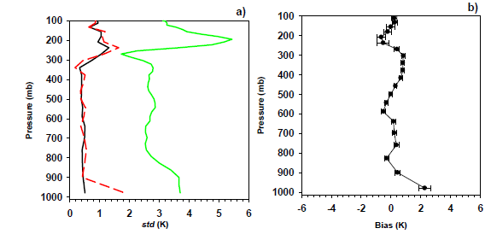
Development of GSI module
5
Since <10% of radiances are assimilated there has been a shift to assimilate some cloud-affected radiances; but this is complex
Hyperspectral IR profile assimilation might offer a less complex approach in partly cloudy regions
Problem: Profiles are traditionally assimilated as rawinsondes and assigned unrepresentative error values
Radiosonde: t = 0.5 K, q = 5%
AIRS: t = 1K/km, q = 15%/2km
T bias against radiosondes more than +/- 0.5 K
Increased error below 900 mb
a) IASI temperature retrieval errors and b) bias against radiosondes. Black line expected std error, red dashed line error assessed by validation, green line variances derived from radiosondes (Pougatchev et al. 2009)
Goal: modify GSI source code to assimilate profiles in a separate module with error values representative of AIRS, IASI, and CrIS

Slide 7
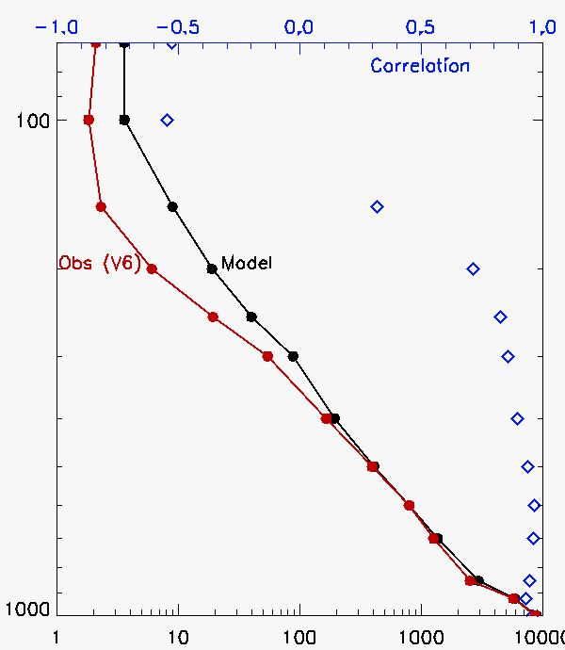
Assimilation of AIRS bias corrected profiles
6
Problem: there is a systematic humidity bias between the model background and AIRS mid-upper level q retrievals
Goal: improve WRF forecasts by assimilation of corrected profiles
Atmospheric River forecasts show bias correction was effective since narrower feature and mean innovation (obs-background) was near zero*
Future opportunities:
Similar studies with CrIS
More optimal profile assimilation
Mean Model/Obs q Profiles
apply bias correction to q profiles at each layer
Drier Obs mid-upper levels
*Narrower feature not just a result of obs drying the model

Slide 8
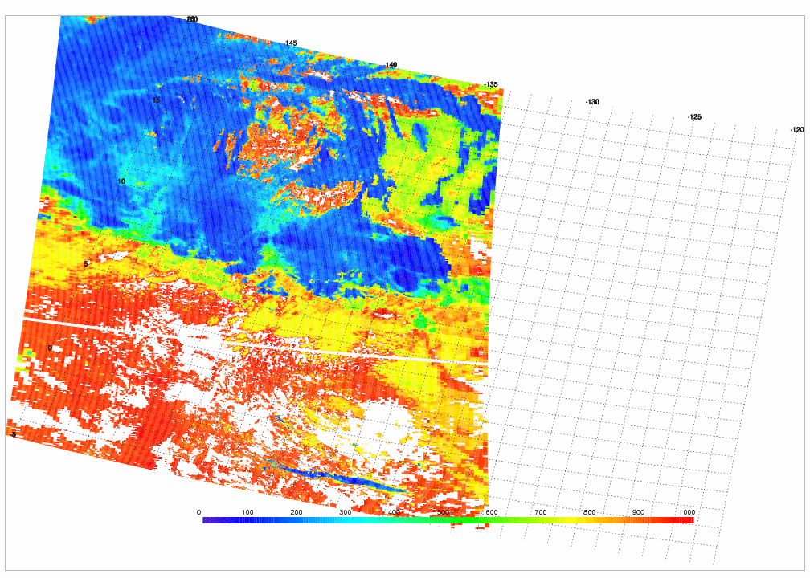
Satellite CTP comparison
7
GSI defined CTP can miss-clouds, incorrectly assign radiances as cloud-free and assimilate cloud-contaminated radiances
A study combining the lessons learned on infrared cloud contamination in data assimilation by SPoRT’s utilization of MODIS Cloud Heights and GMAO’s efforts relating adjoint-based observation impacts to errors in cloud screening is underway to help further quantify the effects of these measurements on analysis statistics, bias correction, and potentially forecast skill
T (K) ID at σ=39 (≈500 hPa) for 0000 UTC analysis 22 November 2011
GSI CTP for 0000 UTC analysis on 22 November 2011
MODIS CTP valid 2240 UTC on 22 November 2011
Larger Profile Impact
Larger Radiance Impact
High Clouds
Low Clouds
High Clouds
Low Clouds

Slide 9
Summary
8
SPoRT is working to improve NWP forecasts through assimilating hyperspectral IR profiles for specific applications
Atmospheric rivers
Stratospheric intrusions and non-convective winds
SPoRT is working to develop methods to improve hyperspectral IR profile and radiance assimilation in GSI
Module for profile assimilation
Bias correction
Satellite CTP comparison
SPoRT initially used AIRS and will continue to expand assimilation activities to include the next-generation SNPP/JPSS CrIS instrument
Use of NUCAPS is an opportunity for consistency across multiple instruments
Increased volume of observations available for assimilation

