Slide 1


Evaluating Cloud Microphysics Schemes in the WRF Model
Andrew Molthan
Fifth Meeting of the Science Advisory Committee
18-20 November, 2009
National Space Science and Technology Center, Huntsville, AL
transitioning unique NASA data and research technologies to operations

Slide 2
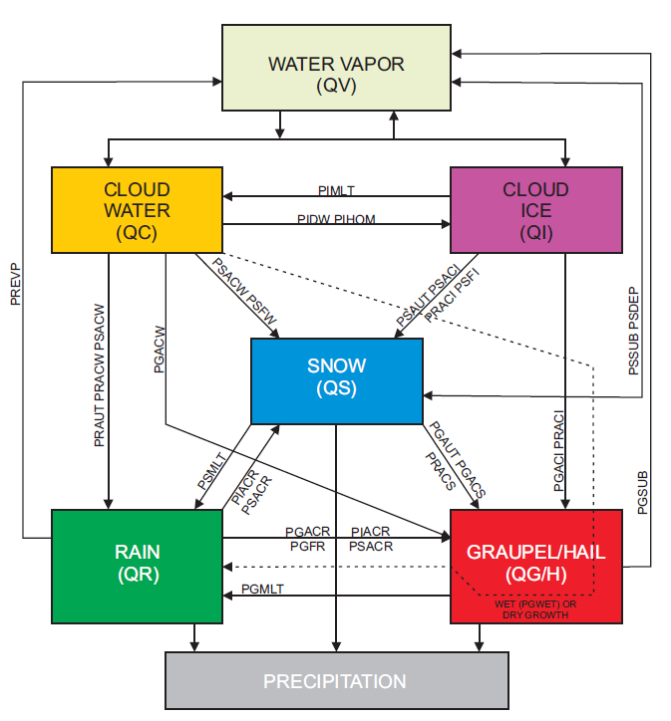
Background
High resolution forecast models are increasingly reliant upon bulk water microphysics schemes.
Predict cloud constituents and precipitation rather than their net effects.
Dilemma:
  Many schemes available.
  Numerous assumptions required.
  Validation is difficult, requiring direct measurement or remote sensing.
Figure 1. Example flow chart of hydrometeor classes and their related processes, adapted from Lin et al. (1983).
transitioning unique NASA data and research technologies to operations

Slide 3
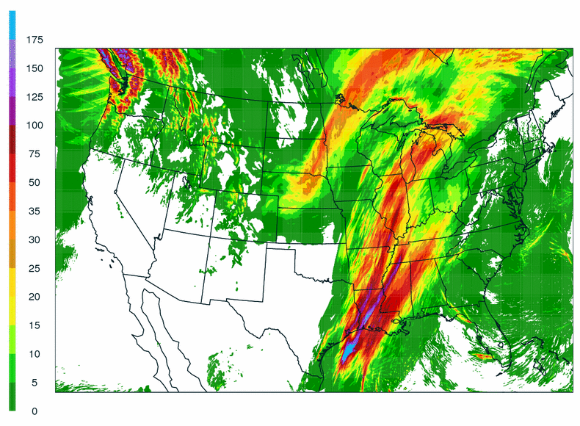
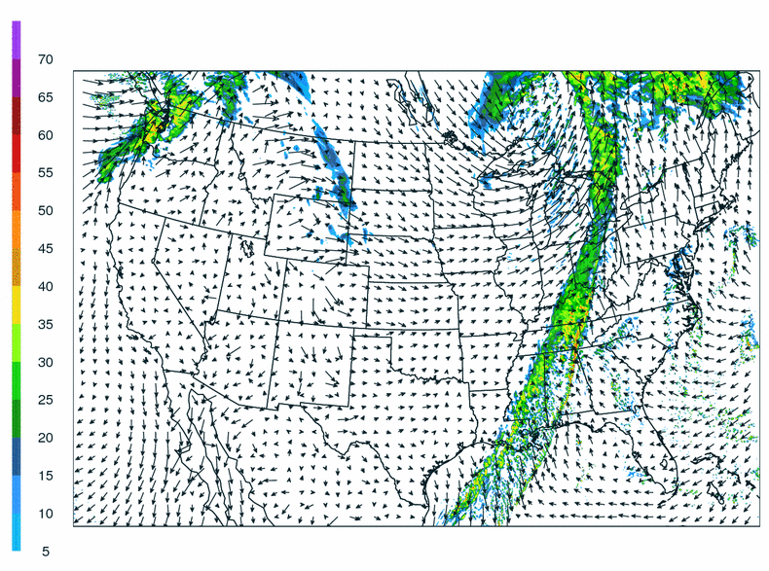
Relevance to NASA/SPoRT
OCTOBER 31, 2009
Emphasis is on short-term forecasts [0-48 hours], which will rely upon increasingly complex microphysics schemes.
  SPoRT participates in the NSSL Spring Experiment
  Developmental Testbed Center exploring use of these schemes in winter weather
  Consistent increase in “detail” desired by operational NWP
By providing validation of scheme assumptions, goal is to improve the prediction of temperature, precipitation, and cloud cover.
PRECIPITATION
RADAR REFLECTIVITY
Figure 2. High resolution (4 km) forecasts produced in real-time as part of the ongoing NSSL experimental forecast program.
transitioning unique NASA data and research technologies to operations

Slide 4
Accomplishments Since 2007 SAC Meeting
Previous Meeting:
  Discussed CloudSat mission.
  Presented retrieval products relevant to model validation.
SAC Comments:
  Understood the proof of concept level of work.
  Advised to “avoid relying upon the model microphysics as truth”.
2007-2009 Emphasis:
  Use simulated CloudSat reflectivity, not retrievals.
  Guided by the SAC statement, instead use CloudSat and field campaign measurements to determine if model microphysics are truthful.
  Questions:
    Are model assumptions valid?
    Do simulated clouds appear anything like observations?
    If not, what are the targets for improvement?
transitioning unique NASA data and research technologies to operations

Slide 5
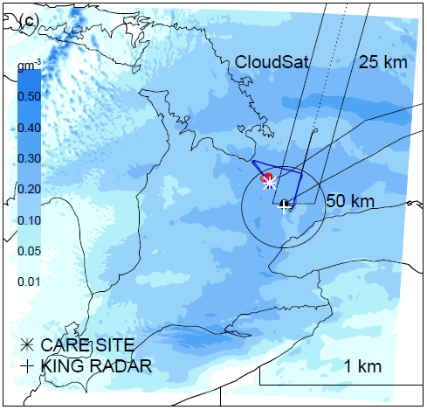
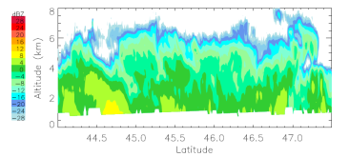
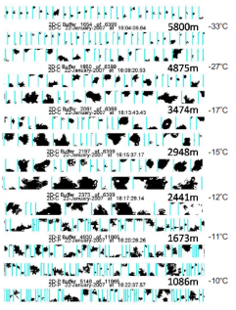
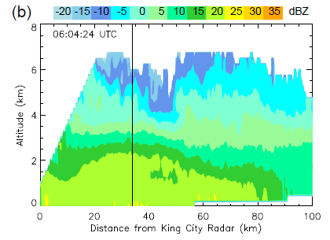
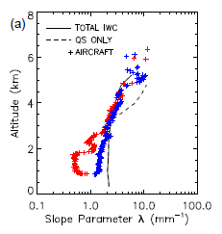
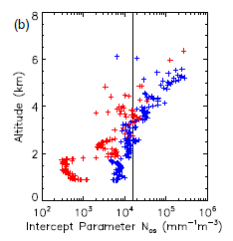
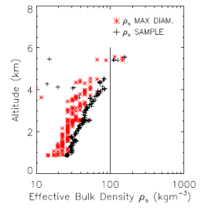
Approach and Methodology
Canadian CloudSat/CALIPSO Validation Project (C3VP), 22 January 2007
  Synoptic scale snowfall event emphasized here, but lake effect cases also available.
Why emphasize snow?
  Forecast challenges of cold season QPF remain.
  Minimal CloudSat and operational radar attenuation.
  Numerous NWP assumptions are made regarding snow and ice.
  Benefits of improved processes may also extend to stratiform precipitation.
WRF + NASA Goddard Scheme
CloudSat
Crystal Habits
King City C-Band Radar
Snow Crystal Size Distributions and Bulk Density
Figure 3. Examples of WRF model forecast output in conjunction with data sets available from the C3VP campaign.
transitioning unique NASA data and research technologies to operations

Slide 6
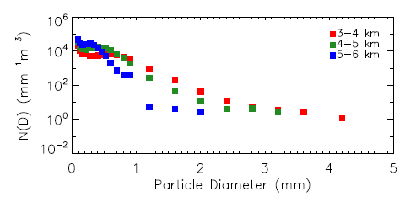
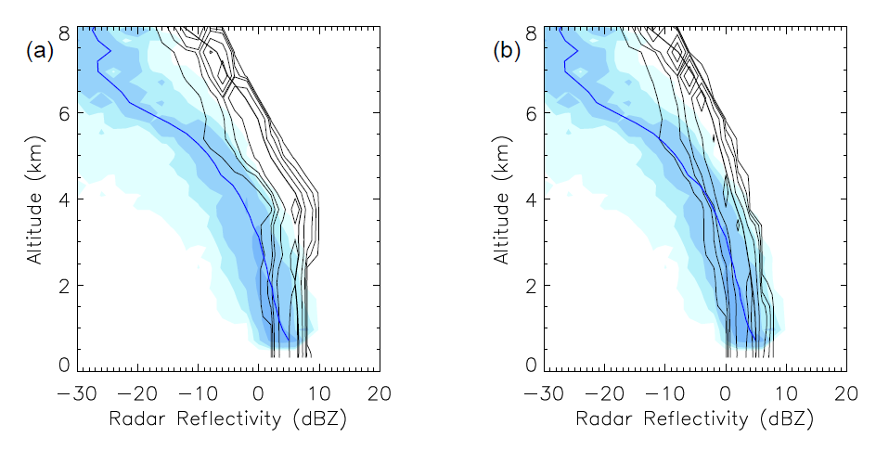
Methods for Evaluation
Aircraft Measurements
  Crystal imagery used to determine size distribution parameters and bulk density.
Surface Measurements
  Measurement of distributions at the surface, along with terminal velocity.
Radar Comparisons
  Simulate CloudSat using ice crystal scattering databases.
  Simulate King City data using equivalent pure ice spheres.
  Compare distributions of reflectivity with height.
N_{os}
λ
ρ_{s} = IWC/VOL
CloudSat CFADs
Snow as Spheres
Snow as Aggregates
Figure 4. Examples of data sets used in the analysis of scheme performance, based upon C3VP data.
transitioning unique NASA data and research technologies to operations

Slide 7
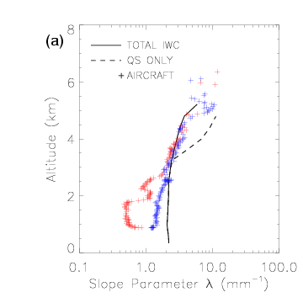
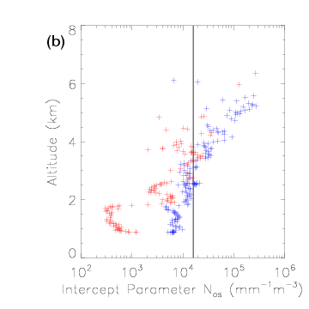
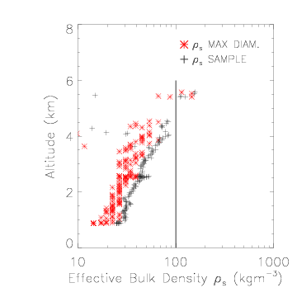
Suggested Improvements
λ
N_{os}
ρ_{s}
The forecast model overestimates the slope parameter.
  Impact: Mean size of simulated crystals are too small.
  The model has difficulty representing continued effect of aggregation.
  In the current framework, λ is a byproduct of other parameters.
The use of a fixed distribution intercept fails to represent natural variability.
Bulk density increases with height but is not represented by a fixed value.
transitioning unique NASA data and research technologies to operations

Slide 8
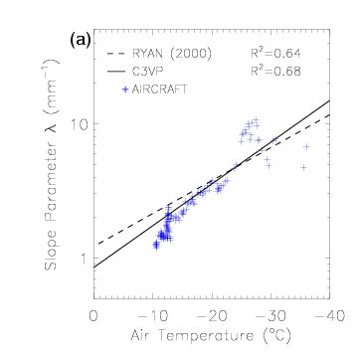
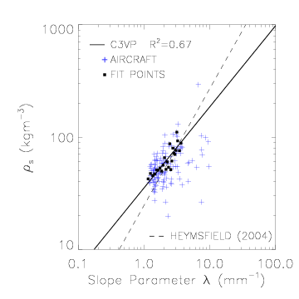
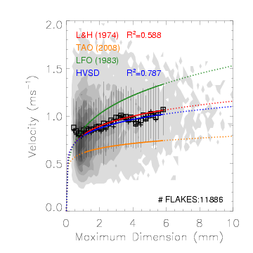
Temperature-Based Approach
Follow the guidance of previously published results.
  Parameterize the slope parameter as a function of temperature: λ(T)
  Parameterize the bulk density as a function of the slope parameter: ρ(λ)
  Modify the terminal velocity-diameter relationship to fit observations.
Improves the representation of size distribution and bulk density in forecasts.
transitioning unique NASA data and research technologies to operations

Slide 9
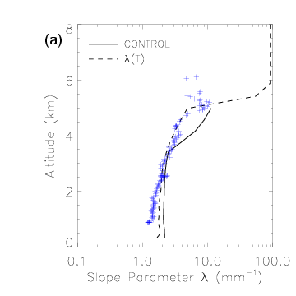
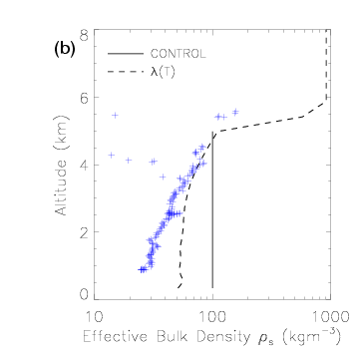
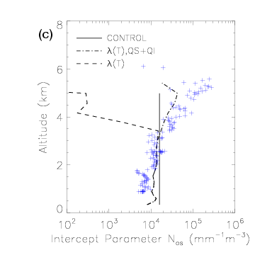
Temperature-Based Approach
λ
ρ_{s}
N_{os}
Each snow-related variable is improved upon versus the control forecast.
Key limitation: Dependence on the temperature profile.
  In this case, the profile is nearly isothermal.
  This limits the range of the parameterized values for λ and ρ.
transitioning unique NASA data and research technologies to operations

Slide 10
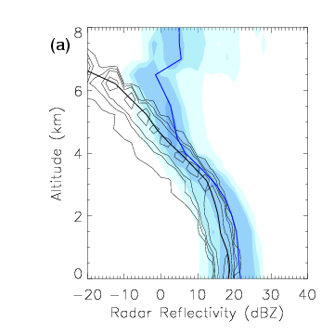
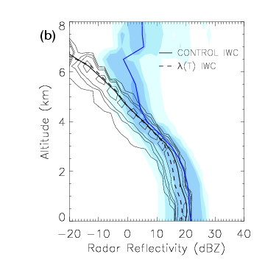
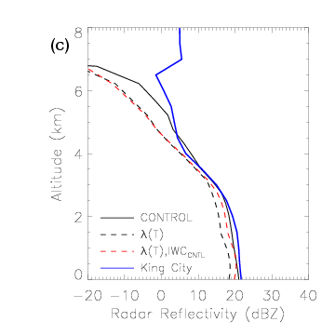

King City Radar Comparisons
CONTROL
λ(T)
King City
sensitive to λ(T)
Model
Only subtle changes are noted in the reflectivity CFAD, although the model improves upon representation of the size distribution and density values.
Difficulty: Profiles of Z dependent upon the shape of the temperature profile.
λ⁷(T)
transitioning unique NASA data and research technologies to operations

Slide 11
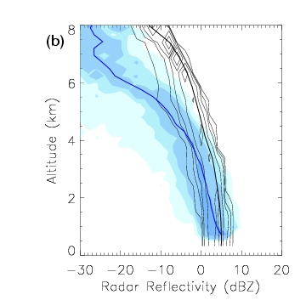
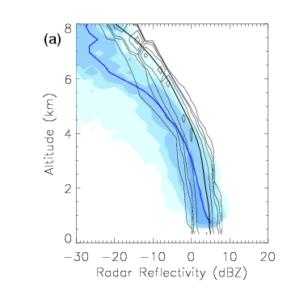
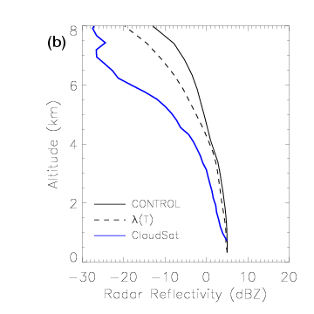
CloudSat Comparisons
CONTROL
λ(T)
CloudSat
Model
The spherical representation of snow crystals is insufficient for CloudSat.
Must simulate CloudSat based on the properties of actual ice crystal shapes.
Little improvement noted in the CloudSat median profile of dBZ using λ(T).
transitioning unique NASA data and research technologies to operations

Slide 12
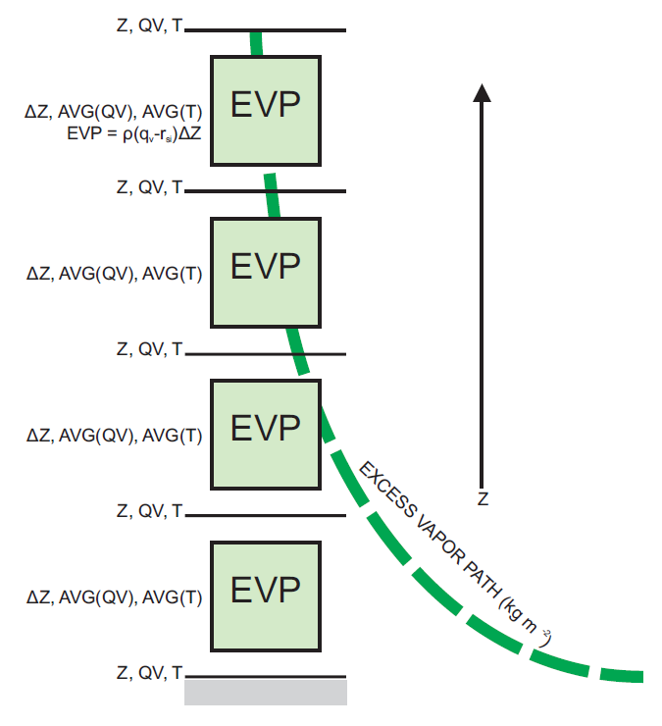
Column-Based Approach
In a second attempt, the “spirit” of temperature-based parameterization is incorporated.
Use the excess vapor with respect to the ice saturated value.
Column integral or “excess vapor path” ignores complex shape of the temperature profile.
transitioning unique NASA data and research technologies to operations

Slide 13
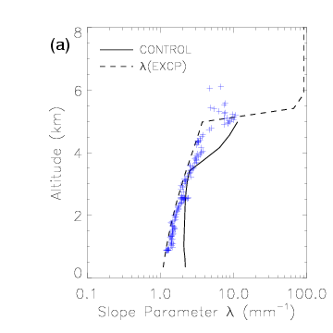

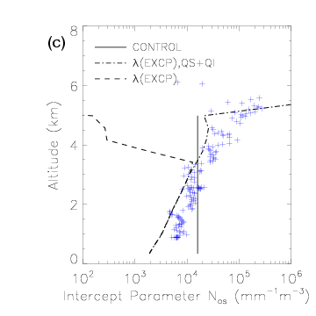
Column-Based Approach
λ
ρ_{s}
N_{os}
Continued improvement over the temperature-based approach.
Column integration ignores the profile shape and allows for a full range of λ.
Representation of N_{os} is improved upon from the previous fixed value.
By avoiding the use of fixed constants, either a temperature or column-based approach improves the representation of snow crystals within the scheme.
transitioning unique NASA data and research technologies to operations

Slide 14
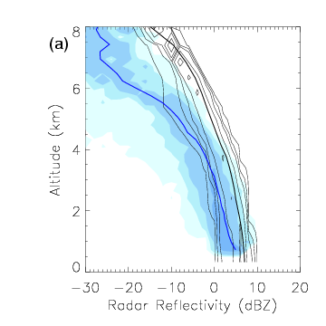
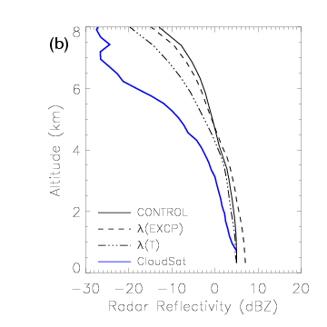
Improved CloudSat Match
CONTROL
λ(EXCP)
CloudSat
Model
Improved the representation of the median CloudSat profile.
Consistent overestimate of dBZ due to the use of simulated aggregates.
  Simulated aggregates likely differ from observed aggregates.
The CloudSat radar can be used for model validation (a mission goal) as long as reflectivity products are simulated with considerations of ice crystal habit.
transitioning unique NASA data and research technologies to operations

Slide 15
Summary and Conclusions
The NWP community is interested in pursuing single-moment (or higher) bulk water microphysics schemes to improve short term forecasts.
Snowfall is an ideal case for use of the CloudSat radar, but simulation of reflectivity from ice crystals is complex at 94 GHz.
Combinations of aircraft and remote sensors demonstrate that the fixed value assumptions in the NASA Goddard scheme fail to represent the character of this case.
By adapting previously published relationships or incorporating column-based approaches, we improve upon the representation of snow within a forecast scheme.
CloudSat has a demonstrated value in model validation, as long as the data are carefully applied and evaluated alongside other instruments.
transitioning unique NASA data and research technologies to operations

Slide 16
Future Work
In applications:
  Examine additional snowfall events.
  Application to convective QPF: stratiform precipitation/MCS.
  Following additional validation, transition to public versions of WRF.
Continued development:
  Adjust the model to avoid a spherical shape assumption.
    Allow for greater flexibility of ice crystal types and simulation of CloudSat data.
    Proposed this in a ROSES 2009 submission, to collaborate with NASA Goddard.
  Explore the simulation of other satellite products from NWP output.
    Build upon a collaboration with NASA Goddard staff (T. Matsui).
    Inclusion of ice crystal scattering, as adapted for CloudSat simulation, is key to accurate translation from NWP to simulated satellite data.
transitioning unique NASA data and research technologies to operations

Slide 17
Questions?
transitioning unique NASA data and research technologies to operations

