Slide 1


High-Resolution SST Impacts on WRF Forecasts
Jonathan Case
Kevin Fuell
Scott Dembek
Fifth Meeting of the Science Advisory Committee
18-20 November, 2009
National Space Science and Technology Center, Huntsville, AL
transitioning unique NASA data and research technologies to operations

Slide 2
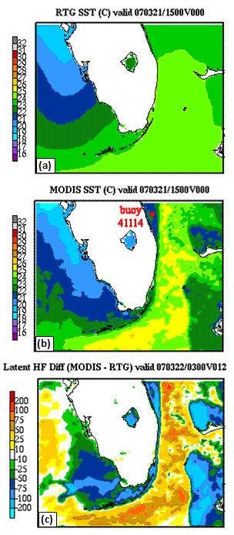
Relevance to NASA/SPoRT
MODIS SST composites
  NASA Earth Observing System product
  Technique developed by SPoRT
  Used in operations by SPoRT NWS partners
Use in modeling
  Provides superior resolution over
  current operational products
  Fosters collaboration opportunities
  Pathway to regional/national operational centers
transitioning unique NASA data and research technologies to operations

Slide 3
Accomplishments Since 2007 SAC Meeting
2007 SAC Recommendation: “Find broader use and dissemination of the MODIS SST composite product.”
  Implemented option for using MODIS SSTs in the NWS/SOO
  WRF Environmental Modeling System (EMS), version 3
    Default option for SSTs in EMS v3
  Ran NSSL/WRF forecasts using MODIS SSTs
    Model verification to compare against operational NSSL/WRF runs
Completed analysis of Miami 2007 modeling study
  Coordinated effort between SPoRT and FIT
  Results supported need for enhanced MODIS SST composite
Conference presentations (2007/09 NWA, 2008/09 AMS)
transitioning unique NASA data and research technologies to operations

Slide 4
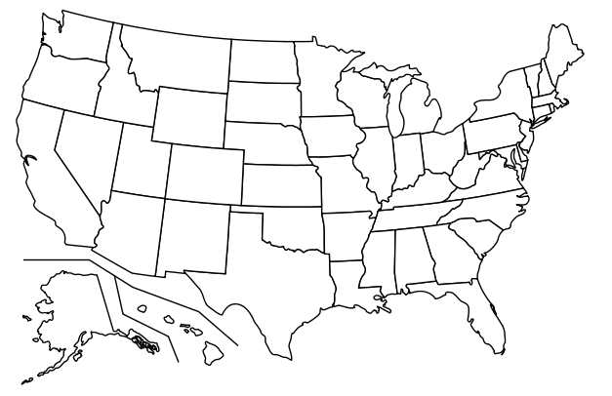
Subset of WRF EMS Users: SPoRT Query
Other groups:
Aviation Weather Center
Spaceflight Meteorology Group
transitioning unique NASA data and research technologies to operations

Slide 5
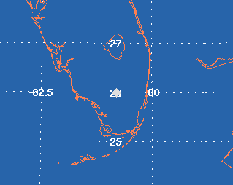
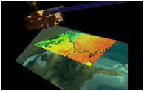
Approach and Methods
Miami, FL multi-month model sensitivity
  4-km WRF-NMM model within EMS
  (same configuration as NWS Miami)
  RTG vs. MODIS initialization; Feb−Aug 2007
  Model initializations at 03, 09, 15, 21z
  Case studies and point verification statistics
NSSL/WRF multi-month parallel runs
  May to Aug 2009
  Verification using MET currently underway
Additional real-time impact case studies
  SPoRT partners currently using MODIS SSTs in WRF EMS
NWS MIA Domain
transitioning unique NASA data and research technologies to operations

Slide 6
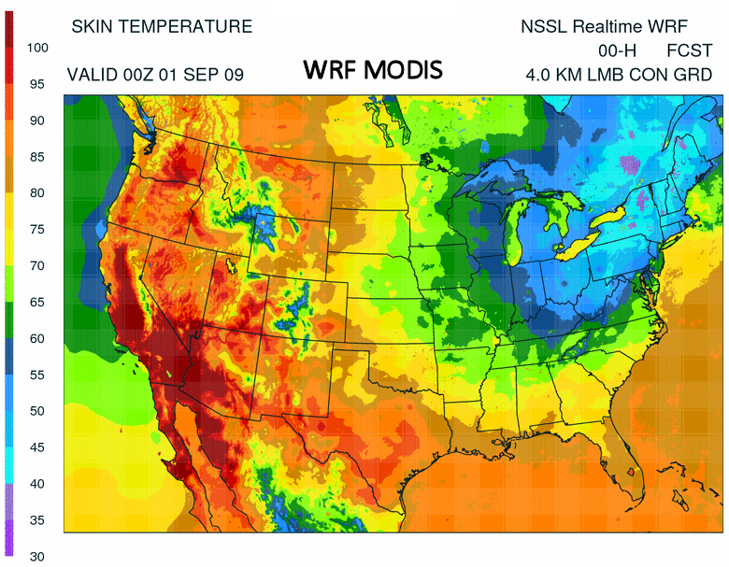
SST Incorporation Method
Miami, FL multi-month model sensitivity
  Simulated a possible real-time configuration
  Each model initialization incorporated newest MODIS composite that would be available in real time
    03z → 19z MODIS from previous day
    09z → 04z MODIS
    15z → 07z MODIS
    21z → 16z MODIS
NSSL/WRF parallel runs
  One per day runs initialized at 00z
  Initialized with 19z MODIS composite
transitioning unique NASA data and research technologies to operations

Slide 7
Miami, FL Point Verification Summary
Little difference in point verification
  Model runs using daytime MODIS: similar errors as RTG
  Model runs using nocturnal MODIS
    Slight cold biases, esp. in summer months
    Latency issues during convective regimes
Initialization and diurnal variations in SSTs
  Diurnal variations in SSTs not taken into account
  Recommended methods
    Use SST composite that matches model initialization time
      E.G. 15z model initialization uses yesterday’s 16z MODIS composite
    Develop time-varying MODIS SST boundary conditions
      Consider WRF SST update or diurnal SST prediction options
transitioning unique NASA data and research technologies to operations

Slide 8
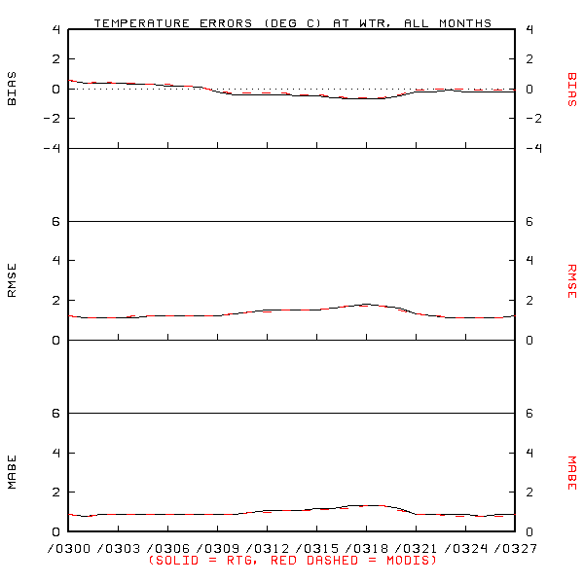
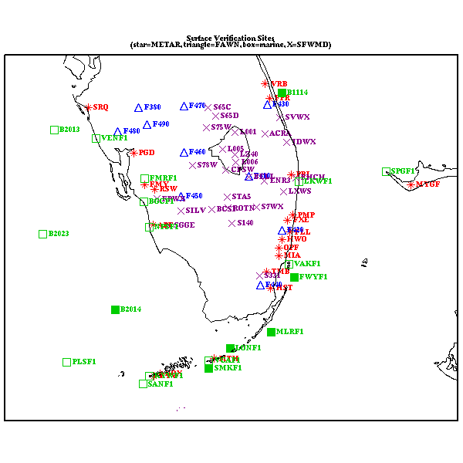
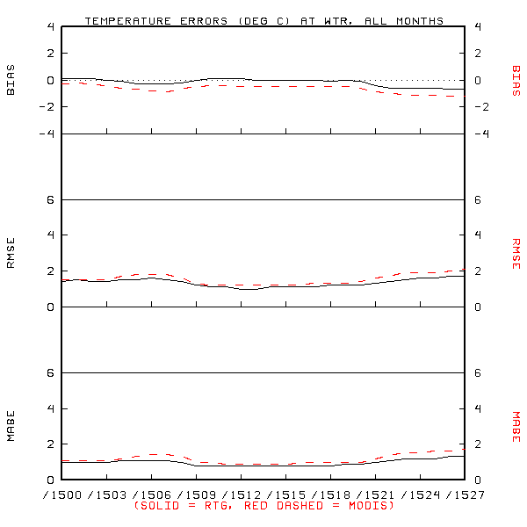
Sample Miami, FL Point Verification Results
Slight cold bias due to cooler nocturnal SSTs and higher latency
in 07z composites
03z, Feb-Aug 2007
15z, Feb-Aug 2007
transitioning unique NASA data and research technologies to operations

Slide 9
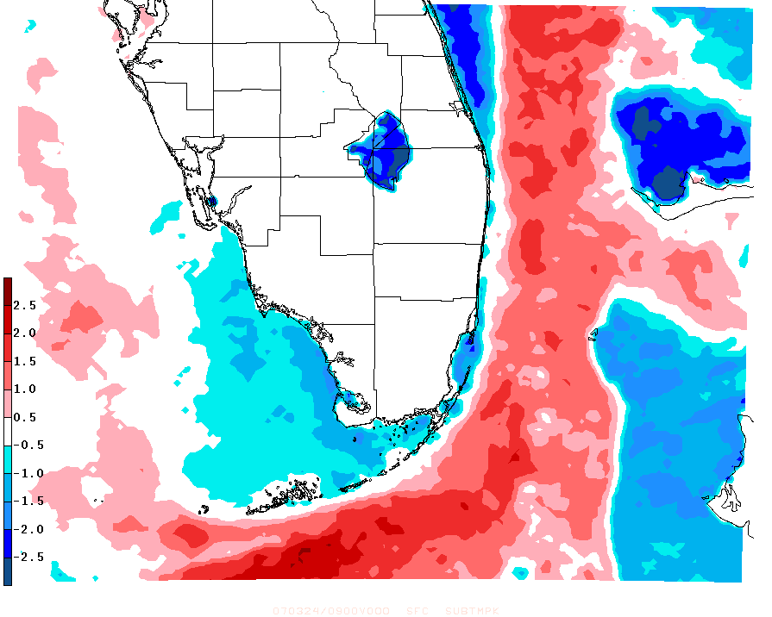
Miami, FL Case Study: 24 March 2007
(NE Flow Surge Case)
Enhanced cold to warm SST gradient (in easterly flow)
MODIS – Control Sea Surface Temperature [°C]
24 Mar 2007 0900 UTC Simulation
transitioning unique NASA data and research technologies to operations

Slide 10
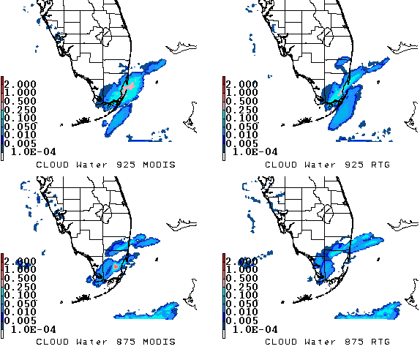
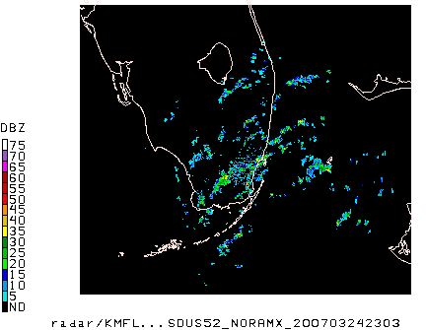
Miami, FL Case Study: 24 March 2007
(14-h Forecast Cloud Water Enhancement)
Cloud liquid water content (g/kg) enhanced over southeastern Florida
Downstream of the convection originating near Grand Bahama Island
Crosses the warmer MODIS Gulf Stream
transitioning unique NASA data and research technologies to operations

Slide 11
Miami, FL Case Study: 24 March 2007
(14-h Forecast Divergence Impact)
Under easterly flow, near-surface winds cross from cooler to warmer SSTs in the MODIS run
Winds accelerate and result in enhanced surface divergence
Consistent with LaCasse et al. 2008 findings
transitioning unique NASA data and research technologies to operations

Slide 12
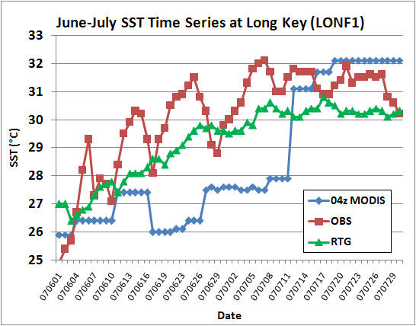
Miami, FL Study: MODIS Latency Issue
Large latency during June−July 2007
  Florida convective season
  Persistent cloud cover during composite times
  Led to increased cold bias in model, particularly with nocturnal MODIS composites
Enhanced MODIS SST composites
  Superior SST verification around Florida
  Improved cold bias on sample June 2007 case
transitioning unique NASA data and research technologies to operations

Slide 13
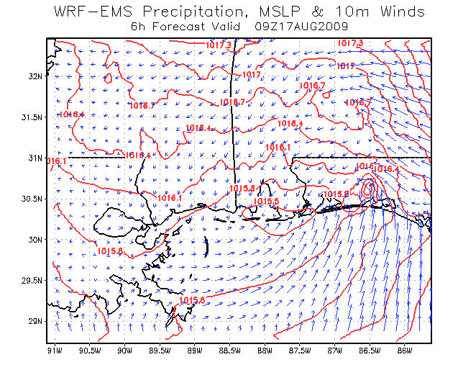
Mobile, AL Case Study: T.S. Claudette
(17 August 2009)
NWS Mobile, AL posted WRF results to SPoRT blog
  WRF EMS version 3 using default MODIS SST option
  Depicted small meso-low in vicinity of T.S. Claudette,
  further east where low actually made landfall
  Surmised that MODIS SSTs helped produce this improvement over the large-scale models
SPoRT re-ran WRF EMS
with RTG vs. MODIS SSTs
  GFS Initial & BCs
  Same domain as
  NWS Mobile
transitioning unique NASA data and research technologies to operations

Slide 14
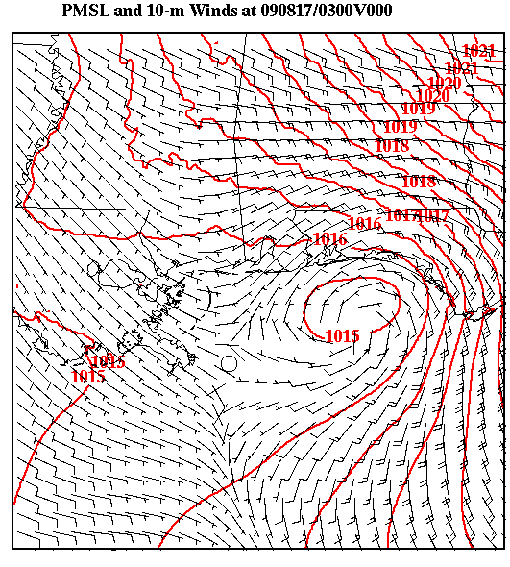
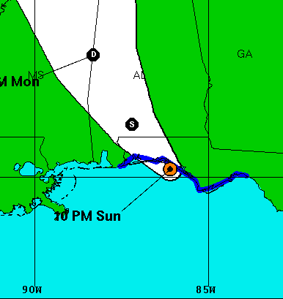
Mobile, AL Case Study: T.S. Claudette
(WRF Initial Condition)
Low slightly too far south-west compared to actual location
transitioning unique NASA data and research technologies to operations

Slide 15
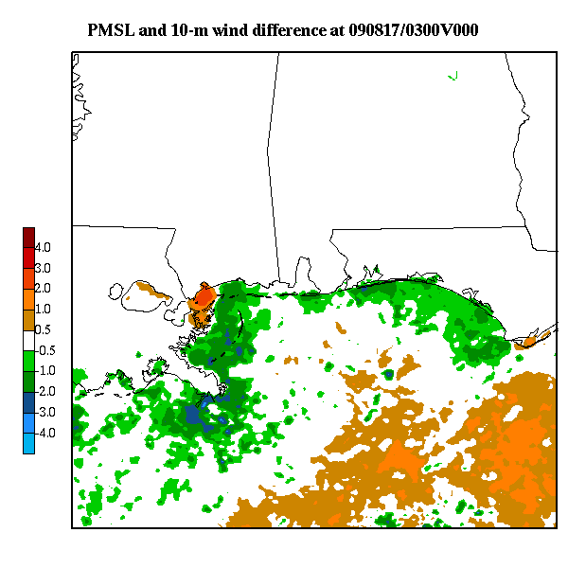
Mobile, AL Case Study: T.S. Claudette
(SST Differences)
Warmer SSTs offshore of western Florida; cooler near-shore
transitioning unique NASA data and research technologies to operations

Slide 16
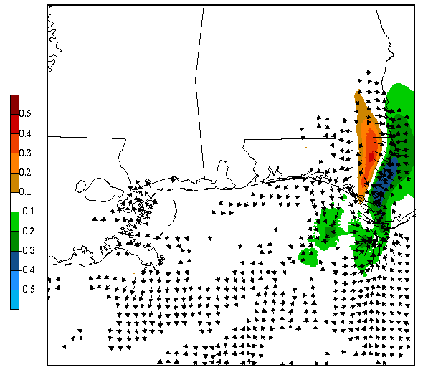
Mobile, AL Case Study: T.S. Claudette
(6-h PMSL and 10-m Wind Differences)
Cyclonic flow and PMSL couplet develop along SST gradient
transitioning unique NASA data and research technologies to operations

Slide 17
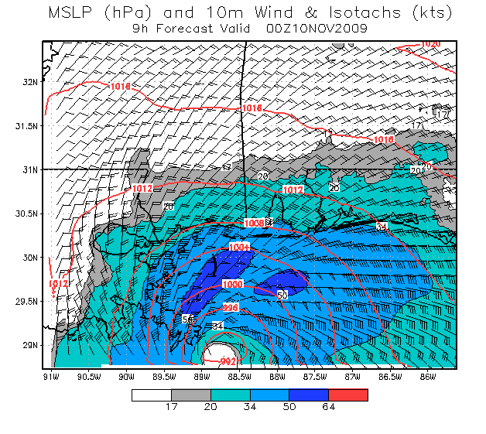
Mobile, AL Ida Simulation w/ MODIS SSTs
(9 to 27 hour Forecast PMSL and 10-m Winds)
SOO Comments (Medlin)
  Forecast very close on track and intensity
  Weakening intensity toward landfall
  Horizontal scale very similar to observed
  Precluded tornado threat due to very stable air on northern periphery
  (not shown)
transitioning unique NASA data and research technologies to operations

Slide 18
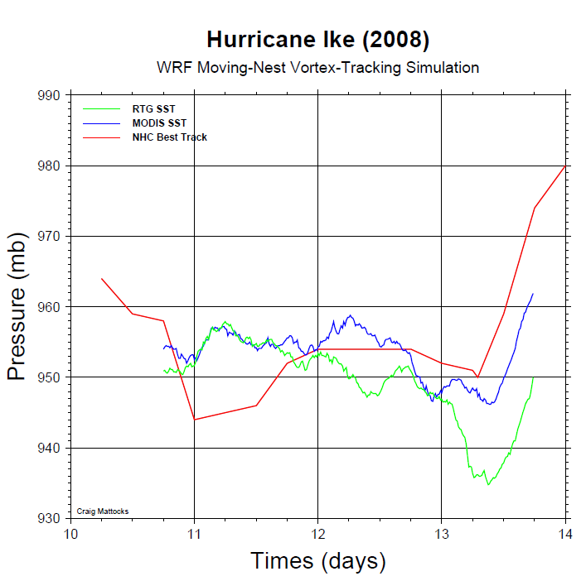
Hurricane Ike WRF Intensity Forecast
(Courtesy: Dr. Craig Mattocks, UNC)
transitioning unique NASA data and research technologies to operations

Slide 19
Summary and Conclusions
Collaboration with local NWS modeling applications
  Incorporated MODIS option into WRF EMS v3
  Enabled NWS offices to use MODIS SSTs in their local model runs
Impacts on point verification / precipitation typically subtle
Modulation of wind fields near SST gradients
  Increased convergence downstream of Bahamas
  Enhancement of cyclonic flow in vicinity of tropical storm
Miami multi-month study revealed latency issue
  Most prevalent during convective season
  Improved with enhanced MODIS composites
transitioning unique NASA data and research technologies to operations

Slide 20
Future Work
Provide EMS v3 background material to SPoRT partners
  Beneficial to new users of MODIS SSTs in WRF EMS modeling
  Assisting SERVIR in implementing WRF EMS v3 w/ MODIS SSTs
Complete verification of NSSL/WRF with MODIS SSTs
  NSSL/SPC assessment of MODIS SST impacts on NSSL/WRF
Re-run selected high latency cases with enhanced MODIS
Experiment with new diurnal SST prognostic scheme
  Zeng and Beljaars (2005, GRL); available in WRF v3.1
Pathway to regional/national operational centers
  NSSL, AOML, NHC, NCEP
transitioning unique NASA data and research technologies to operations

