Slide 1


Data Dissemination
Kevin Fuell, Geoffrey Stano, Frank Lafontaine
Fifth Meeting of the Science Advisory Committee
18-20 November, 2009
National Space Science and Technology Center, Huntsville, AL
transitioning unique NASA data and research technologies to operations

Slide 2


Relevance of Data Distribution to NASA/SPoRT
Others could send data. SPoRT says it is not simply a “data provider”, so why do it?
Think B.K.
“Have it your way!”
……in your DSS
……over your area
Disclaimer – this is not an endorsment of Burger King
transitioning unique NASA data and research technologies to operations

Slide 3
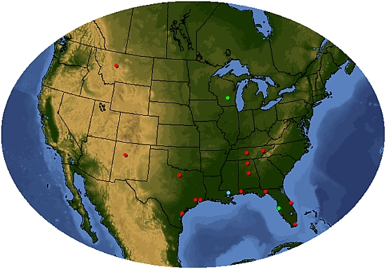




Who was, is, and will be receiving data?
Circa 2007 (6)
  Huntsville, Nashville, Birmingham, Mobile, Miami, Great Falls
2008 expansion (7)
  Morristown/Knoxville, Melbourne, Tallahassee, Houston/Galveston, Corpus Christi, Albuquerque, and the Space Flight Meteorology group
2009 expansion (2)
  Peach Tree/Atlanta (NALMA), Key West (MODIS), Morristown (MODIS)
2010 (4+)
  Jacksonville (LDAR), El Paso (White Sands LDAR), Boise and Glasgow (MODIS-False Color)
Partners Receiving Data
Pre SAC 2007
New WFOs
Private/Govt
NWS Regional HQ
Direct Broadcast sites
transitioning unique NASA data and research technologies to operations

Slide 4
How was... and how is data provided to NWS?
The way it WAS…..
The way it IS…..
FTP
  Each WFO linked to SPoRT (security)
  Constant query for data (latency)
  Hands-on help often needed to receive and display data (logistics)
LDM
  Only NWS Regions linked to SPoRT
  Immediate sending of data
  Documentation available for users to customize feed/display
SPoRT
NWS Region
WFO1
WFO2
WFO3
SPoRT
WFO1
WFO3
WFO4
WFO2
FTP
LDM
Easier to manage one firehose instead of many garden hoses
transitioning unique NASA data and research technologies to operations

Slide 5
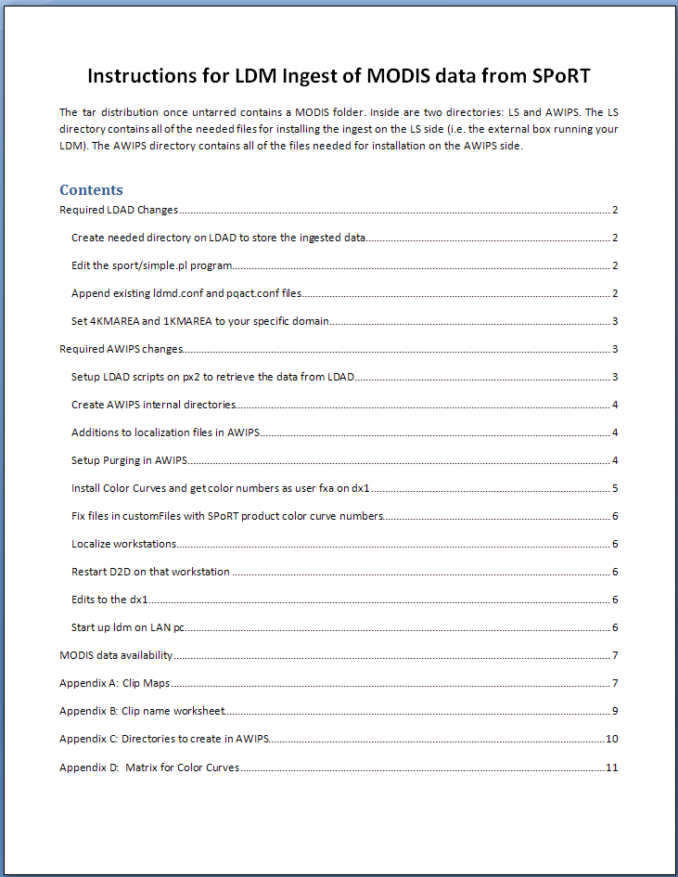
Going through NWS Regions
Why is this important?
  Simplifies data dissemination
  WFOs are free to add or subtract data/products as appropriate
  Easy to add new WFO collaborators
  Easy to add new products to the stream
  Shows that NWS Regional HQ supports SPoRT’s mission and “buys into” the collaborative partnership where NASA EOS data is provided in a test bed mode.
Provide bundled files for AWIPS/D2-d configuration along with documentation
transitioning unique NASA data and research technologies to operations

Slide 6
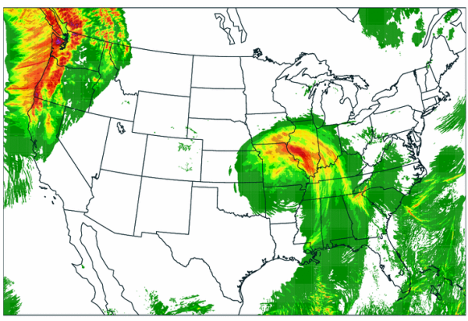
Dissemination to other partners
The Weather Channel
  GOES E/W and MIMIC TPW for tropics
  (FTP, soon to be LDM)
  Discussed MODIS to receive in future
WorldWinds
  MODIS SST, Chlorophyll composites
  (FTP)
Battelle/Ventyx
  NSSL/WRF model output
  (FTP)
FAA/ENSCO (during 2008 project)
  NSSL/WRF, MODIS
  (LDM)
WFO Eureka (request from NESDIS)
  NESDIS 9km SST from GOES/POES
Why do we make this effort?
  Promotes the use of NASA/EOS data in a variety of applications outside of NWS operational forecasting environment.
  Tests the value added to standard industry products.
  Fosters relationships for funded projects.
NSSL/WRF model provides input to Battelle/Ventyx for energy load forecasts
transitioning unique NASA data and research technologies to operations
Notes:
Promotes the use of NASA/EOS data in a variety of applications outside of NWS operational forecasting environment.
Tests the value added by NASA/EOS data to standard industry products.
Fosters relationships with other potential partners for funded projects.
SPoRT puts the MIMIC product into a GeoTIFF format using McIDAS which give the image some navigation information. TWC can use this type of file and they obtain it via ftp from the geo machine.
Check the format of data being used by WorldWinds
Battelle/Ventyx are receiving output from the NSSL WRF that is being formatted into ascii text files by SPoRT for use in their own DSS.

Slide 7
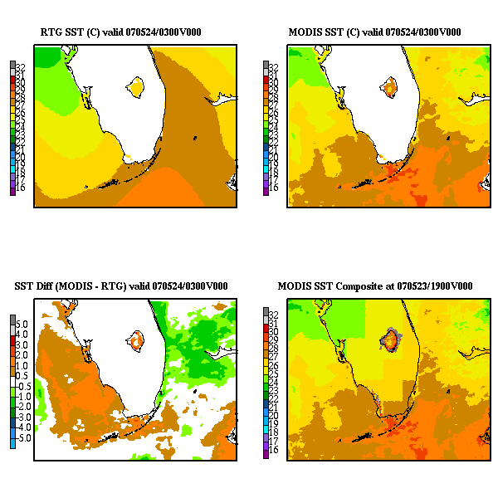
MODIS SST for WRF EMS
MODIS SST composites
  2km resolution
  Available via FTP
Auto ingest option included by developers in WRF EMS v3
  Surface boundary initialization
  Default option over using NCEP
  Real-Time Global (RTG) SSTs
Infrastructure exists in application software for full transition
Graphic: get SST composites and some other WRF output graphic
transitioning unique NASA data and research technologies to operations
Notes:
The WRF EMS developer has added an option that will automatically retrieve the MODIS SST composite via FTP for initialization of the surface boundary conditions

Slide 8
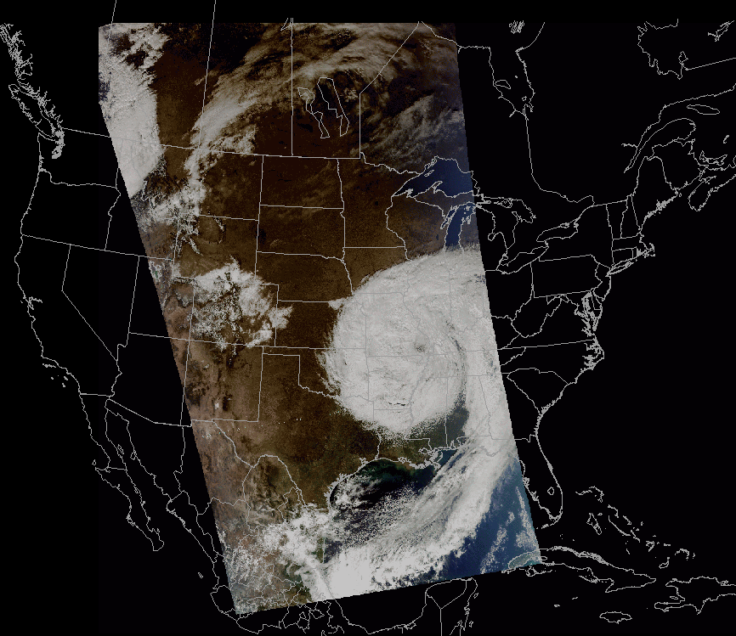
How AWIPS II will change things…
Presently create several grids at varying resolutions to cover geographic areas of interest
  i.e. 4km conus, 1km region,
  500m state, 250m WFO scales
AWIPS II should allow 1 data file at the highest resolution. Then just zoom and pan.
  Can NWS bandwidth handle it?
  Can AWIPS II graphic card handle it?
Data to be sent in a more raw form to retain higher fidelity
transitioning unique NASA data and research technologies to operations

Slide 9
Summary
“Have it your way.”
FTP to LDM
Buy-in from NWS Regions
Increased resources to maintain/monitor data flow
  Fewer disruptions to end users
  Shorter time during outages
  Established main points of contact for improved communication
AMSRE
MODIS
CIRA
GOES Aviation
ADAS
Icebox
Infrared
Drizzle
Matrix
Total Lightning
Branch
Sport
ldm1
SRHQ
WFO
Partner
WFO
Partner
WFO
Partner
transitioning unique NASA data and research technologies to operations

Slide 10
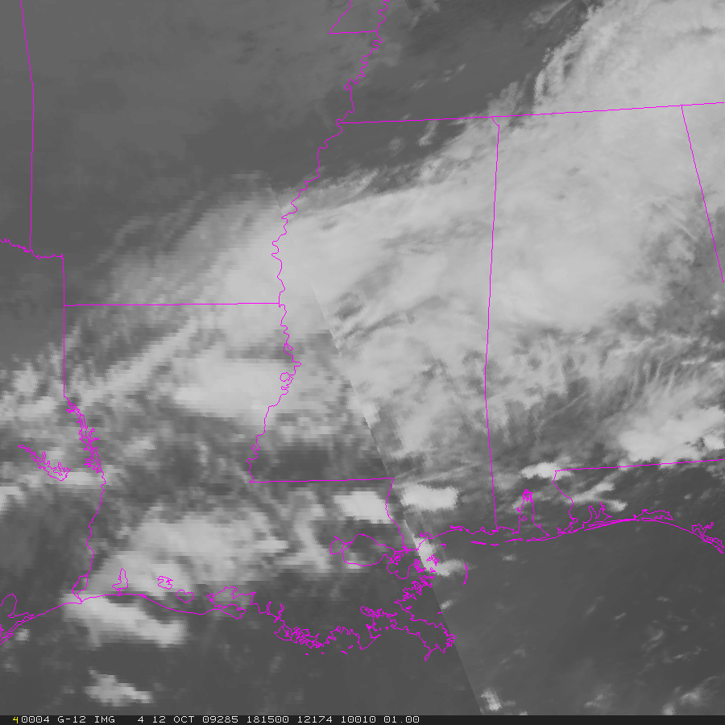
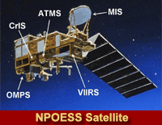
Future Work - Data Dissemination
Make the SPoRT Suite ready for AWIPS II
Provide total lightning data from multiple networks to GOES-R Proving Ground efforts at Experimental Warning Program 2010
Provide ABI proxy products in near real-time to SPoRT partners and GOES-R Proving Ground
Collaborate with NPOESS to distribute NPP and C1 data
GOES-R ABI proxy via MODIS/GOES Hybrid
GOES
MODIS
transitioning unique NASA data and research technologies to operations

