Slide 1
NASA-SPoRT satellite products at WFO MRX
Doug Schneider
Morristown, TN

Slide 2
Satellite products most utilized at WFO MRX
GOES Fog Product and Low Cloud Base
MODIS Fog Product (11µm-3.9µm)
CIRA Total PW and Anomaly

Slide 3
Topography of the MRX CWA
Complex terrain with many lakes, rivers, and valleys
Notes:
The Morristown CWA is bounded by the Appalachian Mountains on the east, and the Cumberland Plateau on the west. The terrain within the Tennessee Valley is also complex, with numerous ridges and valleys, and a complex network of rivers and lakes. This can make forecasting fog and low clouds quite difficult. Some of our TAF sites are located near bodies of water and in valleys, so high resolution satellite data is needed to resolve these small features.

Slide 4
Topography of the MRX CWA
Complex terrain with many lakes, rivers, and valleys...
TRI
...directly adjacent to our TAF sites.
Notes:
One example of the complex terrain and small scale features is the Tri-Cities Airport. It is located directly beside Boone Lake, which can lead to extremely challenging fog forecasts.

Slide 5
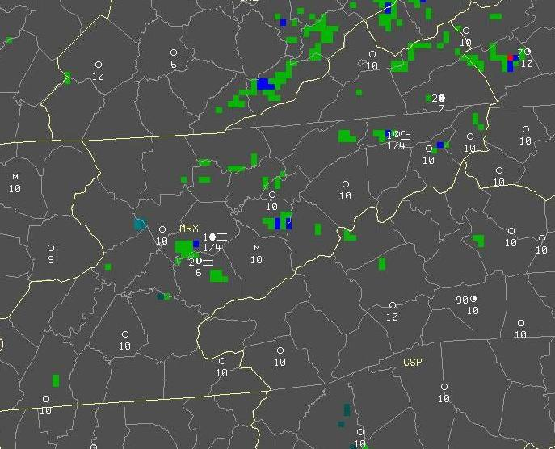
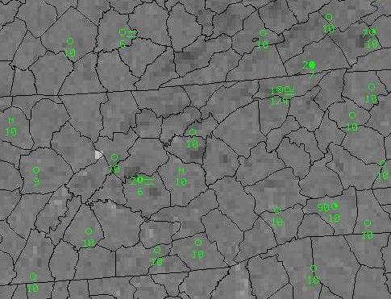
Added value of the GOES Fog Product
GOES Fog Product – clearly showed fog near bodies of water
GOES 11µ-3.9µ - fog not as clear
Notes:
The GOES Fog Product has been helpful when viewing fog associated with these small scale features. In this image, the GOES Fog Product does a pretty good job showing fog formation near bodies of water – Boone Lake near TRI, Douglas Lake, Cherokee Lake, Norris Lake, and the TN River.

Slide 6
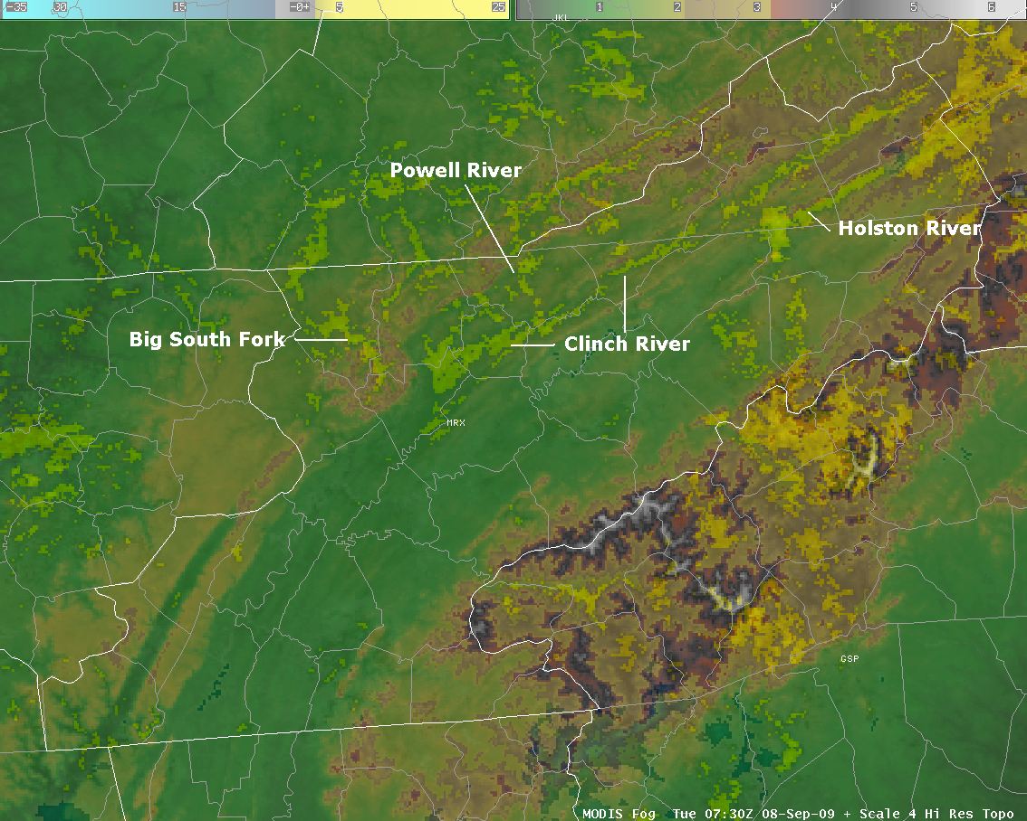
Added value of the MODIS Fog Product
1 km resolution of the MODIS satellite can resolve fog that forms within small-scale terrain features.

Slide 7
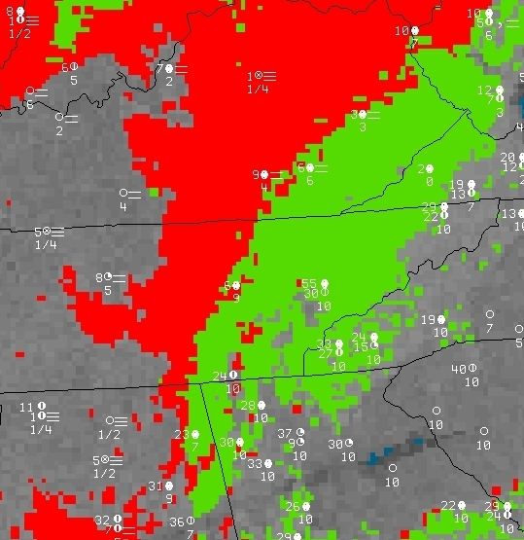
Example – January 18, 2010 low clouds and fog
GOES LCB product distinguishes between ceiling heights (06Z)
Notes:
Here is another example of the utility of the GOES Fog and Low Cloud Base products. The Fog Product showed widespread fog and low ceilings across East TN, but using the Low Cloud Base product allowed us to distinguish between the low clouds and the fog.

Slide 8
Example – January 18, 2010 low clouds and fog
1 km MODIS image (07Z) shows clouds becoming broken to scattered in the southern TN Valley
Notes:
Around the same time, there was a MODIS pass, which showed the clouds in the southern TN valley breaking up. The high resolution of the MODIS data showed this much more clearly than the GOES products.

Slide 9
GOES Fog Product animation 06Z to 12Z
Notes:
An animation of the GOES Fog Product from 06z to 12Z shows the decreasing cloud cover in the southern and central TN Valley through the night.

Slide 10
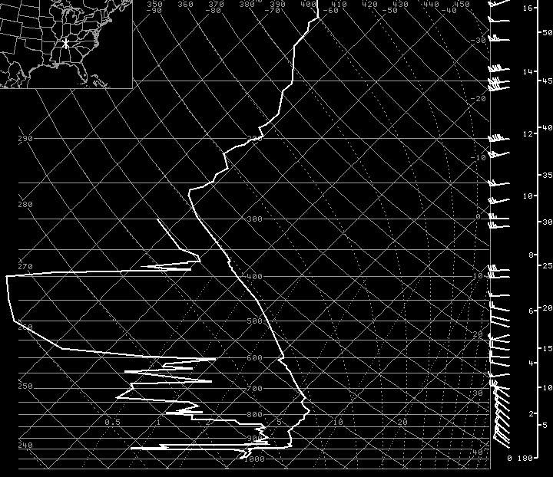
January 18, 2010 soundings from WFO Nashville
00Z
12Z
Winds above surface shifted to NW, creating downslope flow
Notes:
Looking at the 00Z and 12Z soundings from OHX, we see a moist boundary layer at both times, but the winds above the surface shift from north-northeast at 00Z to northwest at 12Z. The northwest winds likely produced a downslope flow off the Cumberland Plateau, which eroded the low clouds across the TN Valley. Using the GOES Fog and Low Clouds Base products helped to capture this trend.

Slide 11
WFO MRX Wish List
More timely and frequent 1 km MODIS products
Better resolution of GOES Fog Product and Low Cloud Base

Slide 12
Utilization of the Lightning Mapping Array (LMA) at WFO MRX
Doug Schneider
Morristown, TN

Slide 13
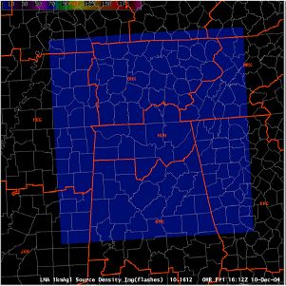
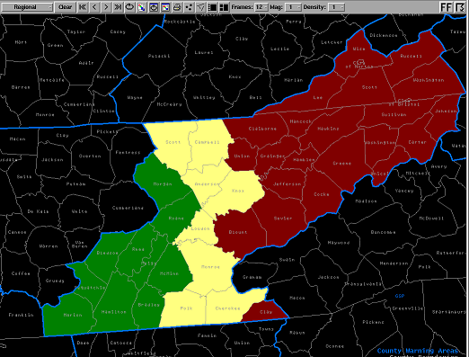
LMA Coverage Area
NALMA Domain
MRX Coverage

Slide 14
LMA Source Density in the severe weather decision-making process
All tilts Z
All tilts SRM and TVS
AWIPS’ Panel Combo Rotate (PCR) feature allows for 4 panel displays to loop through time and through radar elevation slices...
LMA SD and HI
All tilts V and DMD
Notes:
Data from the Lightning Mapping Array has been used at Morristown during severe weather events, and has been an important tool in the warning decision-making process. The LMA coverage area only covers the western half of our area, but we wish it covered more. A procedure has been created in AWIPS to incorporate the LMA Source Density data with other radar products. Using the Panel Combo Rotate feature in AWIPS, we can quickly evaluate storms using 11 different products in one D2D pane.

Slide 15
LMA Source Density in the severe weather decision-making process
Legacy VIL
Digital VIL
...and toggling between images in each panel, allowing quick storm assessment using 11 different data sources.
VIL Density
Echo Tops
Notes:
These are the products that are displayed by pressing the image toggle button.

Slide 16
WFO MRX Wish List
LMA coverage extended over the entire MRX CWA
LMA Source Density difference product

