Slide 1


SPoRT’s Current and Planned Data Assimilation Activities
Bradley Zavodsky
Shih-Hung Chou
Matthew Rigney
Inaugural SPoRT/NWS Collaborative Partners Workshop
3-4 March 2010
National Space Science and Technology Center, Huntsville, AL
transitioning unique NASA data and research technologies to operations

Slide 2
Relevance to NWS WFOs
SPoRT focuses on improvements to short-term, regional weather forecasts using unique satellite products and capabilities
One method to improve forecasts is through assimilation of satellite observations
  Blend observations with model first-guess to provide updated analysis of the atmosphere
  Analyses are then used to initialize model runs
Large data voids over Pacific Ocean, Gulf of Mexico, and Mexico
  Atmospheric rivers and moisture return
  Convective potential
Improvements to precipitation forecasts with assimilation of AIRS profile data
SPoRT can support WFOs by:
  Sharing expertise with assimilating satellite data sets
  Providing satellite-enhanced 3D analyses for nowcasting purposes
  Providing satellite-enhanced initial conditions for local model runs
Lessons learned can be applied to current and future hyperspectral sounders such as IASI (EUMETSAT) or CrIS (NOAA/NASA)
transitioning unique NASA data and research technologies to operations

Slide 3
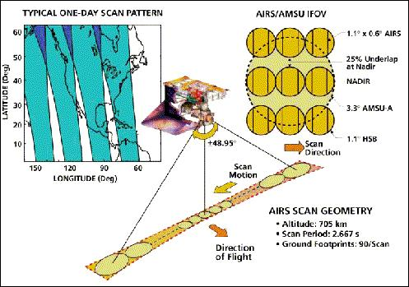
AIRS 101
Aboard Aqua Polar Orbiter
Early afternoon equatorial crossing
  Twice-daily data over SEUS at ≈0700 and ≈1800 UTC (±1 hr)
Radiances: 15-km spatial resolution at nadir
  2378 spectral channels
  3.7 – 15.4 μm
Profiles: 50-km spatial resolution at nadir
  3x3 radiance footprints (golfball)
  54 levels below 100 hPa (100 total)
  Coupling with AMSU allows for retrievals in clear and partly cloudy scenes
  Accuracy of 1K in 1-km layer; 10-15% RH in 2-km layer in troposphere
transitioning unique NASA data and research technologies to operations

Slide 4
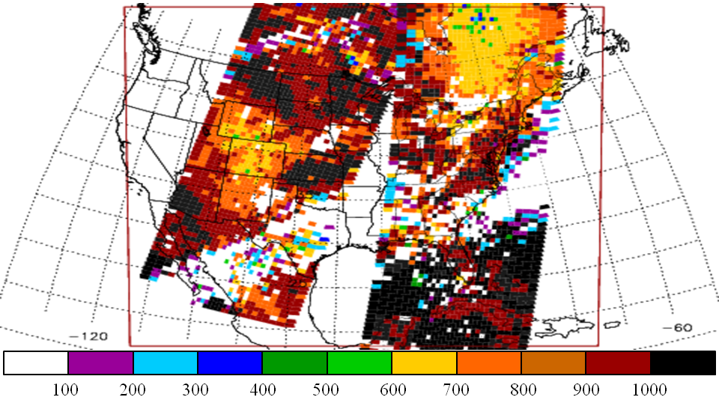
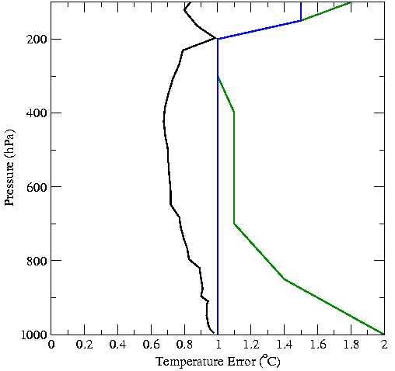
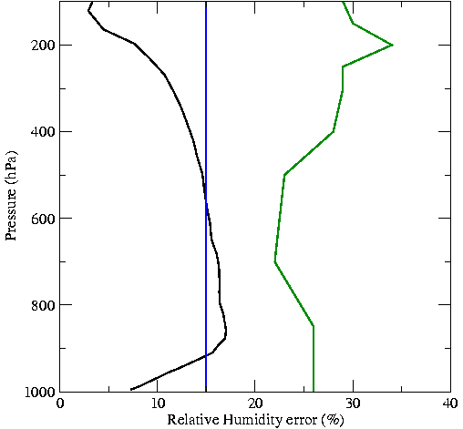
Methodology for Profile Assimilation
AIRS QI’s for 17 Jan 2007
L2 Version 5 temperature and moisture profiles
28-level standard product
Land and water soundings w/ separate errors
Quality control using P_{best} value in each profile
Sensitivity study assimilating only AIRS profiles
Current Analysis Error Characteristics
BKGD
AIRS water
AIRS land
B-matrix from “gen_be”
WRF initialized with 40-km NAM at 0000 UTC (cold start)
12-km analysis and model grid
Short WRF forecast used as background for analysis
transitioning unique NASA data and research technologies to operations

Slide 5
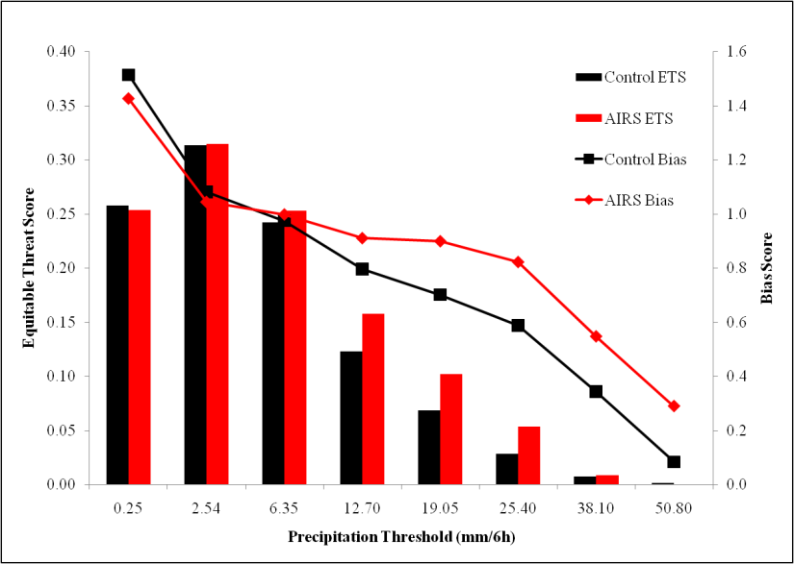
Profile Precipitation Verification
Combined forecast results for 12-48 hr forecasts of precipitation for 37-days from winter 2007
Equitable Threat Score shows forecasted and observed precipitation matches
  Improvement at all thresholds except lightest
  Best results for moderate thresholds (28% at 12.7 mm/6h, 14% at 19.05 mm/6h, 90% at 25.40)
Bias score shows F/O
  Improved (closer to 1) for all thresholds
transitioning unique NASA data and research technologies to operations

Slide 6
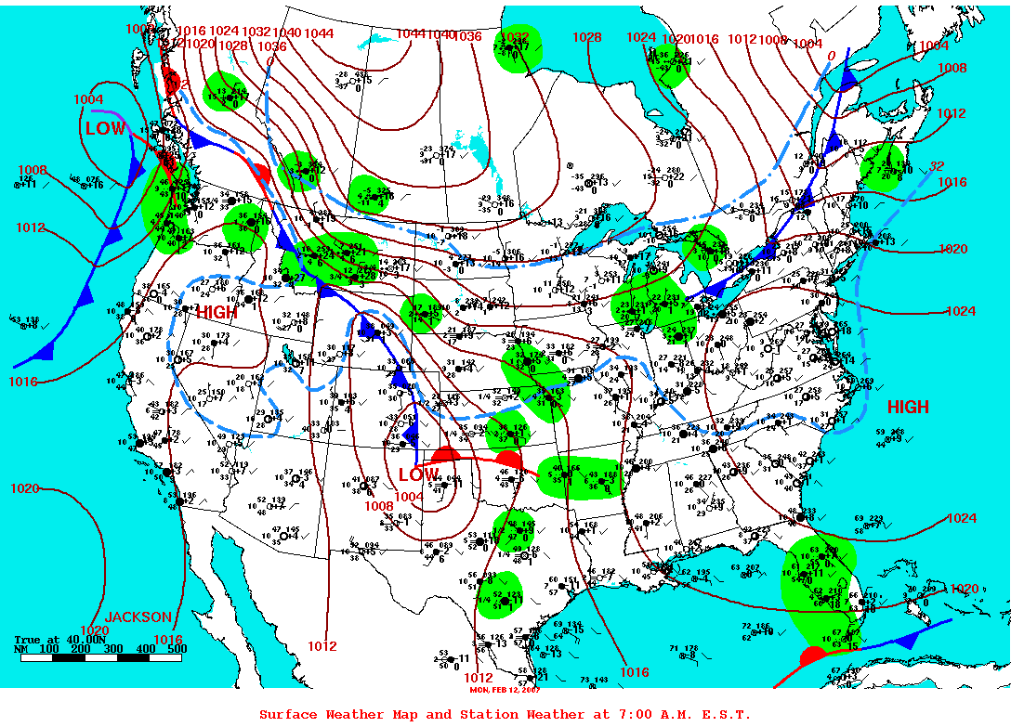
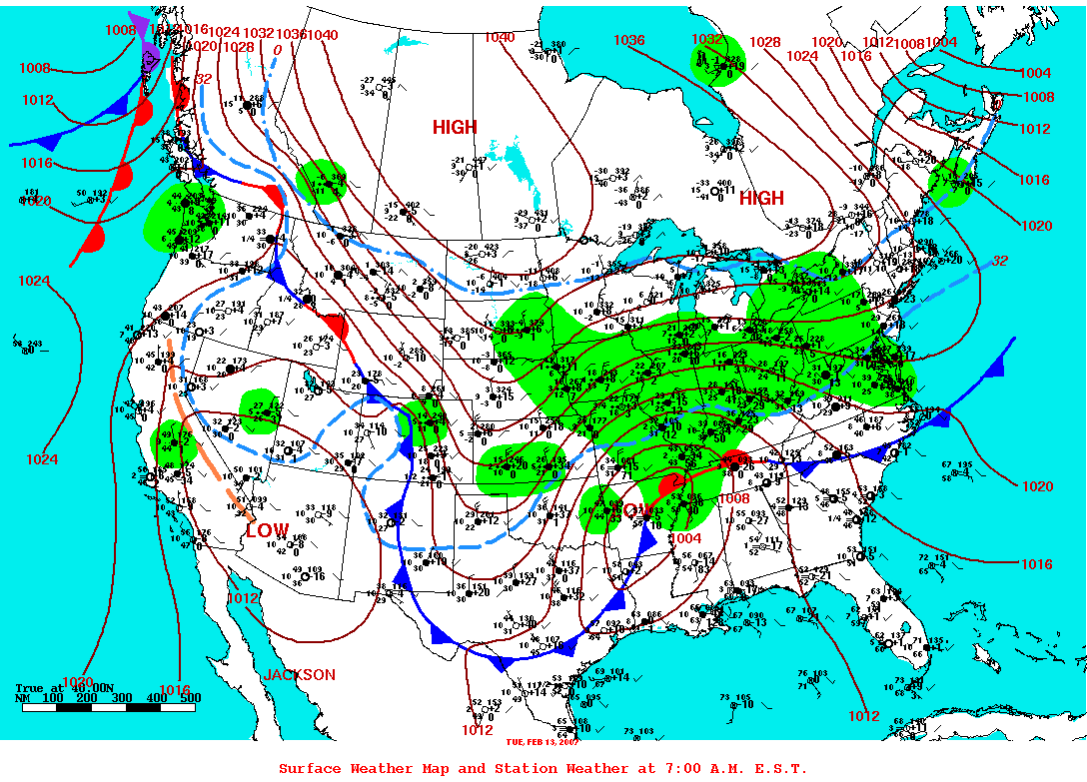
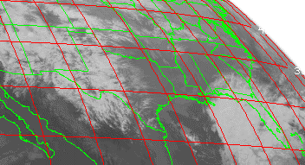
12-13 February 2007 Case
2/12/07 1200Z Surface Analysis
2/13/07 1200Z Surface Analysis
Developing front draped across Texas
2/12/07 0742-0800Z AIRS
2/12/07 0800Z GOES IR Image
High-quality AIRS profiles in clear skies ahead of front
Pressure (hPa)

Slide 7
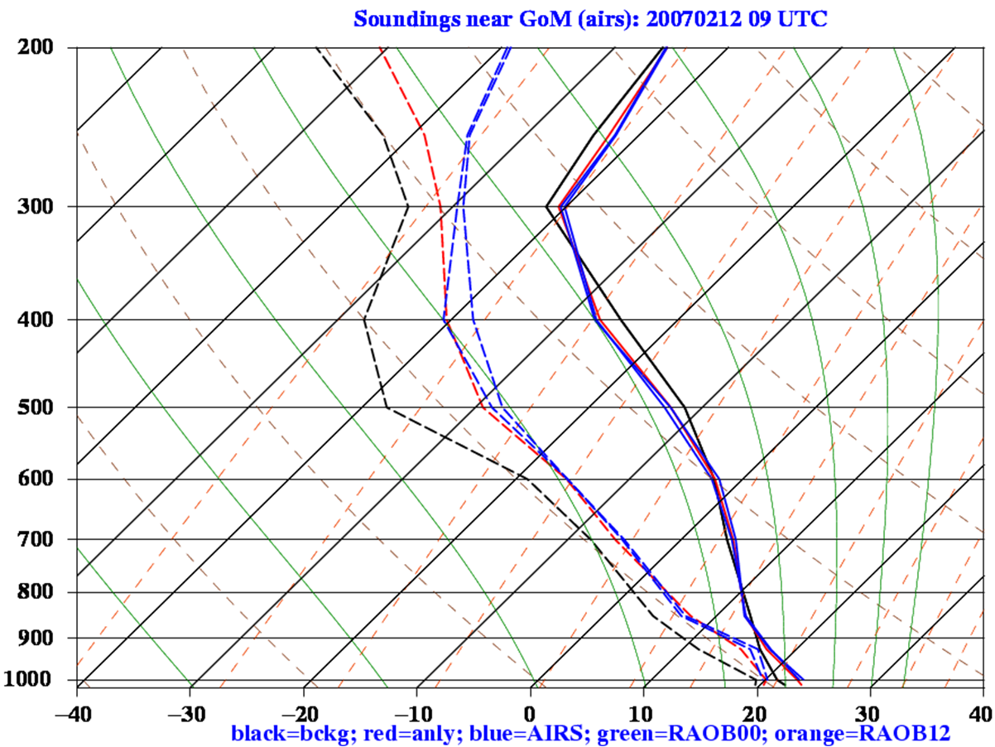
A Sample Analysis Impact
Gulf of Mexico soundings at ≈08 UTC on 12 February 2007
Figure at right shows how assimilation of AIRS temperature and moisture profile impacts a sample Skew-T
Warms near-surface; cools upper levels
Result is a more unstable sounding
Entire column is moistened
Mid-level cooling
Low-level warming
BKGD
AIRS
ALYS
Pressure (hPa)
transitioning unique NASA data and research technologies to operations

Slide 8
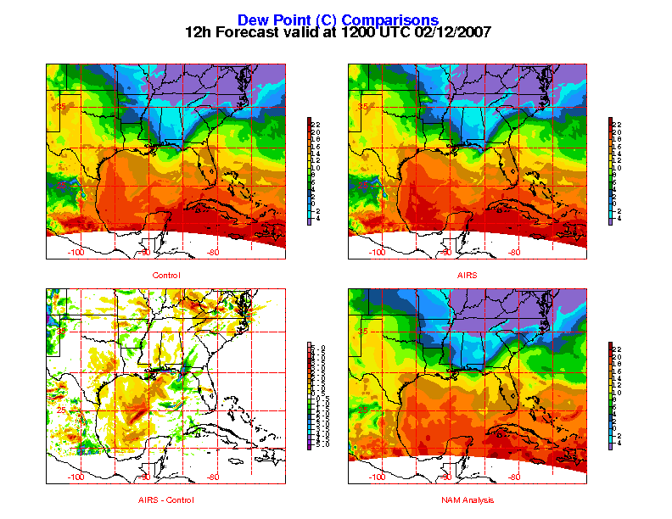
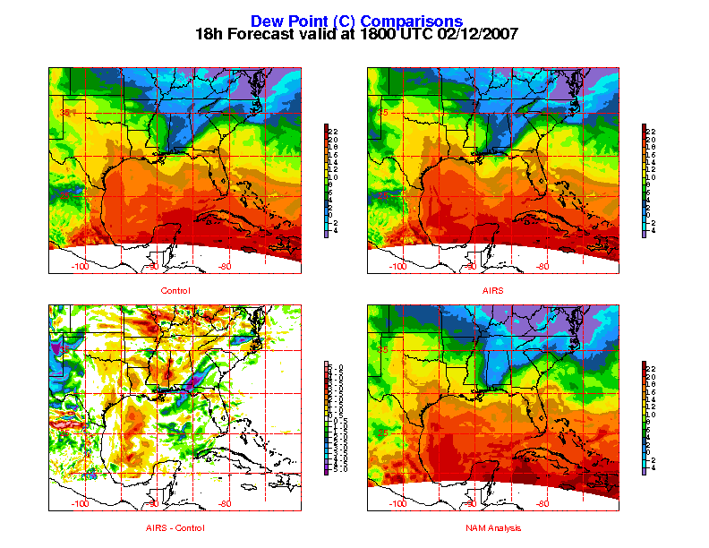
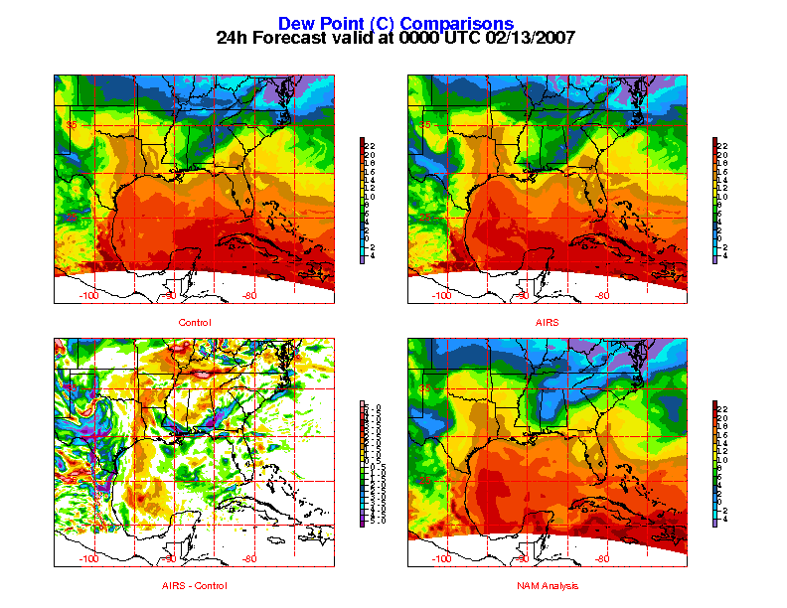
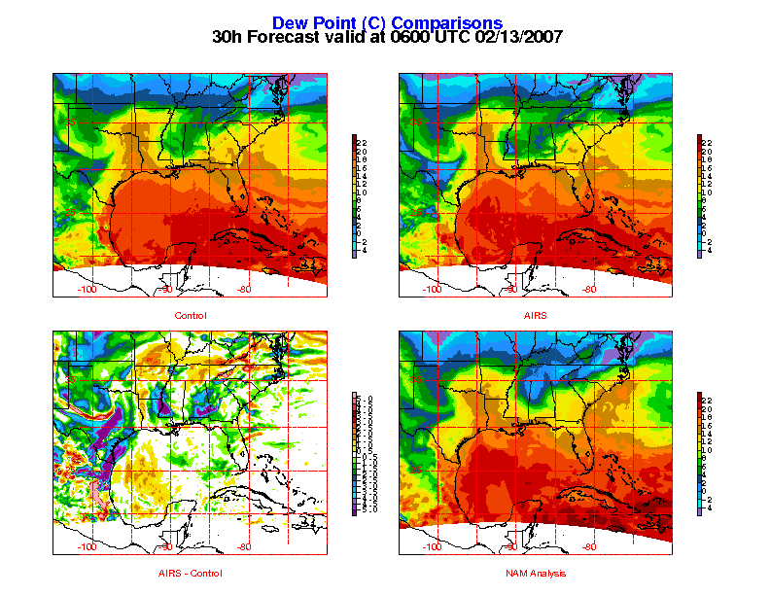
Improved Moisture Forecasts
1000 hPa dew point forecasts
Representative of boundary layer levels
NAM analysis shows large pool of 20-22ºC dew points migrating from Yucatan to Gulf Coast
Control gives no hint of these warmer dew points
AIRS forecast favorably compares to NAM
transitioning unique NASA data and research technologies to operations

Slide 9
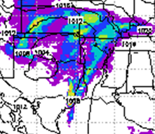
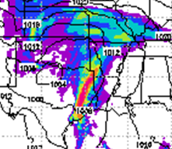
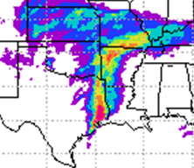
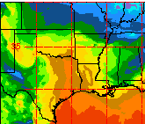
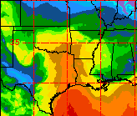
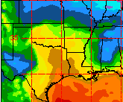
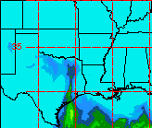
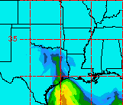
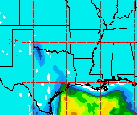

Improved Precipitation Forecasts
24-h forecast valid 00Z 2/13/07
Convective precipitation in Eastern Texas
  Control (upper left) produces some rain but does not capture significant precipitation
  AIRS (upper middle) reproduces convective precipitation line
Better representation of lower level moisture
CAPE values above 1800 J/kg in NAM analysis (lower right)
  AIRS (lower middle) nicely represents CAPE
  Control run (lower left) gives no hint of higher CAPE values
Control
Control + AIRS
Analysis “Truth”
50.80
6-hr precip.
38.10
25.40
19.05
12.70
6.35
2.54
0.25
1000 hPa T_{d}
CAPE
transitioning unique NASA data and research technologies to operations

Slide 10
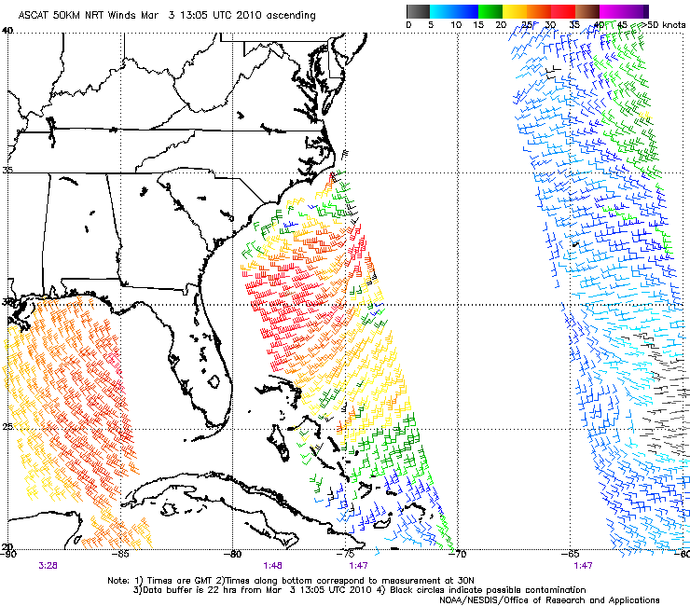
Scatterometer Wind Assimilation
Planned to use QuikSCAT; now focusing on EUMETSAT’s ASCAT (METOP)
Scatterometer uses wave characteristics to calculate wind speeds at ocean surface (10m)
Assimilation of scatterometer winds should produce a better analysis of low-level winds
  Improve marine forecasts
  Possibly improve moisture return forecasts over Gulf
Combine with AIRS profile assimilation to create an integrated “Moisture Return Analysis” product?
From Paul Chang: NOAA/NESDIS
transitioning unique NASA data and research technologies to operations

Slide 11
Summary/Conclusions
SPoRT seeks to improve short-term, regional weather forecasts using satellite products and capabilities
Assimilation of profiles into WRF-Var produced overall improvements in precipitation forecasts
  Improved CAPE and lower-level moisture for extreme precipitation event
Assimilation of scatterometer winds may give improved lower-level wind forecasts
  Improved wind analyses and forecasts
  Improved moisture return forecasts
SPoRT plans to begin generating a real-time 3D analysis product incorporating AIRS profile data
  May be easier for forecasters to use the data in an integrated manner than from raw data alone
  Nowcasting; Initializing WFO model runs
SPoRT is committed to working with WFO partners on projects to investigate the impact of assimilating satellite data into regional models to address unique forecast problems
transitioning unique NASA data and research technologies to operations

Slide 12

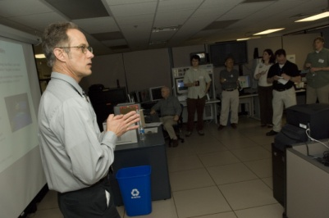
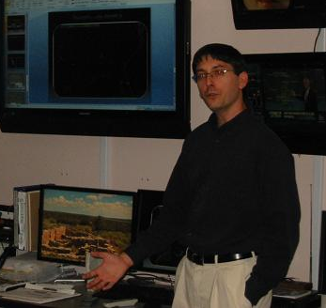
Future Work
Produce a real-time 3D analysis product incorporating AIRS and (and eventually IASI) profile data over data void regions for nowcasting or for initializing local forecast runs to improve stability and moisture return forecasts
Study assimilation of scatterometer winds to better diagnose low-level wind patterns over Pacific and Gulf of Mexico
Pursue creation of an integrated “moisture return” product combining satellite profiles and satellite winds
Work closely with our WFO partners on case studies that have impacted their region with the end goal of conference or journal publications
transitioning unique NASA data and research technologies to operations

