Slide 1
Using NASA/SPoRT Datasets To Improve Warning Decision-Making During The Peninsular Florida Warm/Wet Season
Jonathan C. Guseman, Matthew R. Volkmer,
Peter F. Blottman, and David W. Sharp
NOAA/National Weather Service
Melbourne, FL

Slide 2
Applied Science Research
Focus of Collaboration: To challenge the usefulness of the Convective Initiation (CI) and the Total Lightning Source Density (LDAR) products within the WFO Melbourne warning decision-making process.
Perspective: An operations context which assumes the eventual routine availability of 5-minute satellite data and 1-minute total lightning data.
Two Case Studies: Two separate, but similar, events involving isolated severe storms over Brevard County during the warm/wet season.
Note: Convective Initiation Products provided by University of Alabama - Huntsville through NASA/SPoRT.

Slide 3
Project Goals
Goal #1: Challenge CI to help with limiting the size of severe thunderstorm warning polygons in select situations.
Pulse severe (or hybrid-pulse severe)
Situations when new cell growth must also be taken into account, in addition to the advection/propagation of existing storms.
Isolated to widely scattered convection within the 15-30 minute time frame
Situations when CI should perform well in both space and time.
Warnings for Brevard County
Situations in which this large county suffers from over-warning, especially relative to initial issuances.

Slide 4
Project Goals
Goal #2: Challenge LDAR (Lightning Detection and Ranging; total lightning data) to help with gaining a few minutes of lead time when warning for pulse severe storms, and to then help with providing enhanced information during the warning period.
Use source counts of 80-90 sources per minute (columnar) for highlighting storms of particular interest.
Use source counts that well-exceed 80-90 sources per minute for highlighting suspect severe storms.
Use locations of relative maxima for highlighting threatened areas and polygon maintenance.

Slide 5
Case Study #1
Location: East Central Florida (ECFL); Brevard County
Date: 29 September 2011; 2030 - 2130 UTC
Collaborating WFO(s): Melbourne, FL (MLB)
Event Description: Isolated to widely scattered strong/severe local storms focused toward the ECFL coast behind the east coast sea breeze (ECSB).
Evaluation Context: Parallel operations and post-event.
Case #32

Slide 6
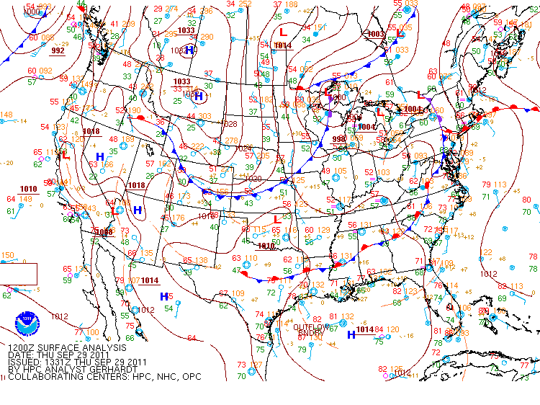
Synoptic Background (Surface)
Local southwest winds ahead of a stalled frontal boundary over Georgia combined with a drier than normal air mass over Florida (despite high surface dew points).
Ridge axis over and east of ECFL.
Isolated inland storms slow to develop; additional lift and interaction with the ECSB near the coast by mid-late afternoon.

Slide 7
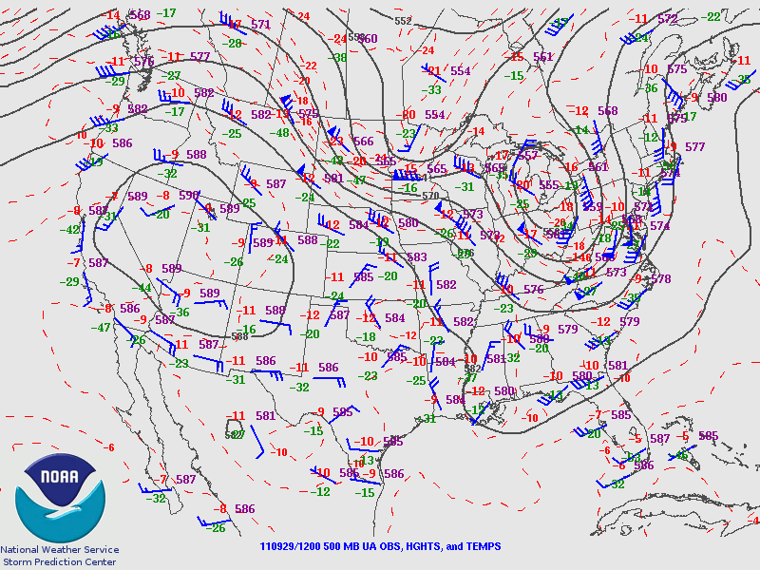
Synoptic Background (500 mb)
Large-scale mid-level trough positioned over eastern United States extending into the Deep South with embedded shortwave(s) moving east.
Relatively warm aloft over the peninsula, but with potential for modest mid-level cooling as secondary trough axis approaches.

Slide 8
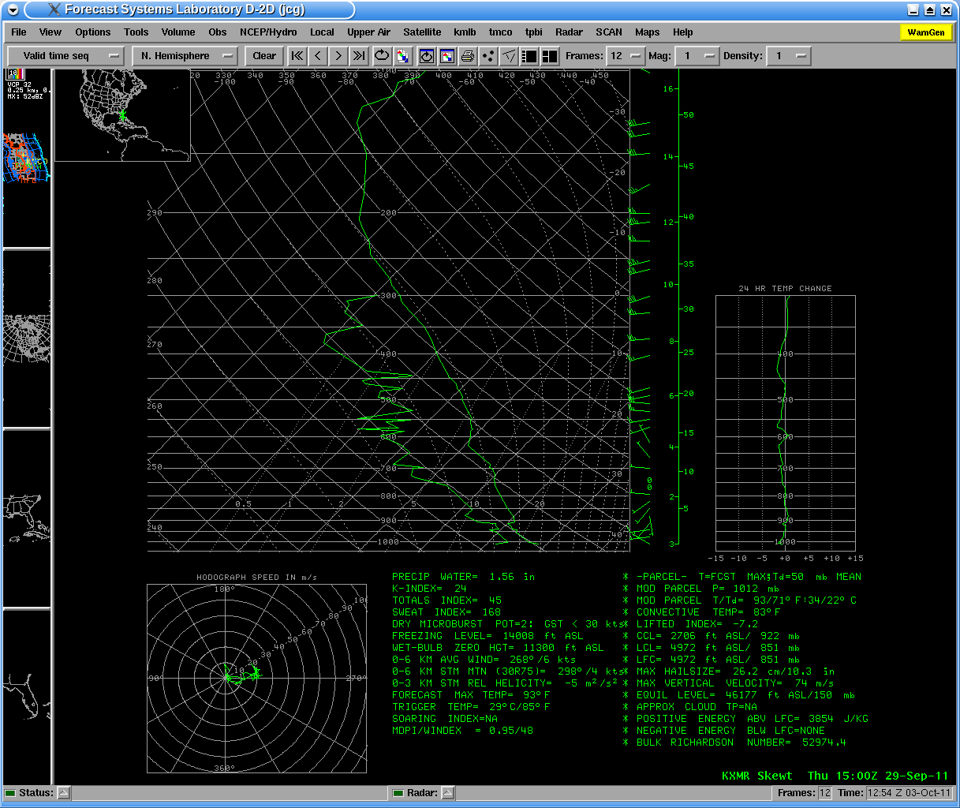
Convective Set-Up
The Convective Set-up
(Consider Baroclinic Intrusion Aloft and Diurnal Evolution of Boundary Layer)
Large-scale mid-level trough positioned over Gulf of Mexico along with embedded shortwave troughs.
Deep layer moisture relatively low compared to climatology, with precipitable water values of about 0.25 inches below normal.
15Z – Cape Canaveral
PW much drier than normal.
Considerable instability.
Sea breeze will cause low-level winds to back to support increased directional shear.
WBZ reasonable for chance of hail, but melting layer still deep.
CAP
ECSB
Weak winds, especially within
lower-half of troposphere

Slide 9
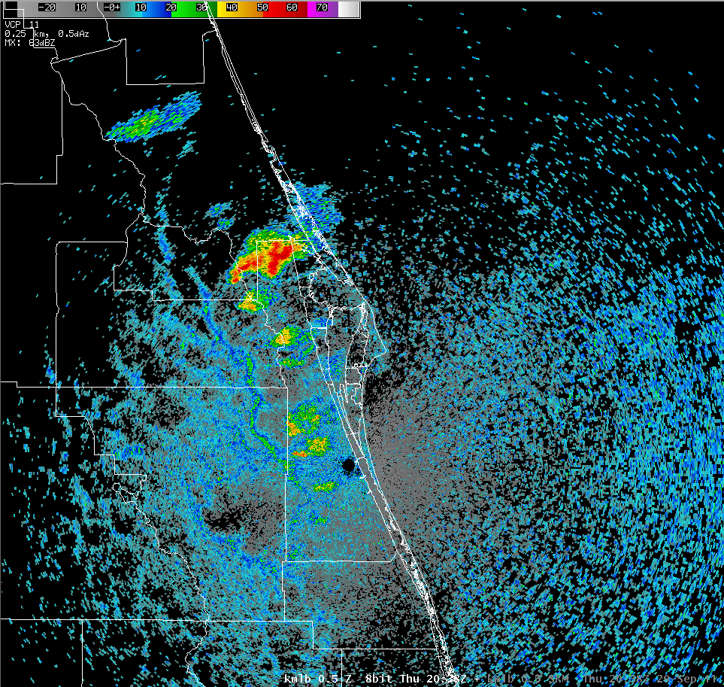
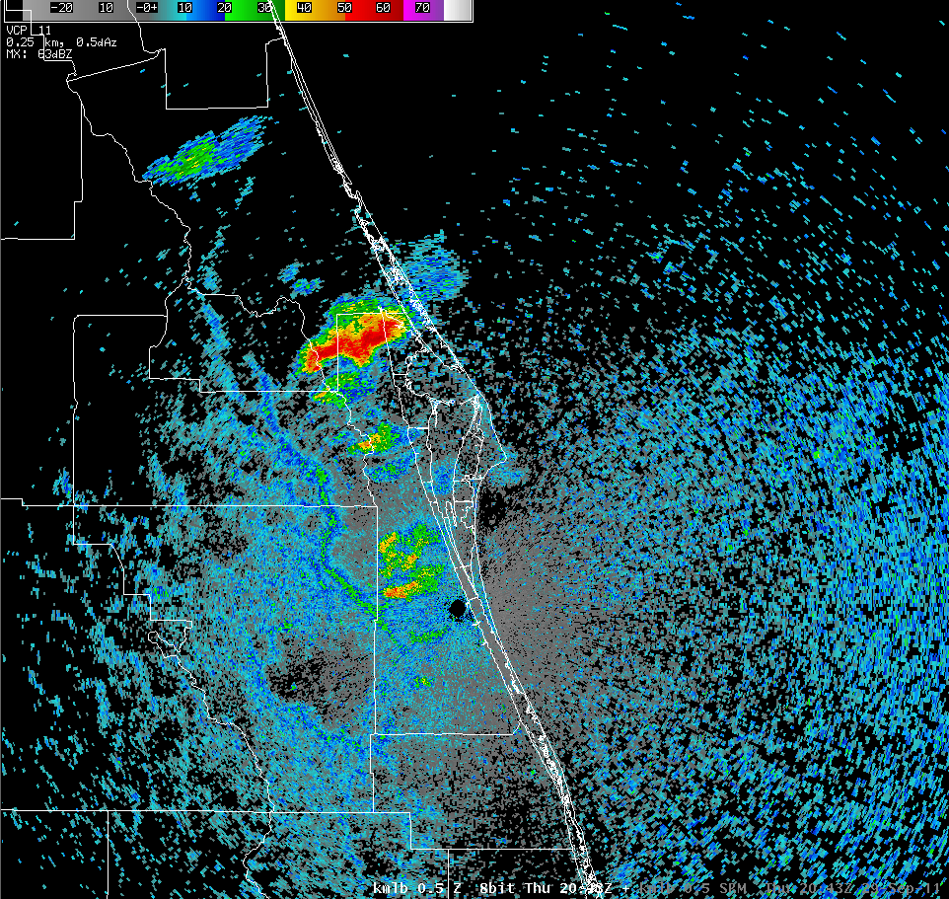
2038 UTC
ECSB provided added source of lift;
Low-level helical organization behind ECSB;
Somewhat better tilt to updrafts;
Updraft/downdraft separation.
Declarative: Based on radar signatures, a Severe Thunderstorm Warning (SVR) would be issued sometime between 438 PM and 443 PM EDT for Brevard County.
ECSB
2043 UTC
Brevard
County
70 miles long
Accentuated Lift
0.5 deg
Warning Decision Making
(radar-based viewpoint)
Concern: severe hail & wind gusts
Motion: 327DEG 12KT
0.5 deg

Slide 10
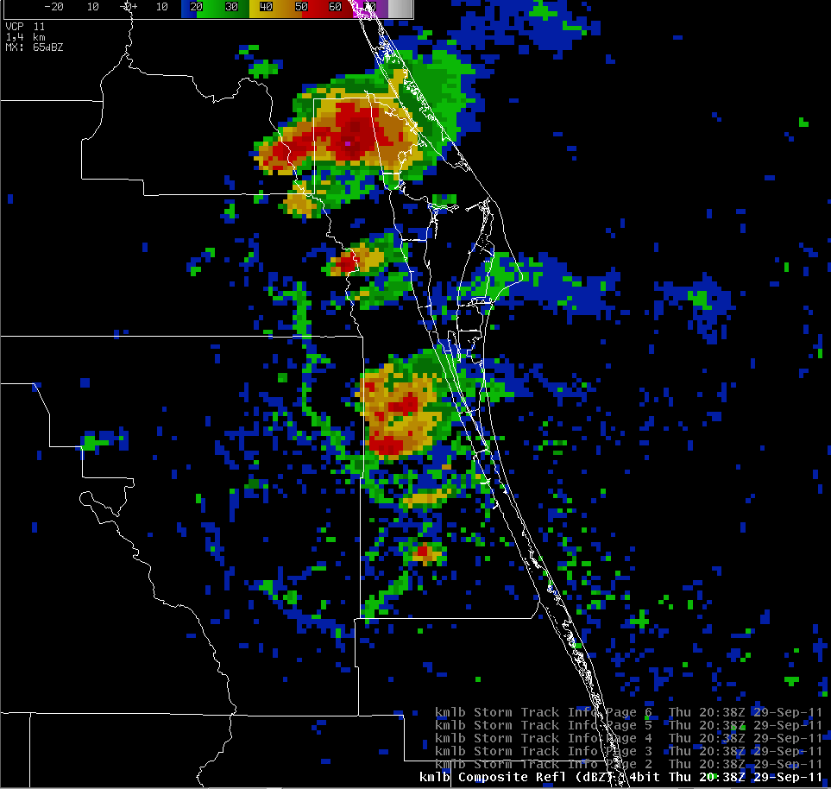
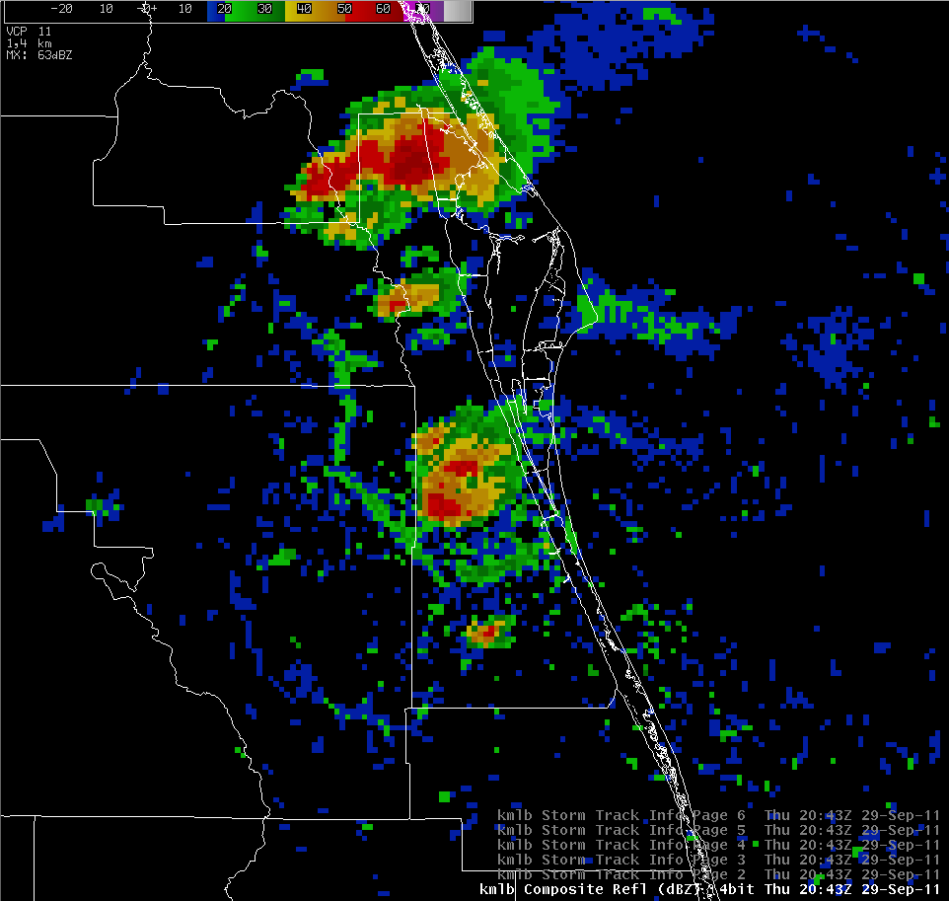
2038 UTC
Declarative: Based on radar signatures, a Severe Thunderstorm Warning (SVR) would be issued sometime between 438 PM and 443 PM EDT for Brevard County.
CR 65+ dBZ
2043 UTC
CR 35+ dBZ
Warning Decision Making
(radar-based viewpoint)
Concern: severe hail & wind gusts
Motion: 327DEG 12KT

Slide 11
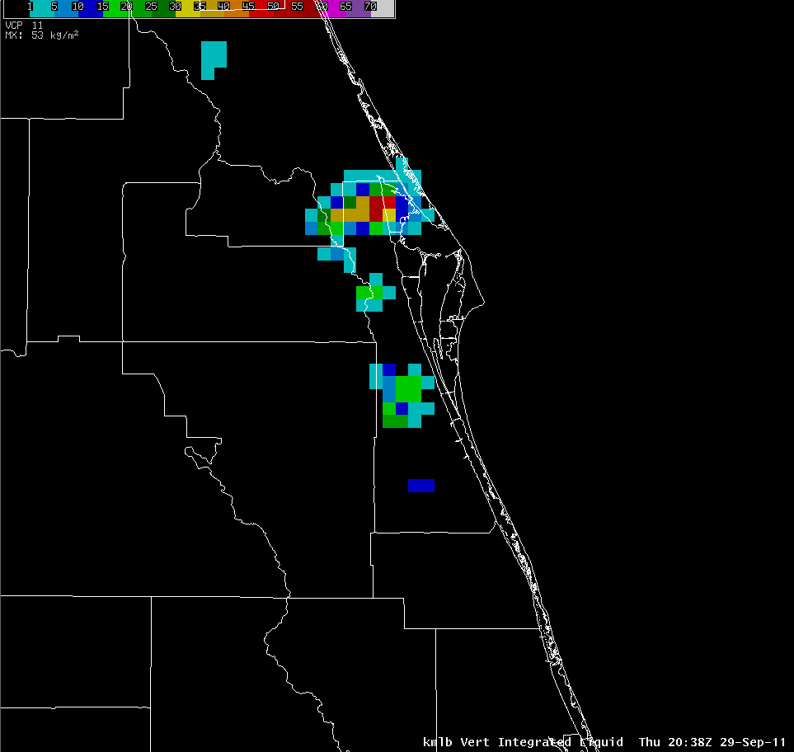
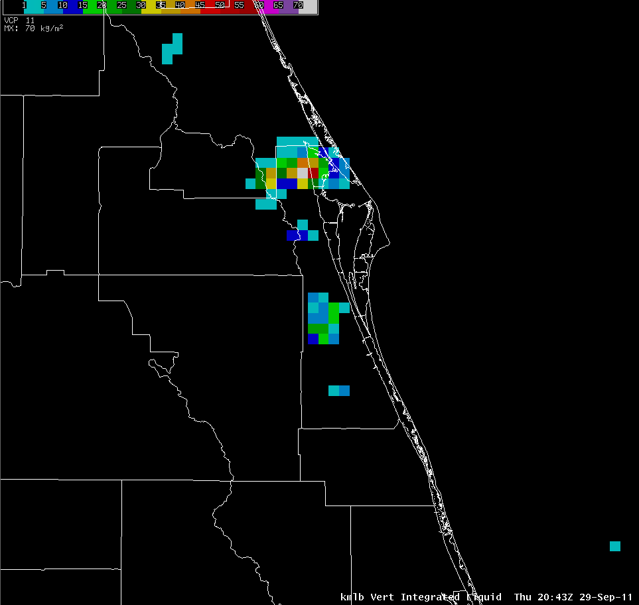
2038 UTC
Declarative: Based on radar signatures, a Severe Thunderstorm Warning (SVR) would be issued sometime between 438 PM and 443 PM EDT for Brevard County.
High VIL Values
2043 UTC
High VIL Values
70 kg/m²
Warning Decision Making
(radar-based viewpoint)
Concern: severe hail & wind gusts
Motion: 327DEG 12KT

Slide 12
Operational Decision
Using SATCAST/CI for WDM
WDM: Warning Polygon Size/Shape
Question: Given that the decision to warn has already been made, what should be the geographic extent of the associated SVR polygon for Brevard County?
That is, should the initial warning include central and south Brevard County together with the warning for north Brevard County?
Question: Also, what should be the geographic extent of the SMW polygon for the adjacent coastal waters?
That is, should the warning extend beyond 5 nm from the north Brevard coast, and/or include the central and south Brevard intra-coastal and near-shore waters?
Note: The majority of small boating traffic occurs over the intra-coastal waterways and within 5 nm of the coast.

Slide 13
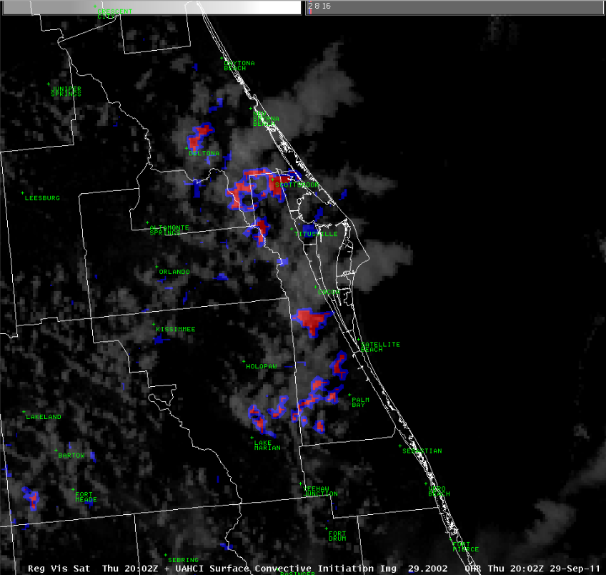
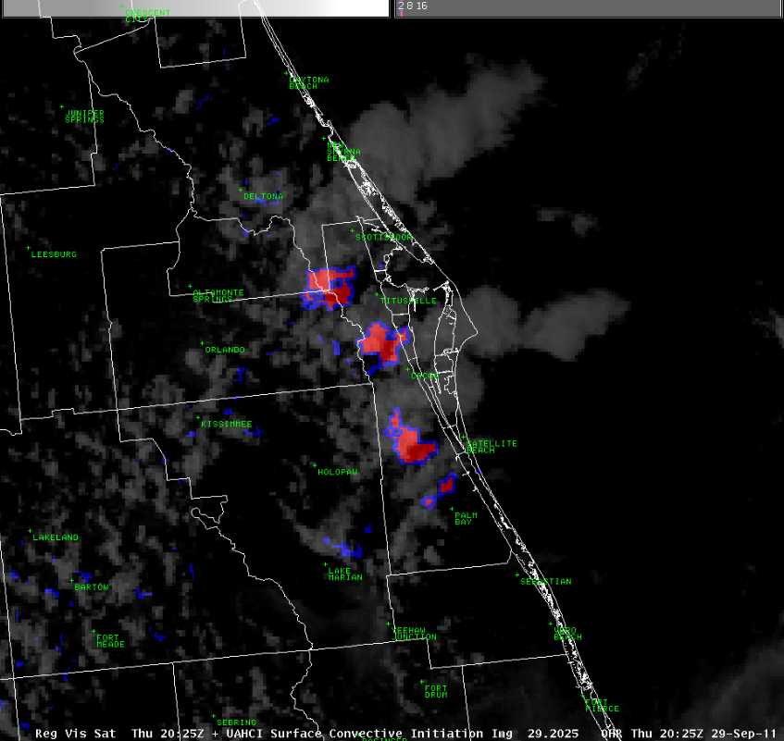
2002 UTC
SATCAST - 2011 Version
Convective Initiation
(Red = Yes; Blue = No)
for 35+ dBZ cells at -10º C
2025 UTC
Early and persistent indication of CI for all of Brevard County 30 to 40 minutes before warning time.

Slide 14
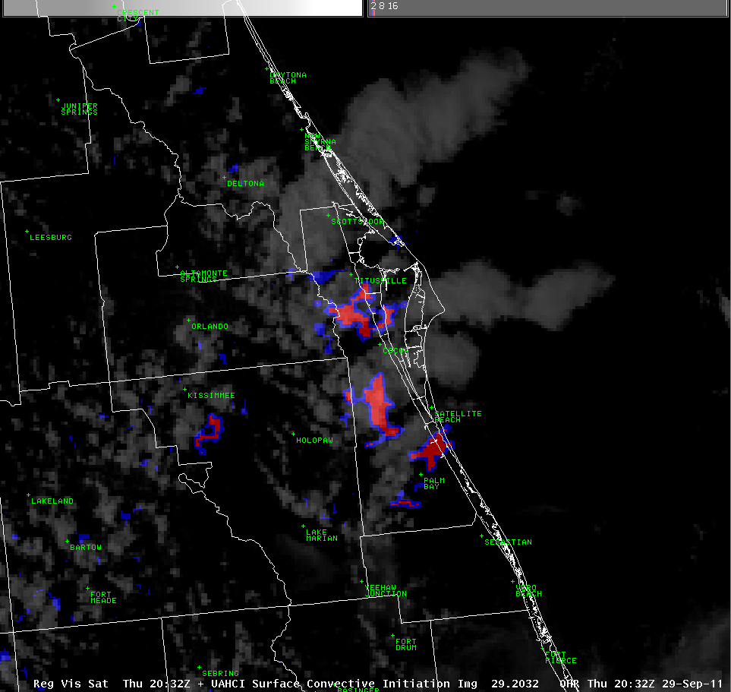
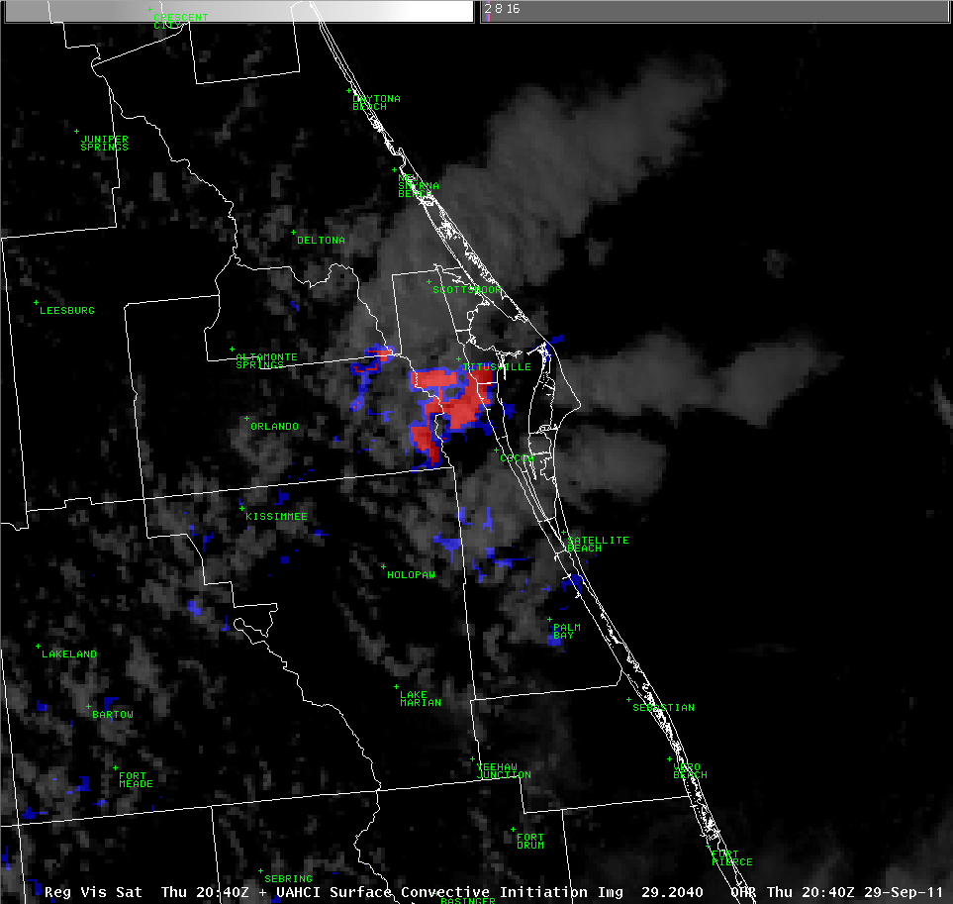
2032 UTC
SATCAST - 2011 Version
Convective Initiation
(Red = Yes; Blue = No)
Storms
underway
for 35+ dBZ cells at -10º C
2040 UTC
Storms
underway
Continued CI for central and south Brevard now teamed with existing storms over north Brevard, but then no additional CI indicated central/south around warning time.

Slide 15
2032 UTC
SATCAST - 2011 Version
Convective Initiation
(Red = Yes; Blue = No)
for 35+ dBZ cells at -10º C
2040 UTC
Value Judgment: Can the SATCAST fully “see” what’s going on here?
Continued CI for central and south Brevard now teamed with existing storms over north Brevard, but then no additional CI indicated central/south around warning time.

Slide 16
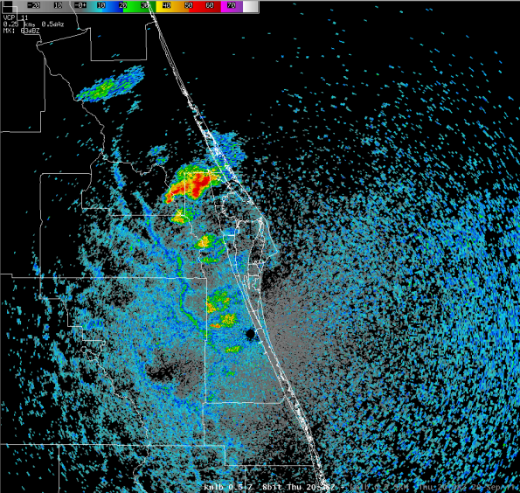
Potential for new
cell growth
2040 UTC
Existing strong
to severe storms
2038 UTC
Brevard County is 70 miles long with diversified interests.
During the wet season, it often suffers from being over-warned, especially in areal extent.
An attempt to use the 15-30 minute CI signals from SATCAST by considering polygon size relative to potential new growth for isolated severe storms.
Here, we cannot say that warnings won’t be needed for central and south Brevard. Yet, we can suggest that the initial polygon(s) not be inclusive.
No
Existing convection present, but no new cell growth.
CI = Binary
Yes or No

Slide 17
Severe Thunderstorm Warning
(for 50+ knot gusts & 1.0 inch hail)
2040 UTC
2038 UTC
Additional CI indicated over north Brevard. OK
Additional CI not indicated over central or south Brevard. OK(?)
Additional CI not indicated over the adjacent coastal waters. OK(?)
WDM: Focus on existing and developing storms over north Brevard.
CI doesn’t indicate potential strength or severity.
CI doesn’t give more information about existing (35+ dBZ) storms.

Slide 18
2040 UTC
2038 UTC
Additional CI indicated over north Brevard. OK
Additional CI not indicated over central or south Brevard. OK(?)
Additional CI not indicated over the adjacent coastal waters. OK(?)
WDM: Focus on existing and developing storms over north Brevard.
CI doesn’t indicate potential strength or severity.
CI doesn’t give more information about existing (35+ dBZ) storms.
Special Marine Warning
(for 34+ knot gusts)

Slide 19
Severe Thunderstorm Warning
(for 50+ knot gusts & 1.0 inch hail)
2040 UTC
2038 UTC
Additional CI indicated over north Brevard. OK
Additional CI not indicated over central or south Brevard. OK(?)
Additional CI not indicated over the adjacent coastal waters. OK(?)
WDM: Focus on existing and developing storms over north Brevard.
CI doesn’t indicate potential strength or severity.
CI doesn’t give more information about existing (35+ dBZ) storms.
Monitor
Special Marine Warning
(for 34+ knot gusts)

Slide 20
Operational Decision
Using LDAR for WDM
WDM: Warning Lead Time
Question: Using threshold values around 80-100 sources per minute (layer; columnar) as those of relative significance during the Peninsular Florida wet season for strong to marginally severe storms, can the total lightning signal offer increased confidence toward issuing the SVR early in the 4:38-4:43 PM window or perhaps just before?
That is, can total lightning data serve as an effective complement to radar data for warning decision-making to positively effect POD, FAR, and LT?
Question: Also, using LDAR, might a Significant Weather Advisory (SPS) be otherwise prompted in advance of the SVR highlighting the potential for strong/severe storms?

Slide 21
Operational Decision
Using LDAR for WDM
Caveats:
WFO Melbourne currently receives total lightning (LDAR) data in two ways:
Raw source plots from a direct feed with NASA/KSC and USAF/45WS. No time lag; minimal data interrogation or alternative display techniques; on a separate stand-alone workstation.
Processed source densities from NASA/SPoRT. Several minute time lag; aspects of data interrogation and imaging functionality (e.g., source densities); on AWIPS.

Slide 22
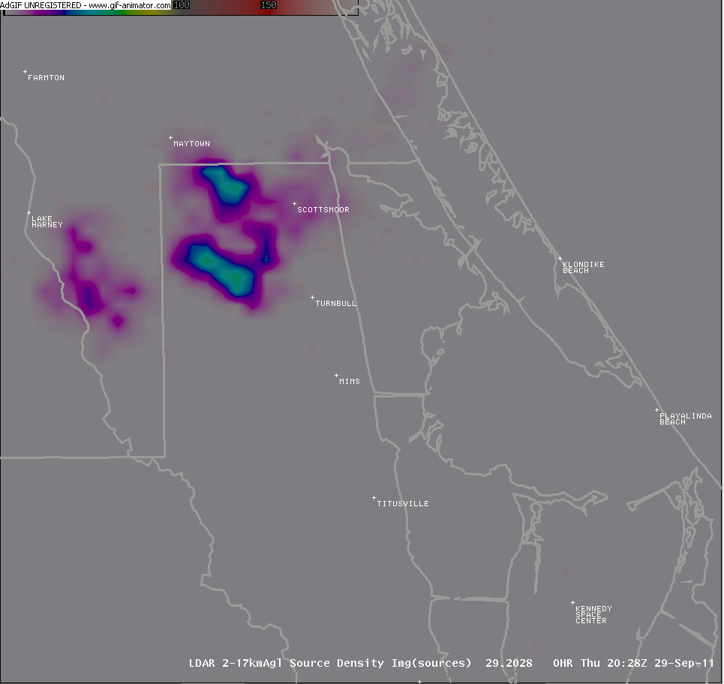
Prior to a radar-only based warning, LDAR would certainly give forecasters a “heads-up” for an advanced SPS. It would also help tip the WDM scales by complementing information from the 438 PM radar scan, or perhaps even provide a few minutes of Lead Time beforehand.
Y E S !
Y E S !
Total lightning values pulse to near, and at times over, 80-90 sources per minute 5 to 10 minutes prior to 438 PM. Suspicions are clearly raised.
Total lightning signals can help appreciate the relative strength of the updraft(s), especially in the anxious time between volume scans.

Slide 23
Operational Decision
Using LDAR for WDM
WDM: Warning Continuance
Question: Using values which far exceed 80-90 sources per minute (especially if realized within perceived “jumps”) as those of relative significance for severe storms during the Peninsular Florida wet season, could the total lightning data have given indication of the recurrence and location of severe weather potential enough for an enhanced SVS narrative as to update the original warning information?
If so, what might be said around 458 PM EDT (2058 UTC)? Can any of the original SVR polygon be confidently trimmed?

Slide 24
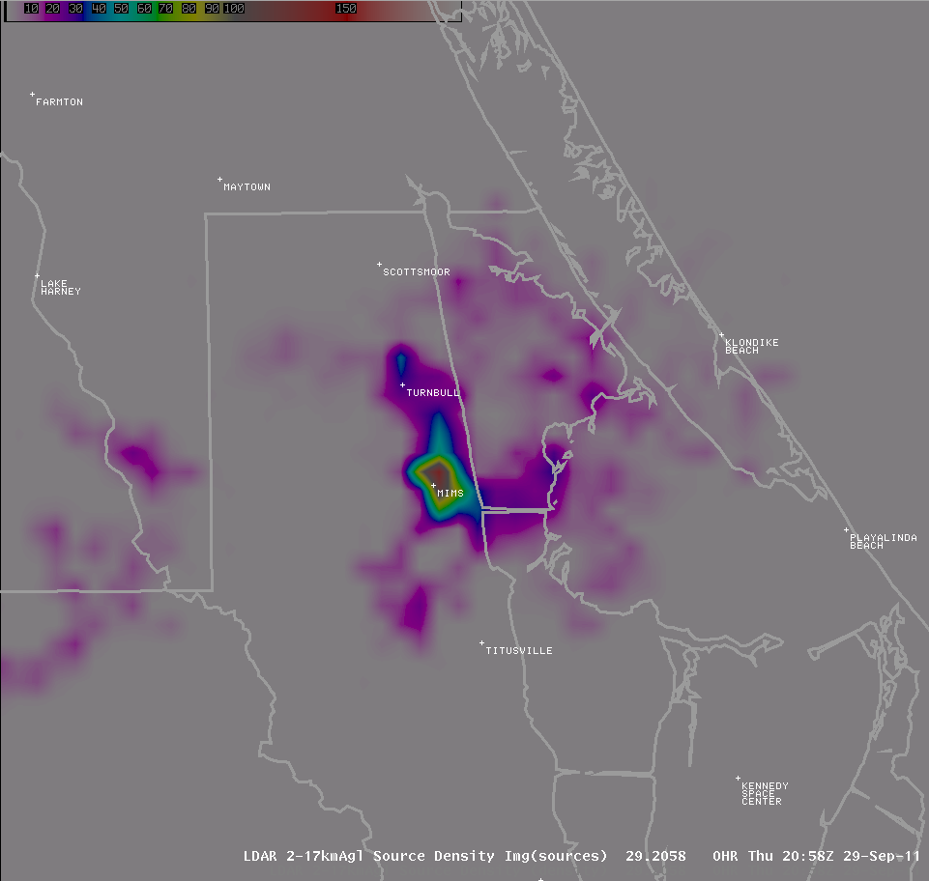
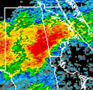
So, the back (north) edge of the initial warning polygon can be trimmed, even though thunder/lightning is still present there.
Y E S !
Total lightning values pulse well over 80-90 sources per minute at 458 PM EDT.
Severe weather manifestation is focused in vicinity of Mims where large (but not giant) hail is likely falling teamed with severe wind gusts emanating south and east.

Slide 25
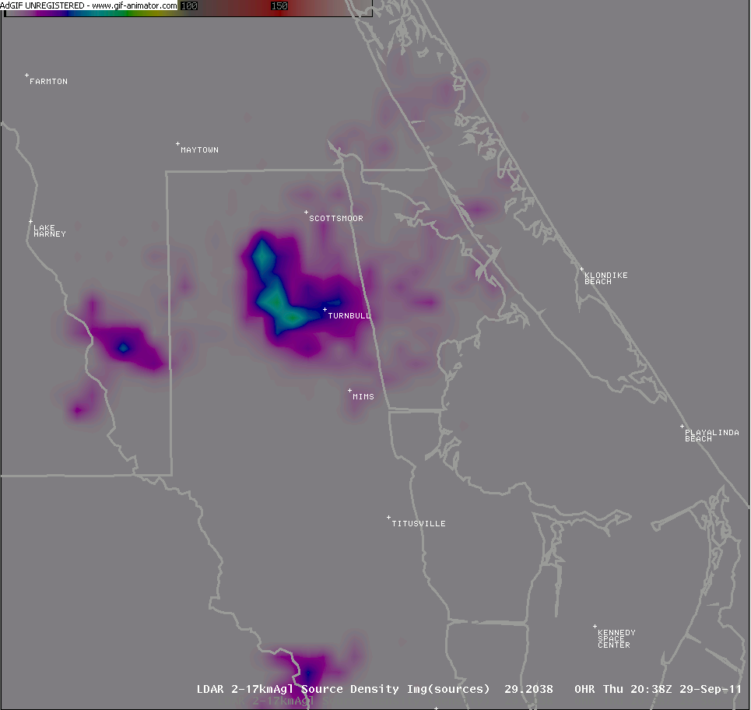
If the time lag issue relative to data delivery can be overcome, processed 1-minute (or 2-minute) total lightning products could fill in the anxious void between radar scans.
A loop of the total lightning signal from 438 PM (earliest radar-based SVR) to 458 PM EST.
During this time, there are 21 frames of total lightning information but only 5 frames of radar information.

Slide 26
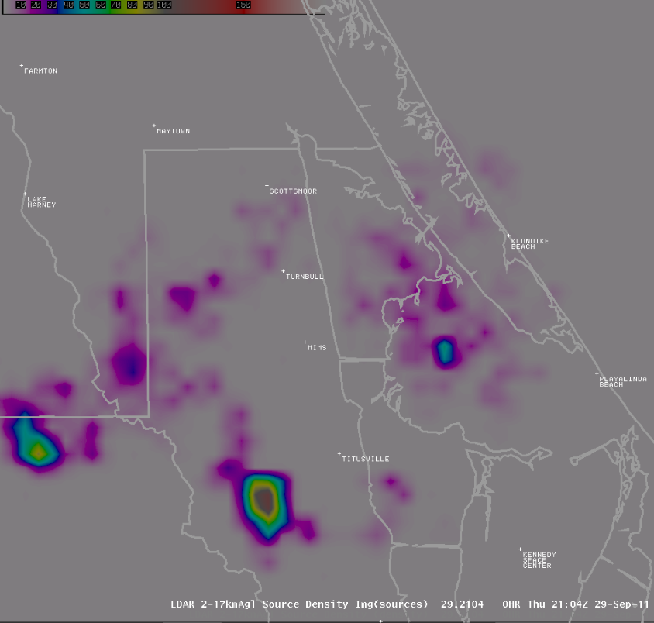
Later in the warning period, LDAR did indicate a continued severe threat southwest of Titusville.
Also, although not shown, LDAR did not indicate a concern for the intensification of existing storms over central and south Brevard, while CI did not indicate a concern for additional new growth there either (cirrus contamination aside).

Slide 27
Verification
Brevard County: WFTV Channel 9 relayed reports of quarter-sized hail (E1.00 inch) recurring from 500 to 512 PM EDT around Mims.
No other reports of severe weather were received in East Central Florida, to include the remainder of Brevard County.

Slide 28
Case Study #2
Location: East Central Florida (ECFL); Brevard County
Date: 16 August 2012; 1855 - 2002 UTC
Collaborating WFO(s): Melbourne, FL (MLB)
Event Description: Widely scattered inland storms focused toward the ECFL coast interacting with ECSB convection, along with accentuated outflows. Storms behind the ECSB will be of interest.
Evaluation Context: Parallel operations and post-event.

Slide 29
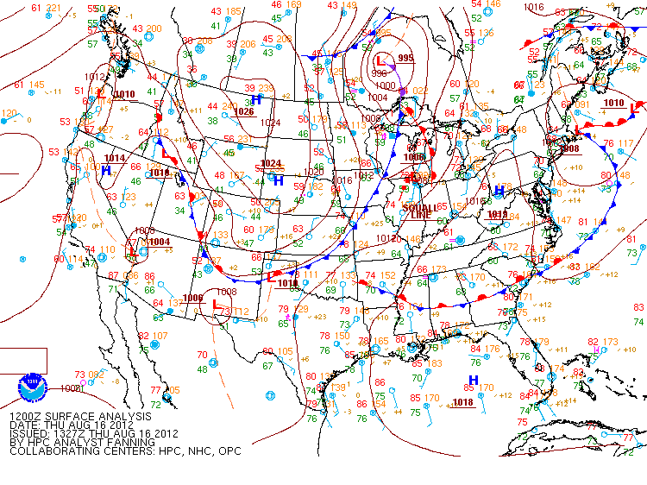
Synoptic Background
Local southwest winds ahead of a stalled frontal boundary over Georgia combined with a moist air mass over Florida.
Ridge axis south of ECFL.
Widely scattered inland storms to develop; additional lift and interaction with the ECSB near the coast by mid-late afternoon.

Slide 30
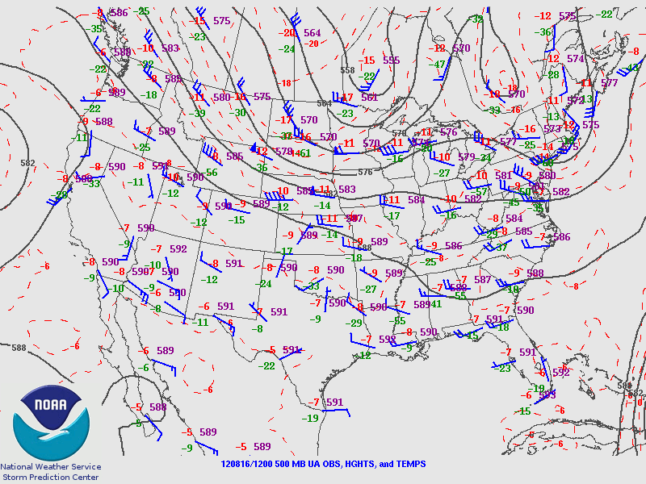
Synoptic Background
Broad mid-level trough positioned over southeastern United States.
Relatively warm aloft over Florida Peninsula, but with no advective mid-level cooling.
Weak tropospheric winds.

Slide 31
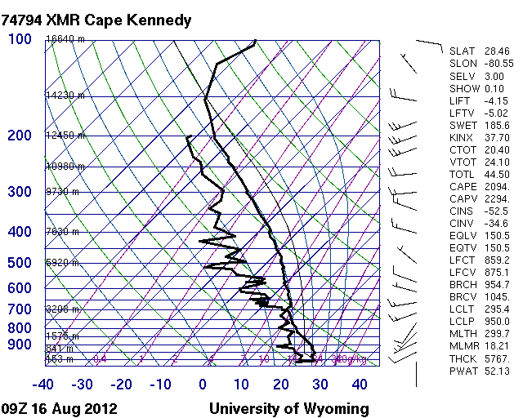
The Convective Set-up
Note: Sounding at 09Z, not 12Z
Deep moisture, but with embedded layers of drier air.
Good instability, but still warm aloft; marginally severe hail.
Sea breeze will cause low-level winds to back to support increased directional shear.
Accentuated downdrafts via evaporative cooling and precipitation loading.
A boundary rich day.
CAP
ECSB
Pwat ~2 inches

Slide 32
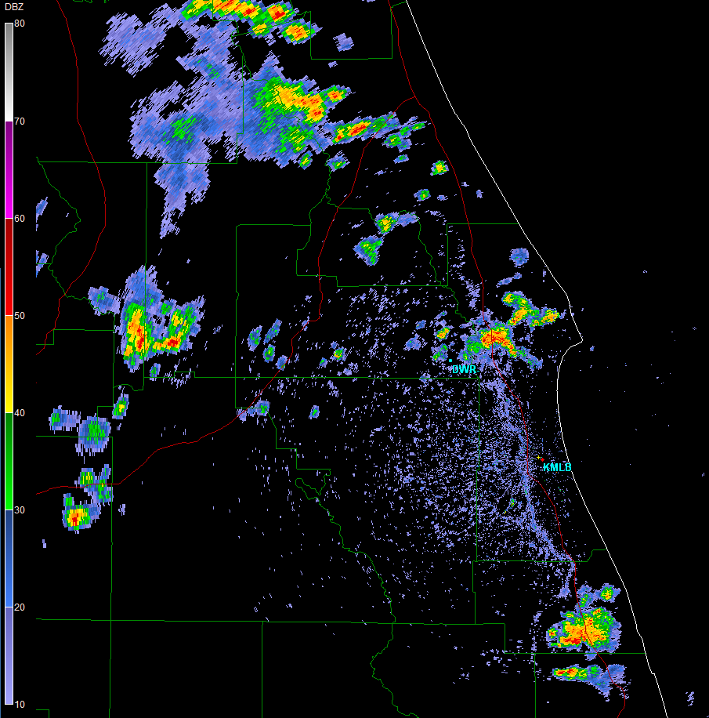
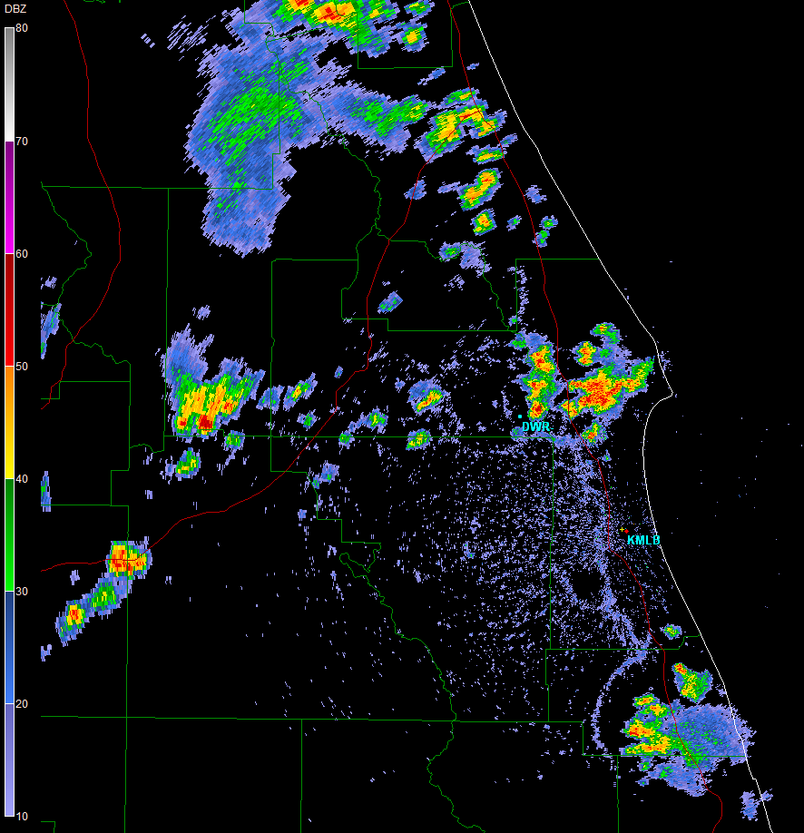
1904 UTC
Situation: Inland convection has formed, but with the ECSB providing lift for convection near coast. Storms behind ECSB realize low-level direction shear due to locally backed winds. Storms are moving slow, however. Downdraft outflows make for a boundary rich environment.
ECSB
1928 UTC
ECSB
0.5 deg
Warning Decision Making
(radar-based viewpoint)
Outflows
Concern: severe hail & wind gusts
Motion: 290DEG 7KT
0.5 deg

Slide 33
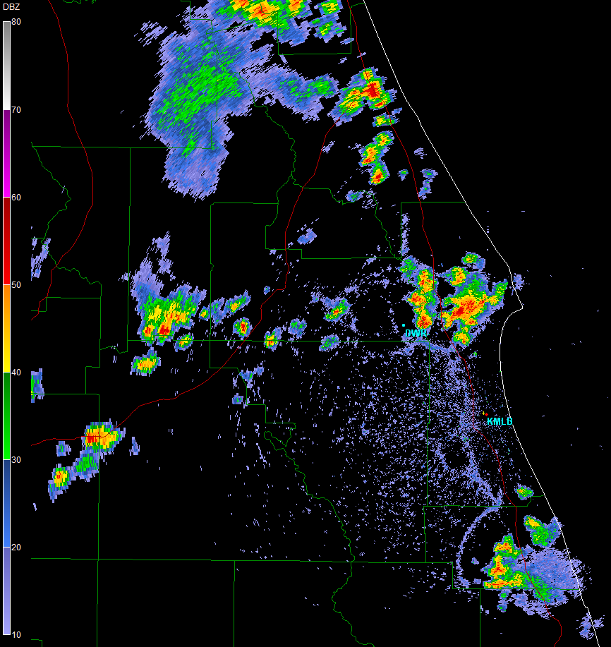
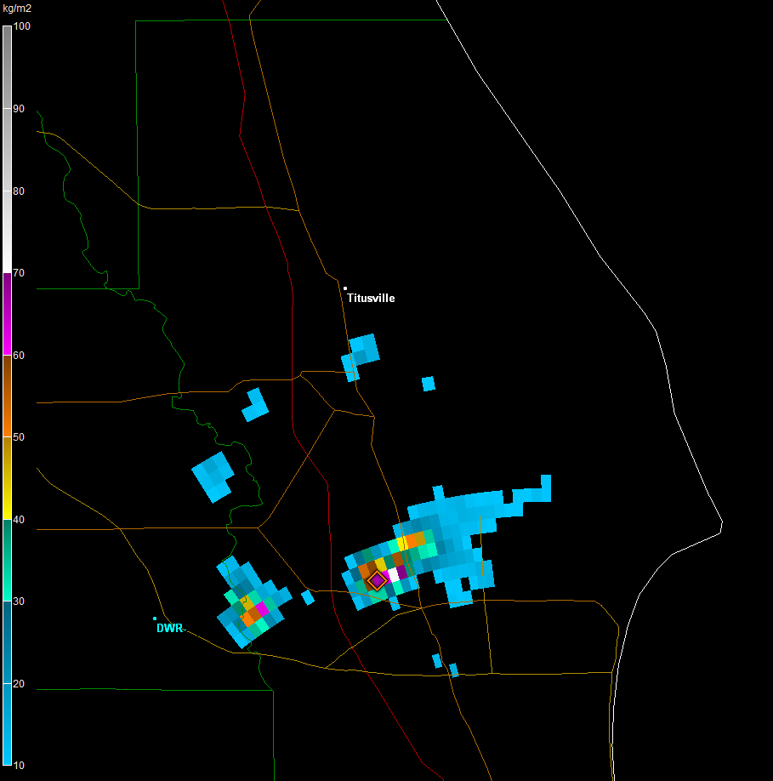
1933 UTC
Situation: Inland convection has formed, but with the ECSB providing lift for convection near coast. Storms behind ECSB realize low-level direction shear due to locally backed winds. Storms are moving slow, however. Downdraft outflows make for a boundary rich environment.
1933 UTC
Boundary Interactions
ECSB / Outflows
High VIL Values
0.5 deg
70 kg/m²
Warning Decision Making
(radar-based viewpoint)
Concern: severe hail & wind gusts
Motion: 290DEG 7KT

Slide 34
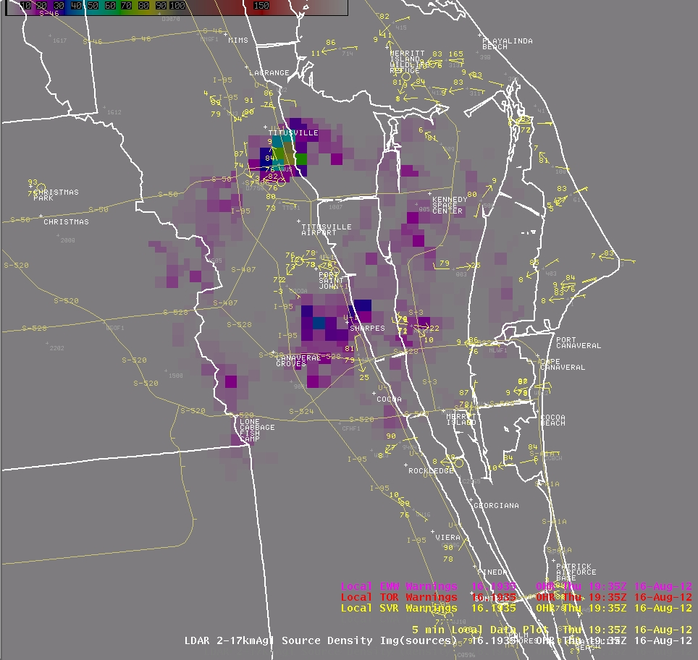
1935 UTC
LDAR: 80-90 sources per minute

Slide 35
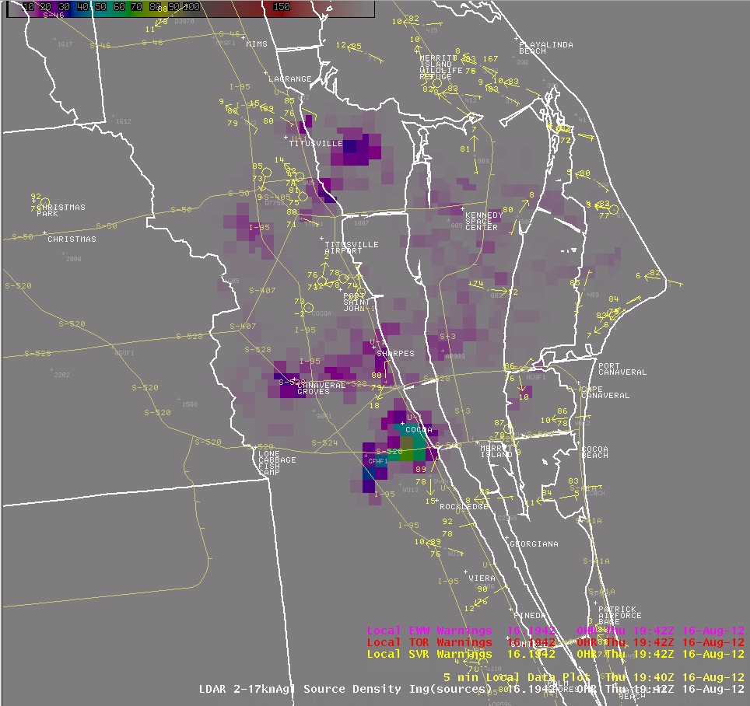
1942 UTC
LDAR: 80-90 sources per minute

Slide 36
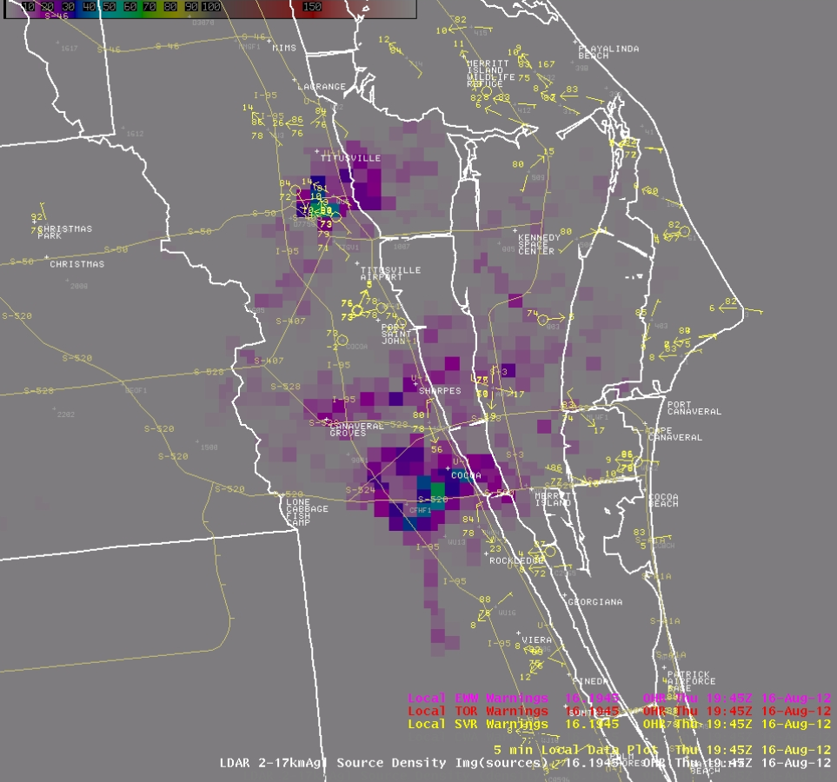
1945 UTC
G56KT
LDAR: A noticeable drop in sources
Wind Tower – 54 ft

Slide 37
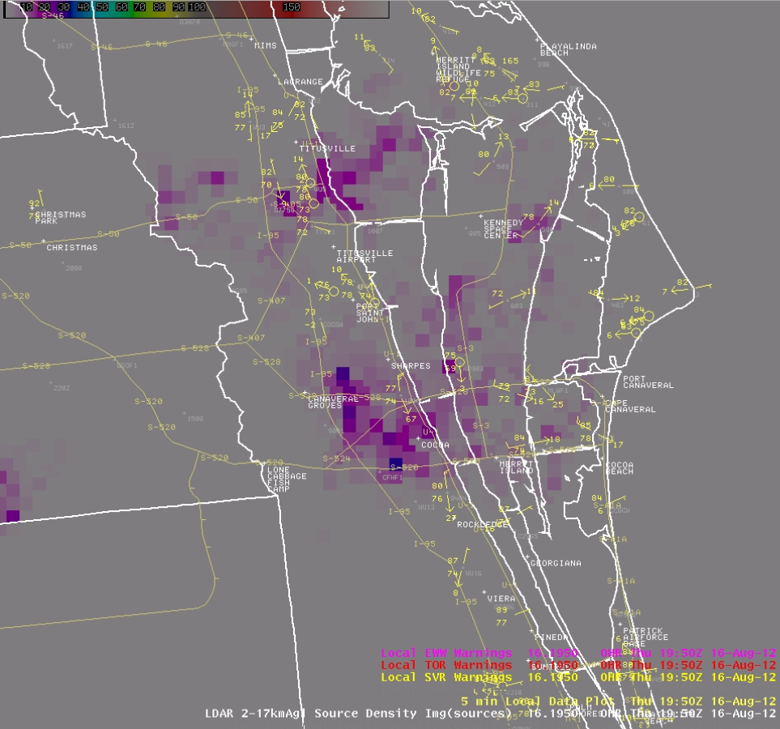
1950 UTC
G67KT
LDAR: A further drop in sources
Wind Tower – 54 ft

Slide 38
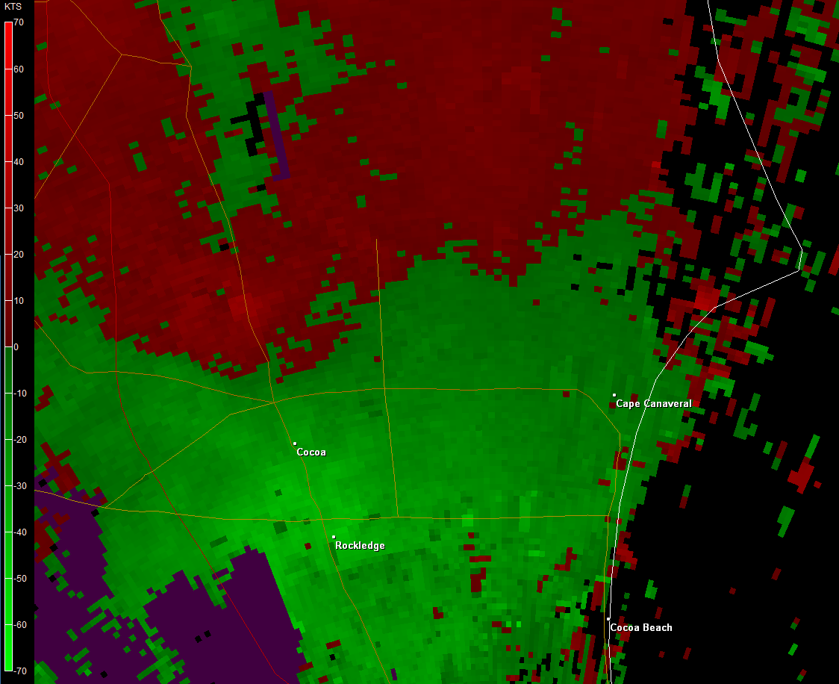
1952 UTC
Divergent radial velocities around 950 ft;
Highest sampled velocities about 44 kt;
Likely a mini-microburst directly over wind tower.
Base Velocity
0.5 deg

Slide 39
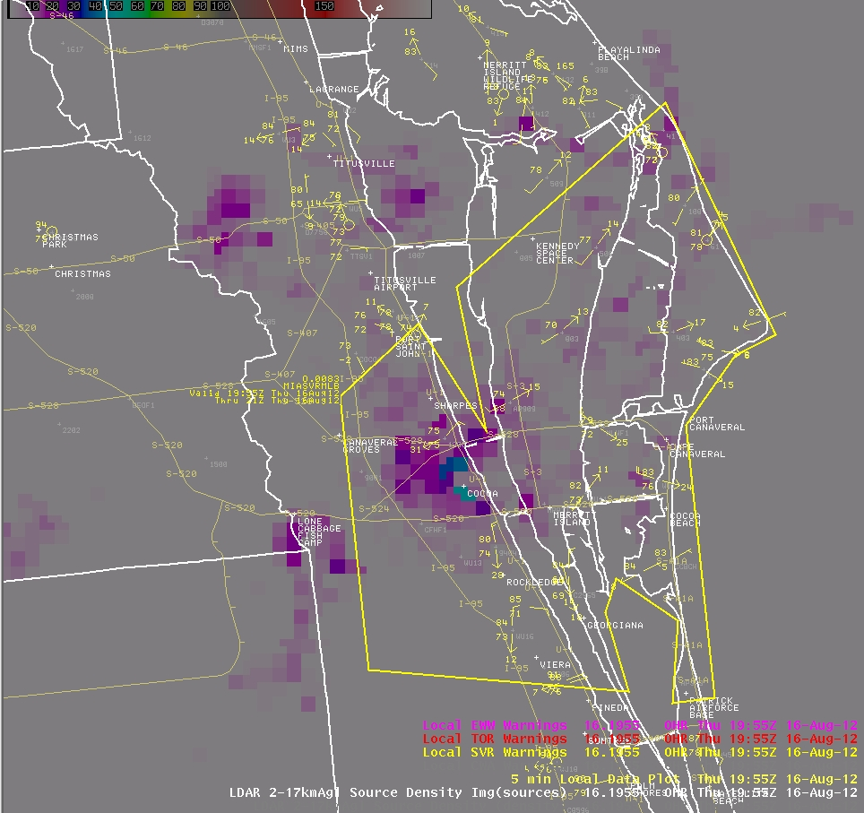
1955 UTC
Missed Warning;
Reactive SVR

Slide 40
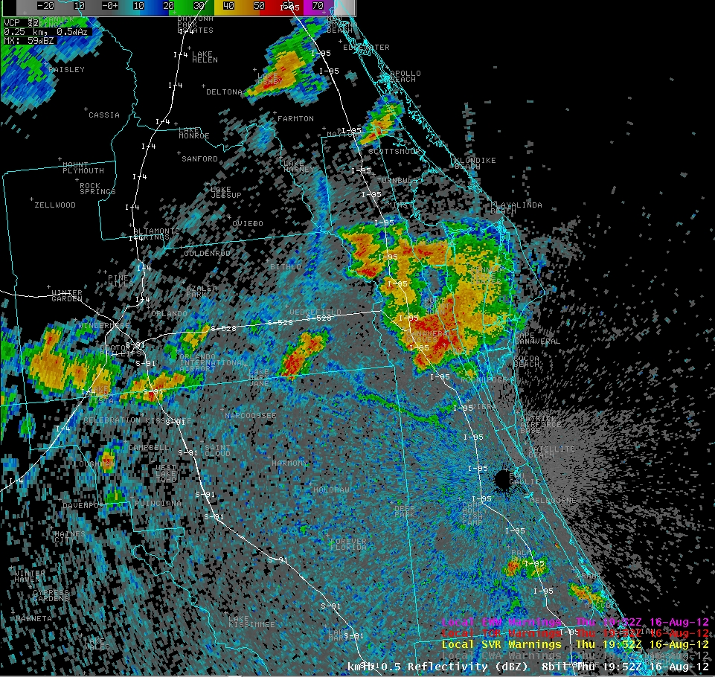
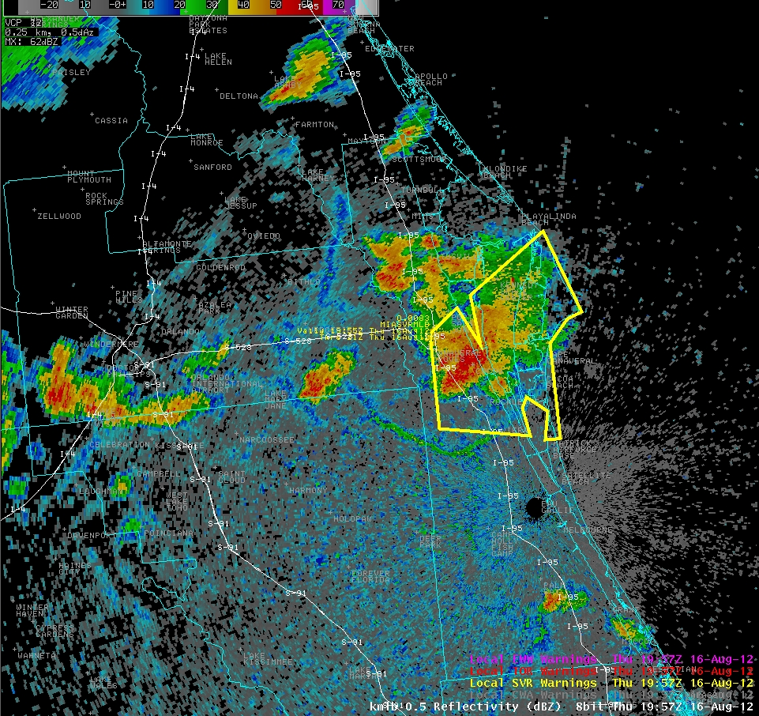
2038 UTC
1952 UTC
1952 UTC
Situation: Although a timely SPS had already highlighted the threat of 40-45 kt wind gusts, forecasters were caught off guard with the 56-67 kt gust over north Brevard County. Determination was made that severe potential still existed.
1957 UTC
ECSB
1957 UTC
Accentuated Lift
Brevard
County
Warning Decision Making
(radar-based viewpoint)
Concern: severe hail & wind gusts
Motion: 290DEG 7KT

Slide 41
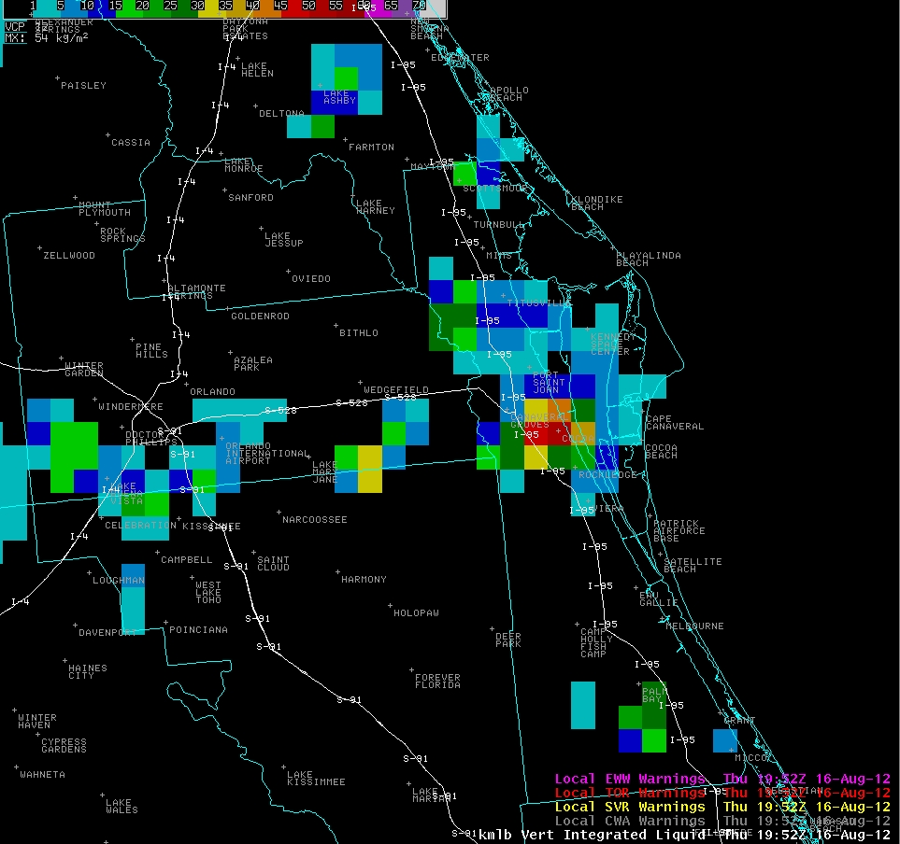
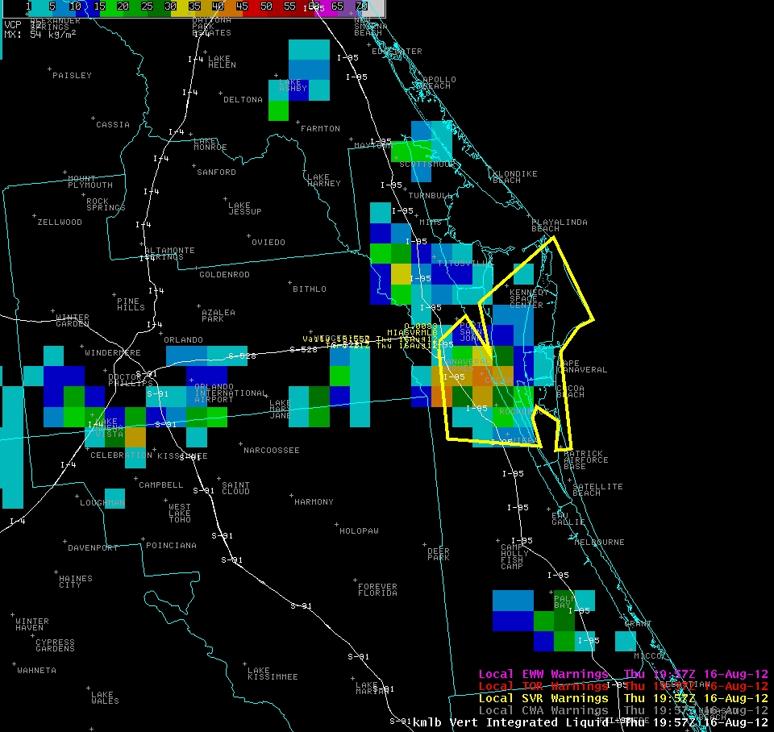
2038 UTC
1952 UTC
1952 UTC
1952 UTC
Situation: Although a timely SPS had already highlighted the threat of 40-45 kt wind gusts, forecasters were caught off guard with the 56-67 kt gust over north Brevard County. Determination was made that severe potential still existed.
1957 UTC
ECSB
1957 UTC
Accentuated Lift
Warning Decision Making
(radar-based viewpoint)
Concern: severe hail & wind gusts
Motion: 290DEG 7KT

Slide 42
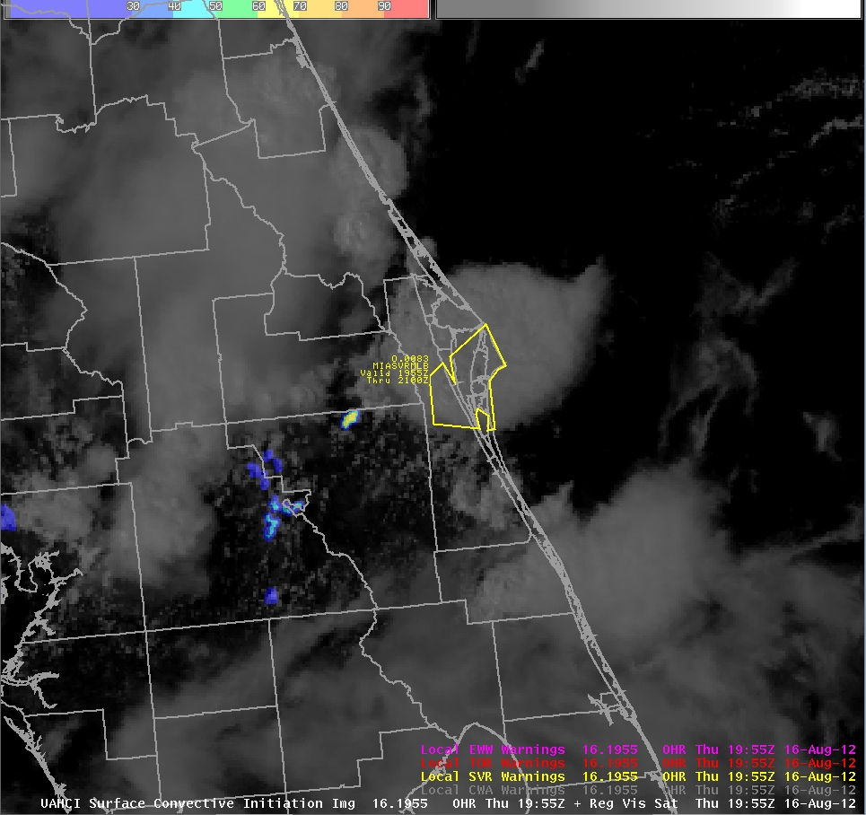
Convective Initiation
SATCAST – 2012 Version
“Strength of Signal”
Special Marine Warning
(312 PM for 34+ knot gusts)
Severe Thunderstorm Warning
(355 PM for additional 50+ knot gusts & 1.0 inch hail)
1955 UTC

Slide 43
Convective Initiation
SATCAST – 2012 Version
“Strength of Signal”
Existing Storms &
Cirrus Contamination
SVR Polygon Size ???
Existing Storms &
Cirrus Contamination
1955 UTC

Slide 44
No additional CI indicated over north and central Brevard. OK(?)
Existing storms and cirrus contamination
No additional CI indicated over south Brevard. OK
No persistent CI signal
WDM: Focus on existing storms over north and central Brevard.
Convective Initiation
SATCAST – 2012 Version
“Strength of Signal”
SVR Polygon Size ???
???
Monitor
1955 UTC

Slide 45
Convective Initiation
SATCAST – 2012 Version
“Strength of Signal”
There was early indication and increasing confidence for storms over north and central Brevard County.
Then there was a general loss of the CI signal there.
1815 UTC - 1915 UTC

Slide 46
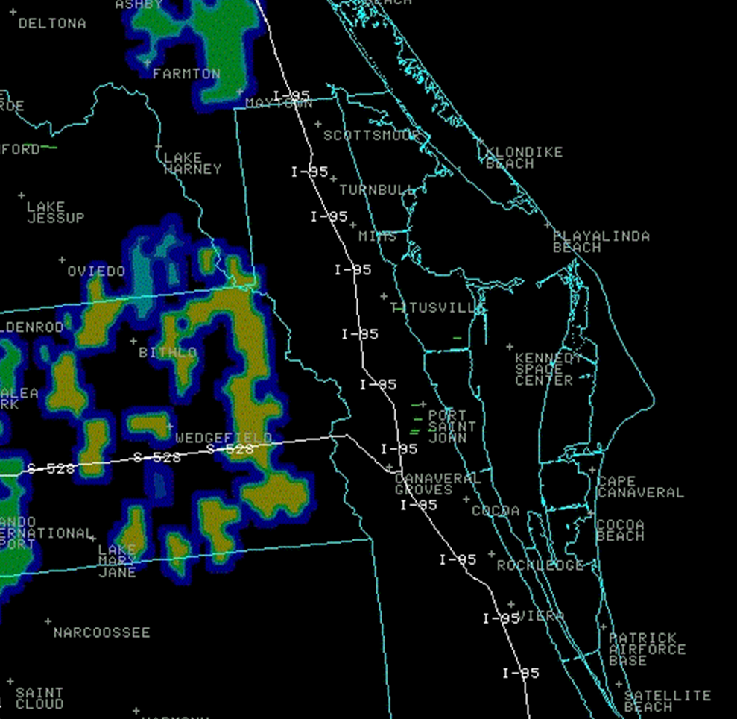
Convective Initiation
SATCAST – 2012 Version
“Strength of Signal”
Point of Interest:
A woman was struck by lightning in Port Saint John at 1906 UTC as CG lightning ensued.
DSS / Public Safety ???
1902 UTC

Slide 47
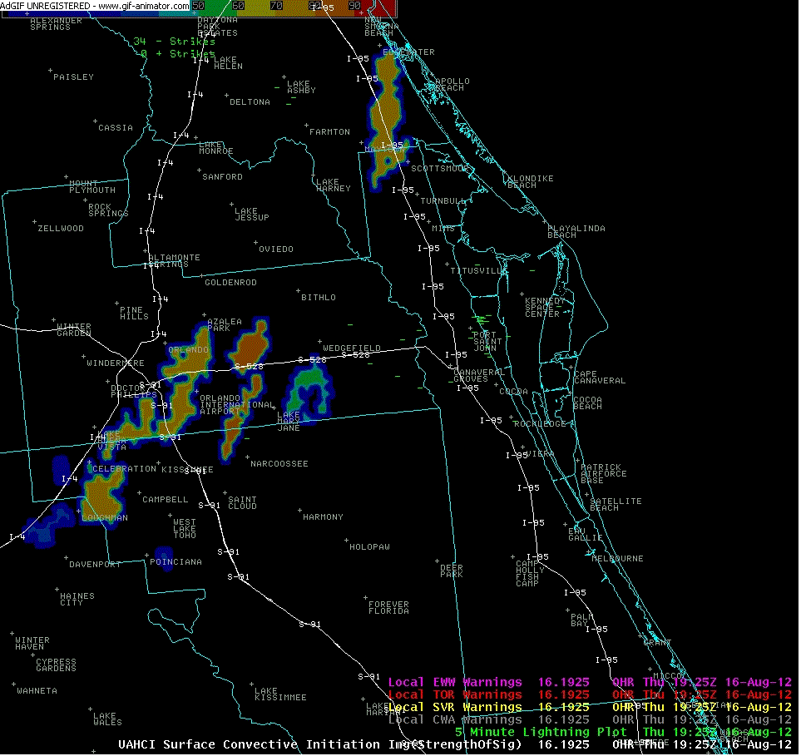
Convective Initiation
SATCAST – 2012 Version
“Strength of Signal”
There wasn’t really a persistent CI signal over south Brevard County.
So, the initial polygon didn’t need to be extended there.
1925 UTC - 2002 UTC

Slide 48
Verification
Brevard County: USAF Wind Tower at NASA/KSC recorded a 67 kt (77 mph) wind gust at 350 PM EDT, and an off-duty weather observer reported quarter-sized hail (E1.00 inch) just west of I-95 on Highway 520 at 410 PM EDT. No damage was reported.
No other severe weather was reported, although there were several reports of dime-sized hail just before and during the warning period.
An additional SVR was issued for central and south Brevard County much later, but no severe weather was reported.

Slide 49
Summary
Operational Insights:
These evaluations were made during parallel operations and within post-event scrutiny.
Deliberate considerations were made relative to how forecasters might holistically use CI and LDAR integrated with radar and CG lightning data.
The context was toward improving short-term forecast and warning operations during the Florida warm/wet season.
The specific challenge was whether CI and LDAR could help mitigate the problem of over-warning for Brevard County.
To reduce the size of needlessly large initial warning polygons.
To be more effective in trimming the size of initial warning polygons during the warning period.
To improve the probability of detection and lead time for isolated summertime severe storms.

Slide 50
Summary
Operational Insights:
In pulse (hybrid-pulse) severe local storm situations, many times it is as equally important to account for nearby storm development as it is to account for the advection and/or propagation of existing storms.
Evaluators took the lag time issue of both CI and LDAR into reasonable account.
Because of their high temporal frequency, not every product arrived, or arrived in a timely manner.
Imagined operations when 1-minute total lightning data and 5-minute satellite data would be routine.
Evaluators endeavored to leverage the strengths of CI within the 15 to 30 minute time period for isolated to widely scattered convection.
This is a narrow spectrum of convective situations.

Slide 51
Summary
Operational Insights:
CI offered forecasters detection/projection aspects of developing convection, while LDAR offered the ability to effectively monitor the character of the related updrafts being detected/projected.
Used in tandem, CI and LDAR were helpful for assessing the potential for storms, whether new or existing, to affect areas of interest (e.g., “onset of first storms” for a location). This is especially true when used as complements to radar and CG lightning data.

Slide 52
Summary
Operational Insights:
CI performance: {WDM; size of initial polygons}
This was a non-traditional application for CI; it is not universally advocated.
Showed some value during isolated to widely scattered storm events.
Cirrus contamination was the primary limiting factor; CI struggled with secondary and tertiary convection.
Forecasters seemed to prefer the SoS depiction over the Binary depiction.
Alternative display techniques need to be developed which depict new cell growth potential together with existing storms.

Slide 53
Summary
Operational Insights:
LDAR performance: {WDM; lead time & polygon maintenance}
Temporal resolution is a strong point; lag time must be minimal.
Need improved ways to trend sources; consider storm associations.
Storms which achieve empirical count threshold levels are not necessarily severe. Rather, they become storms of particular interest and suspicion.
Considerations should always be given relative to the environment and the ability for updrafts to penetrate upward into the mixed-phase region.
At times, source density maxima can be helpful with locating severe weather manifestation for improved SVS products.
LDAR and CI data showed promise for DSS & Public Safety applications; excessive lightning, along with first/last strikes.

Slide 54
THANK YOU

