Slide 1
SPoRT Virtual Workshop 2012 September 12-13
A Better Hybrid
VIIRS imagery
Matt Smith, Geoffrey Stano

Slide 2
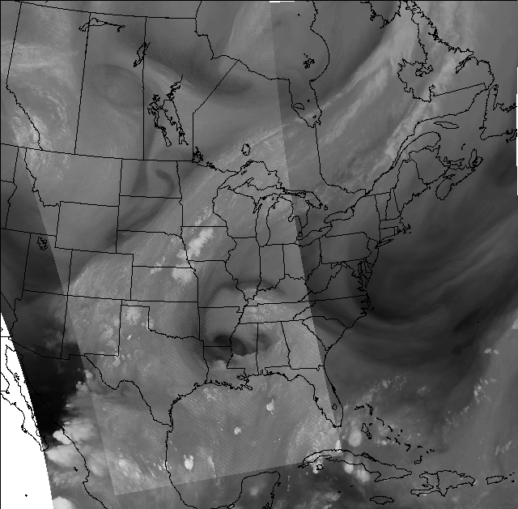
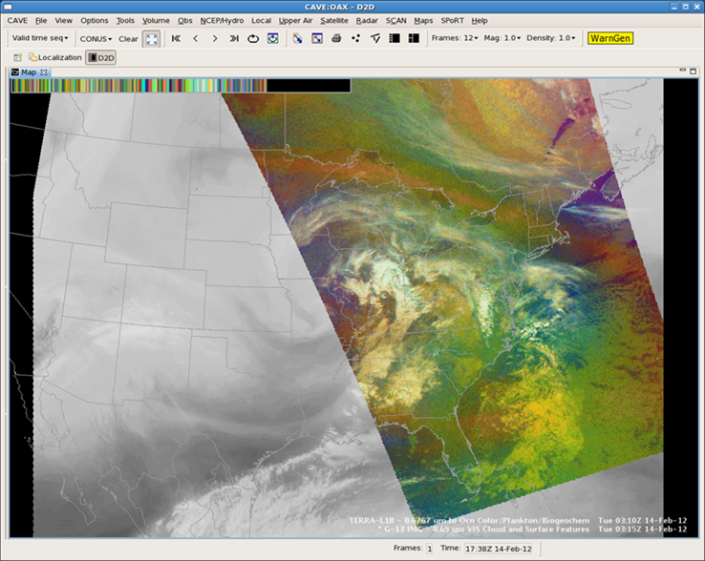
Current MODIS/GOES Hybrid
MODIS (Aqua/Terra) swaths in GOES-E imagery
Distorted 3-hourly GOES-W image
No GOES -> No Hybrid
Dropouts from rooftop GOES system
Delays from busy processing systems
CCONUS domain only

Slide 3
New VIIRS/MODIS/GOES Hybrid
VIIRS swaths also included with MODIS
No GOES-W images in CONUS Hybrid (0Z,3Z,6Z,…)
Swaths provided whenever available
Now getting GOES-E data directly from NESDIS
Will have new, faster processing systems
Products
Vis (250m)
SW, IR, Spectral difference (1km)
Water Vapor/Air Mass RGB hybrid (1km)
More RGB Hybrids to come
Alaska and Pacific Regional Domains
Alaska (may reduced resolution due to lower bandwidth)
Pacific (30 minute frequency [GOES-W])

Slide 4
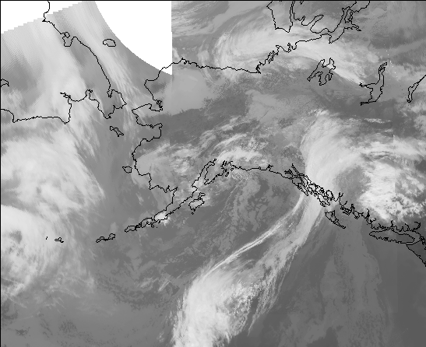
Hybrid – Alaska Domain GOES-W with MODIS & VIIRS (UAF/GINA)

Slide 5
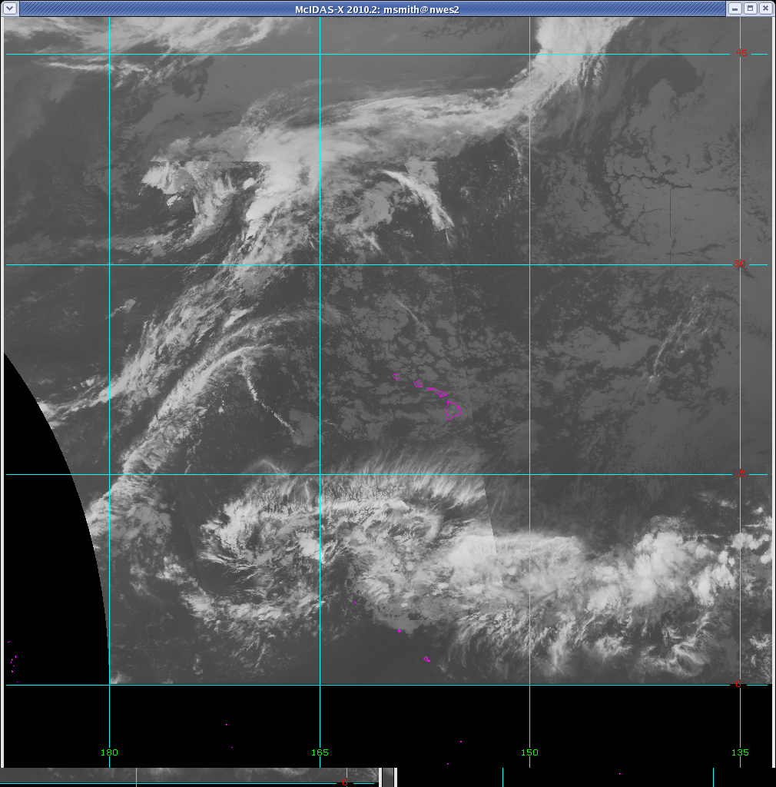
Hybrid – Pacific Domain GOES-W with MODIS & VIIRS (via PR)

Slide 6
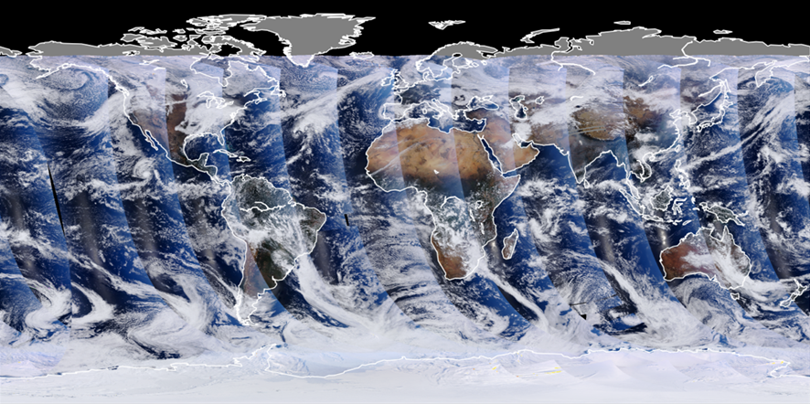
Transitioning SNPP / VIIRS Observations
VIIRS aboard Soumi NPP
Key Features
Continues many capabilities of MODIS
Precursor to GOES-R ABI instrument
Superior data swath and limb resolution
New channels: Day-Night Band
Missing Water Vapor band
Status
Now have data access
Preparing initial products
Identifying evaluators
VIIRS global true color composite. Note no gaps
between passes as would be seen in MODIS.
Each swath ~3000 km wide.
Notes:
Get an up to date image of a survey
Go out to the web to show the surveys, blog, and training modules

Slide 7
MODIS vs VIIRS swath width
MODIS True Color Swath
VIIRS True Color Swath

Slide 8
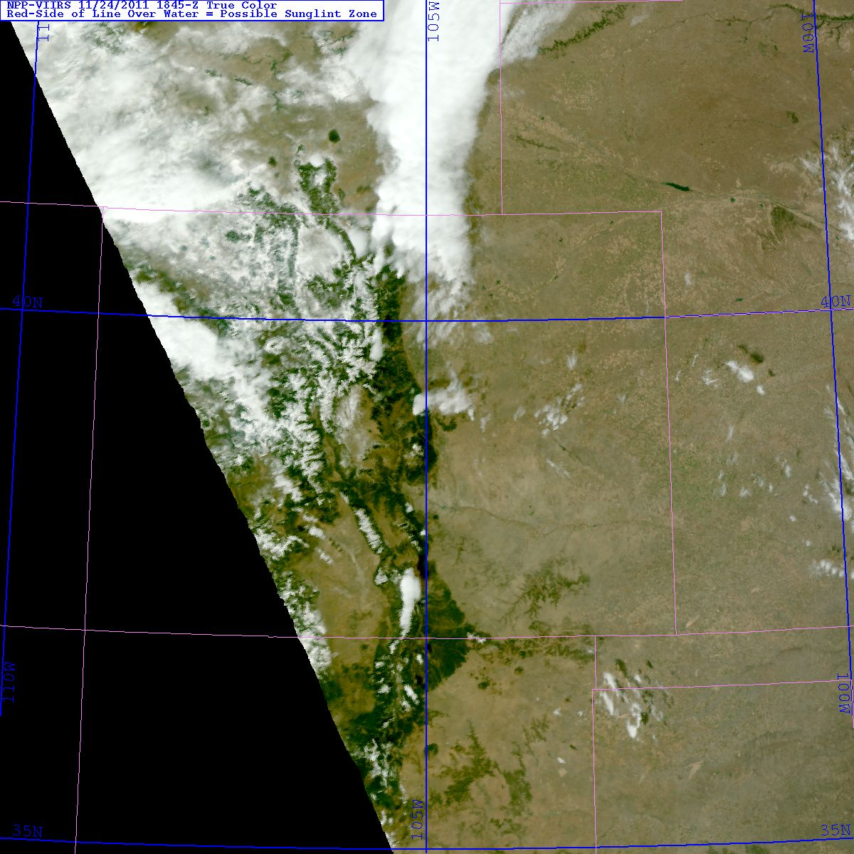
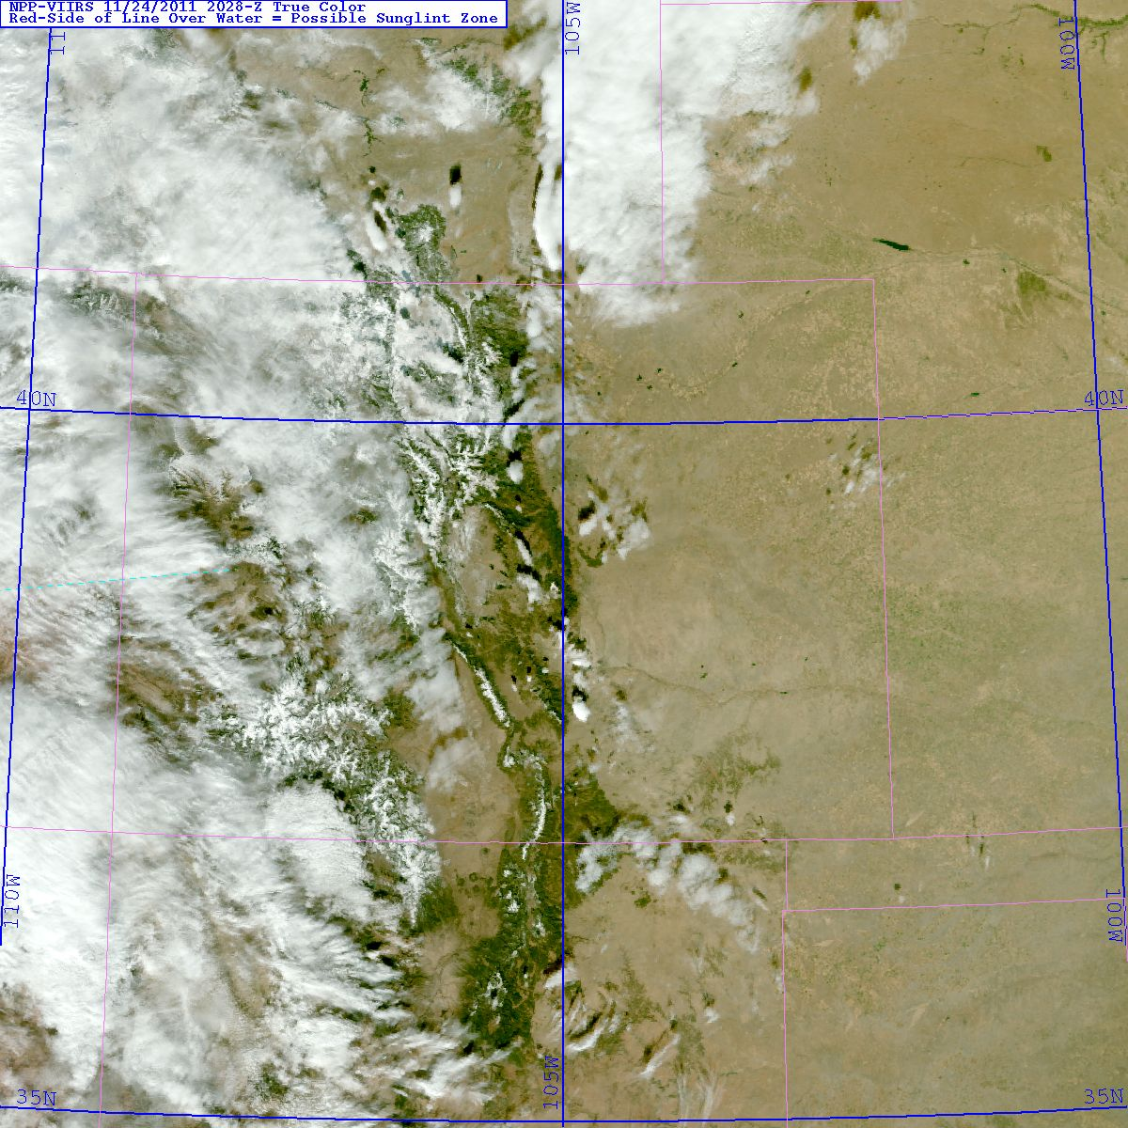
Unique VIIRS Features
VIIRS maintains spatial resolution at edge of swath.
Near edge 1845 UTC
Near nadir 2028 UTC
Notes:
Get an up to date image of a survey
Go out to the web to show the surveys, blog, and training modules

Slide 9
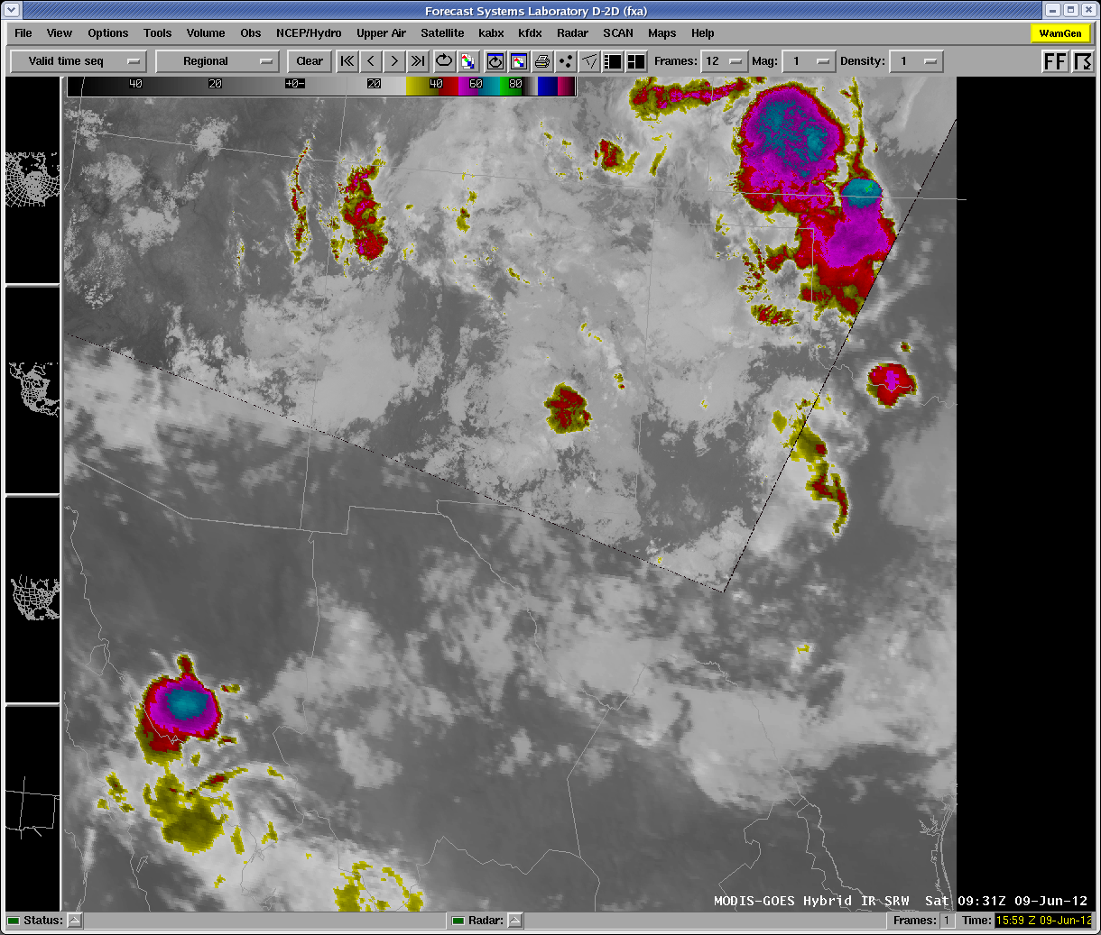
VIIRS in the SPoRT Hybrid
VIIRS
GOES
Notes:
Get an up to date image of a survey
Go out to the web to show the surveys, blog, and training modules

Slide 10
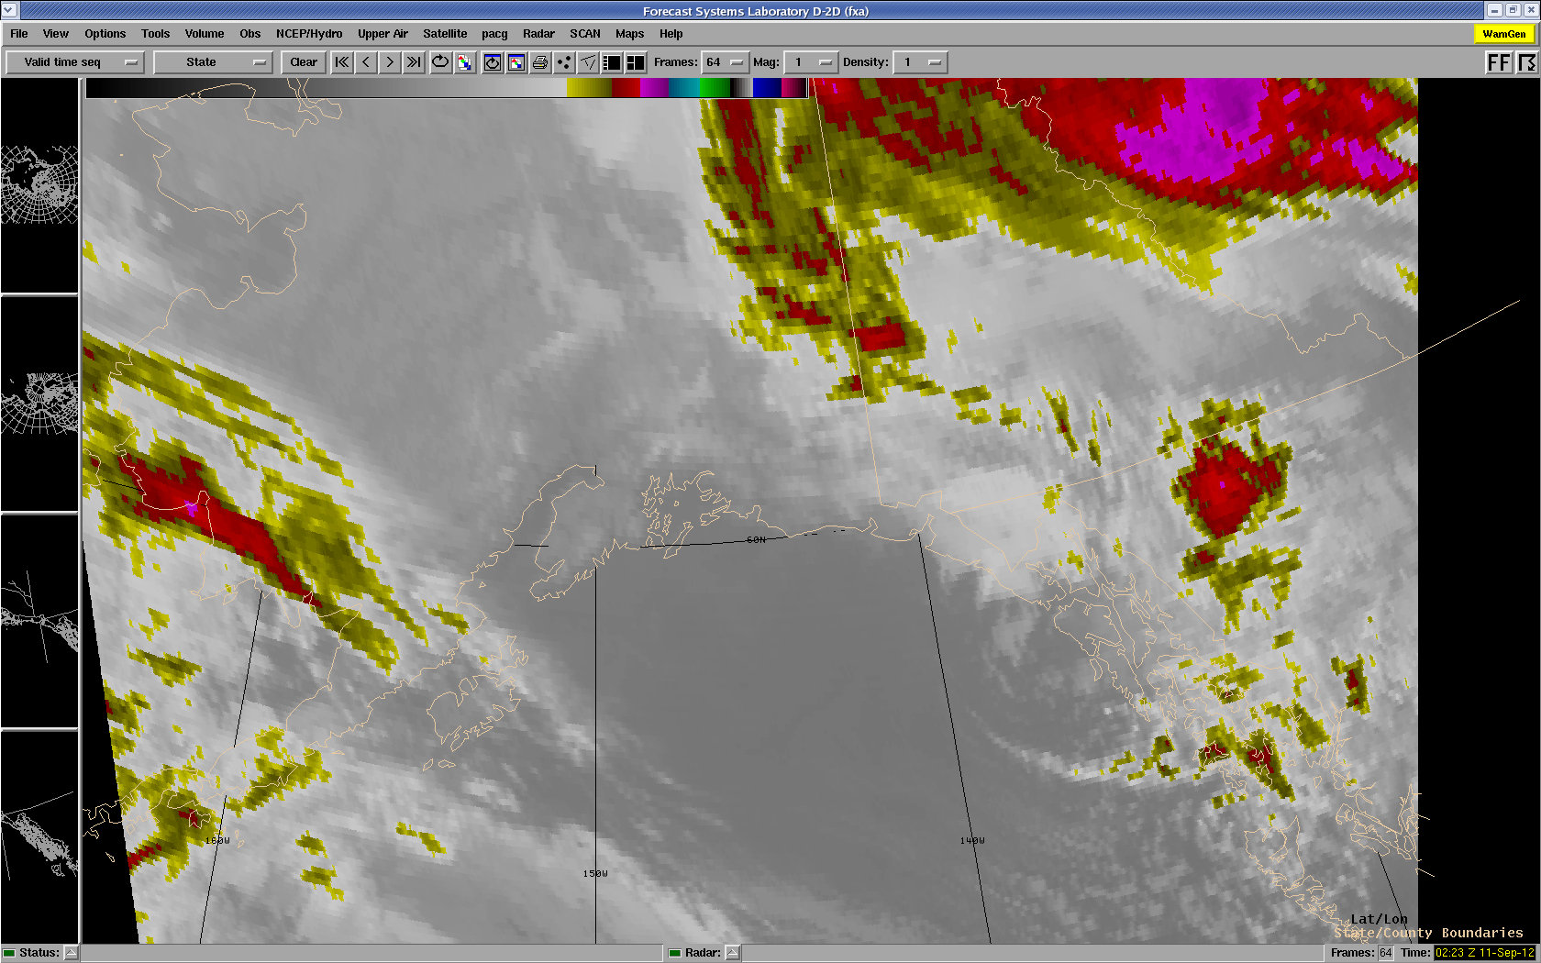
Alaska Region Hybrid IR (Southeast) (GOES-only)

Slide 11
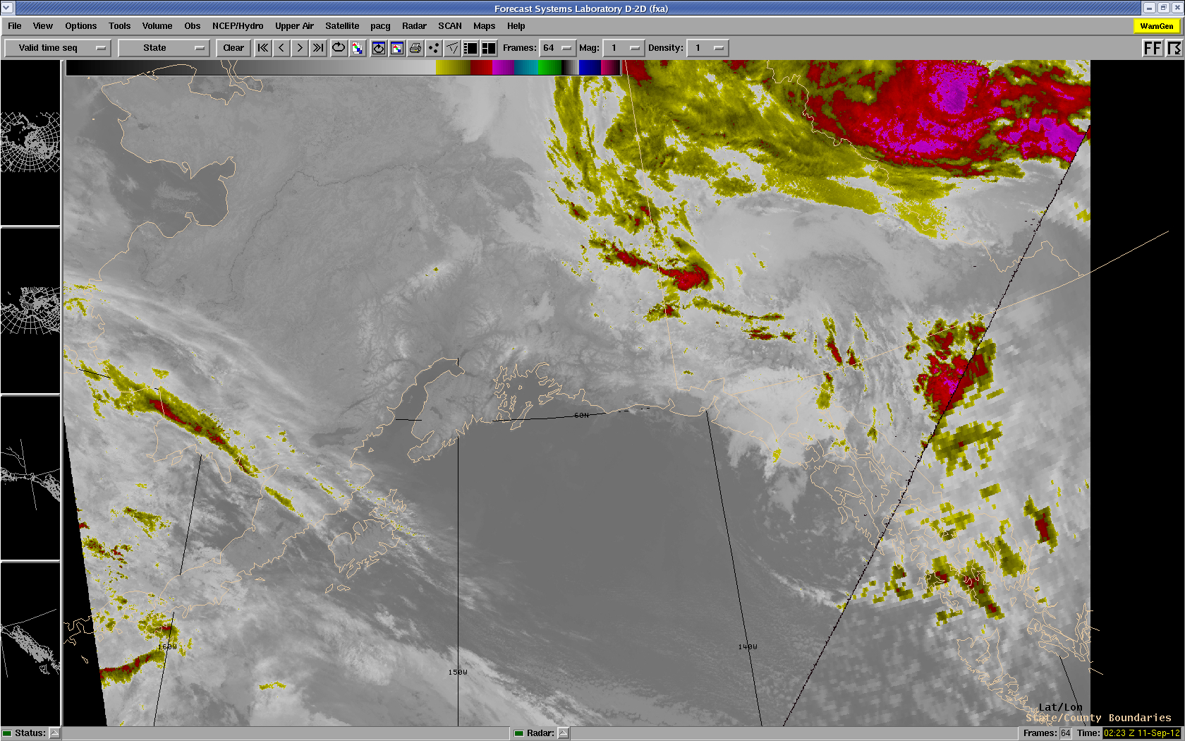
Alaska Region Hybrid IR (Southeast) (GOES w/ VIIRS)

Slide 12
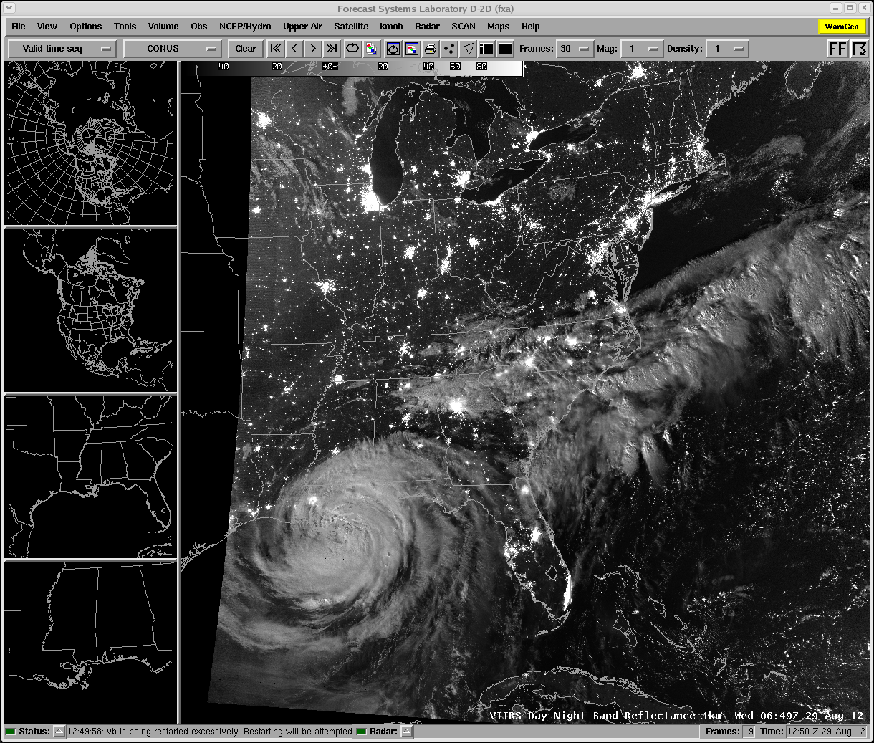
VIIRS Day Night Band
0649 UTC
Notes:
Get an up to date image of a survey
Go out to the web to show the surveys, blog, and training modules

Slide 13
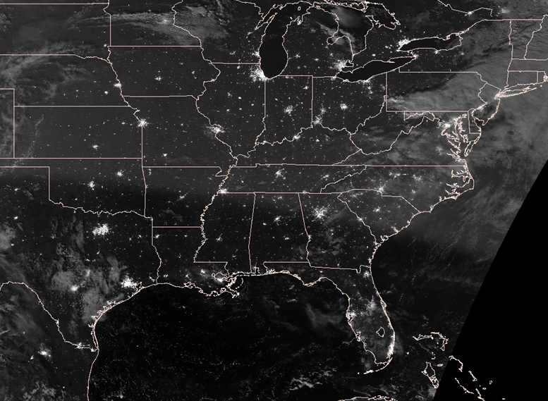
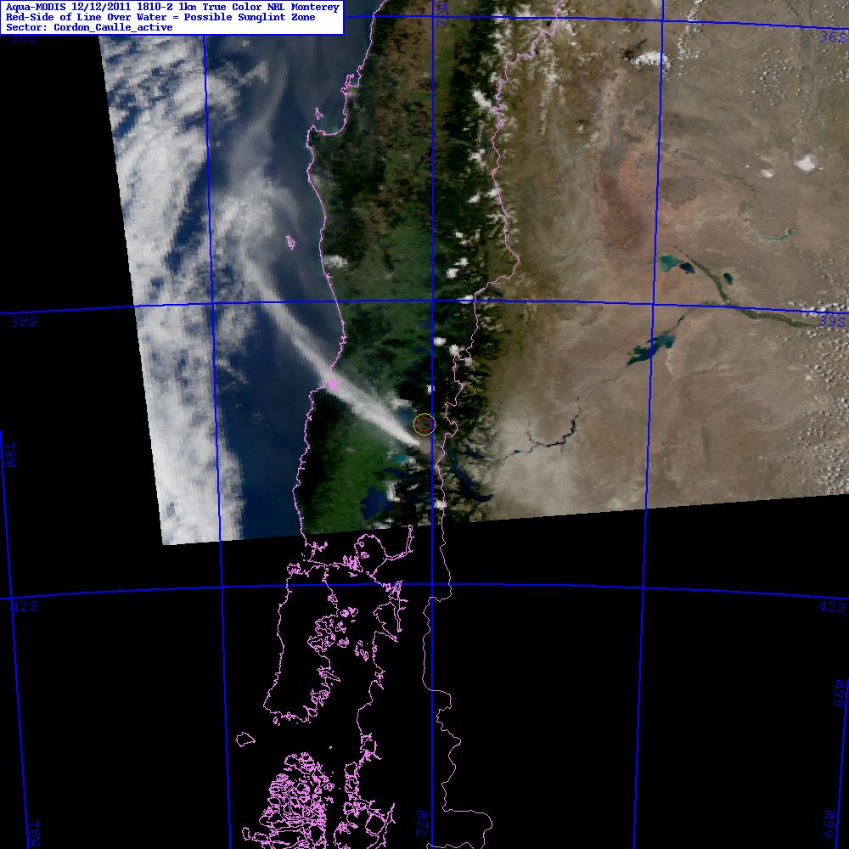
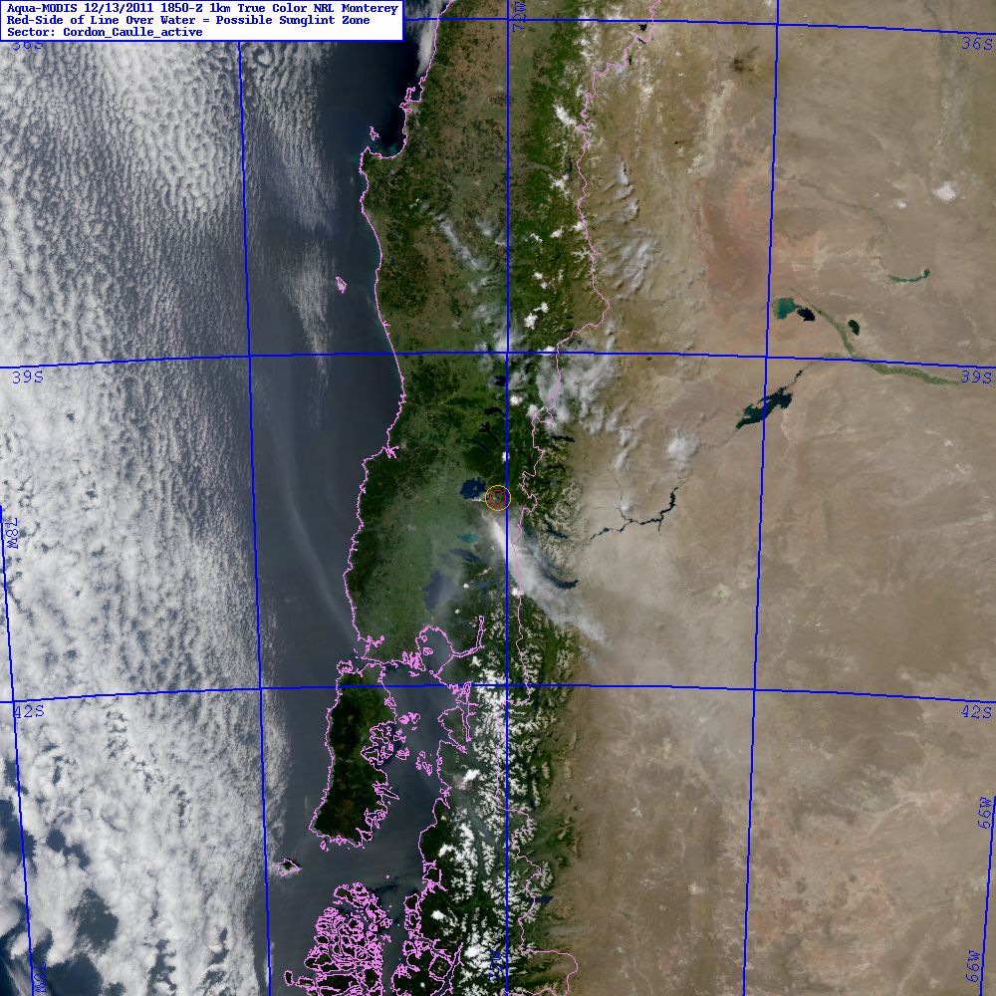
VIIRS Day Night Band
Afternoon
Night
Morning
Nighttime pass fills in the temporal gap between last PM and first available AM visible-light observations.
Courtesy: CIRA and NRL
Notes:
Get an up to date image of a survey
Go out to the web to show the surveys, blog, and training modules

Slide 14
Questions ?

Slide 15
Backup slides

Slide 16
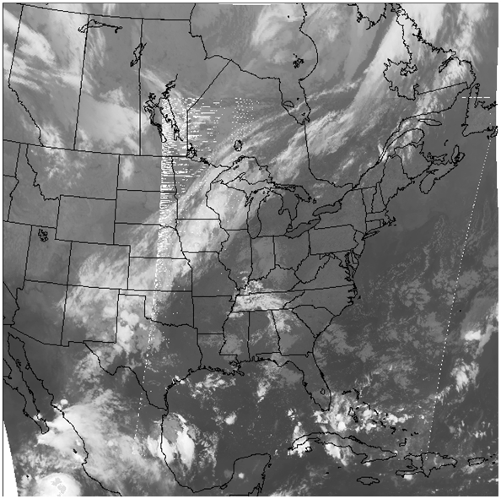
Hybrid Water Vapor with Air Mass RGB over CCONUS domain

