Slide 1


SPoRT Total Lightning Activities and Updates
Geoffrey Stano
NASA SPoRT / ENSCO, Inc.
2014 SPoRT Partners Virtual Workshop
13 February 2014
Transitioning unique NASA data and research technologies to operations

Slide 2
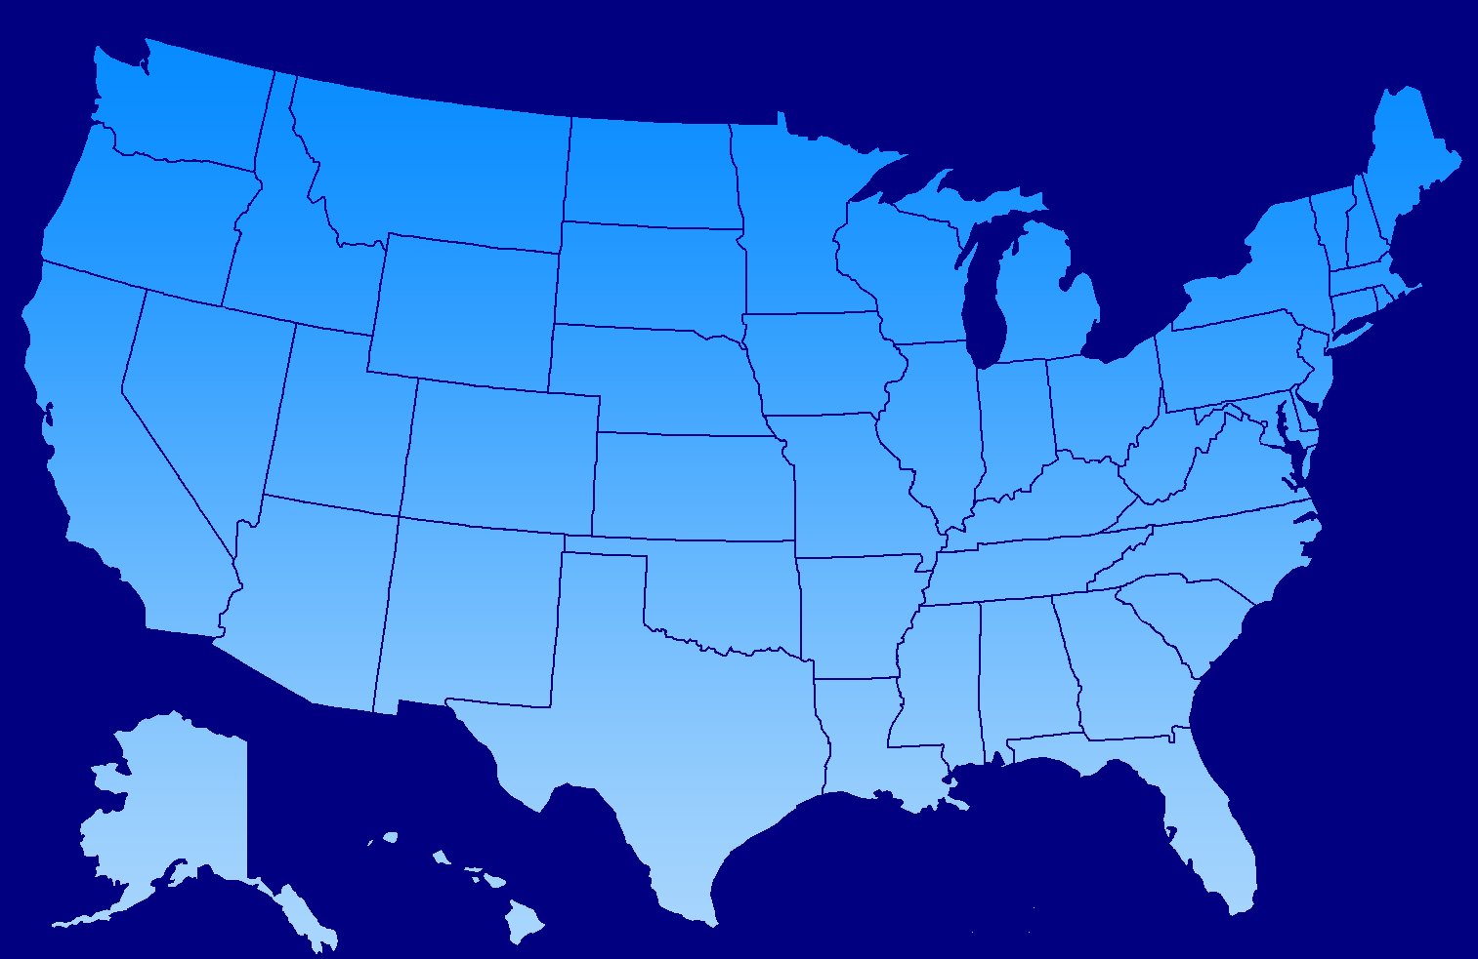
SPoRT and Total Lightning
SPoRT Collaborations
  Supporting real-time use since 2003
  Working with several data providers
  Core SPoRT activity with the GOES-R Proving Ground
Other existing or planned networks
WFOs SPoRT supports
Washington D.C.
Dugway Proving Ground
Colorado
Oklahoma
North Alabama
Langmuir Laboratory
Atlanta
Kennedy Space Center
White Sands
West Texas
Houston
Transitioning unique NASA data and research technologies to operations

Slide 3
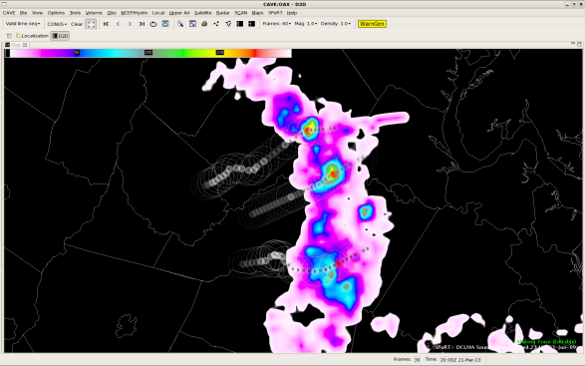
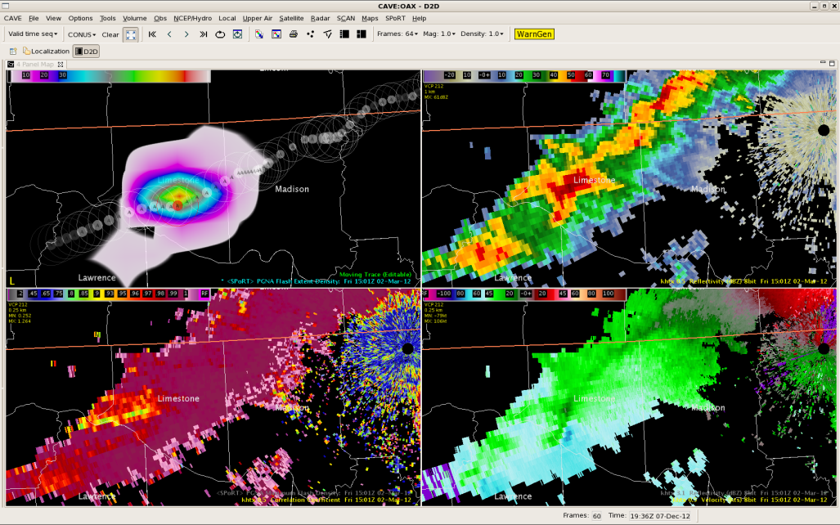
AWIPS II Availability
Successful transition in 2011 to Huntsville
  Houston and SMG followed shortly thereafter
  WFO Boulder successful yesterday
SPoRT working to baseline the plug-in
  Discussing with NOAA on using plug-in to support Earth Networks data visualization
Will provide greater flexibility than current AWIPS I display
  National Centers using the PGLM mosaic product
  Merges all available LMAs into a single product
  Includes range rings and network status bars
  Demonstrating the demo product for the Geostationary Lightning Mapper as part of the GOES-R Proving Ground
Transitioning unique NASA data and research technologies to operations

Slide 4
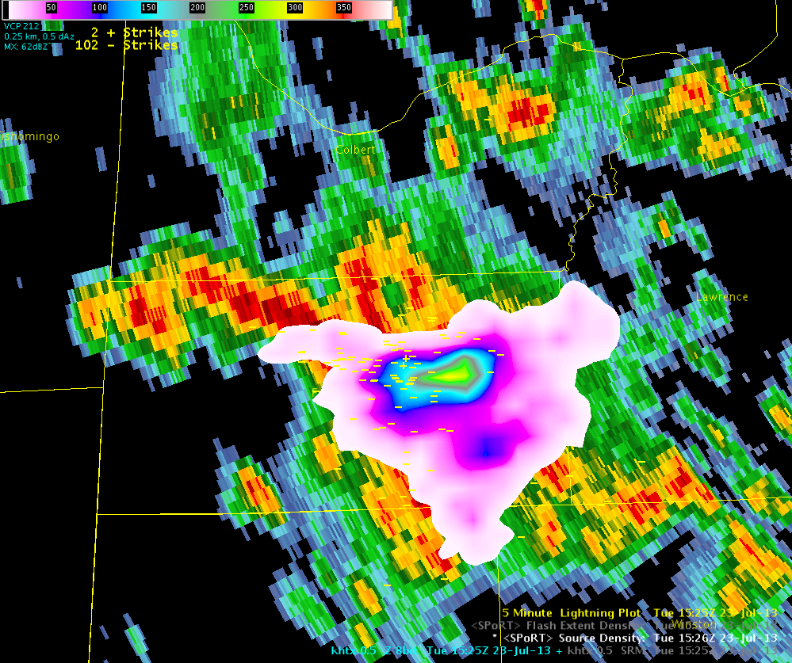
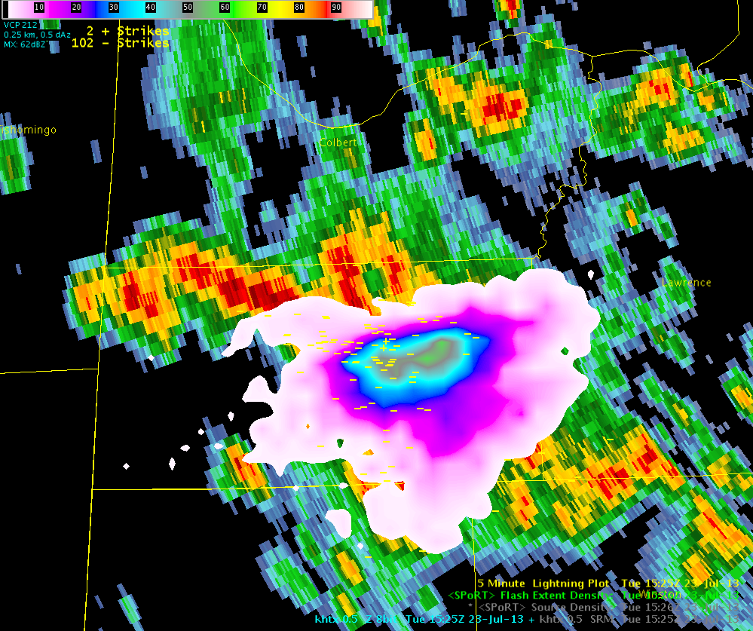
Shifting from Sources to Flashes
Source Density
~200 sources
Flashes are used in scientific literature (e.g., lightning jump)
Now have capability to reassemble sources into flashes in real-time
Flashes are “normalized” and have less issues with detection efficiency, particularly at range
Flashes more intuitive than sources
Evaluating with WFO Huntsville the effort needed to shift from source density to flash extent density
Flash Density
~55 sources
Transitioning unique NASA data and research technologies to operations

Slide 5
Another Product Concept
Based on conversations with WFO Melbourne
Interest in keeping 1 min time resolution
  Issue is that 1 min data can look noisey
Concept based on the previous 30 min maximum density product
  30 min max density displayed the largest value for each grid box over the past 30 min
  Instead will use a 2 min summation updating every minute
  Use the current observation with the previous observation
  Need to evaluate if this provides the same level of information as other products
Transitioning unique NASA data and research technologies to operations

Slide 6
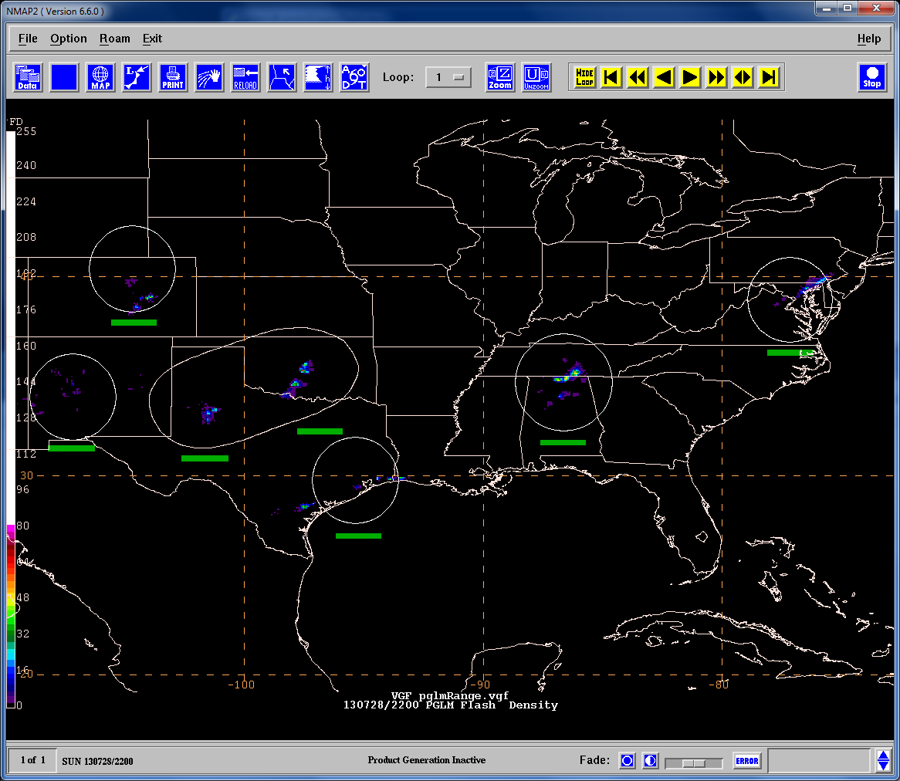
Total Lightning in N-AWIPS
National Centers using the PGLM mosaic
Merges all available LMAs into one product
Includes range rings and network status bars
Demonstrates the demo product for the Geostationary Lightning Mapper as part of the GOES-R Proving Ground
Range Ring
Status Bars
Transitioning unique NASA data and research technologies to operations

