Slide 1
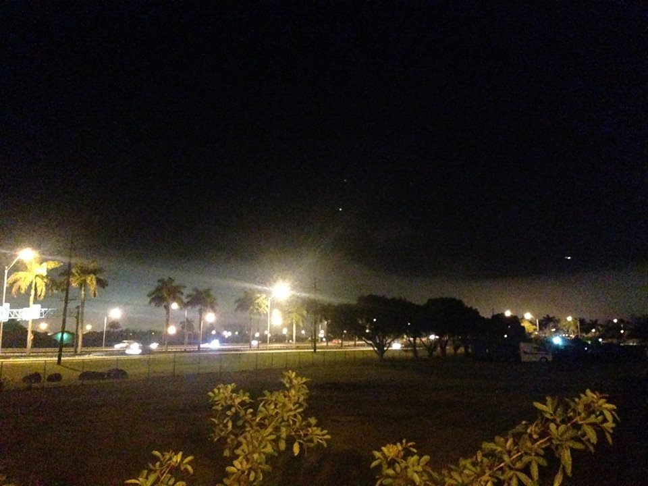
Validation of a Modified Fog Algorithm at WFO Miami using NASA SPoRT Satellite Imagery and Surface Observations
Alannah Irwin
Florida International University, Miami FL
Jeral Estupiñán and Andrew Kennedy
NOAA/National Weather Service, Miami, FL

Slide 2
Overview
The purpose of this study is to validate the new fog algorithm developed at the Miami Weather Forecast Office
The algorithm is based on a combination technique that uses the crossover temperature (United Parcel Service (UPS) Airlines technique ) in conjunction with a 15-knot maximum threshold of 925 mb winds.
This study evaluates the results of the algorithm using the NASA SPoRT Nighttime Microphysics image, GOES Spectral Difference (11µm minus 3.9 µm), and surface observations.
The period of this study starts on November 19 and will span toward the end of the 2013-2014 fog season for the Miami County Warning Area.
Notes:
However, a quantitative approach based on research results has not been used yet in South Florida.

Slide 3
Overview Con’t
All nights/mornings for the fog season 2013-14 reporting fog by ground observations or visual confirmation of reporters are used in the study
Days with confirmed fog reports are compared with the satellite imagery
Preliminary results are shown here for 4 cases
Notes:
However, a quantitative approach based on research results has not been used yet in South Florida.

Slide 4
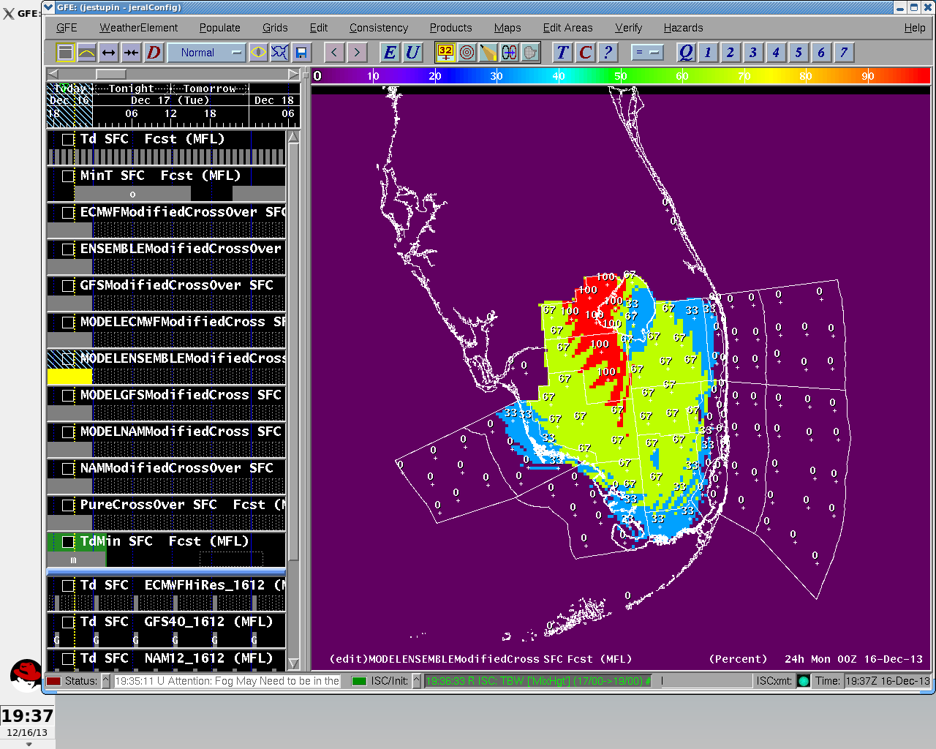
12Z Fog Algorithm
Captured images of the 12Z model runs for fog
Example: 12Z Model Ensemble Modified Crossover Product from 2013DEC16
Forecast model is valid for next day

Slide 5
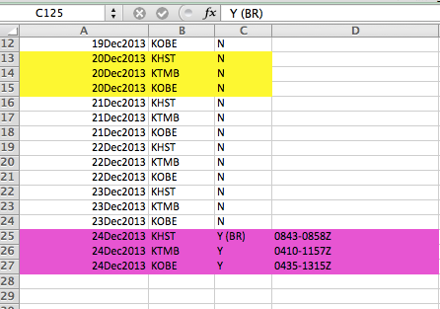
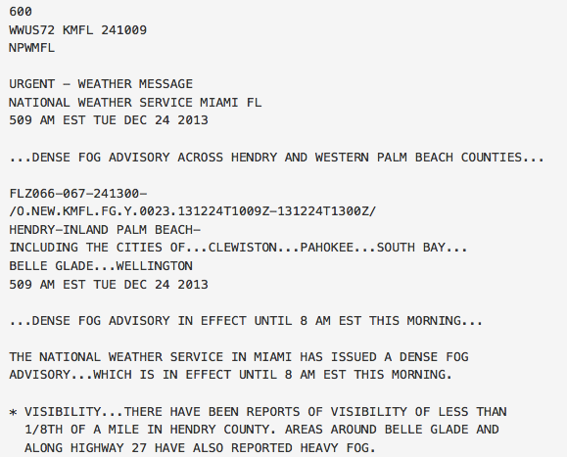
METAR/AFOS
Archived METAR data to verify fog events
Archived AFOS data from IA Mesonet
Example of AFOS data archived on 2013DEC24. http://mesonet.agron.iastate.edu/wx/afos/
Notes:
METARs from KOBE, KHST, and KTMB

Slide 6
Products Used – RGB Nighttime Microphysics
Important to help distinguish between low lying clouds and fog
Uses difference between 10.8 and 3.9 channels, but also uses a new channel to determine surface temperature
Courtesy: NASA SPoRT RGB Nighttime Microphysics Reference Guide
Notes:
Higher the contribution, the thicker the clouds, the more water located, and the warmer the surface

Slide 7
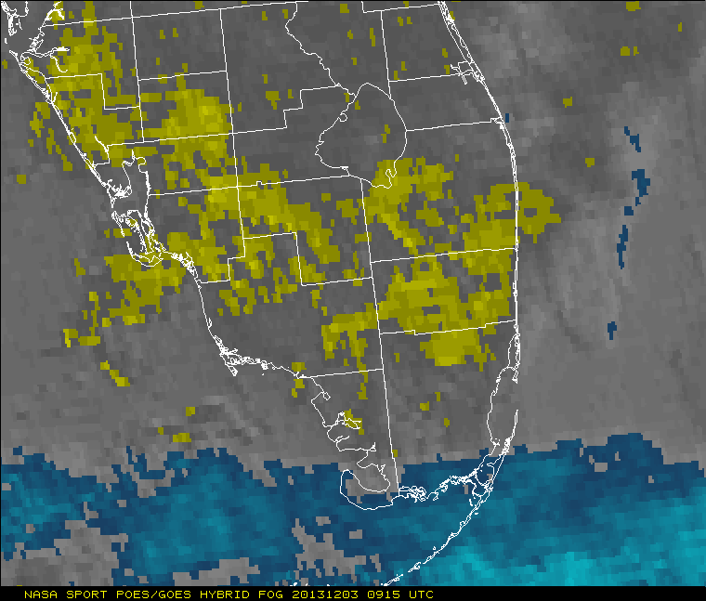
Products Used – MODIS Spectral Difference
Also called MODIS Fog Product
1km resolution model complementing the GOES fog product and Low Cloud Base Model

Slide 8
How Did We Use NASA SPoRT
Identify the success rate of fog detection of the NASA SPoRT imagery
Use NASA SPoRT to verify fog in interior sections of South Florida.
Parameters for detecting fog on RGB Nighttime Microphysics imagery. For the MODIS Fog Product, areas of yellow were used to indicate fog.
Courtesy: NASA SPoRT Training Modules and Nighttime Microphysics Reference Guide

Slide 9
The Results
Project ongoing
However, presenting 2 successful and unsuccessful algorithm days
2013DEC17 and 2014JAN14 unsuccessful
2013DEC24 and 2014JAN18 successful

Slide 10
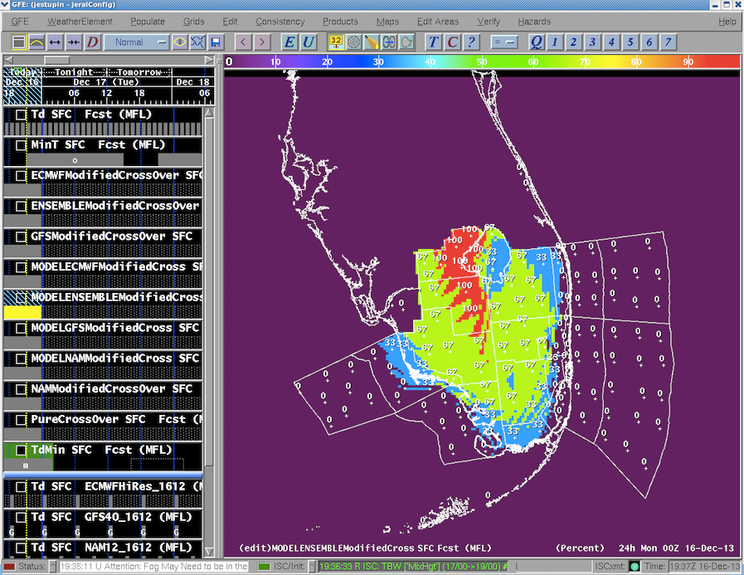
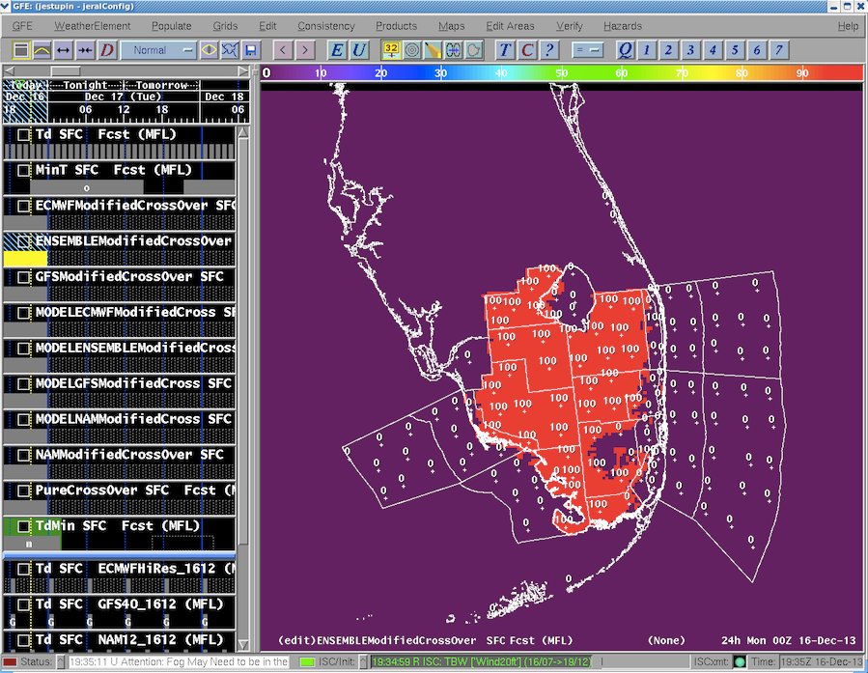
Case 1 – 2013DEC17

Slide 11
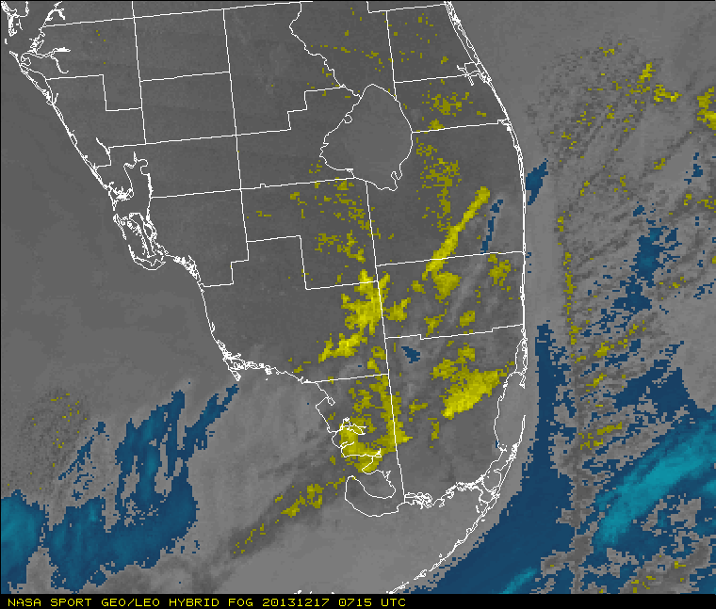
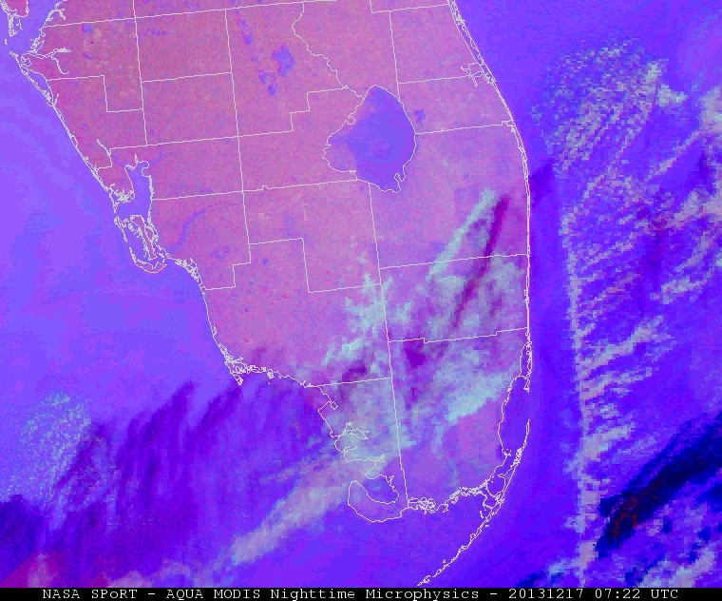
Case 1 – 2013DEC17 Results

Slide 12
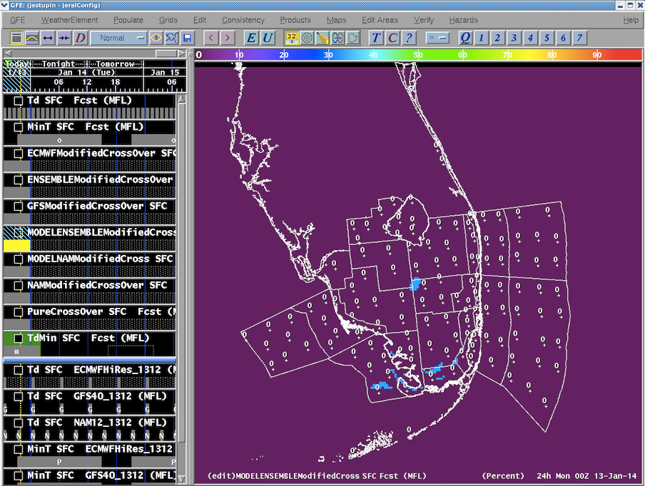
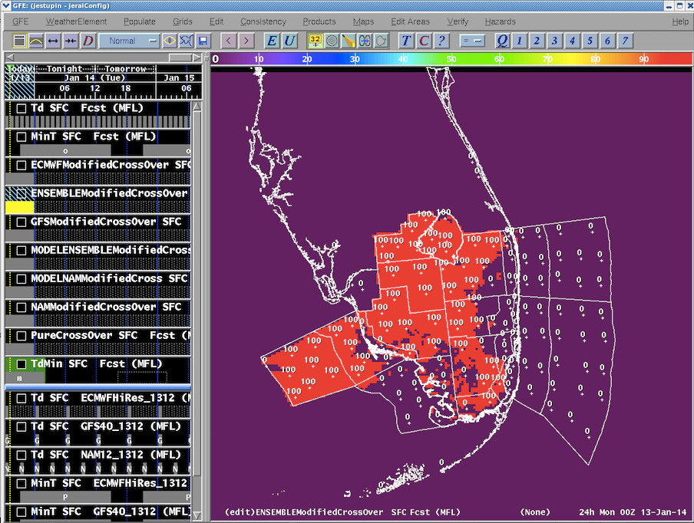
Case 2 – 2014JAN14

Slide 13
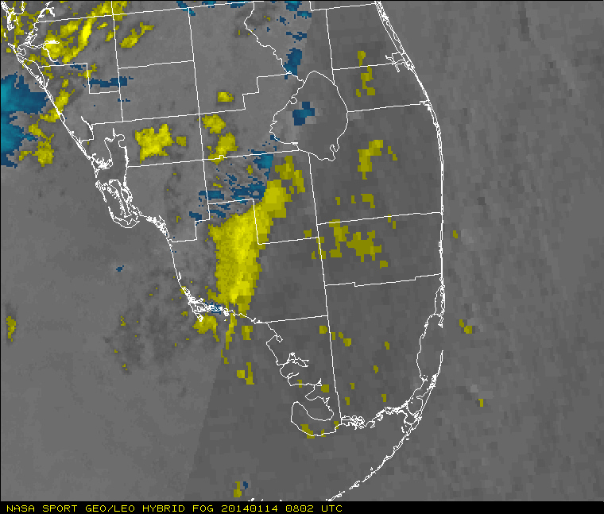
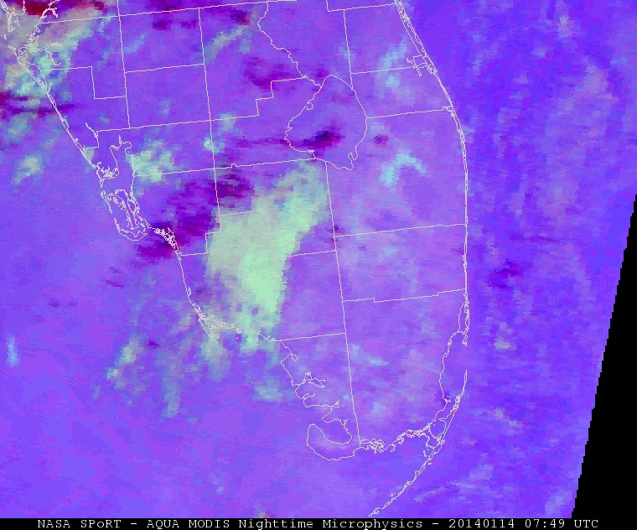
Case 2 – 2014JAN14 Results

Slide 14
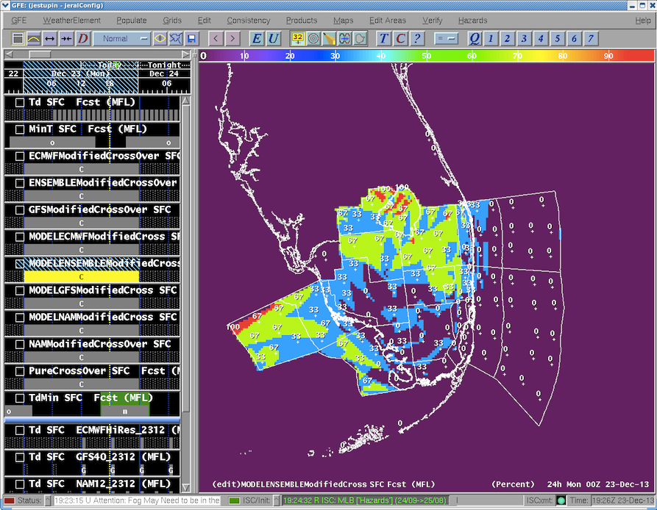
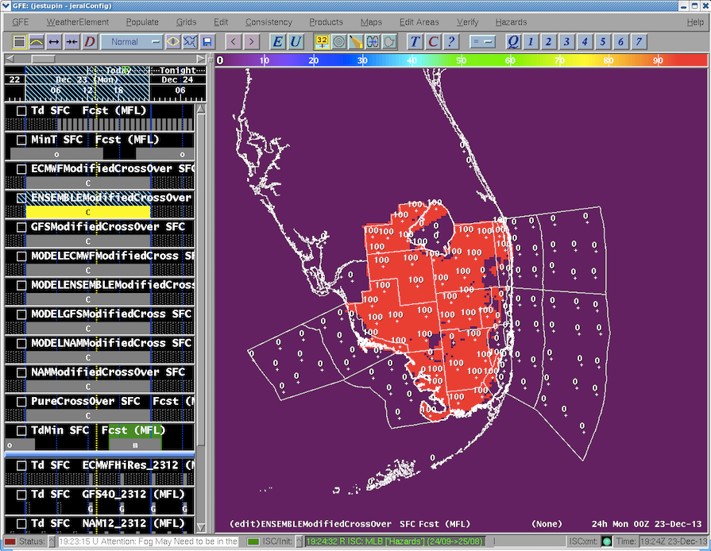
Case 3 – 2013DEC24

Slide 15
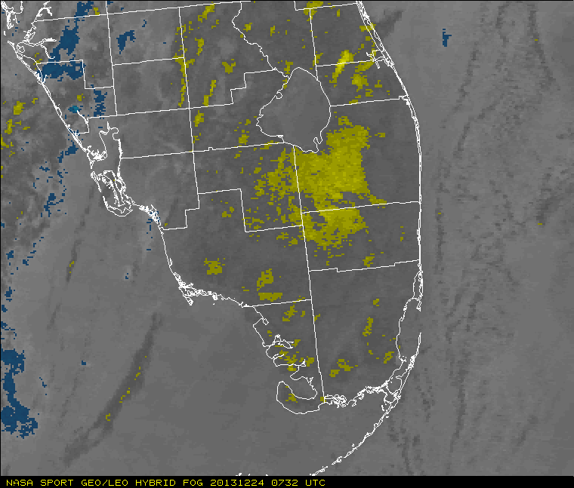
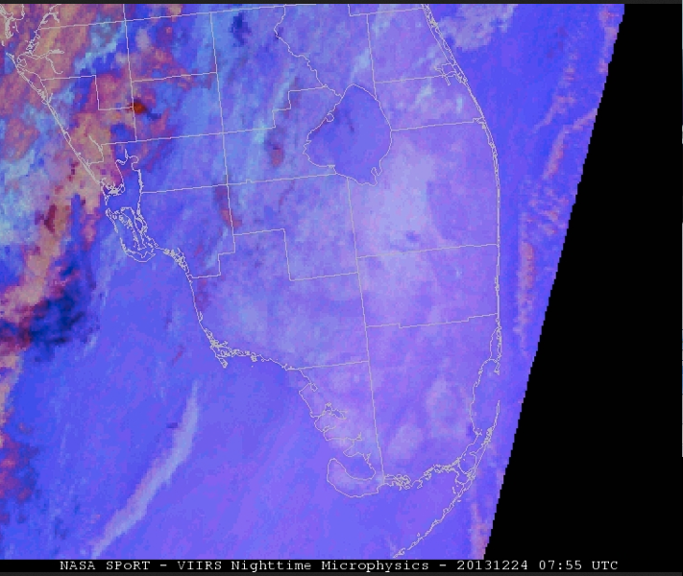
Case 3 – 2014DEC24 Results

Slide 16
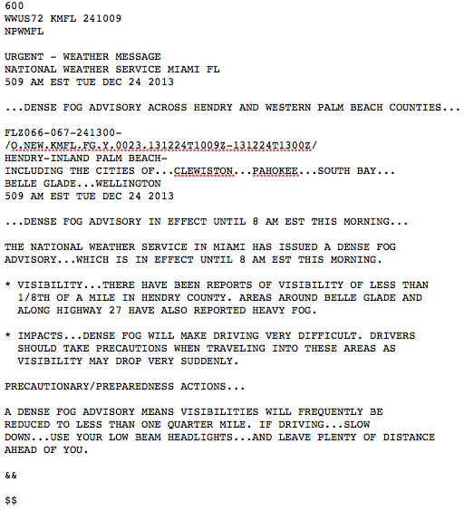
Why Case 3 is Considered Successful
All models forecast ground obscuration at three METAR stations
Fog also reported at Naples Municipal (KAPF) and SW FL International Airport (KRSW)
Mist reported at Ft. Myers (KFMY) and Hollywood (KHWO)
Ensemble models were most accurate
Dense fog advisories issued
NASA SPoRT imagery verifies fog formation forecast by models

Slide 17
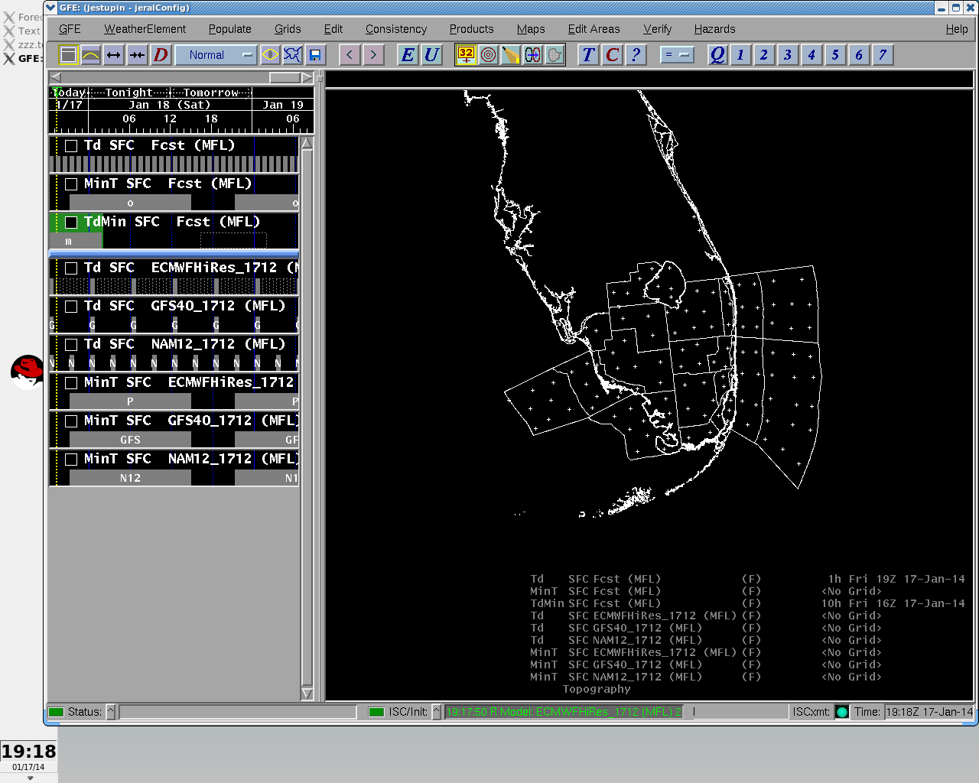
Case 4 – 2014JAN18

Slide 18
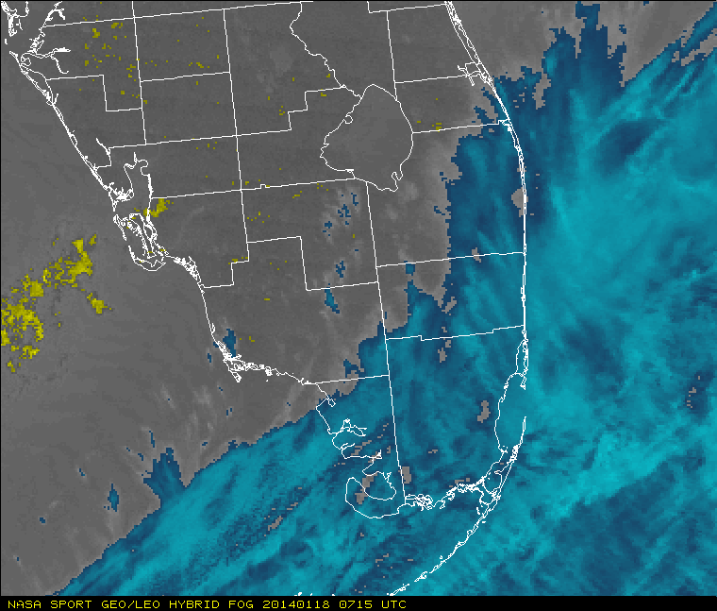
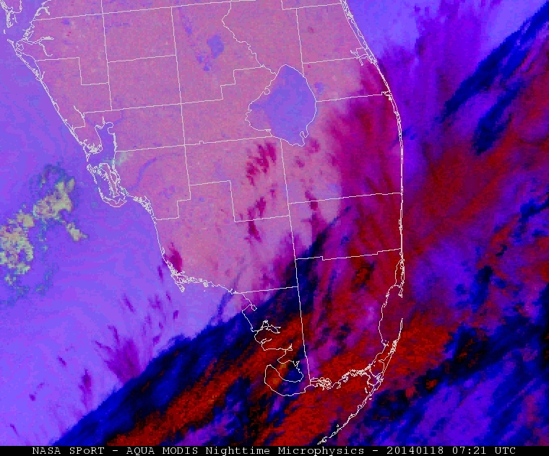
Case 4 – 2014JAN18

Slide 19
Why Case 4 is Considered Successful
The models for the fog algorithm did not forecast any fog for this day
NASA SPoRT confirms this by showing no fog in the imagery

Slide 20
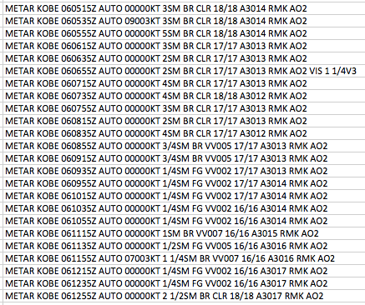
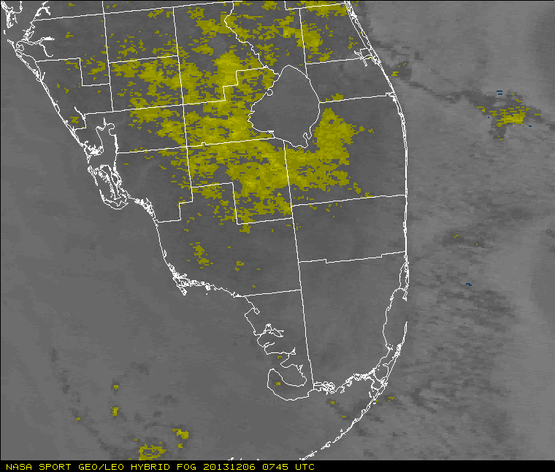
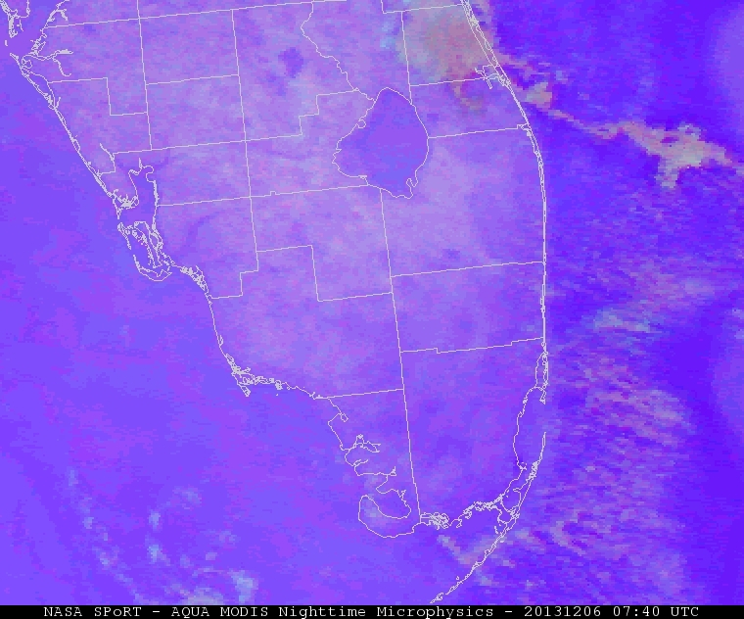
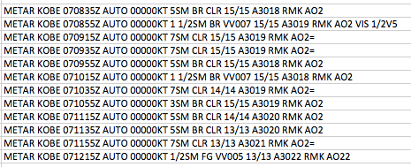
TABLE OF RESULTS
2013DEC06 KOBE METARs, Fog Product (0745Z), and Nighttime Microphysics (0740Z)
2013DEC07

Slide 21
Conclusions so far
The project is ongoing, but there are signs of success in this validation of the fog algorithm.
The results will allow to investigate performance of the algorithm for different intensities of fog (e.g. patchy fog or dense fog)
NASA SPoRT’s fog products have been crucial in both validating the WFO’s fog algorithm and tracking fog operationally

Slide 22
Work Cited
http://weather.msfc.nasa.gov/sport/jpsspg/rgb.html#ntmicro
http://glossary.ametsoc.org/wiki/Fog
http://weather.msfc.nasa.gov/sport/training/
http://weather.msfc.nasa.gov/sport/training/MODIS_fog_training/player.html

