Slide 1
California Communities Against Toxics Jane Williams Executive Director
MAIA-TEMPO Environmental Justice Workshop
August 5, 2022

Slide 2

Our mission:
To Reduce Pollution
Pollution Prevention
Advocating for Peace
Environmental Justice
Notes:
Feel free to change slide headings and so forth

Slide 3
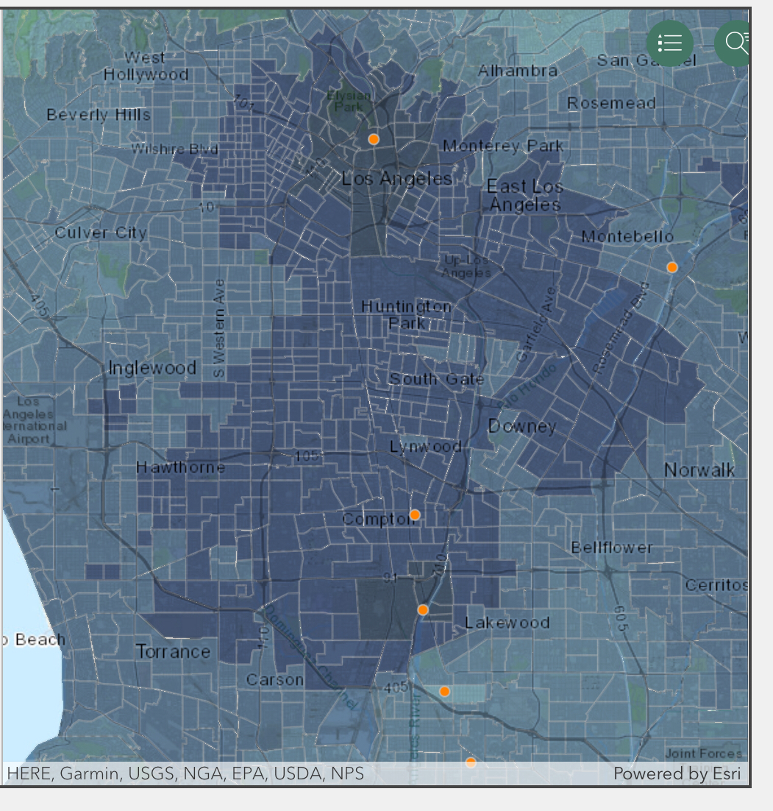
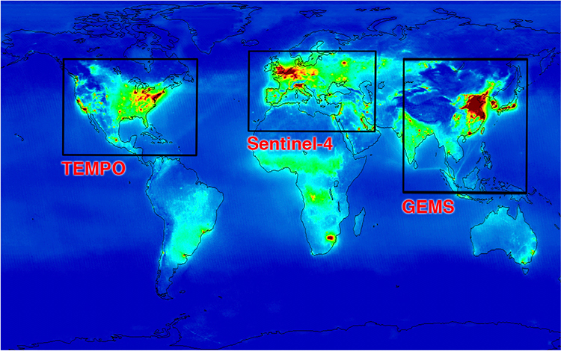
Our area of interest
We work on state, national and international issues.
We recently worked on the Public Health Air Quality Management Act which would mandate USEPA use satellite data to better regulate high pollution areas in the nation.
MAIA target areas – Alameda Corridor PM 2.5 Levels
TEMPO will collect data inside the “TEMPO” box on this figure
Notes:
You can remove the explanatory text and images of course!

Slide 4
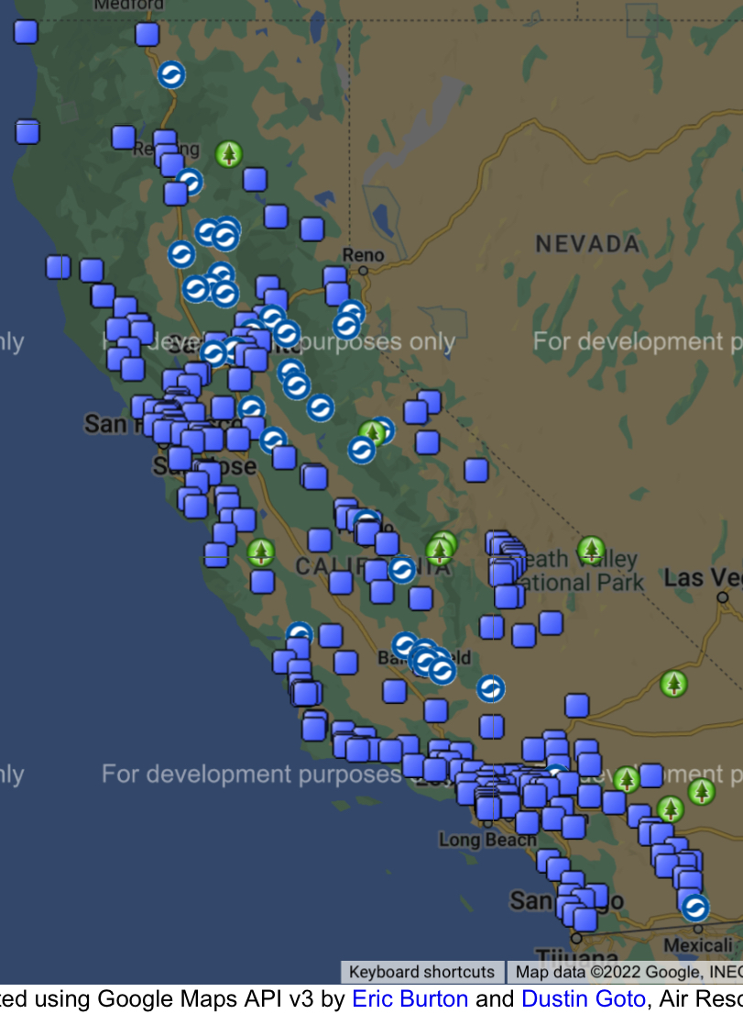
Our community/communities
We work with communities affected by air pollution in highly impact areas across California.
We provide technical expertise to communities across the country on air pollution monitoring with community based monitors, NCORE, BAMs, SLAMS, and fenceline monitoring for air toxics.
We work to reduce air pollution and criteria pollution from the petrochemical sector, mining sector, energy sector, and large stationary sources of air pollution with our environmental justice partners across the country.
Notes:
Feel free to change slide headings and so forth

Slide 5
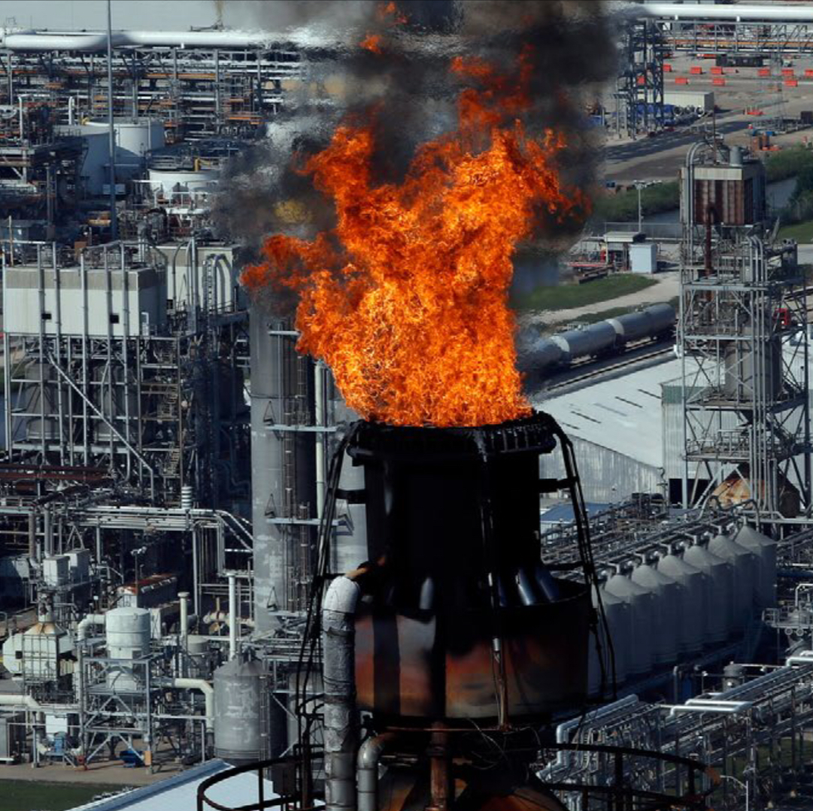
Our work on air pollution
Chrome Platers
Lead Smelters
Copper Smelters
Refineries
Chemical Manufacturing Facilities
Storage Tanks for Petrochemicals
Oil and Gas Infrastructure
Power Plants
Notes:
Feel free to change slide headings and so forth

Slide 6

The data and tools we use
We constantly watch fenceline monitoring technology and methods for air toxics, especially for ethylene oxide, benzene, lead, chloroprene, and hexavalent chromium.
We are starting to work on epichlorhydrin, an emerging super toxic hazards air pollutant.
We advocate for the use of satellite monitoring to identify areas of the country that are not in compliance with the National Ambient Air Quality Standards.
Notes:
Feel free to change slide headings and so forth

Slide 7
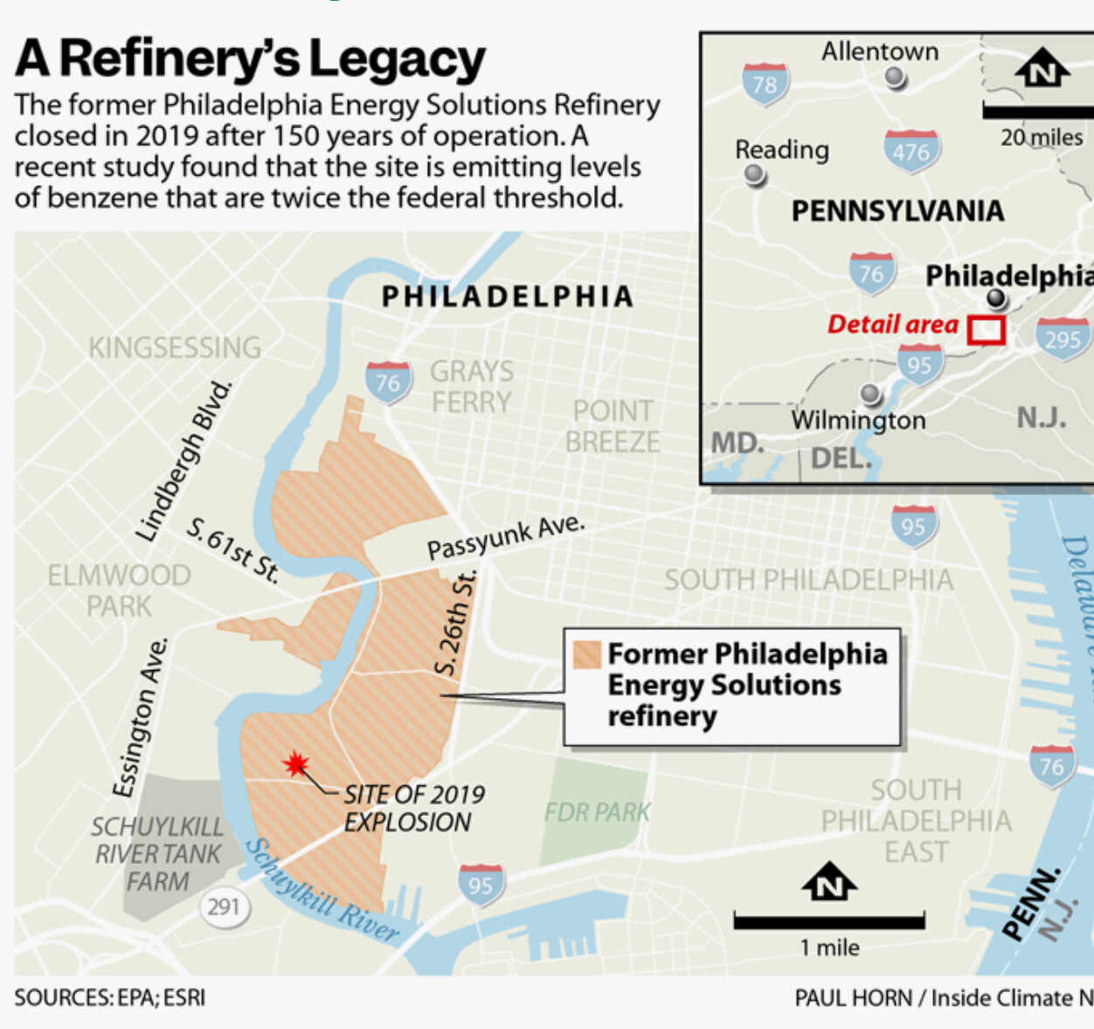
Using new data: the process
Applications for satellite monitoring would be enhanced if we had data that would be more user- friendly for the public and the advocacy community.
We are interested in using satellite data to track compliance with the NAAQS.
We advocate for the use of the satellite data by our local, state, and federal air quality agencies to help improve air quality.
Notes:
Feel free to change slide headings and so forth

Slide 8
