Slide 1
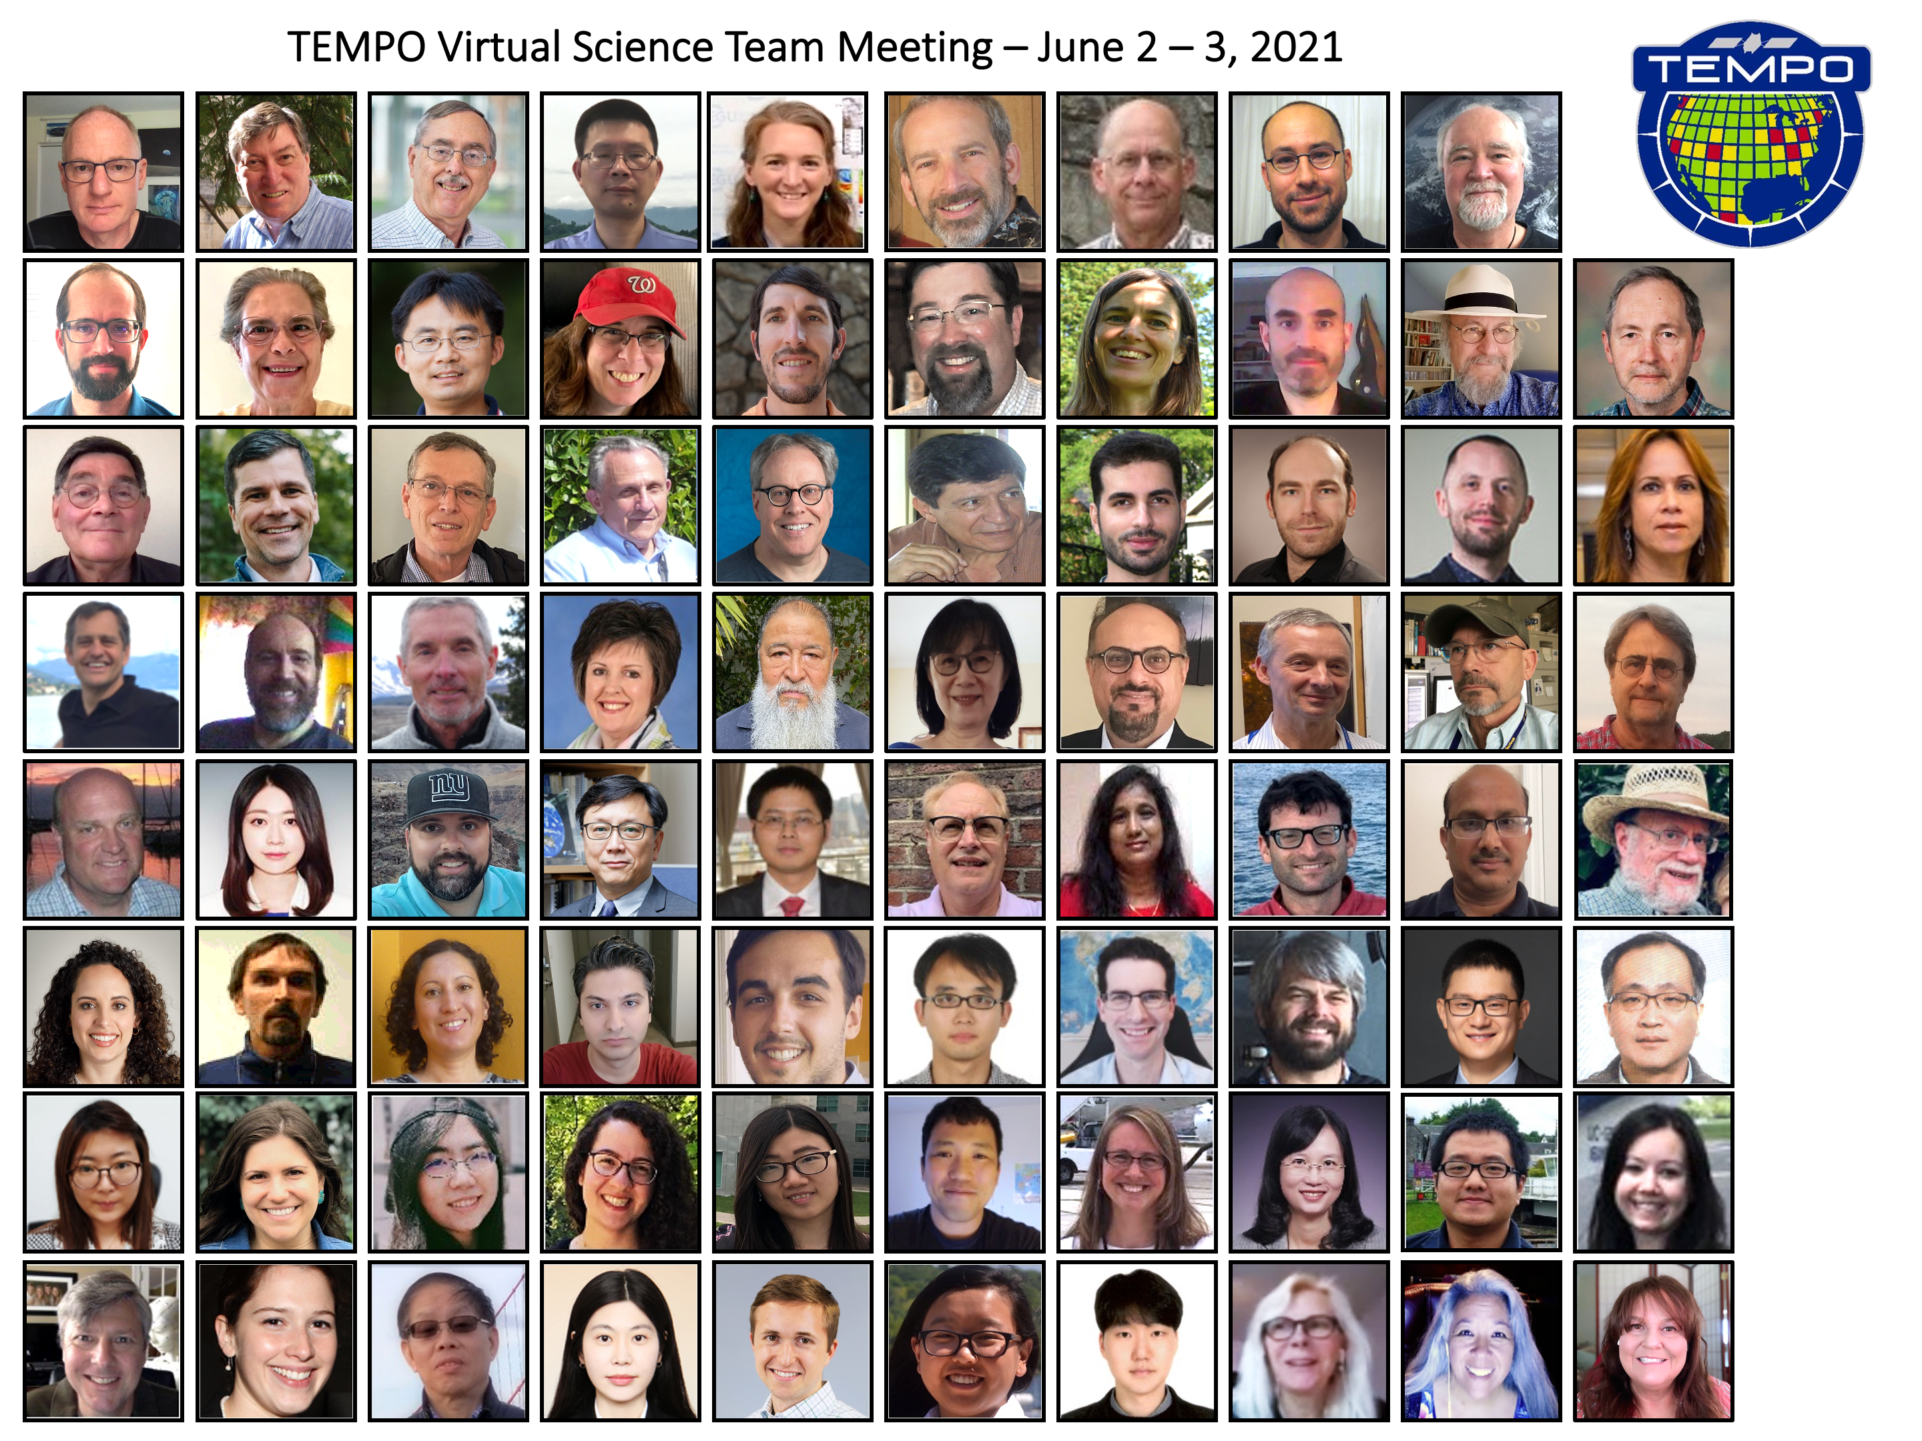

Tropospheric Emissions: Monitoring of Pollution (TEMPO)
Xiong Liu^{1,*}, Kelly Chance¹
on behalf of The TEMPO Team
¹Center for Astrophysics | Harvard & Smithsonian
* xliu@cfa.harvard.edu
MAIA-TEMPO Environmental Justice Workshop
August 5, 2022

Slide 2
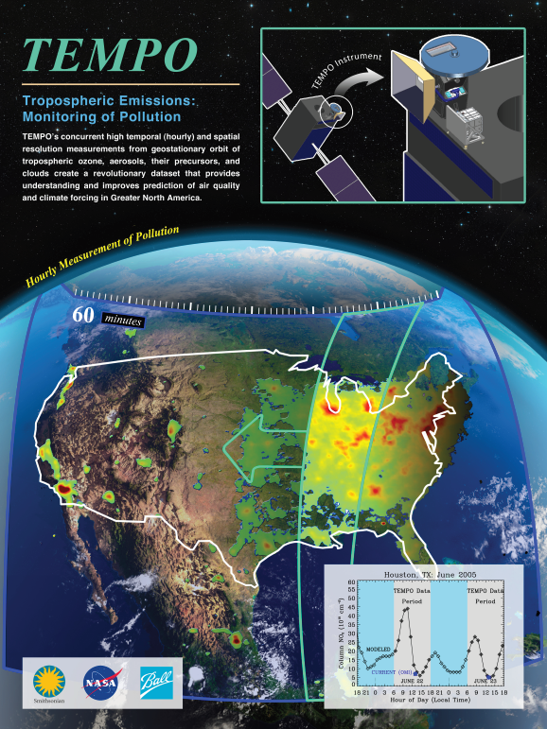
Hourly daytime atmospheric pollution over North America from the GEO
NASA’s first Earth Venture Instrument (EVI) selected in 2012 & first host payload
PI: Kelly Chance, SAO: STM, ground systems, science data processing center
Instrument Development: Ball Aerospace
Instrument Project Management: NASA LaRC, PM: Kevin Daugherty
Other Institutions: NASA GSFC, NOAA, EPA, NCAR, Harvard, UC Berkeley, St. Louis U, UAH, U Nebraska, Sitting Bull College, RT Solutions, Carr Astronautics
International collaboration: Mexico, Canada, Cuba, Korea, U.K., ESA, Spain
Mission Project Management: NASA LaRC, current PM: Kevin Daugherty
Host Satellite Provider: Maxar Technologies
Satellite Host: Intelsat (IS40e)
Launch: SpaceX
Provides hourly daylight observations to capture rapidly varying emissions & chemistry important for air quality
  UV/visible grating spectrometer to measure key elements in tropospheric ozone and aerosol pollution
  Distinguishes boundary layer from free tropospheric & stratospheric ozone
Aligned with Earth Science 2007 Decadal Survey recommendations
  Makes many of the GEO-CAPE atmospheric measurements
  Responds to the phased implementation recommendation of GEO-CAPE mission design team along with GeoCarb and GLIMR

Slide 3
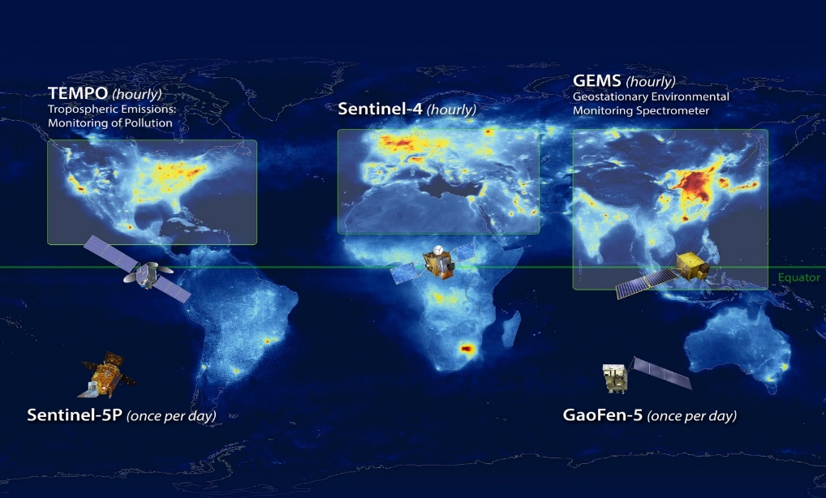
North American Component of An International Geostationary Air Quality Constellation
Launch March 2023
Launch early 2024
Launch Feb 2020
Image Credit: NASA LaRC

Slide 4
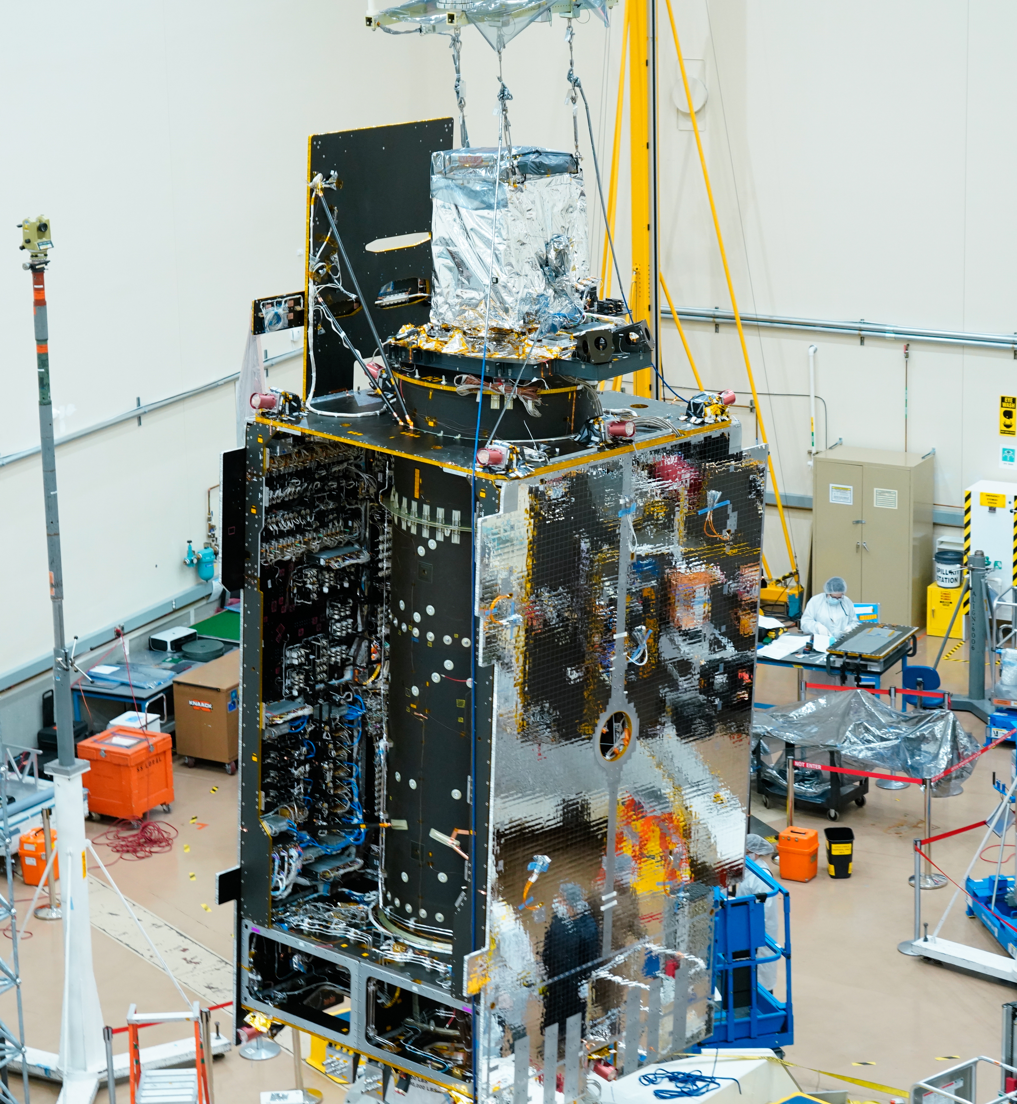
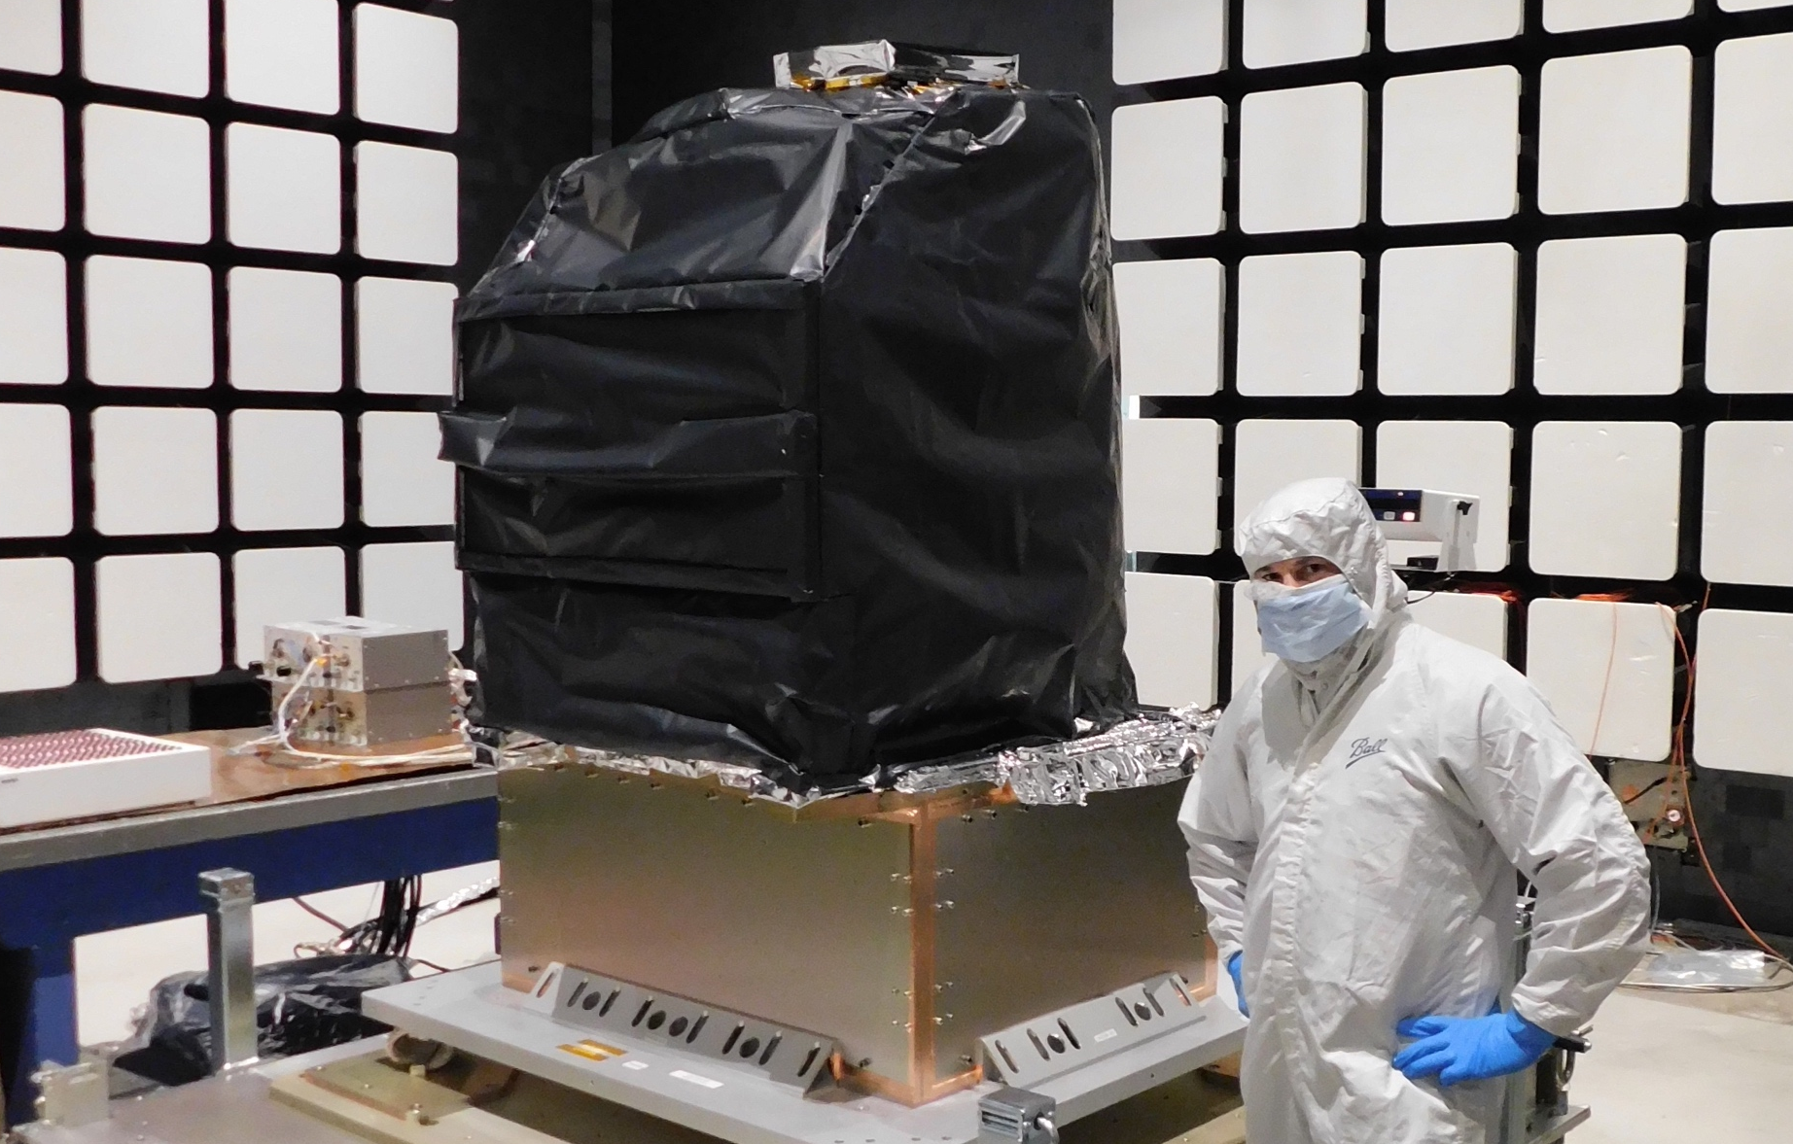
TEMPO Status
  Instrument delivery by Ball Aerospace in Nov. 2018
  Host satellite provider: Maxar selected in July 2019
  Host: Intelsat 40e (IS40e) selected on Feb 2020
  TEMPO sensor integrated onto IS-40e on 11/17/2021, and integration completed on 6/30/2022.
  TEMPO Ground Systems to be ready in Aug/Sep 2022
  Operation/Mission Readiness Review (ORR/MRR) in Dec. 2022
  Launch on SpaceX Falcon 9 around 3/1/2023 (TBD)
Courtesy from Ball Aerospace
Courtesy from Maxar

Slide 5
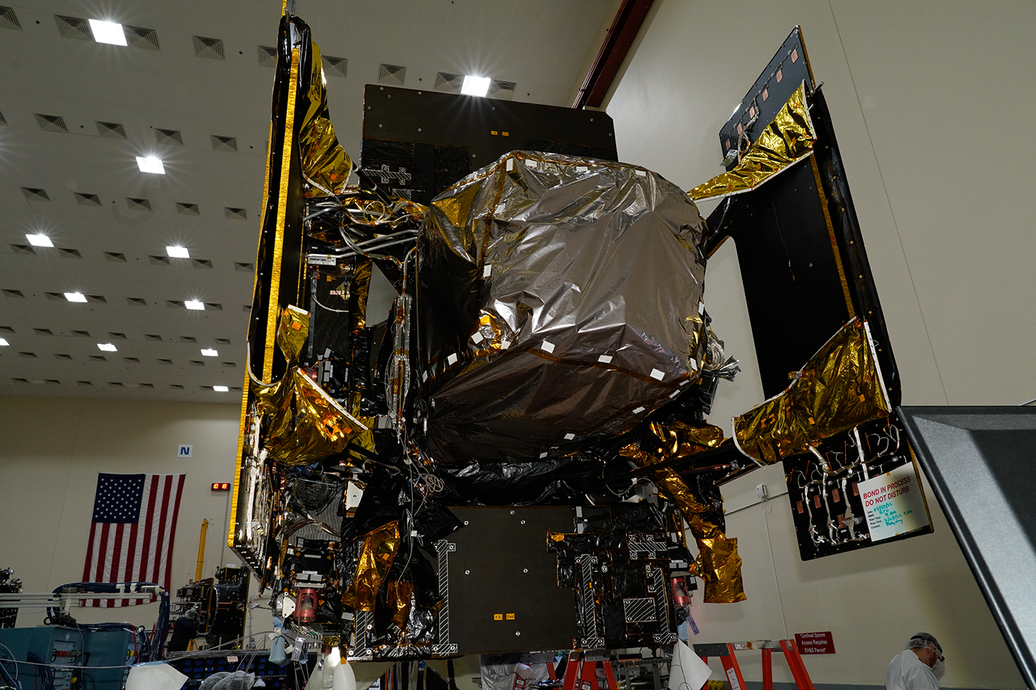
TEMPO Status
  Instrument delivery by Ball Aerospace in Nov. 2018
  Host satellite provider: Maxar selected in July 2019
  Host: Intelsat 40e (IS40e) selected on Feb 2020
  TEMPO sensor integrated onto IS-40e on 11/17/2021, and integration completed on 6/30/2022.
  TEMPO Ground Systems to be ready in Aug/Sep 2022
  Operation/Mission Readiness Review (ORR/MRR) in Dec. 2022
  Launch on SpaceX Falcon 9 around 3/1/2023 (TBD)
Crews recently completed the first fully integrated powered testing of TEMPO, instrument on Intelsat IS40e at Maxar Technologies' satellite manufacturing facility in Palo Alto, California.
Credits: Image courtesy of Maxar Technologies

Slide 6
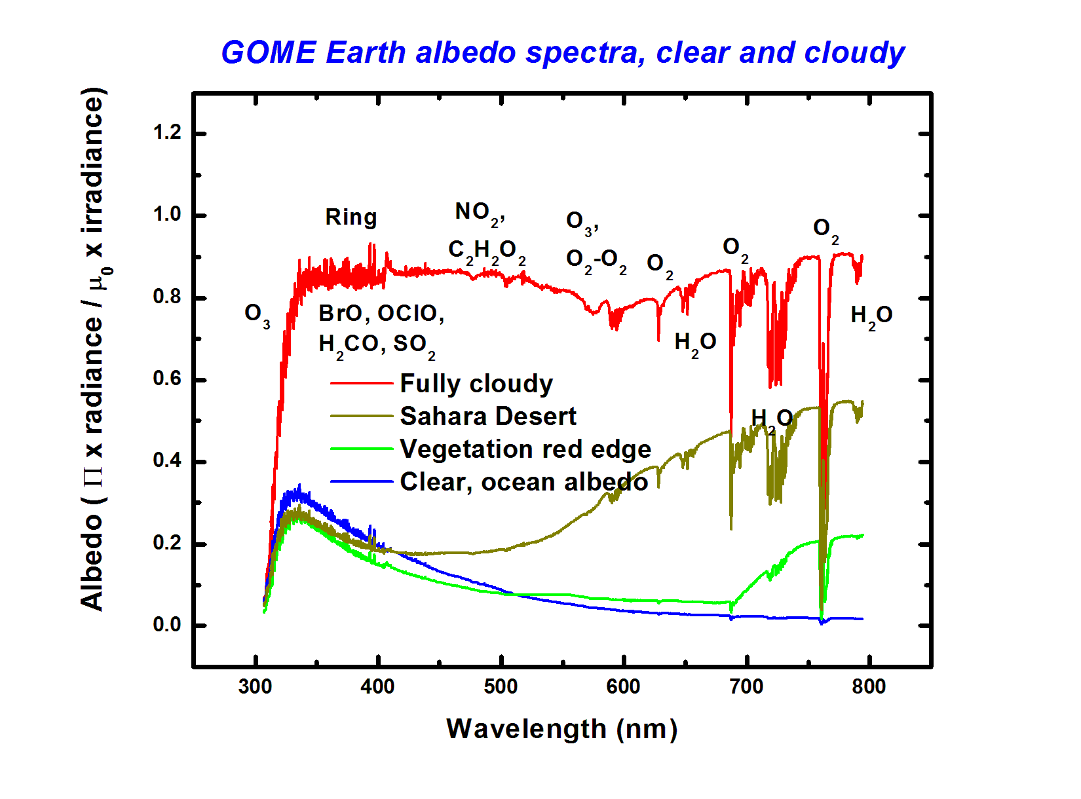
TEMPO Instrument
  Imaging grating spectrometer measuring solar backscattered Earth radiance
    2 channels (1 focal plane but with 2 2-D 2 k x 1k detectors ): ~293-494 + 538-741 nm
    ~0.6 nm FWHM, ~0.2 nm sampling
~293-494 nm
~538-741 nm
Examples of spectra based on GOME

Slide 7
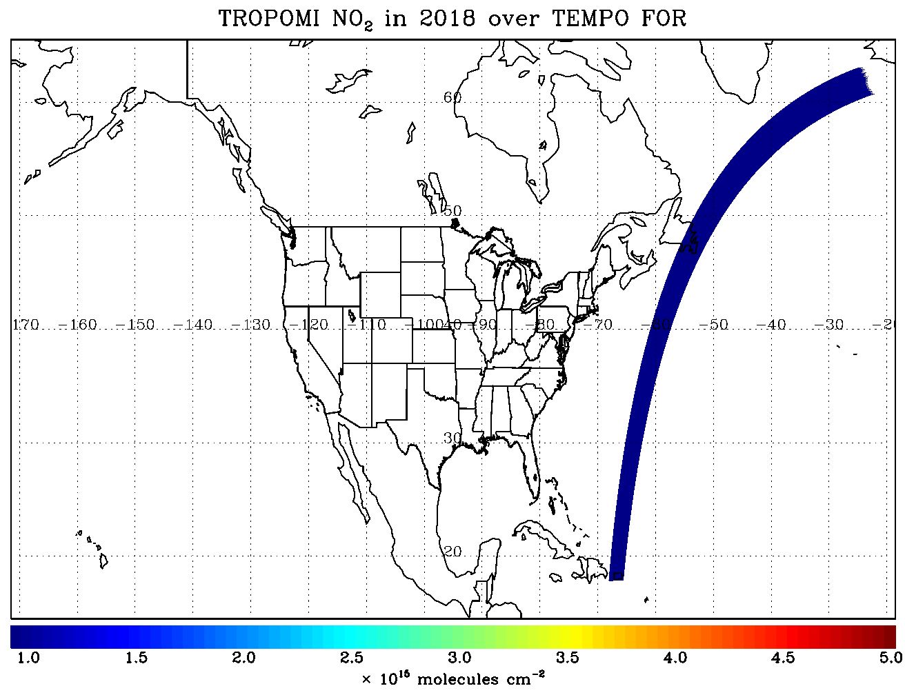
TEMPO Operation
  Operate on geostationary communications satellite Intelsat 40e (IS40e) at 91 ∘ W
Nominal: Scan FOR in 1 hour with 10 granules
~ 2K N/S pixels x 1226 steps/hr, ~ 2.5 M pixels/hr, daily # spatial pixels ~TROPOMI
2 x 4.75 km² @center of FOR, from 8 km² at Mexico City to 21 km² at Canadian Tar Sands
FOR: N/S +/-210 pixels,
E/W +230/160 pixels
Optimized scan: in the early morning and late afternoon, daylight portion of FOR, higher temporal resolution
High-time scan (up to 25%): selected portion of FOR at higher temporal resolution (e.g., <= 10 mins)
Field of regard is optimized to cover both Puerto Rico and Canadian tar sands.
S5p-TROPOMI NO2 product oversampled by Kang Sun.

Slide 8
Baseline and Threshold Products (Variables) & Requirements
Species/Products | Required Precision | Temporal Revisit*
0-2 km O₃ (Selected Scenes) Baseline only | 10 ppbv | 2 hour
Tropospheric O₃ | 10 ppbv | 1 hour
Total O₃ | 3% | 1 hour
Tropospheric NO₂ | 1.0 × 10¹⁵ molecules cm⁻² | 1 hour
Tropospheric H₂CO | 1.0 × 10¹⁶ molecules cm⁻² | 3 hour
Tropospheric SO₂ | 1.0 × 10¹⁶ molecules cm⁻² | 3 hour
Tropospheric C₂H₂O₂ | 4.0 × 10¹⁴ molecules cm⁻² | 3 hour
Aerosol Optical Depth | 0.10 | 1 hour
* # of hourly measurements to be averaged to achieve required precision
Mission duration: 20 months for baseline
Spatial resolution: < 60 km² for baseline (4 native pixels coadded)
Aerosols, SO₂, C₂H₂O₂ were removed from baseline products during KDPC
  Proposed to bring them back along with additional products and produce NRT/off-line products for some species, pending on funding from Satellite Needs Working Group (SNWG) in late 2022 or 2023.
Cloud product (cloud fraction, cloud pressure): used in trace gas/aerosol retrievals

Slide 9
TEMPO Data Products
(Inc. Proposed Additional & NRT Products)
Level | Product | Algorithm | Major Outputs | Res km^{2 **} | Freq/Size
L0 | Digital counts | Raw to L0 | Reconstructed/reformatted digital counts | 2.0 x 4.75 | Daily/hourly
L1-b | irradiance^{NRT} | SAO L0-1 | Calibrated & quality flags |  | daily
 | radiance^{NRT} | SAO L0-1 | Geolocated,calibrated, viewing,geolocation&quality flags | 2.0 x 4.75 | Hourly, granule
L2 | Cloud ^{NRT} | OMI O2-O2* | Cloud fraction, cloud pressure | 2.0 x 4.75 | Hourly, granule
 | O₃ profile | SAO O3 profile | O3 profile, total/strat/trop/0-2 km O3 column, errors, a priori, AKs | 8.0 x 4.75 *** | Hourly, granule
 | Total O₃ | TOMS V8.5 | Total O3, AI, cloud fraction | 2.0 x 4.75 | Hourly, granule
 | NO₂ ^{NRT} | SAO trace gas, BU strat/trop sep. | SCD, strat./trop. VCD, error, shape factor, scattering weights | 2.0 x 4.75 | Hourly, granule
 | H₂CO ^{NRT} | SAO trace gas | SCD, VCD, error, shape factor, scattering weights | 2.0 x 4.75 | Hourly, granule
 | C₂H₂O₂ | SAO trace gas |  | 2.0 x 4.75 | Hourly, granule
 | H₂O | SAO trace gas |  | 2.0 x 4.75 | Hourly, granule
 | BrO | SAO trace gas |  | 2.0 x 4.75 | Hourly, granule
 | Aerosol ^{NRT} | OMAERUV+UI AOCH | AAI, UVAOD, UVSSA, AOCH, VISAOD | 8.0 x 4.75 | Hourly, granule
 | SO₂ ^{NRT} | OMSO2 PCA | SCD, VCD (PBL,TRL,TRM,TRU,STL) | 2.0 x 4.75 | Hourly, granule
 | TEMPO/GOES-R Synerg. product | GOES-R products on TEMPO pixels | Radiance, aerosol, cloud & mask, fire/hotspot, snow/ice, rainfall, precipitable water, land/sea surface T, lightning | 2.0 x 4.75 | Hourly, granule
L3 | Gridded L2 | SAO L2-3 | Same as L2 | 2 x 2 (?) | Hourly, scan
L4 | UVB | GEMS/GSFC UVB | UV irradiance, erythemal irradiance, UVI | TBD | Hourly, scan
*Algorithm changed from NASA GSFC’s OMCLDRR to GSFC’s new O₂-O₂ cloud algorithm combined with SAO’s trace gas retrieval algorithm to retrieve O2-O₂ SCDs. ** Spatial resolution at center of FOR. *** Might be at 8 x 9.5km²
Black: baseline, green/orange/purple: additional products (being proposed)
^{NRT}: NRT products & off-line products (with additional NRT funding, otherwise produce 1 product within 3-6 hours except for O₃ profile)

Slide 10
Algorithm Development
Algorithm Development Status & Plan
SDPC V3 (launch ready) completed in Feb. 2022
Algorithm mostly based on OMI heritage algorithms except for new L0-1b processor (including INR using GOES-R from Carr Astronautics)
Updates to L1-2 algorithms (O₃ profile, NO₂, HCHO, cloud, total O₃):
  Adapted for TEMPO in NetCDF-4 format
  Add visible to SAO UV O3 profile algorithm, SAO trace gas algorithm with adapted NASA strat/trop separation for NO2
  CLDO4^{new}: SAO O₂-O₂ fitting + GSFC’s O₂-O₂ cloud at ~477/466 nm (Huiqun Wang, Eun-Su Yang, Alexander Vasilkov)
  NASA GMAO’s GEOS-CF trace gas profiles and meteorology (Emma Knowland and GMAO)
  Hourly resolved monthly mean Geometry-dependent Lambertian Equivalent Reflectivity (GLER) climatology (Christopher Chan Miller, Wenhan Qin, Zachary Fasnacht)
Development of other products
  CHOCHO, H₂O, BrO: will use SAO’s trace gas algorithm
  SO₂: OMI PCA SO₂ algorithm adapted for TEMPO/GEMS from synthetic/GEMS data (Can Li)
  Aerosols: being adapted from OMI/TROPOMI AERUV algorithm (Omar’s team), from EPIC/TROPOMI Aerosol Layer Height algorithm using O₂-A/B (Jun Wang’s team)
Continue to make minor updates to improve beyond V3
  Further improvements using synthetic and GEMS data: destriping, radiance reference & background correction, cross section updates, empirical correction
  Algorithm refinement/optimization during commissioning (Jul-Sep 2023) and nominal operation

Slide 11
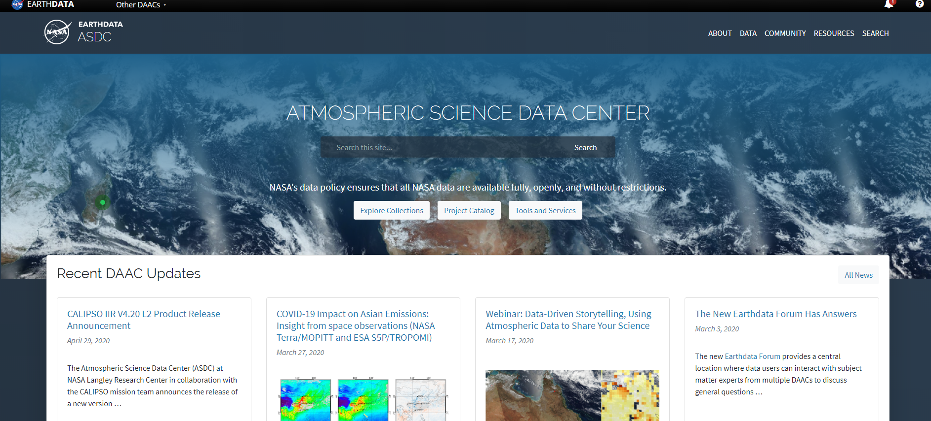



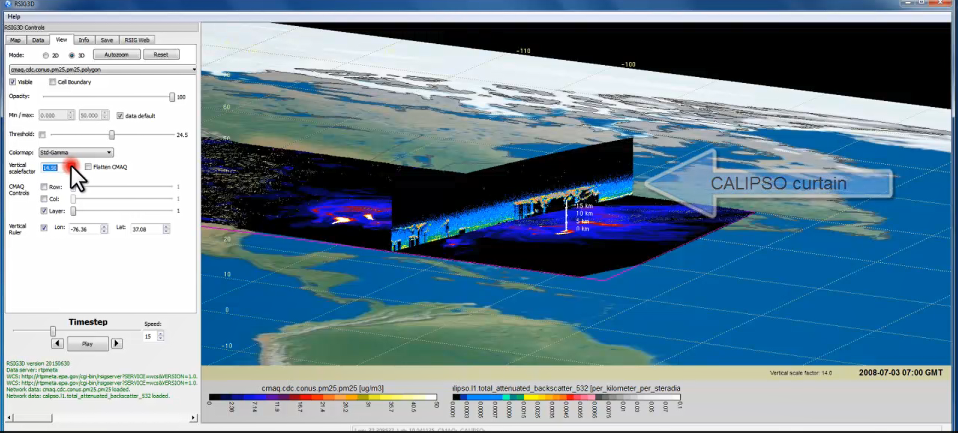
TEMPO Data Products Distribution
ASDC Data Archival & Distribution: Tools and Services
NASA Earthdata Search
  CMR Search ⚬ Metadata
NASA WorldView
  GIBS API ⚬ visualization
Harmony and OPeNDAP
  ⚬ transform ⚬ subsetting
  ⚬ reformatting ⚬ distribution
HTTPS data access
  ⚬ datapool
  ⚬ permanent URL/direct access
  ⚬ enables scripts/workflow
Geospatial Web Services
  ⚬ WCS ⚬ WMS ⚬ ArcGIS Image Service
Example scripts
  ⚬ Python/Jupyter Notebook
  ⚬ R scripts
  ⚬ contributed tutorials/scripts
EPA RSIG3D Gateway
TEMPO data can be served directly through the EPA RSIG. https://www.epa.gov/hesc/remote-sensing-information-gateway
User Support and Other Resources
Earthdata Login https://urs.earthdata.nasa.gov
Earthdata Forum https://forum.earthdata.nasa.gov/
ASDC User Support support-asdc@earthdata.nasa.gov
Slides from Jeff Walters, Tim Larson at TEMPO STM 2020 & EAWNov2021

Slide 12
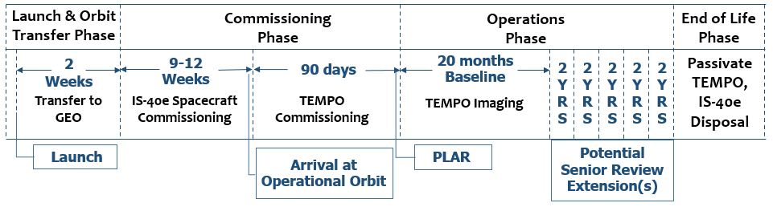
Commissioning Timeline & Data Release
TEMPO commissioning: ~L+105-L+195 (mid-June – mid September)
Nominal operation: ~6 months after launch
Plan to release initial L1b in ~4 mons, L2/3 in ~6 mons to the public after commissioning (i.e., Jan 2024 for L1b, Mar 2024 for L2/3).
Provide data products to validation team priori to the public release via ASDC.

Slide 13
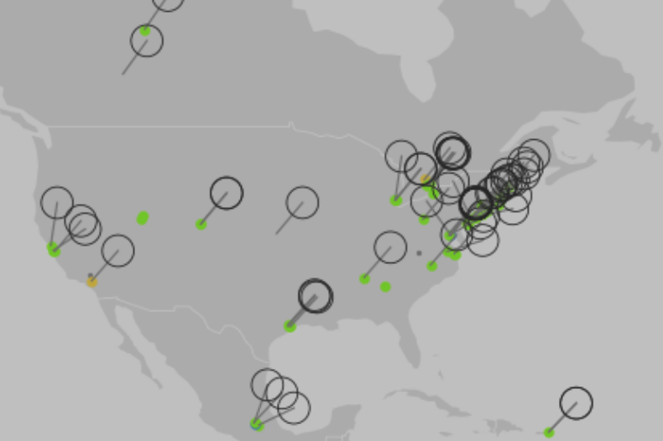
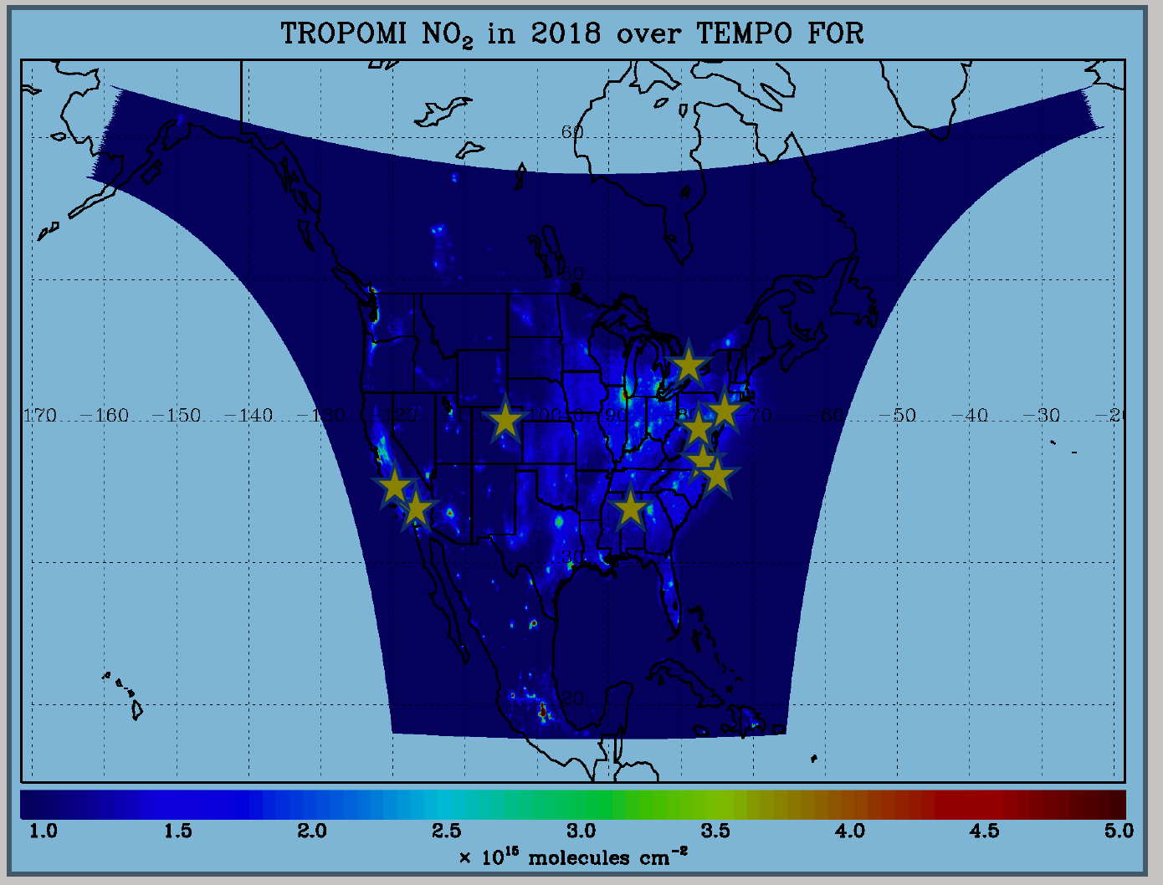
TEMPO Validation Plan
TEMPO PLRA has a bare minimum validation requirements (3 Pandoras, 1 month per season)
Jim Szykman is leading development of best-of-effort basis validation plan: beta, provisional, full
Use satellite observations (i.e., LEO and EPIC/DSCOVR) for cross validations
Pandora & Pandonia Global Network (PGN): validate NO₂, HCHO, total O₃ and diurnal variation
TOLNet: 8 LIDAR instruments by time of launch to validate tropospheric O₃ & 0-2 km O₃ and diurnal variation
https://www.pandonia-global-network.org/
www-air.larc.nasa.gov/missions/TOLNet/
~60 PGNs in TEMPO FoR, ~20 to add in the next 2 years
Nowlan et al. (2018) GCAS, DISCOVER-AQ, Texas, Sep 2013
Airborne instruments: GEO-TASO, GCAS, HSRL-2, SeaRey UAV
Other instruments: ozonesonde, MAXDOAS, FTIR, Dobson/Brewer, AERONET, …
Planned flight campaigns like STAQS, AEROMMA, GOTHAAM during June-Aug 2003, provide integrated approaches linking TEMPO Science, Applications, and Validation

Slide 14
TEMPO Green Paper:
Chemistry Experiments with TEMPO
NORMAL TIME RESOLUTION STUDIES | Volcanoes
Air quality and health | Socio-economic studies
Ultraviolet exposure | National pollution inventories
Biomass burning | Regional and local transport of pollutants
Synergistic GOES-16/17 Products | Sea breeze studies for Florida and Cuba
Advanced aerosol products | Transboundary pollution gradients
Soil NO_{x} after fertilizer application and after rainfall | Transatlantic dust transport
Solar-induced fluorescence from chlorophyll | HIGH TIME RESOLUTION EXPERIMENTS
Foliage studies | Lightning NO_{x}
Mapping NO₂ and SO₂ dry deposition at high resolution | Morning and evening higher-frequency scans
Crop and forest damage from ground-level ozone | Dwell-time studies and temporal selection to improve detection limits
Halogen oxide studies in coastal and lake regions | Exploring the value of TEMPO in assessing pollution transport during upslope flows
Air pollution from oil and gas fields | Tidal effects on estuarine circulation and outflow plumes
Night light measurements resolving lighting type | Air quality responses to sudden changes in emissions
Ship tracks, drilling platform plumes, and other concentrated sources. | Cloud field correlation with pollution
Water vapor studies | Agricultural soil NO_{x} emissions and air quality
Early Adopters are key to building the TEMPO Green Paper!
The TEMPO Green Paper living document at weather.msfc.nasa.gov/tempo/
Early Adopters can request high-time observations!

Slide 15





















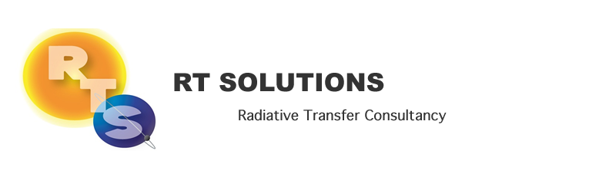





We are on track to get ready for the TEMPO launch in January 2023.

Slide 16
NRT vs. Off-line Trace Gas Products
(if with additional NRT funding)
Implementing both NRT and off-line trace gas products (e.g., NO₂, HCHO) for NO2, HCHO, aerosol, SO₂, cloud
Major potential differences between NRT and offline products
 | NRT | Off-line
Trace gas profiles/Met data | GEOS-CF | GEOS-CF Replay
Surface | GLER climatology | MODIS/VIIRS albedo/BRDF products
L1B | Skip wavelength calibration One-pass INR Default/No Pol. Correction | Two-pass Kalman Filter INR Improved pol. Correction with L2 retrievals?
L2 algorithms | Smaller fitting windows Avoid waiting for the entire hourly scan | More optimized fitting windows Improve radiance reference & cross-track correction
Data Latency | Within 2-3 hours upon receipt of raw data at SAO Ground System | + 8 days as MODIS BRDF is produced using data +/- 8 days

Slide 17
Research Products
TEMPO research products will greatly extend science and applications
  OClO, IO, HNO₂, NO₃, volcanic (SO₂ plume height and VCD)
  Additional/improved cloud with O₂-O₂ bands / O₂-B bands
  Additional aerosol products from hyperspectral spectra, O₂-B and O₂-O₂-bands, and TEMPO + GOES-R synergy at @U Iowa, NOAA, GSFC
  Vegetation/Ocean Color products: vegetation indices, Growth Primary Productivity (GPP), Solar Induced fluorescence (SIF), ocean color
  Surface albedo/BRDF products
  Diurnal out-going shortwave radiation and cloud forcing
  Night lights: allows discrimination between lightning types
  Higher-level products: Near-real-time pollution/AQ indices

