Slide 1
MAIA-TEMPO Environmental Justice Workshop
August 5, 2022
Denise Bruce, Citizen Science Manager
Notes:
1

Slide 2

We advocate for the health of all North Carolinians by pursuing equitable and collaborative solutions that address climate change and air pollution.
Notes:
2

Slide 3
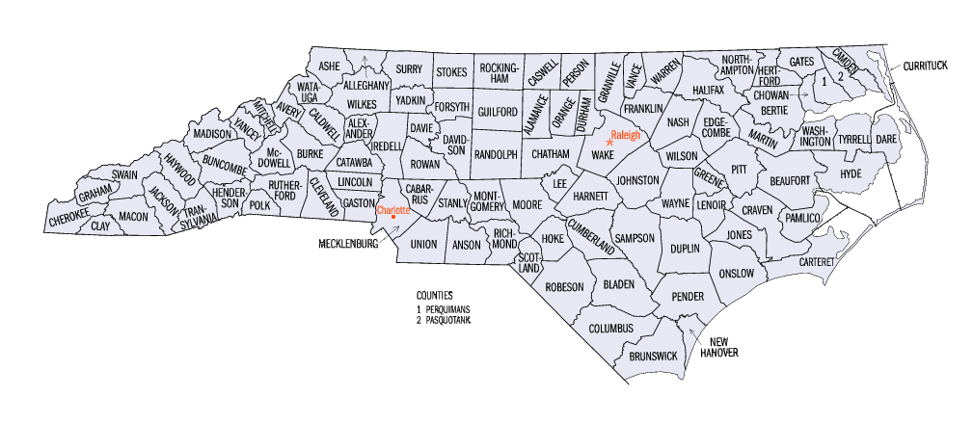


Our Areas of Interest
North Carolina
Charlotte’s Historic West End
Sampson County
Wilmington
Notes:
3

Slide 4
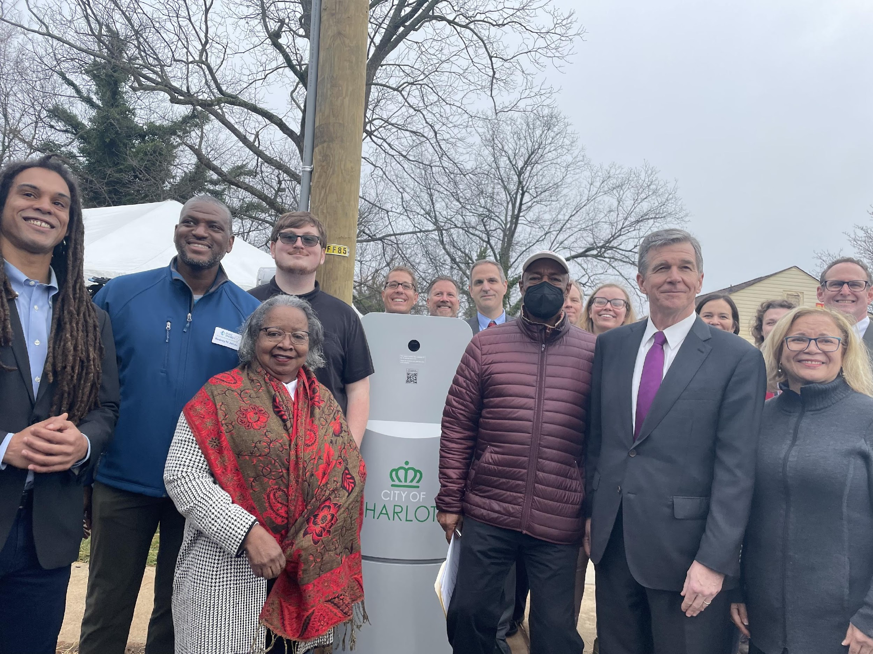
Our Communities
Implementing cluster networks of 15- 20 sensors near pollution sources in a single county affecting environmental justice communities.
  Charlotte/Historic West End
  Sampson County
  Wilmington/New Hanover
Celebration of EV charging station in Historic West End with Gov. Cooper. A monitor is now installed at the station.
Notes:
4

Slide 5
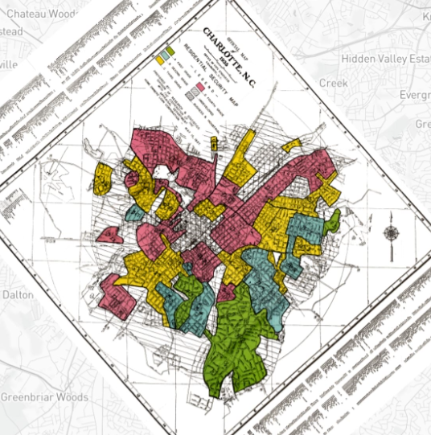
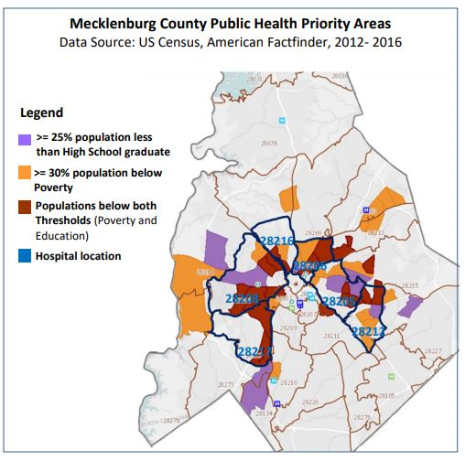
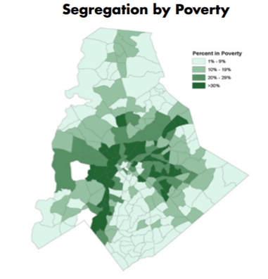
Historic West End Challenges
Historical Place-Based Social Exclusion
1935 Redlining Disinvestment Map Crescent
Social Determinants of Health
2012-2016 Public Health Priority Areas
Continued Economic Segregation
2020 Poverty
Sources: 2017-18 Mecklenburg County Health Assessment, 2018 Mecklenburg State of the County Health Report (SCOTCH)

Slide 6
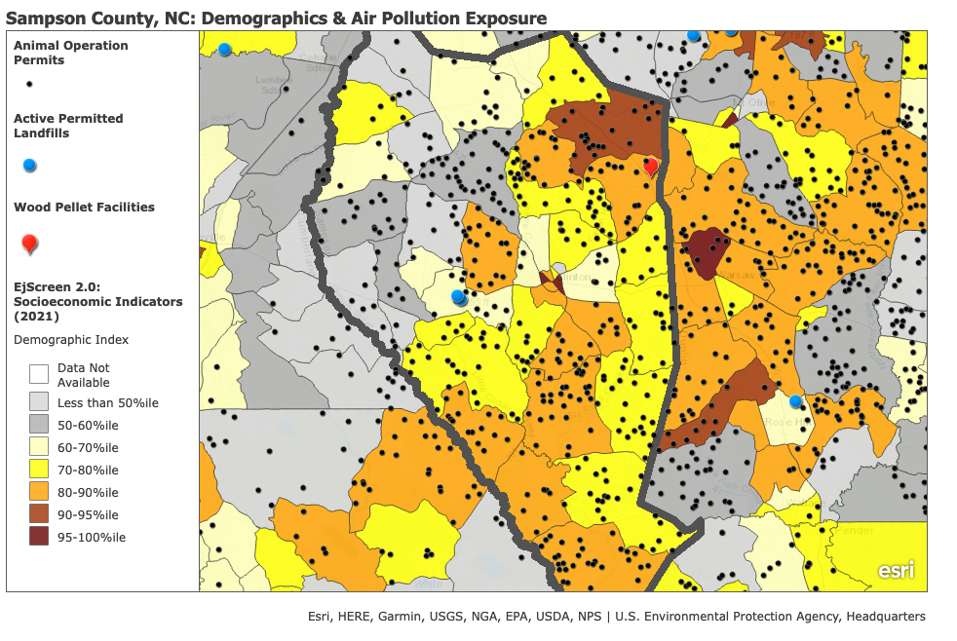
Sampson County NC
Number #2 in Swine and poultry production. CAFO Pollutants:
Particulate Matter
Ammonia
Hydrogen Sulfide (H2S)
Documented Health Impacts
Low Birth Weight
Shorter Life Expectancy
Diabetes
Kidney Disease

Slide 7
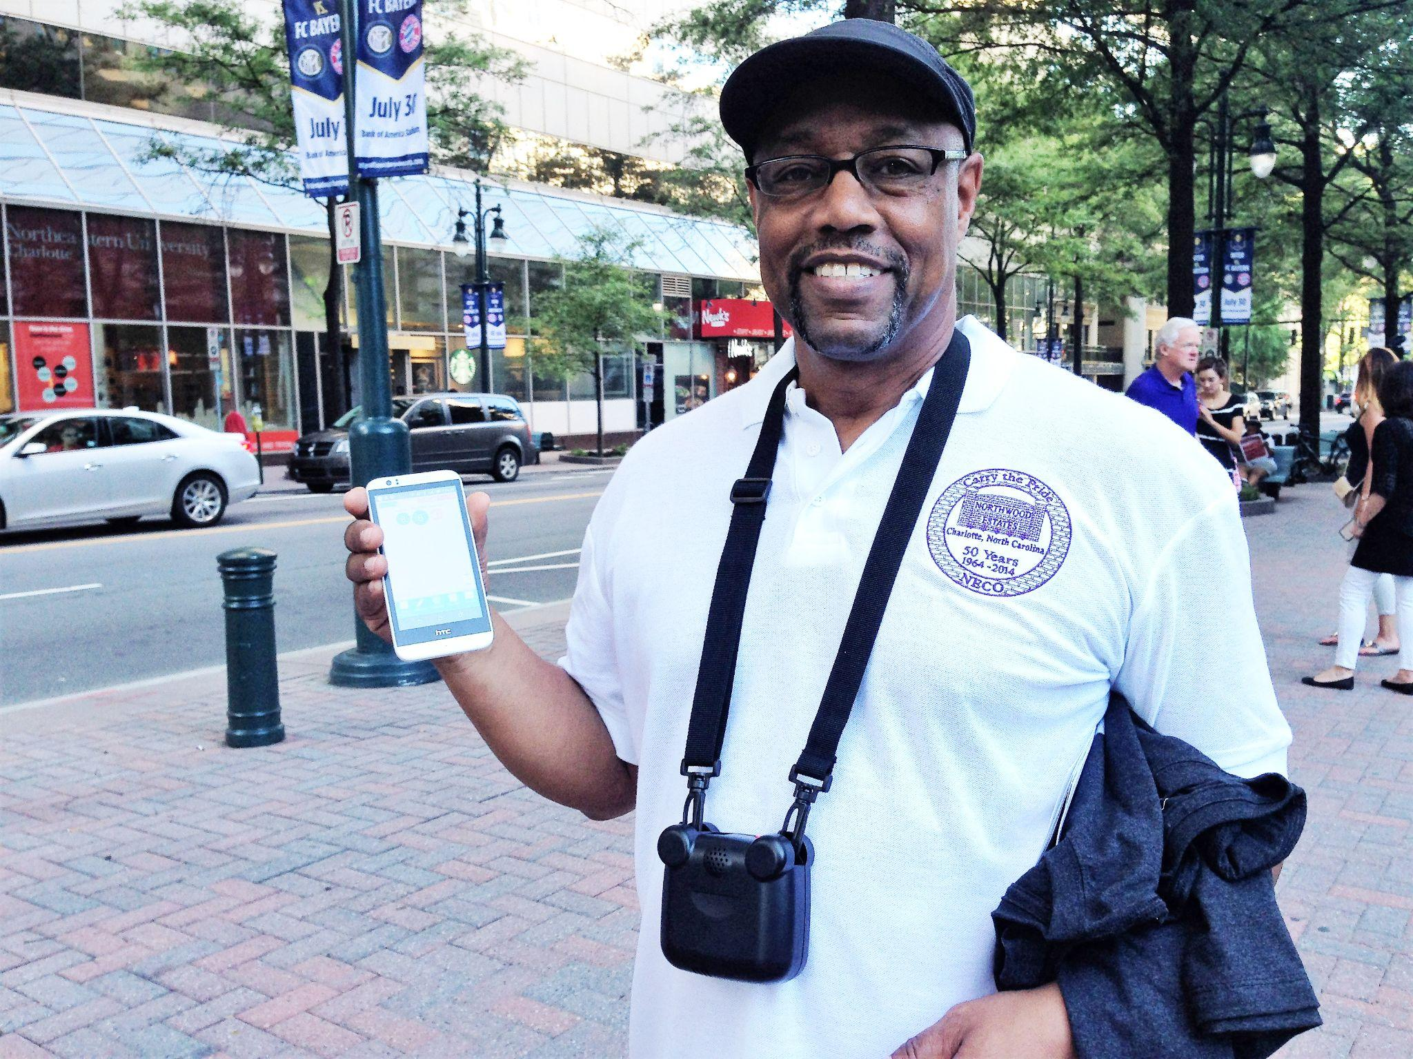
Our EJ work on air pollution
The CleanAIRE NC Citizen Science program engages North Carolinians in the fight for cleaner air.
PM 2.5 Monitoring Network
Sensor Hosts: AirKeepers
Sensor Lending Library
Notes:
7

Slide 8
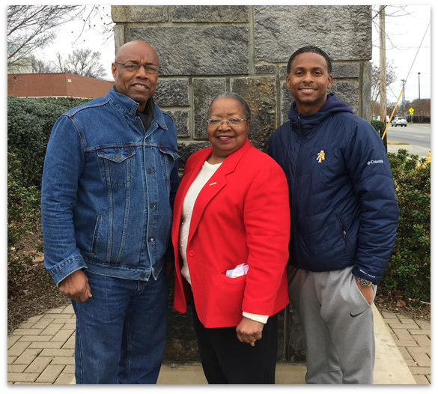
Citizen Science AirKeepers
Monitoring Program
Started in Charlotte’s Historic West End (HWE) in the fall of 2016
To address health inequities caused by air pollution in environmental justice communities
Use PurpleAir Monitors to measure PM 2.5
Historic West End AirKeepers

Slide 9
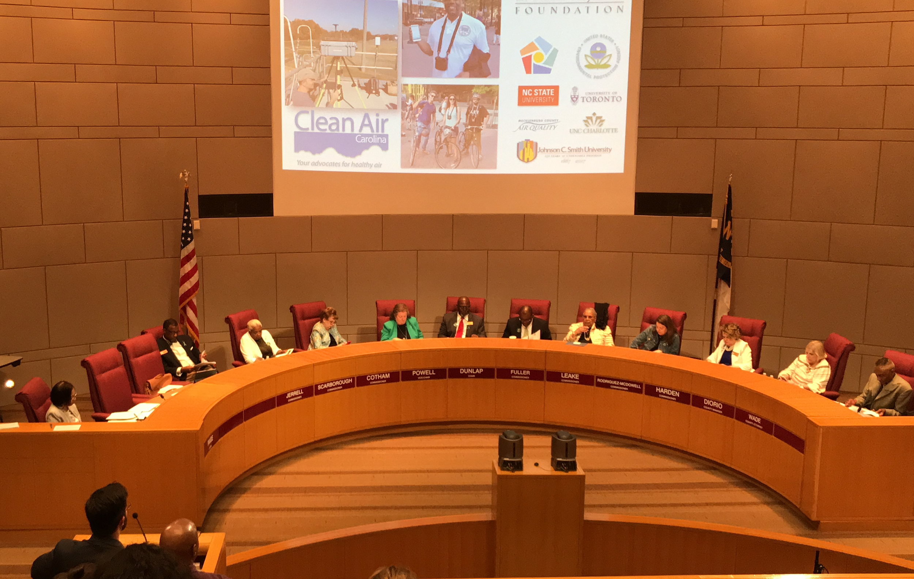
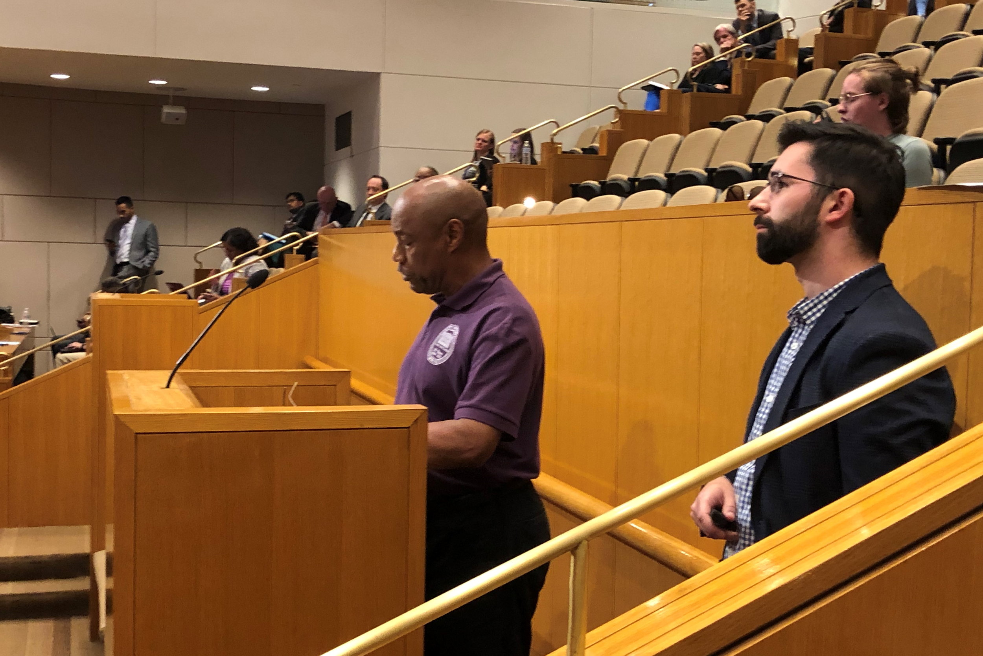
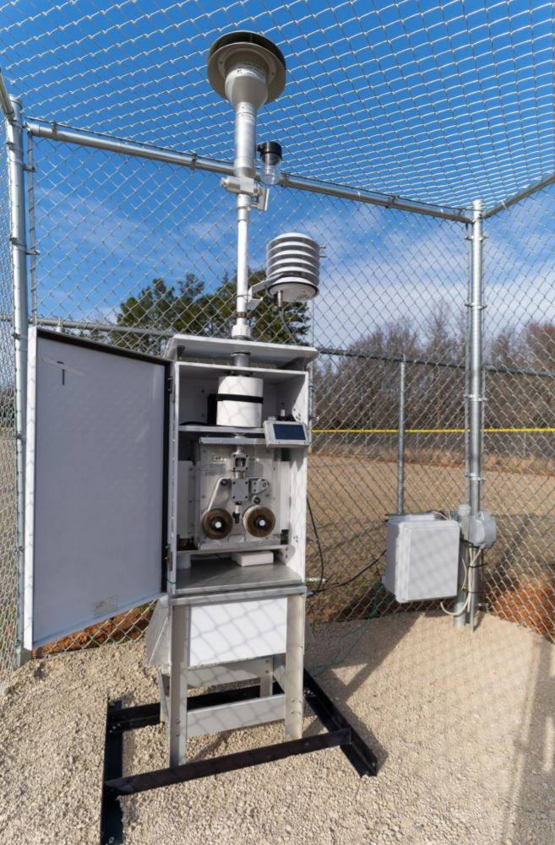
Mecklenburg County Commission Approves EPA Monitor as a result of Citizen Science Monitoring
Goals of Historic West End Green District
Increase strategic tree planting and monitoring along highway corridors and in sensitive areas
Install green roofs, green walls, and other green infrastructure to filter pollution/cool the area
Advocate for electric vehicle charging stations and more walking, biking, and clean transit
Increase education around health impacts of air pollution and provide air quality advocacy training to residents

Slide 10
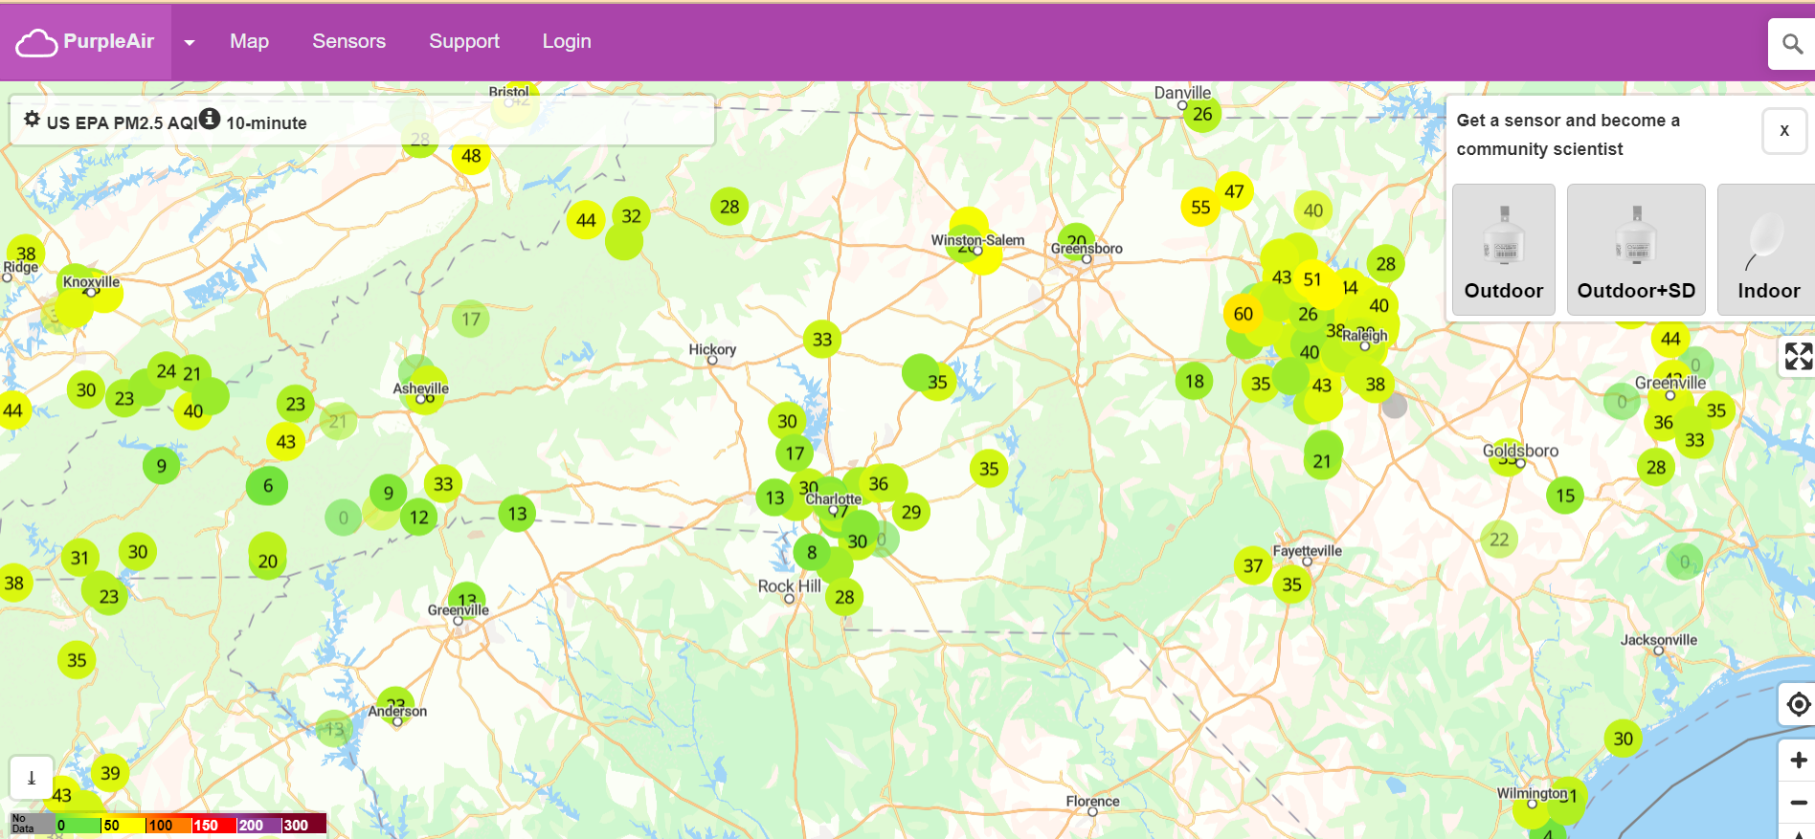
Tools We Use
PurpleAir.com
EJScreen
AirNow.gov
USDA.gov
GreenLink
Equity Mapping
HERE
GARMIN
ESRI
USGS
Notes:
10

Slide 11
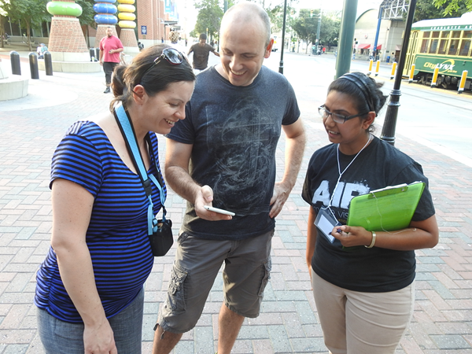
Incorporating New Data
Science Advisory Team
Eastern Research Group
  DART
  Dashboard Creation
  Reports
Research Triangle Institute
Notes:
11

Slide 12
THANK YOU
(704) 307-9528 | denise@cleanairenc.org | PO Box 5311
Charlotte, NC 28299 | www.cleanairenc.org

