Slide 1



NOAA’s APHEX Hurricane Field Program
TROPICS Satellite Validation Module
Hurricane Ernesto G-IV Missions
Brittany Dahl^{1,2}, Jason Dunion^{1,2}, Rob Rogers¹, and Trey Alvey^{1,2}
¹Univ. of Miami/CIMAS
²NOAA/AOML Hurricane Research Division
brittany.dahl@noaa.gov
TROPICS Applications Telecon – August 29, 2024

Slide 2



2023/2024 HFP TROPICS Satellite Validation Module
Objectives
Collect GPS dropsonde and aircraft tail Doppler radar data to validate TROPICS satellite-derived temperature, moisture, and precipitation profiles in a variety of tropical environments.
Coordinate GPS dropsonde locations and TROPICS satellite overpasses in time (within 30 min) and space (within 750 km of satellite nadir) with high-altitude dropsondes from the G-IV preferred.
Evaluate the impact of TROPICS data on regional numerical prediction of tropical cyclones.
NOAA Gulfstream-IV (NOAA49) Aircraft
Mission Duration | 7 - 8.5 h
Flight Level Altitude | 41,000 - 45,000 ft
Expendables | Dropsondes -- 50 NASA + NOAA/AOML/HRD in-kind available
Onboard Instrumentation | Tail Doppler radar

Slide 3
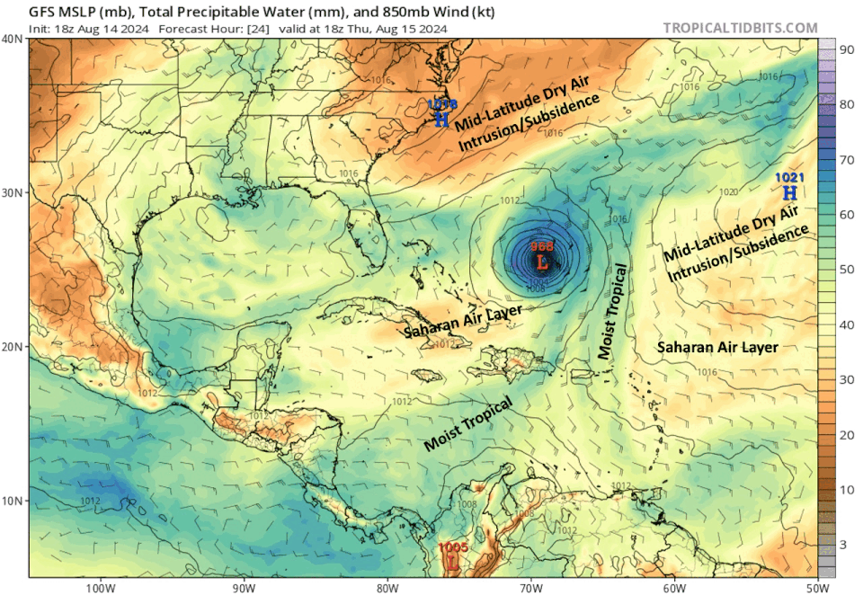
Hurricane Ernesto – Aug 15-16 Environment

Slide 4
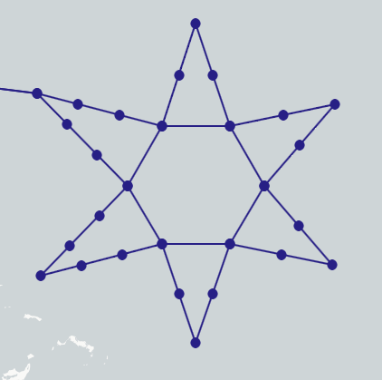
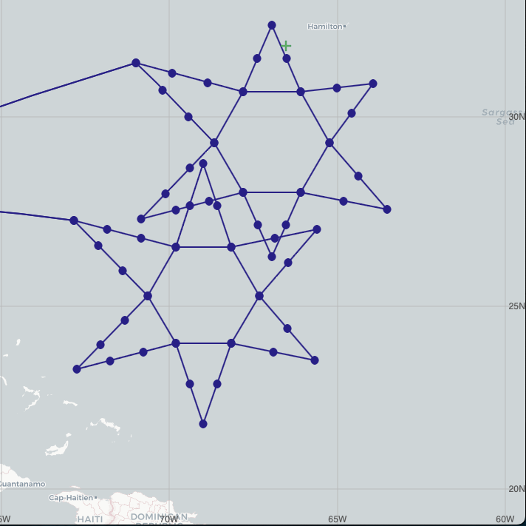
Star Flight Pattern
Part 1
TROPICS Missions As Planned
Inner radius: 90 NM
Outer radius: 180-240 NM
Radius of start points adjusted to target features of interest
20240816N1
Part 2
20240815N1
90 NM circumnavigation
+ final leg of star
Circles = dropsonde release points

Slide 5
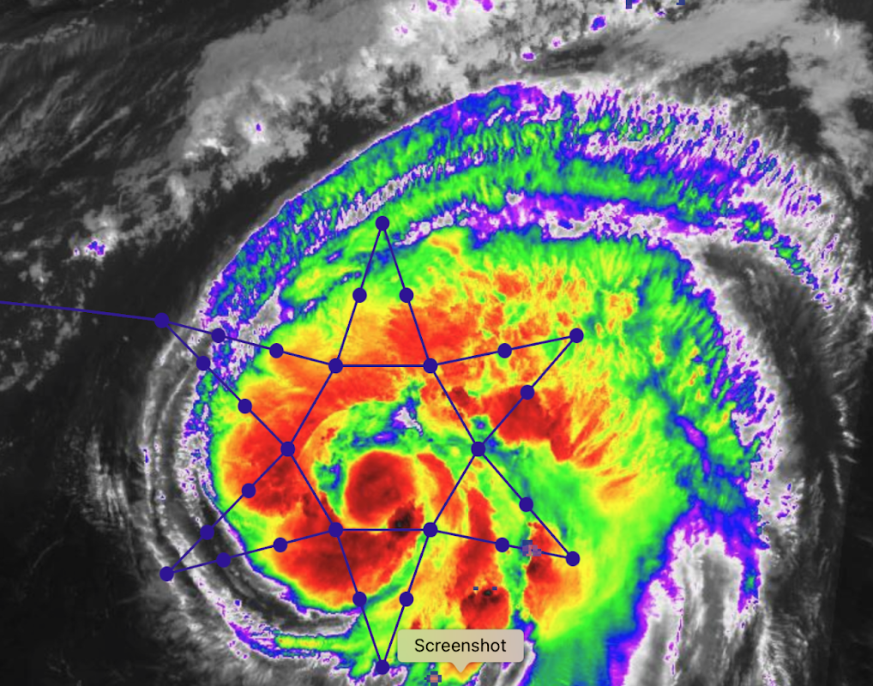
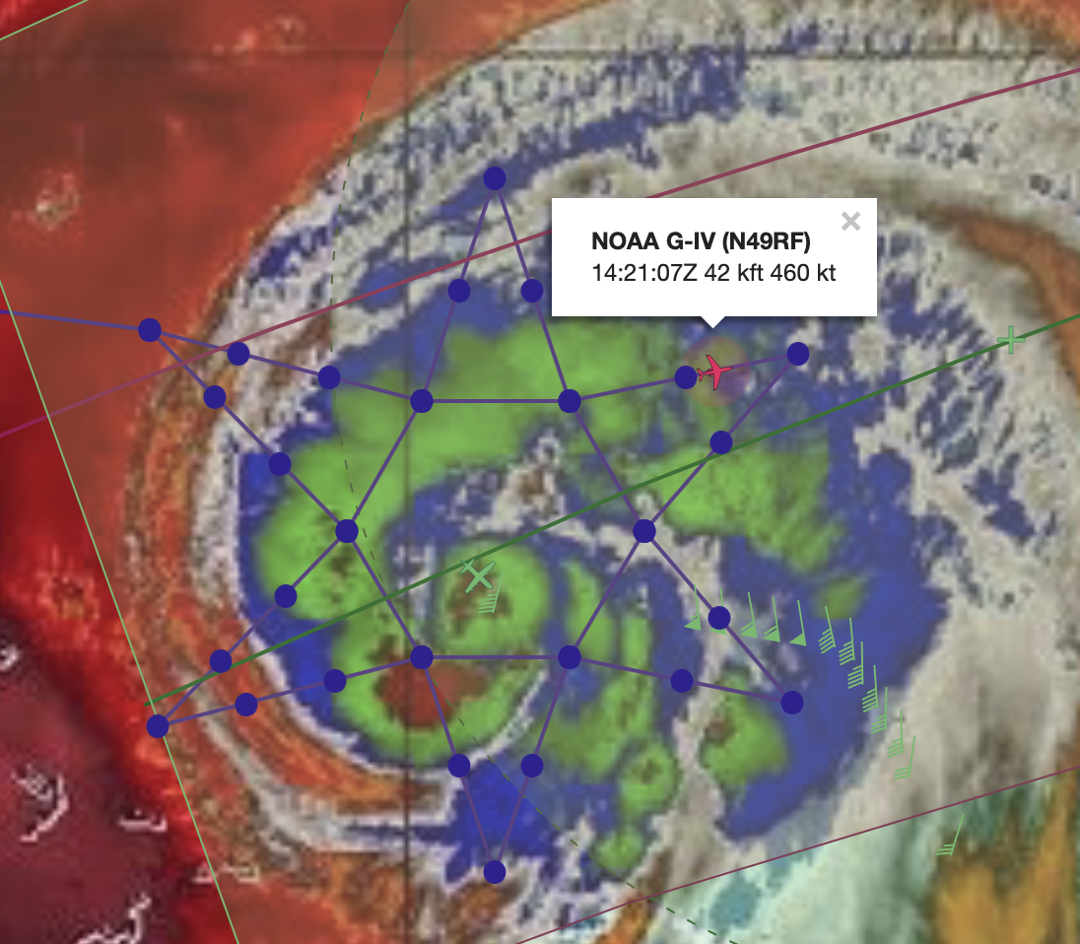
Mission 1: 20240815N1
GOES-IR w/ Planned Flight Track at 1230Z
Mission duration: 1200Z – 1923Z
37 total sondes deployed -> 31 transmitted to GTS
17 sondes met 750 km & 30 min module criteria
2 sondes met criteria for 2 overpasses (* in table)
G-IV within ~85 km of nadir for TROPICS-06 overpass at 1420Z
TROPICS Overpass | 1339Z T05 | 1418Z T06 | 1519Z T05 | 1559Z T06 | 1700Z T05 | 1739Z T06
Sonde Times w/in 30 min | 1315 1324 1331 1338 1347 1403 | 1411 1418 1426 1435 1444 | 1500 1508 1517 1525 1534* 1546* | 1534* 1546* 1550 1558 1604 1610 1618 1625 | 1637 1649 1702 1727 | 1740 1748 1755 1803

Slide 6
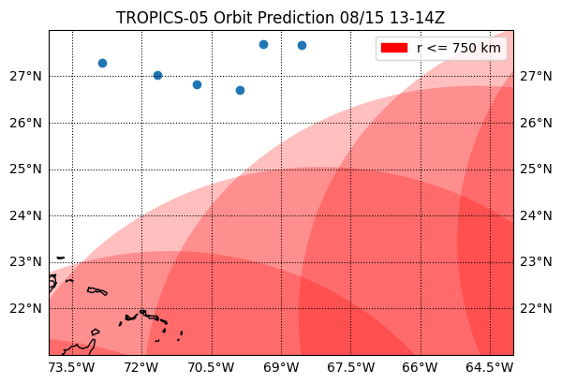
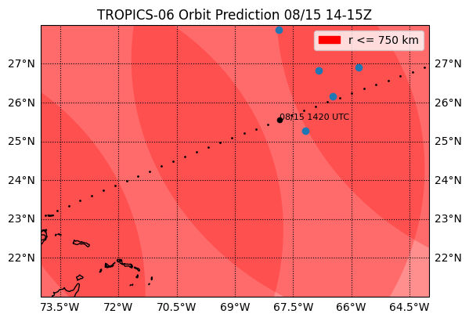
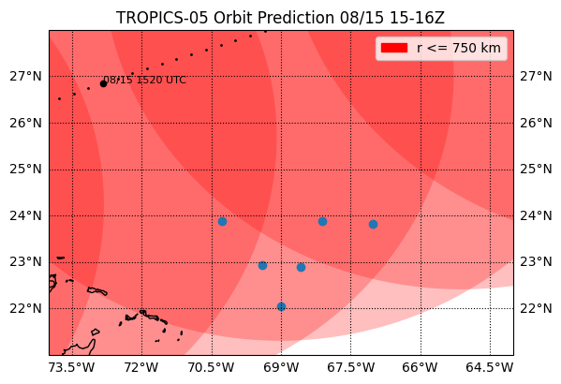
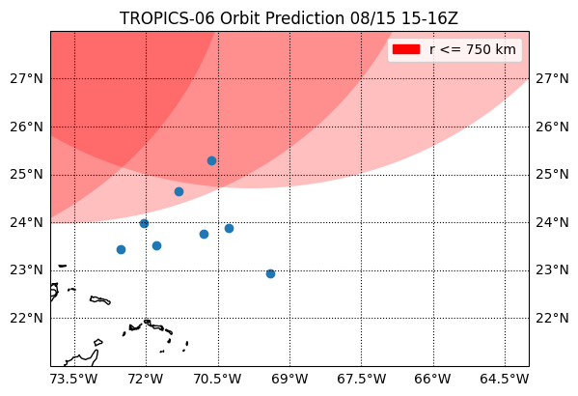
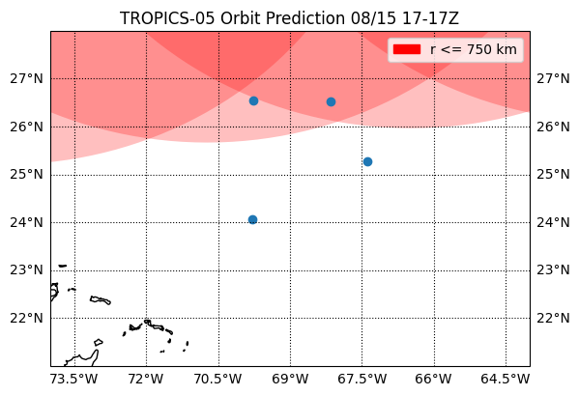
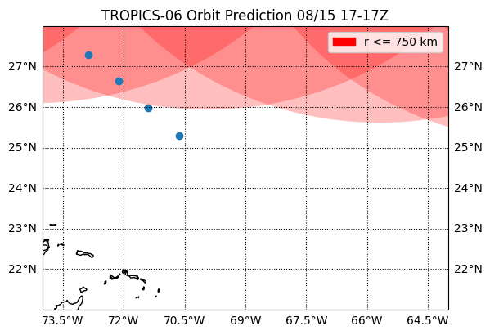
Mission 1: 20240815N1 – Drops within 30 min of Overpass
TROPICS-05 1339Z
TROPICS-06 1418Z
TROPICS-05 1519Z
TROPICS-06 1559Z
TROPICS-05 1700Z
TROPICS-06 1739Z

Slide 7
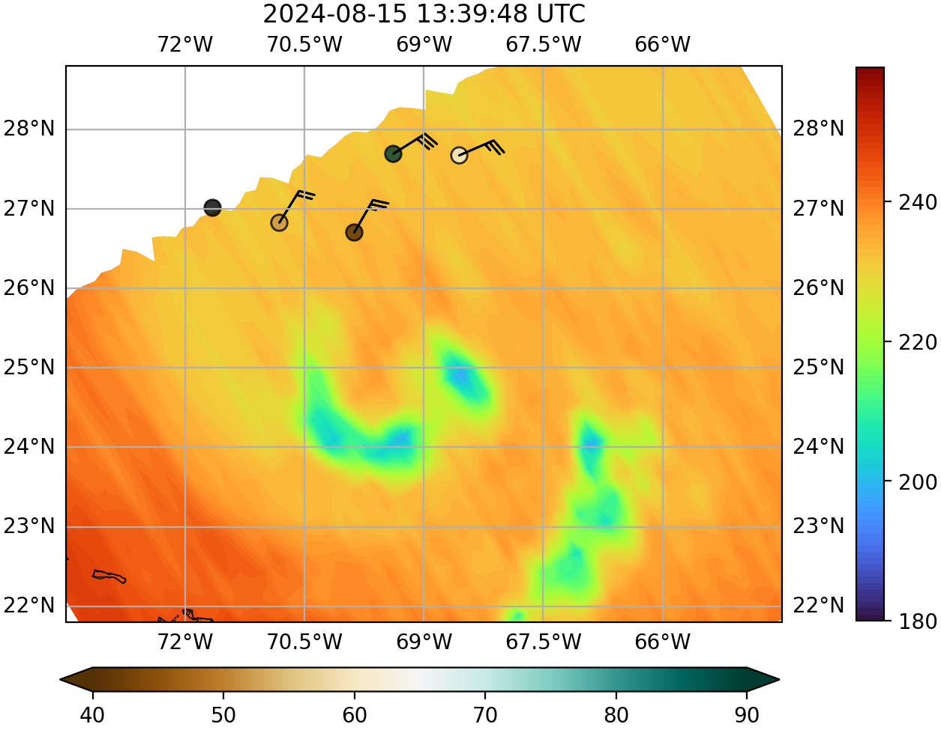
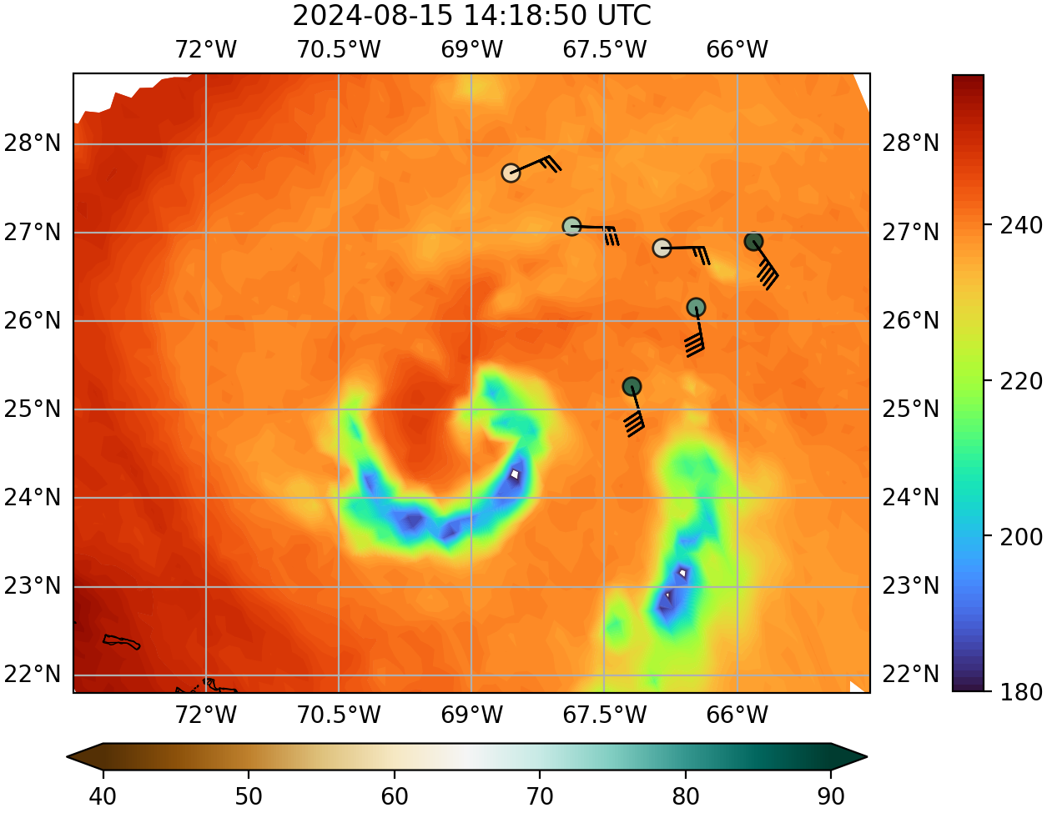
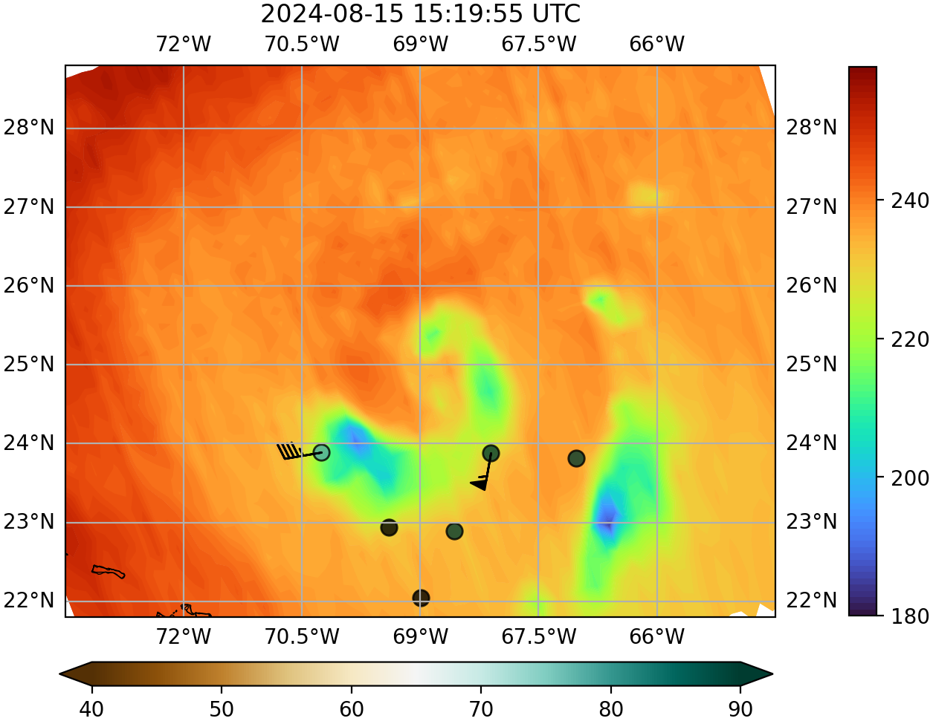
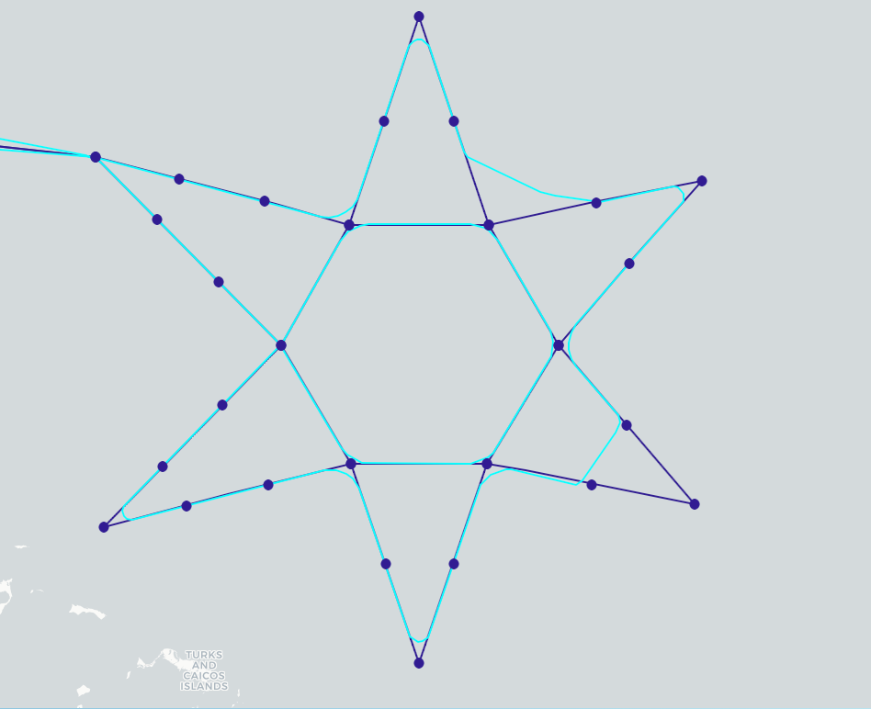
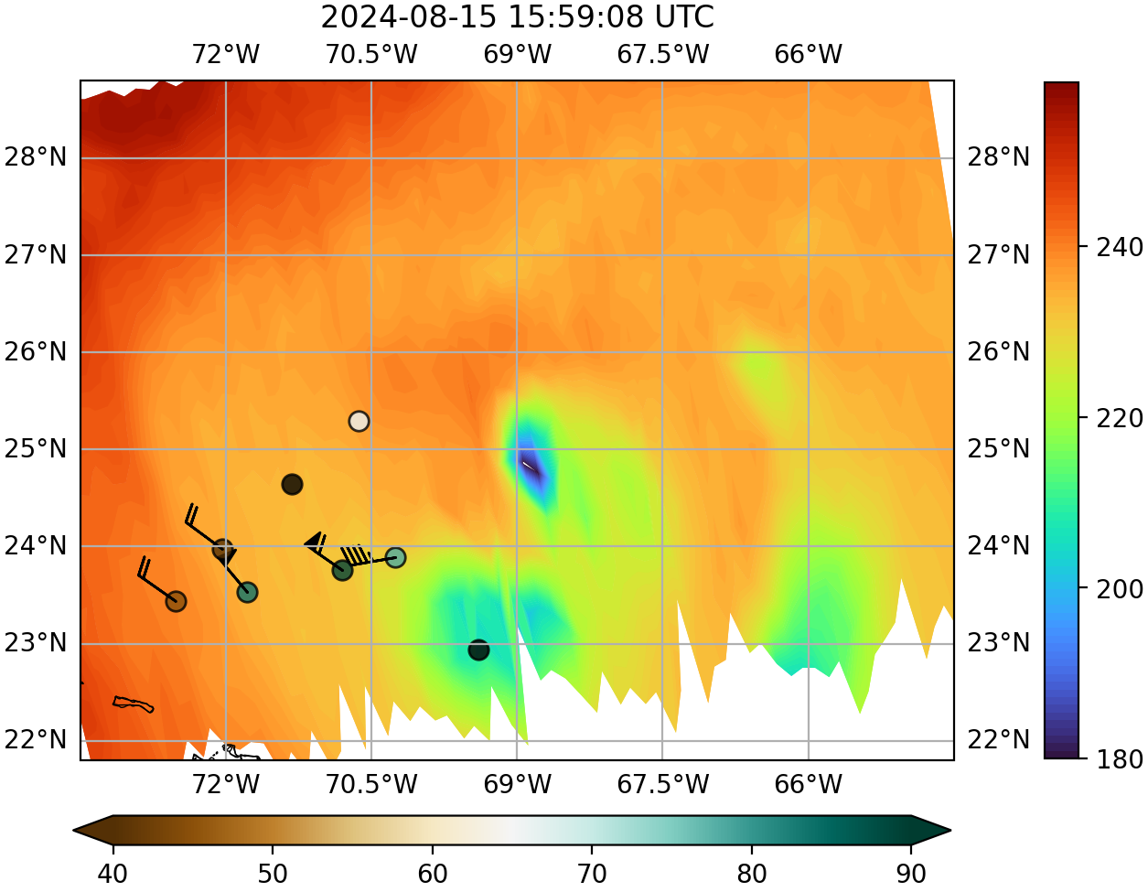
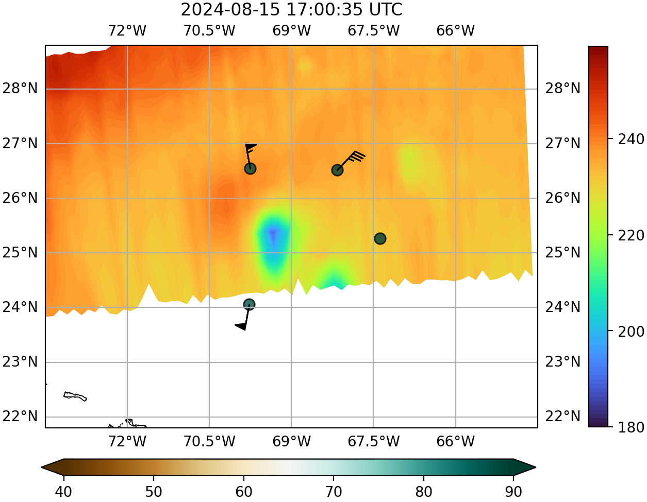
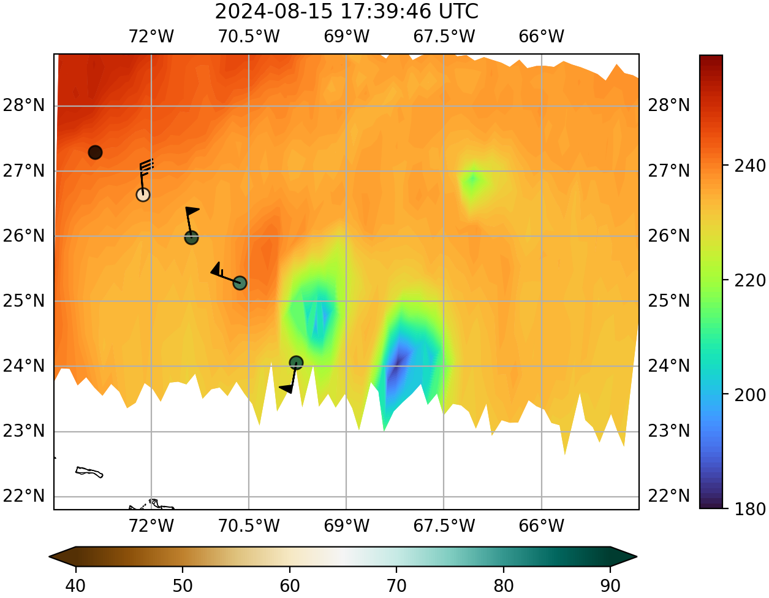
Mission 1: 20240815N1 – TROPICS Ch 9 (184 GHz) BT + Drops
Planned track Actual track
Dropsondes = 700-500 hPa RH and layer avg winds

Slide 8
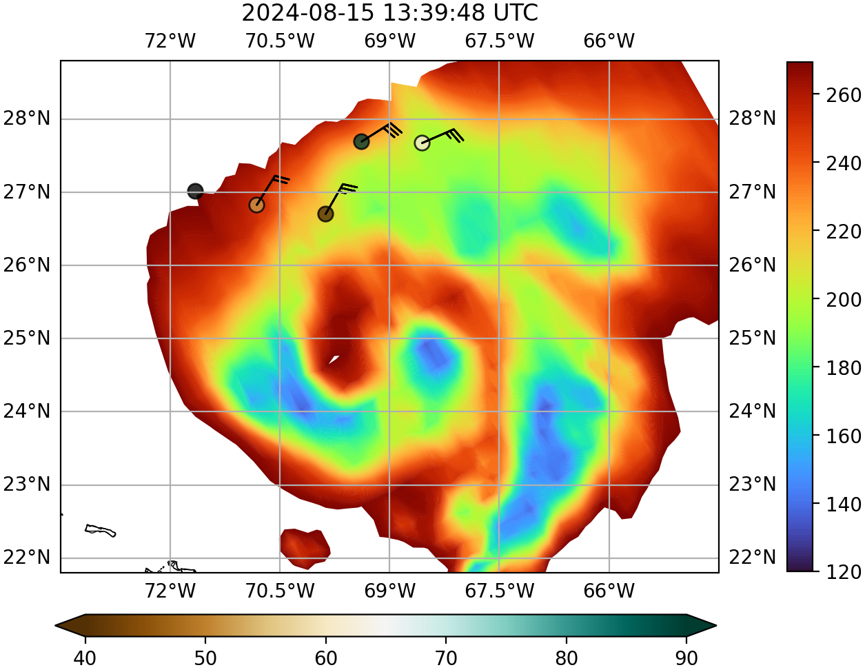
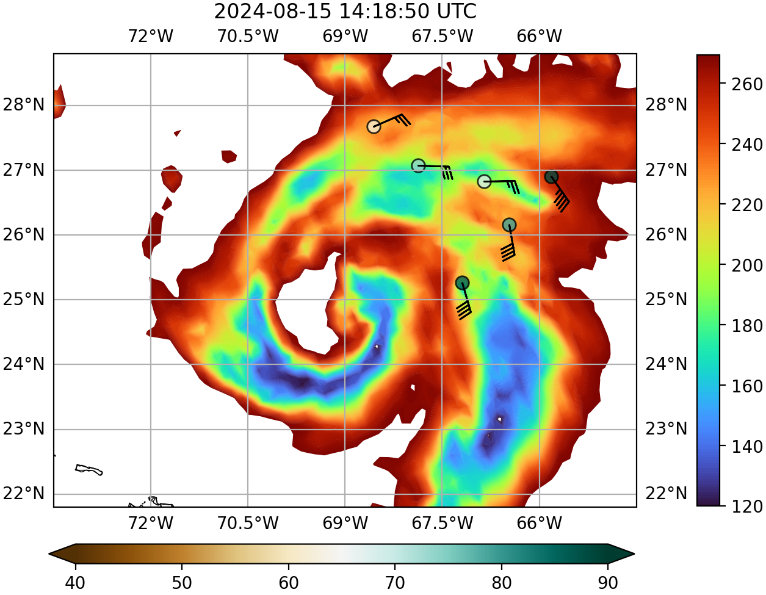
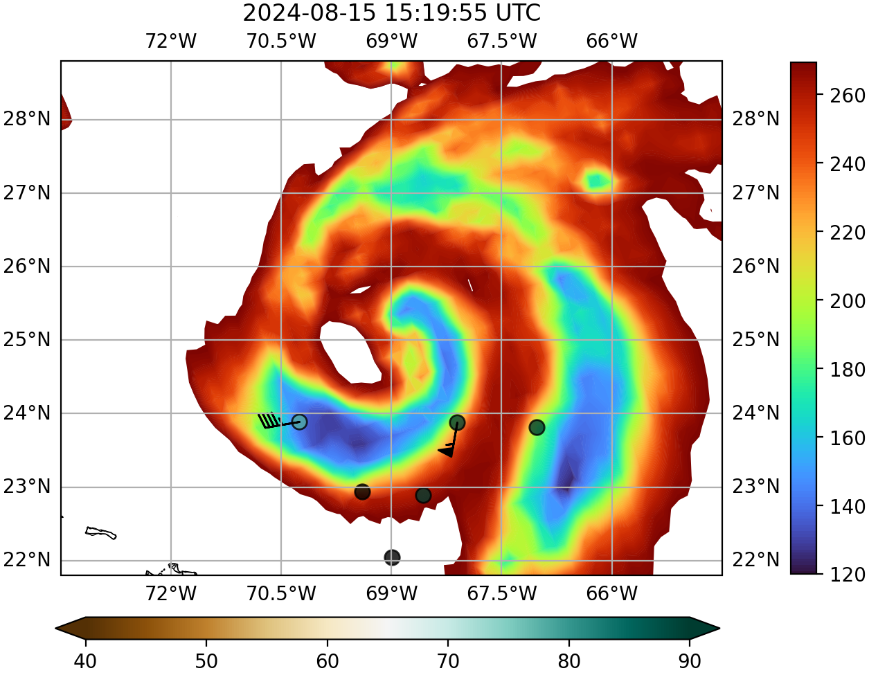
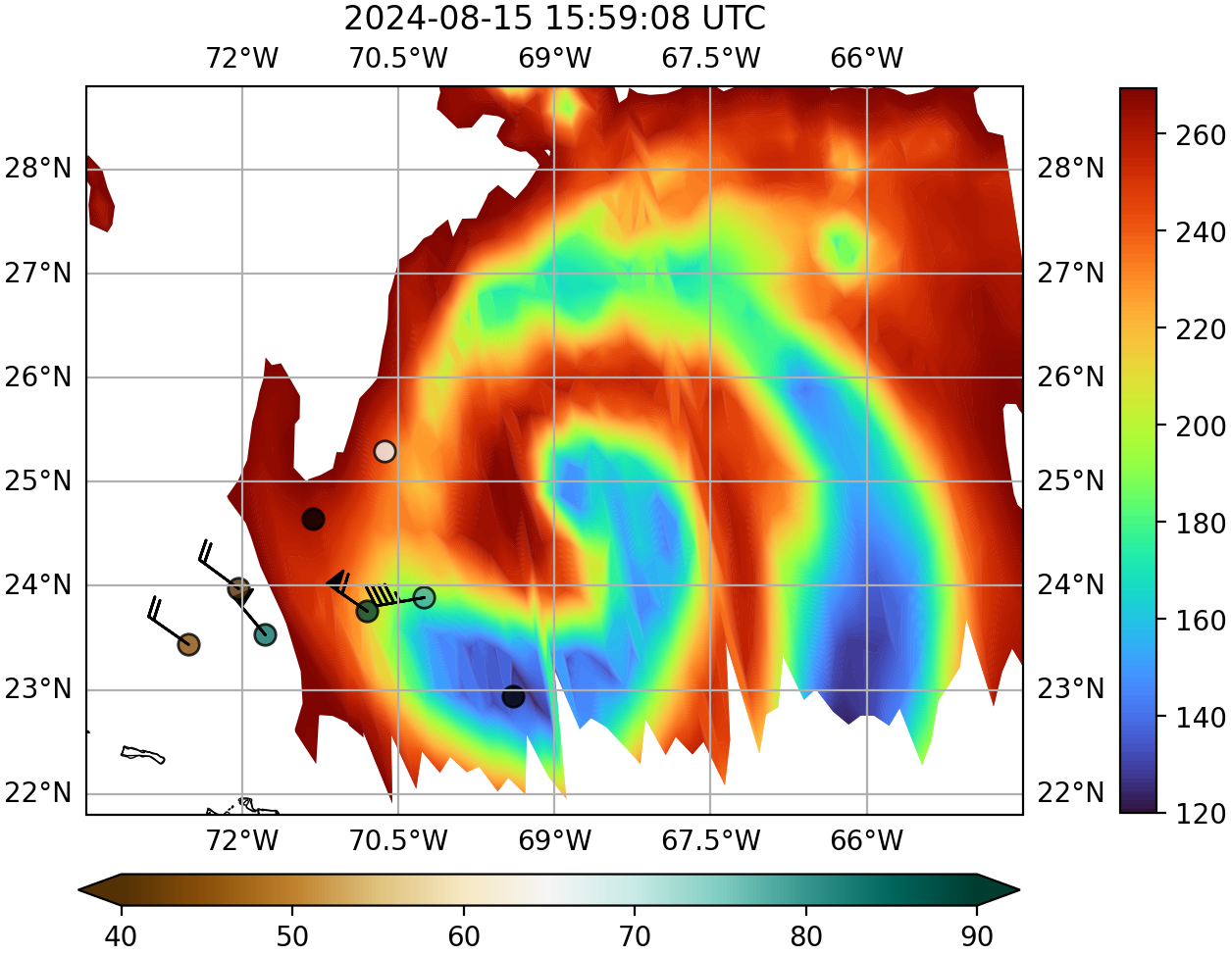
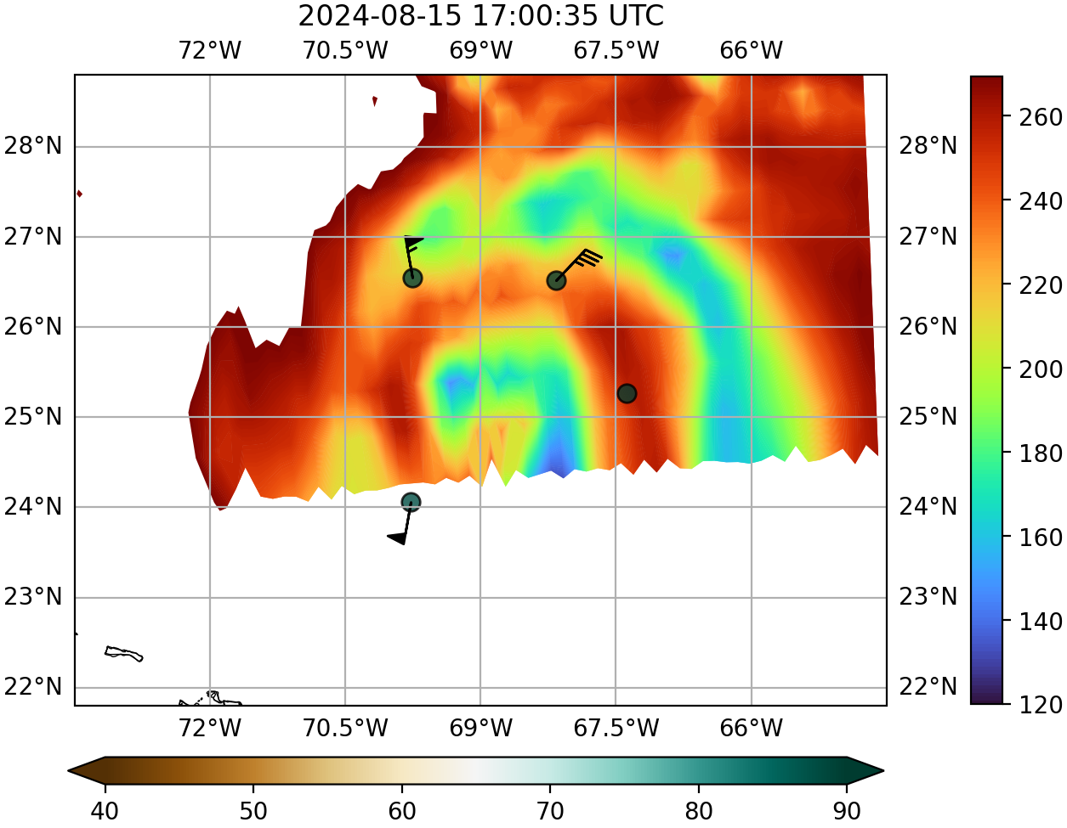
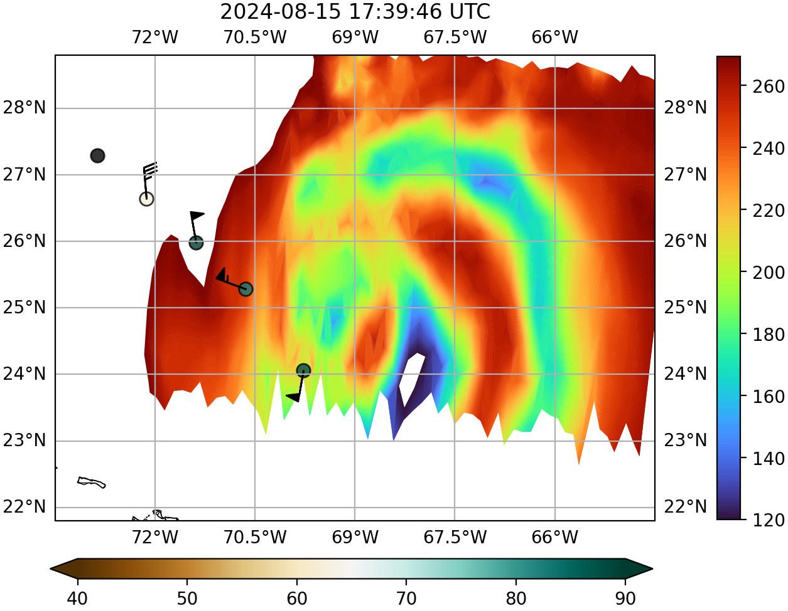
Mission 1: 20240815N1 – TROPICS Ch 12 (205 GHz) + Drops
Planned track Actual track
Dropsondes = 700-500 hPa RH and layer avg winds

Slide 9
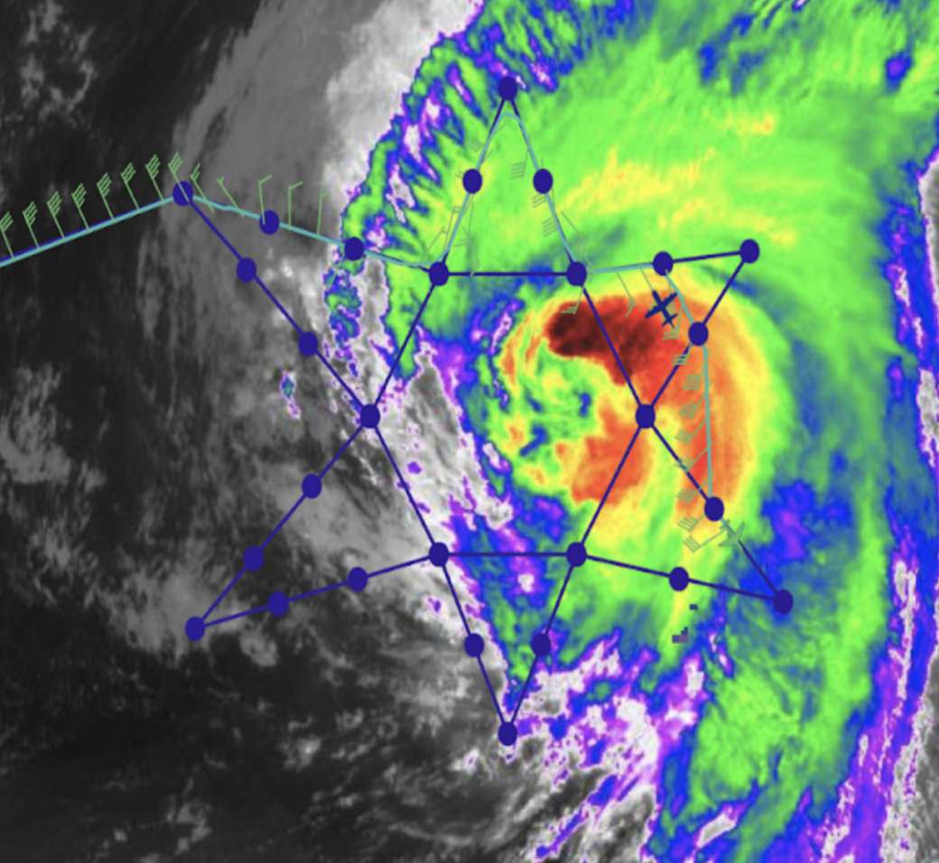
Mission 2: 20240816N1
GOES-IR w/ Planned Flight Track at 15Z
Mission duration: 1238Z – 2019Z
Shifted actual circumnavigation to east to avoid deep convection
35 total dropsondes deployed, 34 transmitted to GTS
All 34 sondes met 750 km & 30 min module criteria
8 sondes met criteria for two overpasses (* in table)
TROPICS Overpass | 1356Z T06 | 1459Z T05 | 1536Z T06 | 1639 T05 | 1716Z T06 | 1820Z T05 | 1856Z T06
Sonde Times w/in 30 min | 1406 1414 | 1428 1435 1447 1455 1502 1504 1508* 1516* 1522* | 1508* 1516* 1522* 1538 1555 1602 | 1608 1616 1623 1631 1637 1643 1651* 1658* | 1651* 1658* 1717 1728 1740 | 1758 1811 1822 1833* 1841* 1848* | 1833* 1841* 1848*

Slide 10
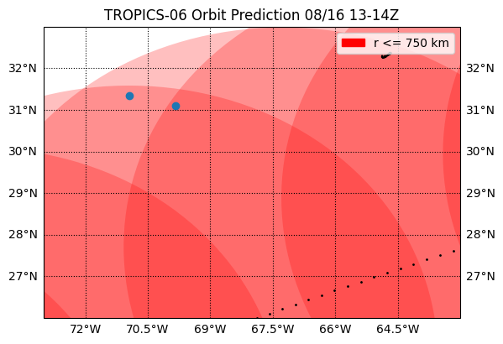
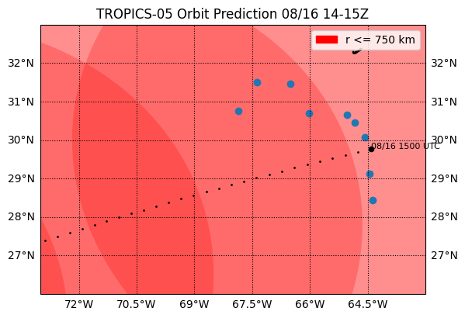
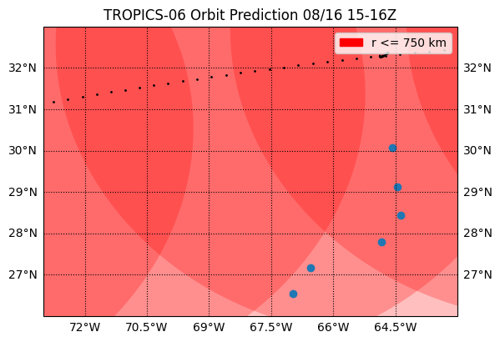
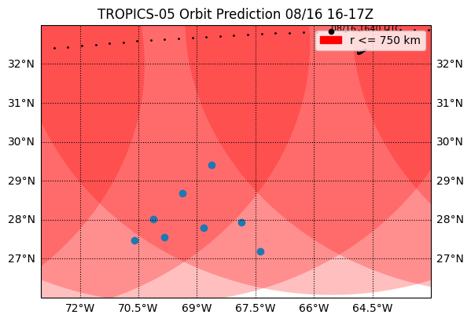
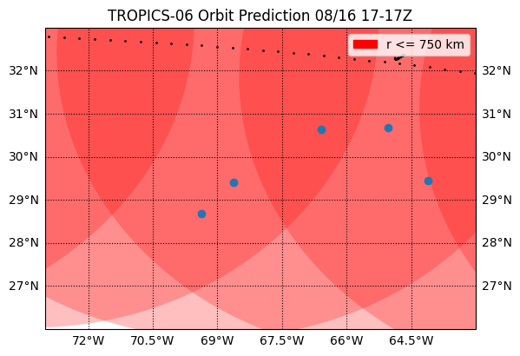
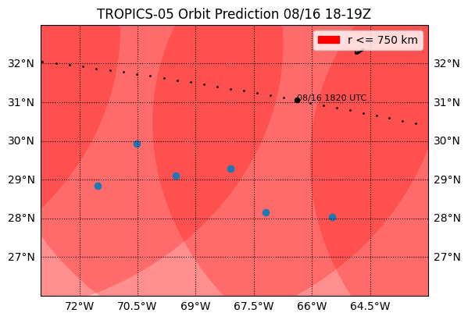
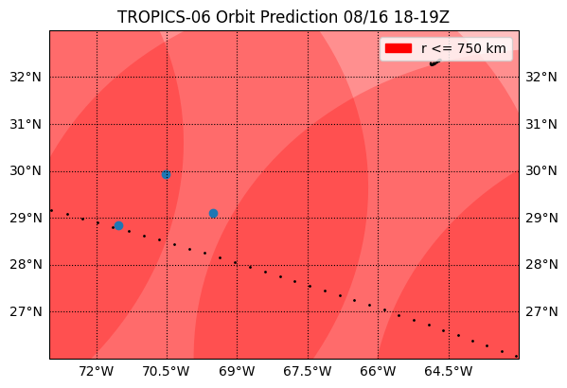
Mission 2: 20240816N1 – Drops within 30 min of Overpass
TROPICS-06 1356Z
TROPICS-05 1459Z
TROPICS-06 1536Z
TROPICS-05 1639Z
TROPICS-06 1716Z
TROPICS-05 1819Z
TROPICS-06 1856Z

Slide 11
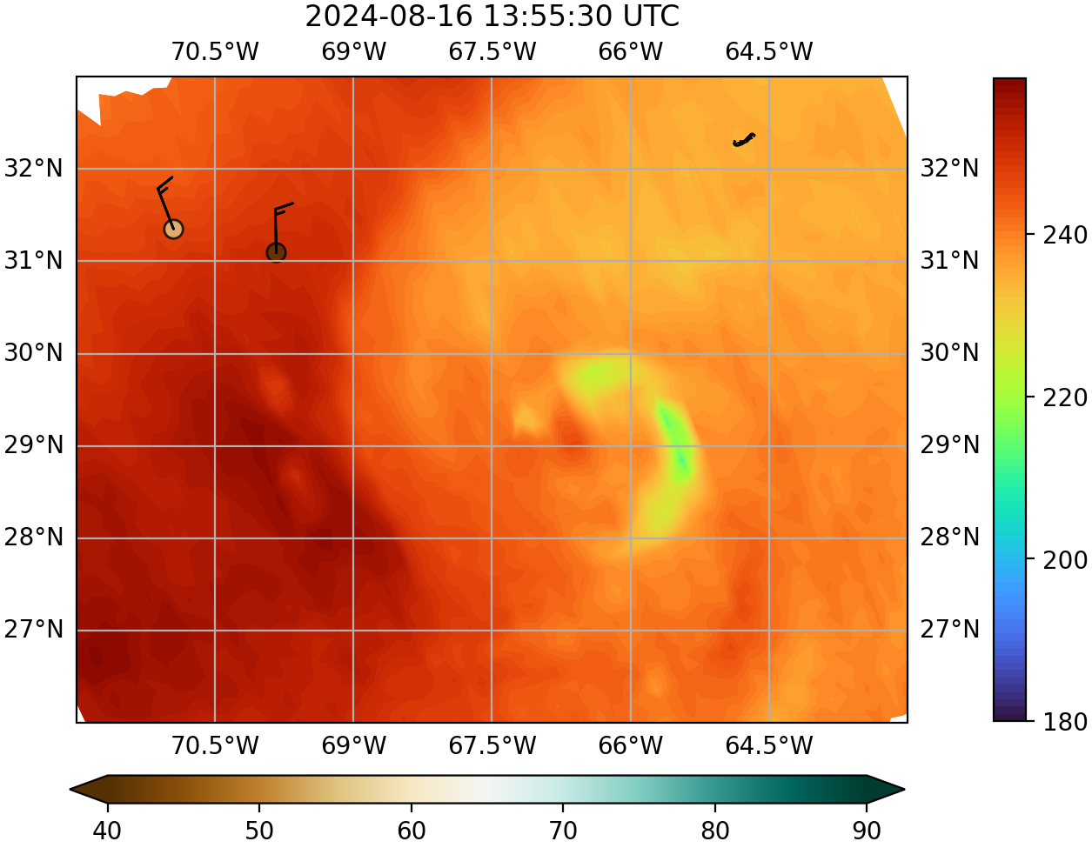
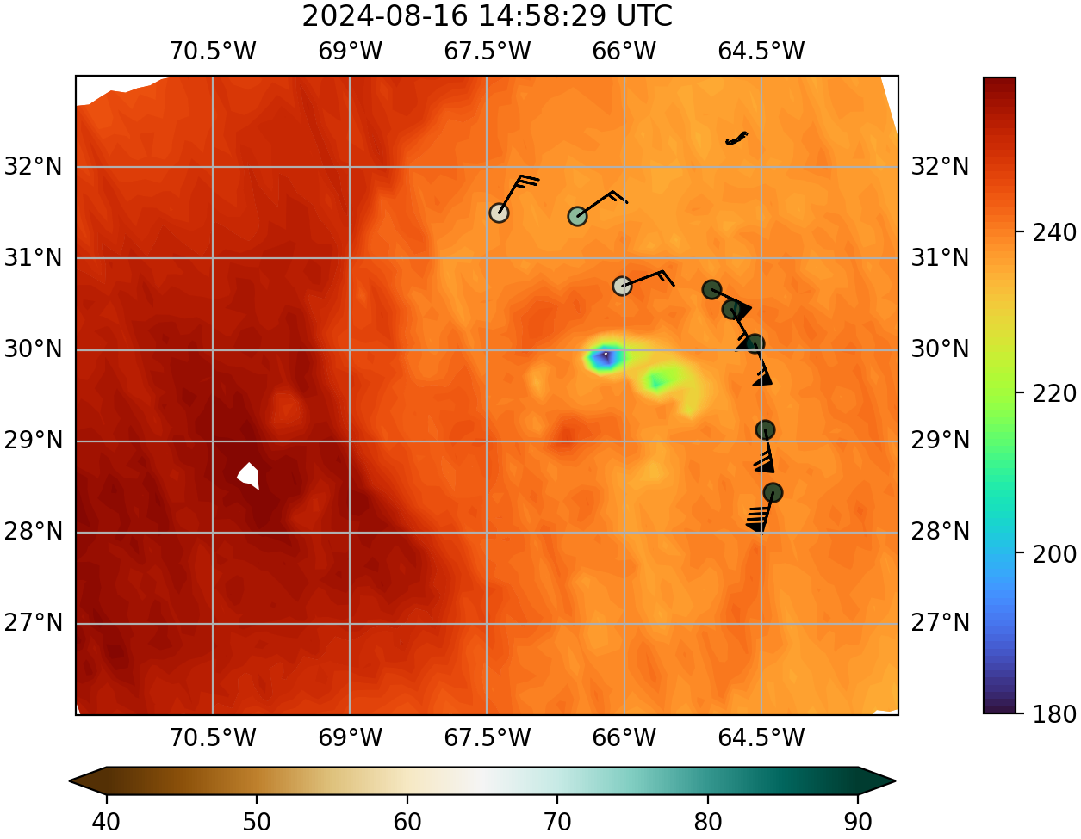
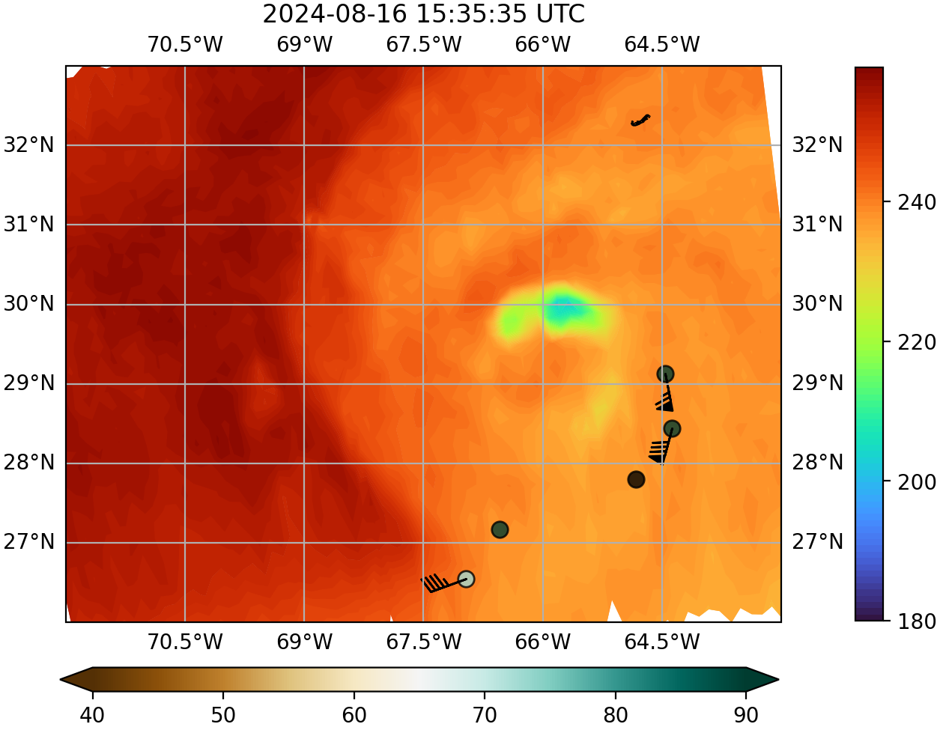
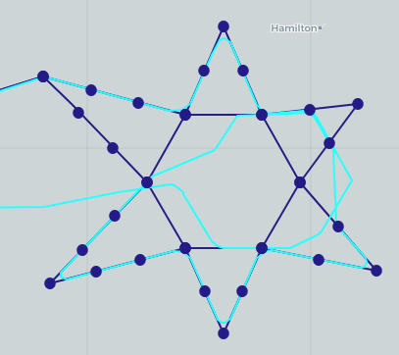
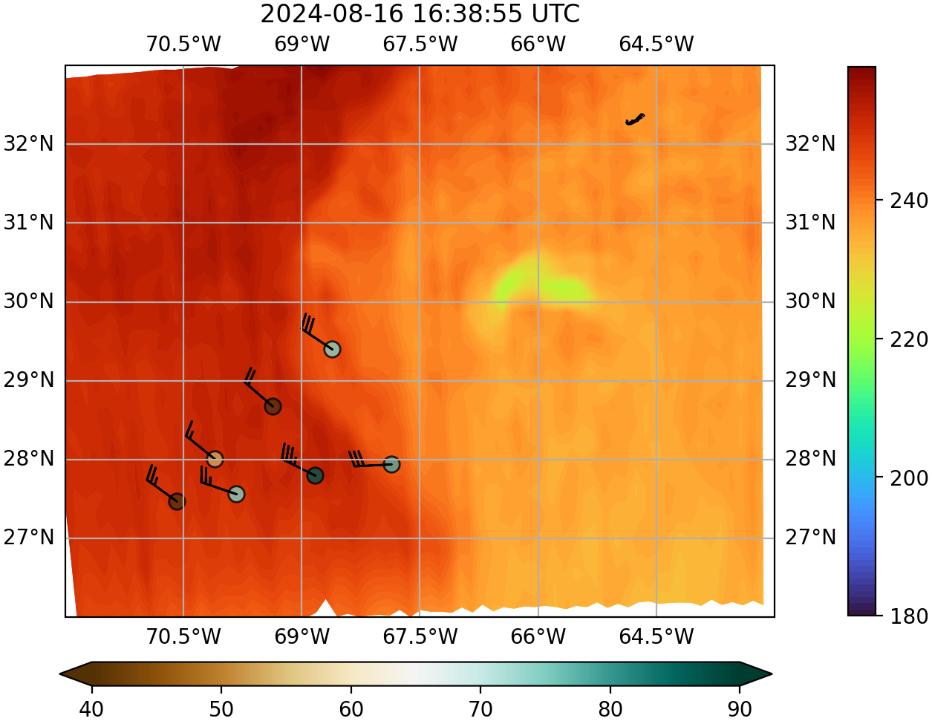
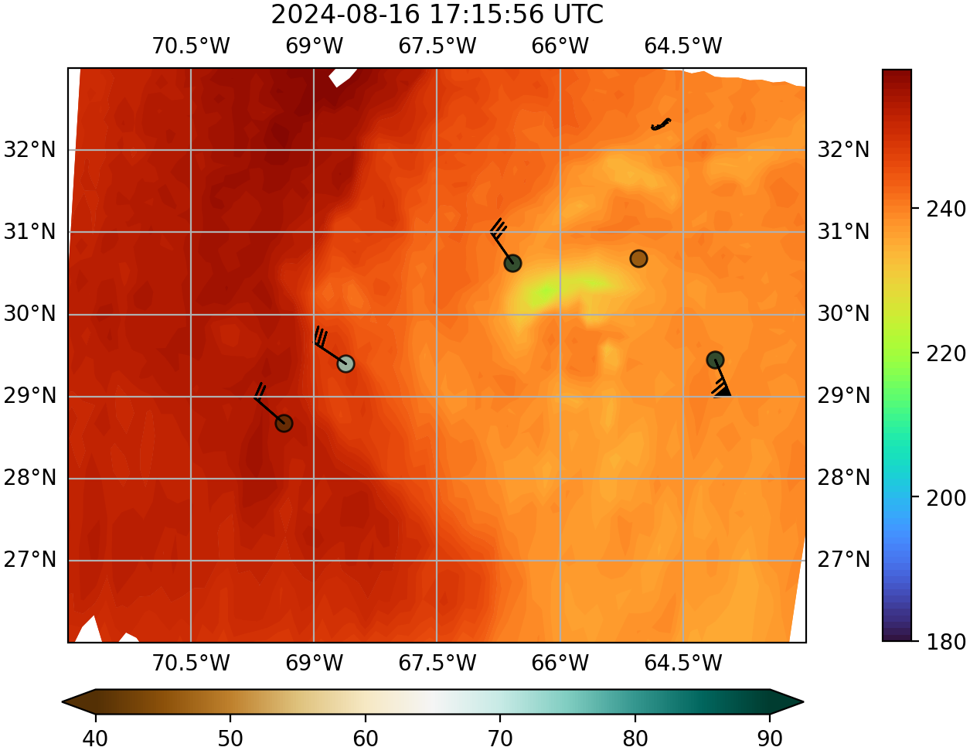
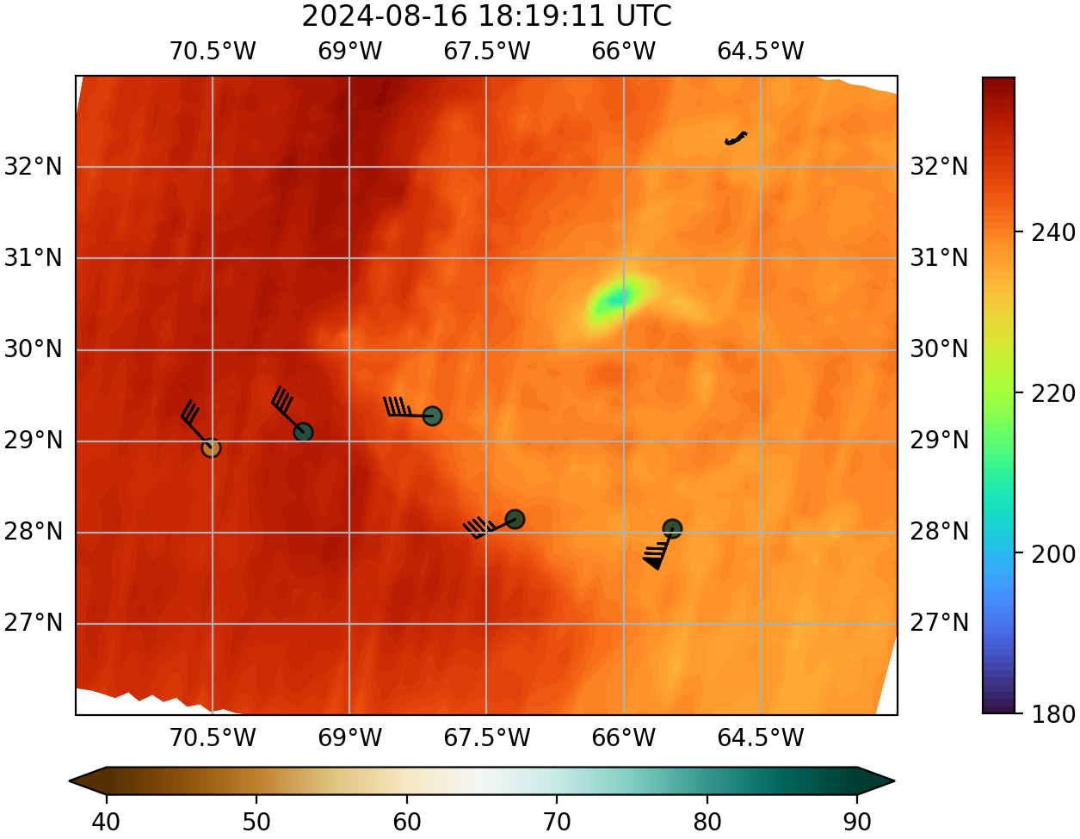
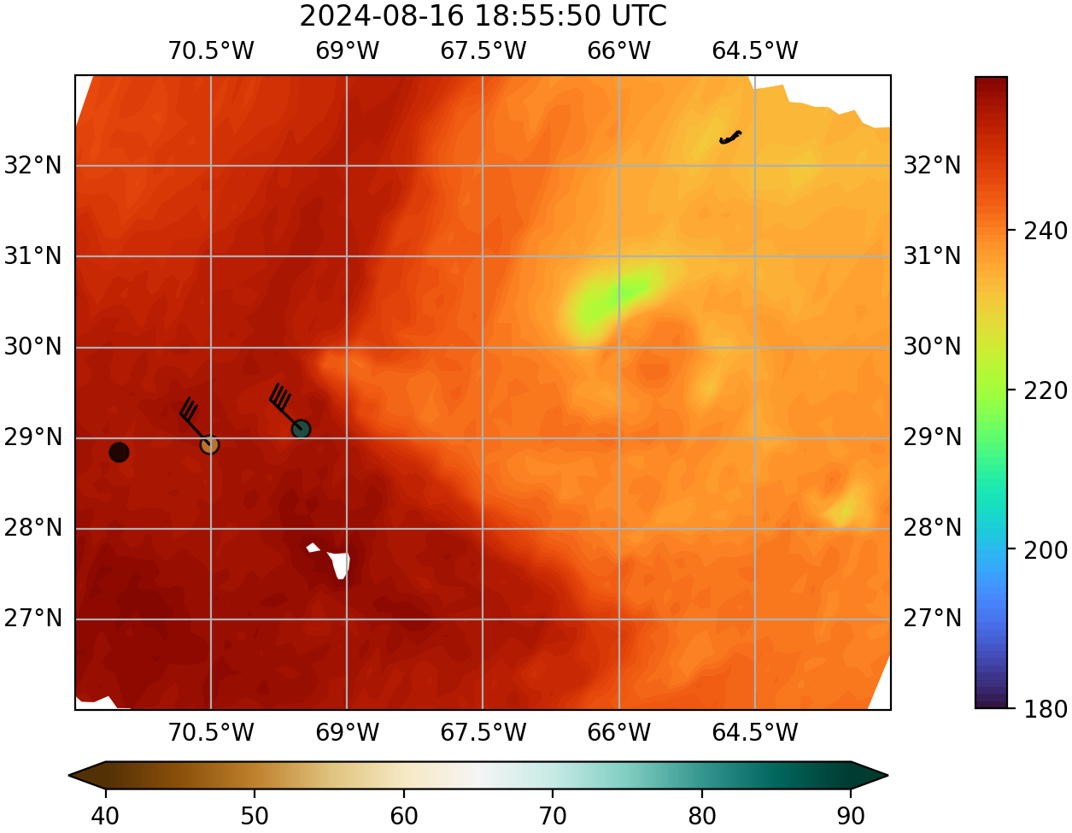
Mission 2: 20240816N1 - TROPICS Ch 9 (184 GHz) BT + Drops
Planned track Actual track
Dropsondes = 700-500 hPa RH and layer avg winds

Slide 12
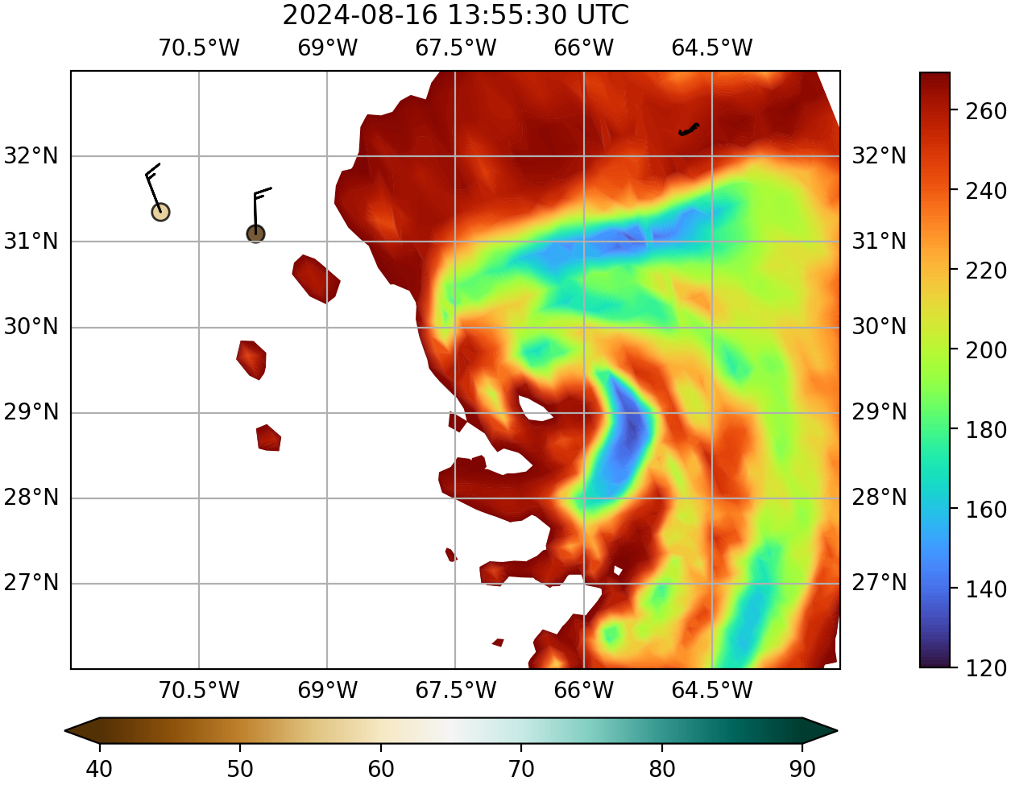
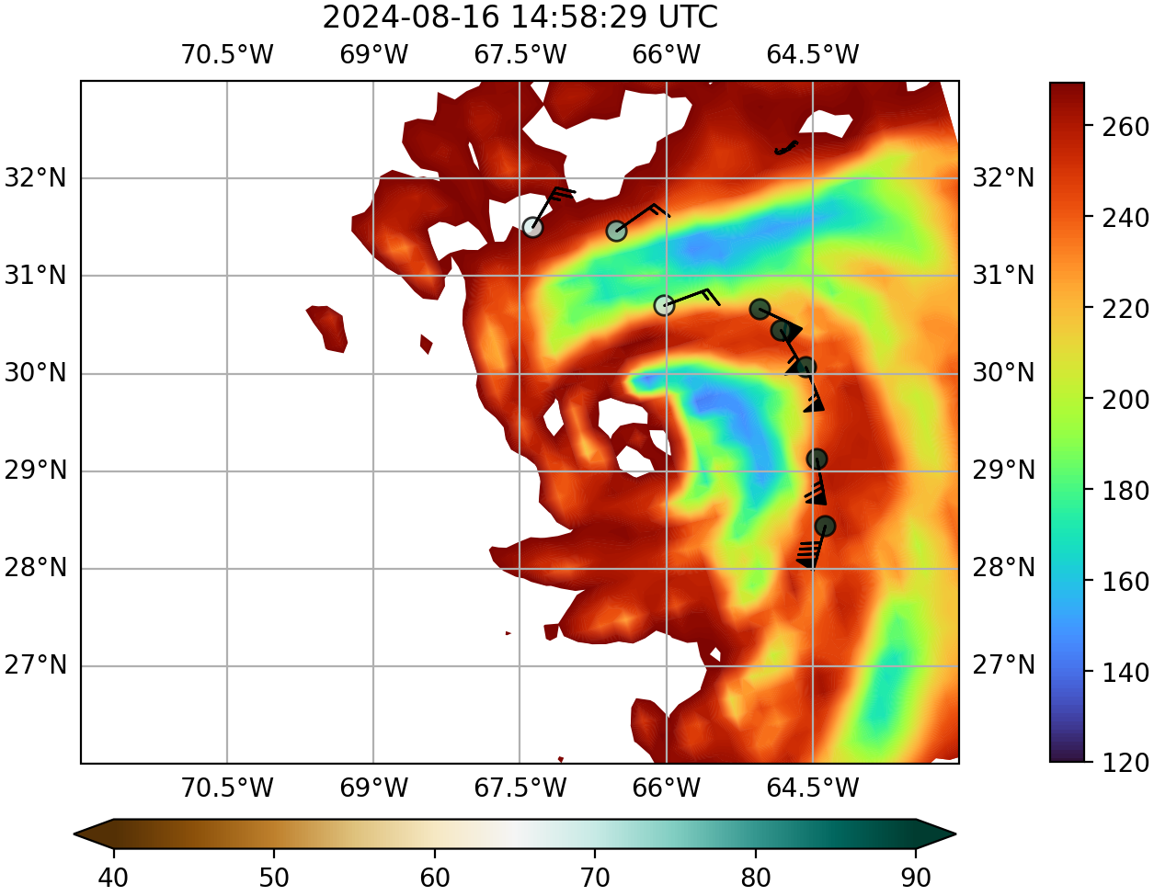
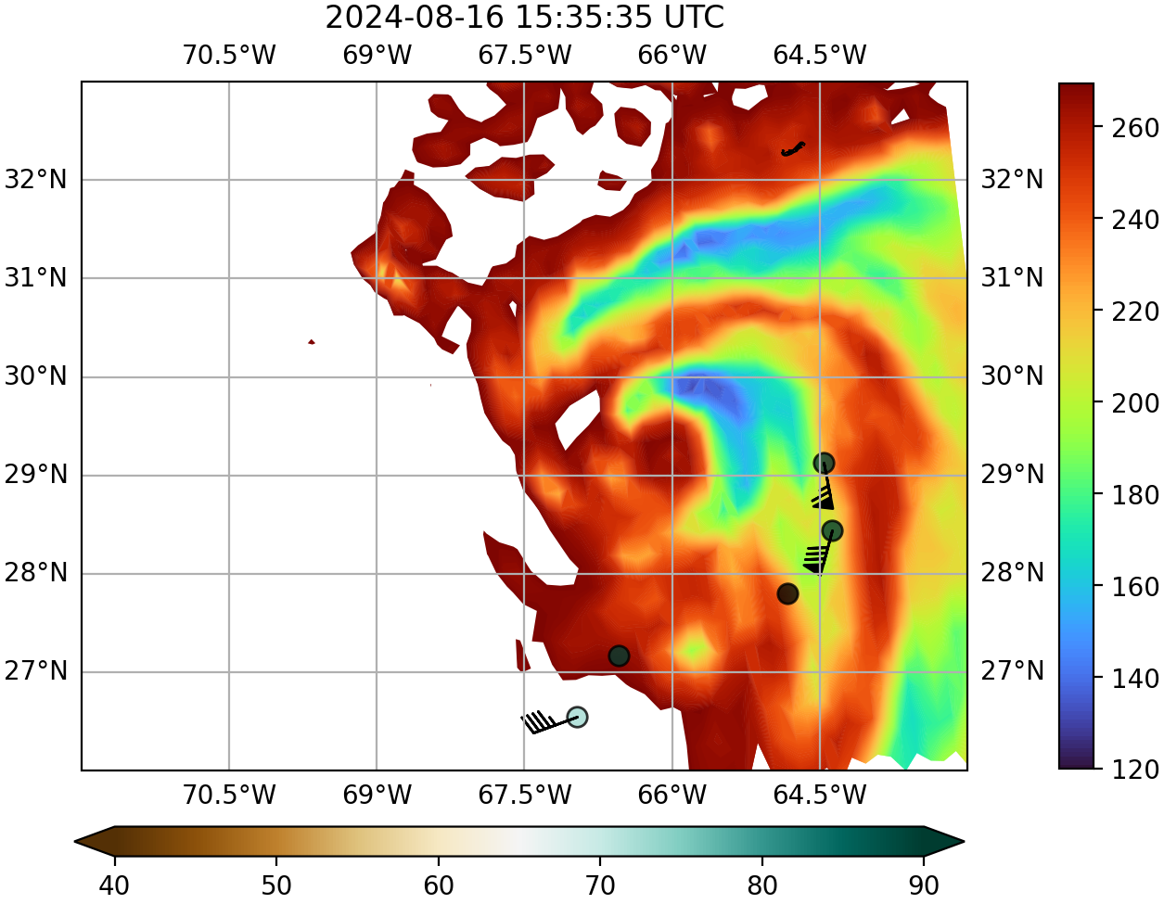
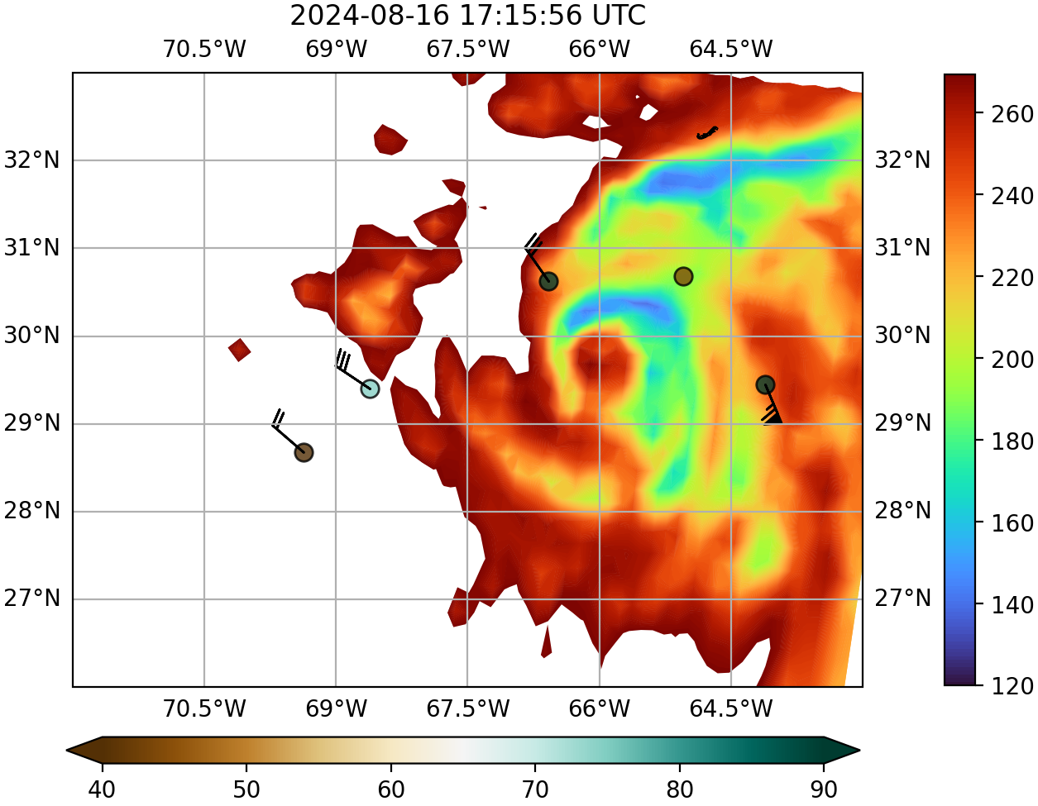
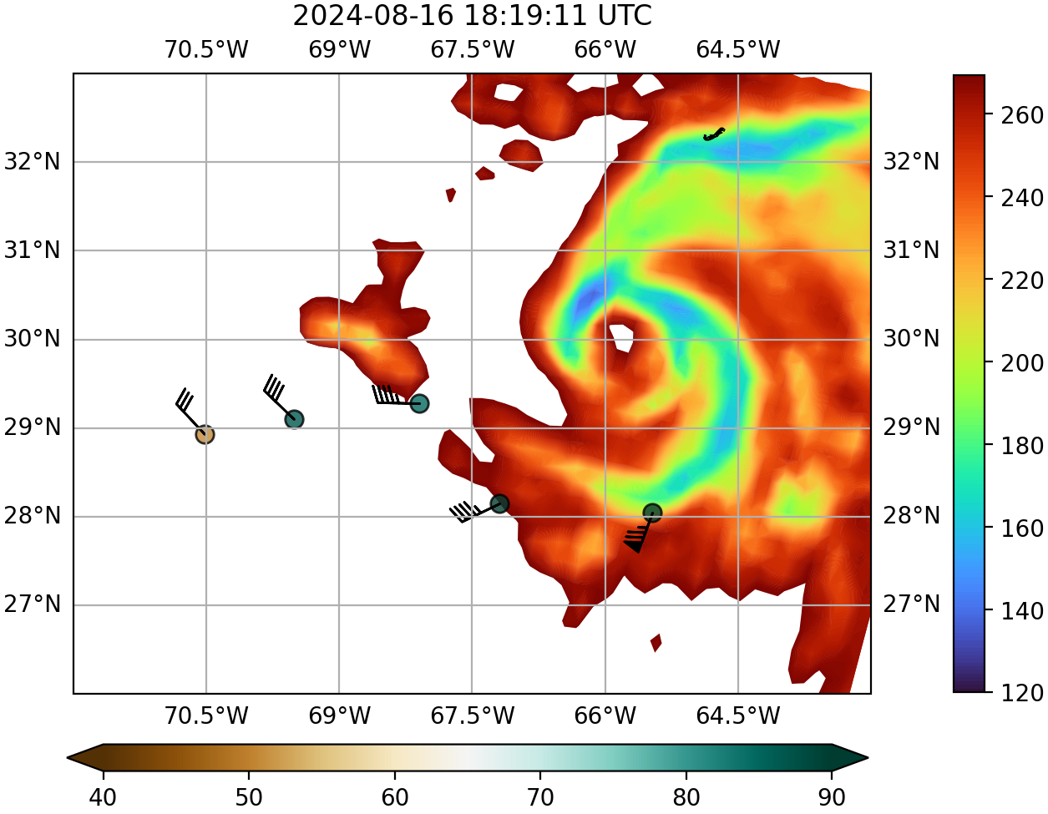
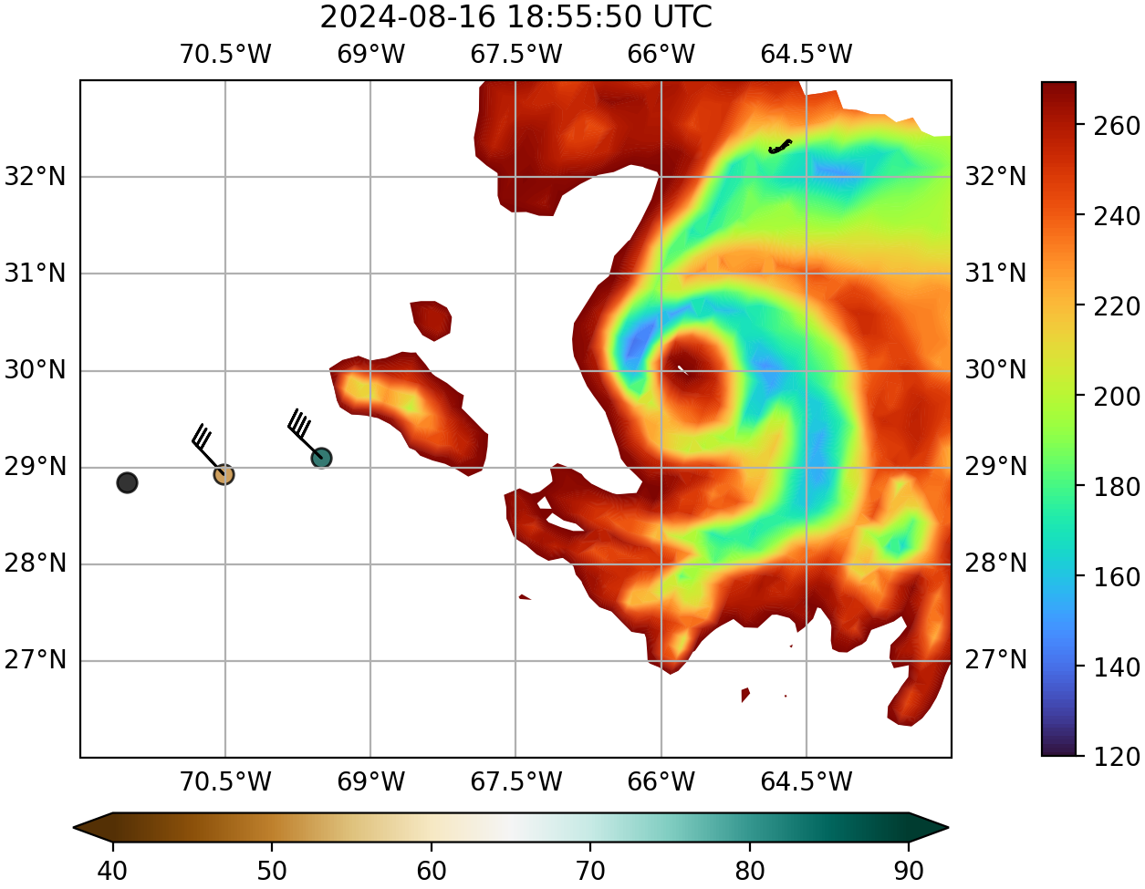
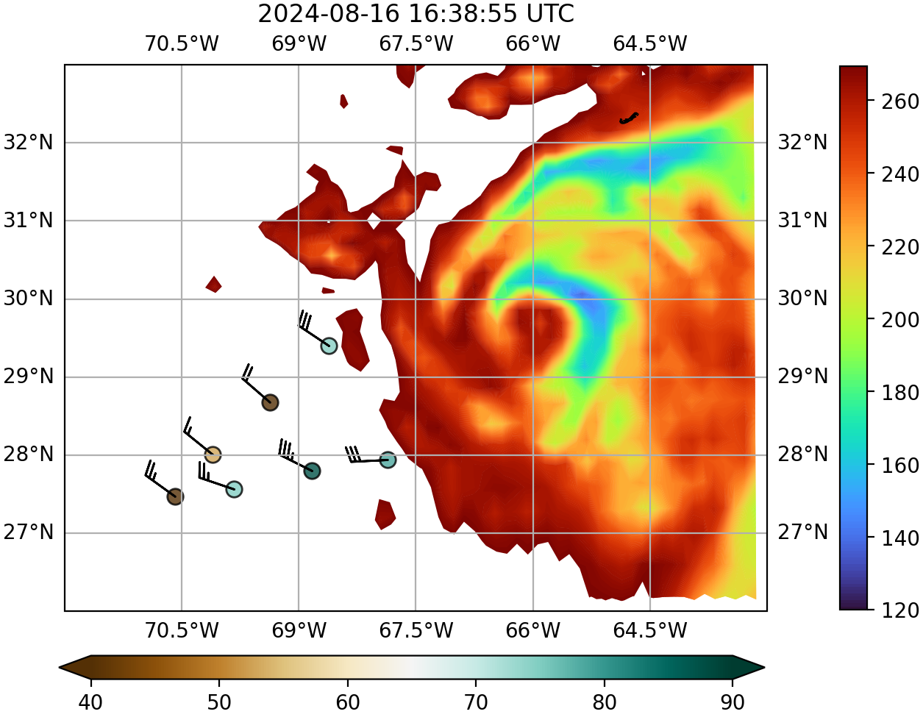
Mission 2: 20240816N1 - TROPICS Ch 12 (205 GHz) + Drops
Planned track Actual track
Dropsondes = 700-500 hPa RH and layer avg winds

Slide 13
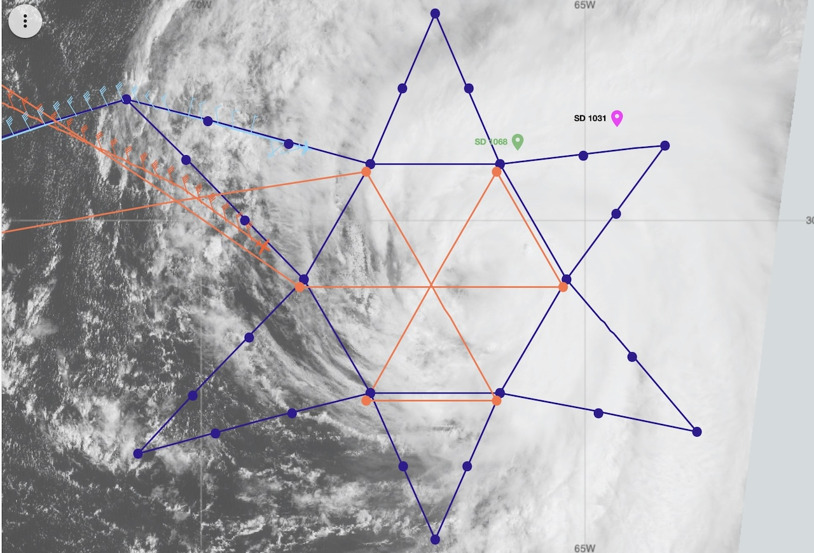
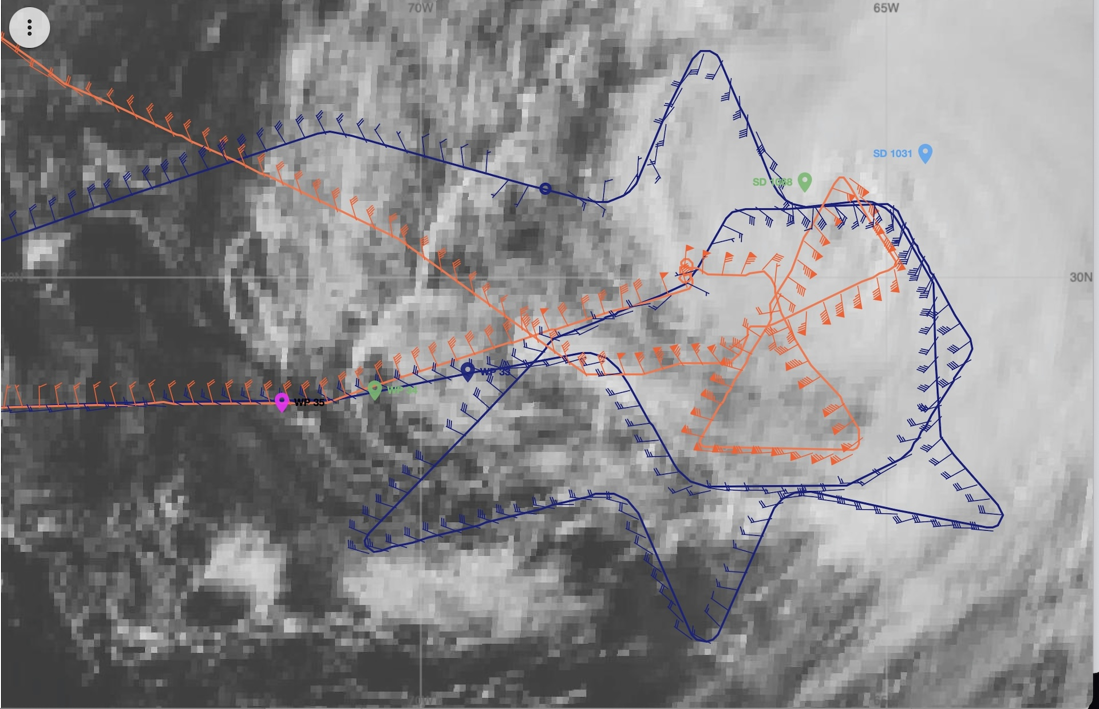
Mission 2: 20240816N1 – Complementary NOAA P-3 Mission
Planned Track
Actual Track
NOAA G-IV (NOAA49) NOAA P-3 (NOAA43)
P-3 Mission ID: 20240816I1
Data collected:
  Flight level (10 kft)
  Tail Doppler radar
  Dropsondes
  SFMR (surface wind) *possible calibration issues
WSRA (sea surface/waves and rain rate)
W-Band radar (sea spray)
2 Blackswift S0 small UAS

Slide 14
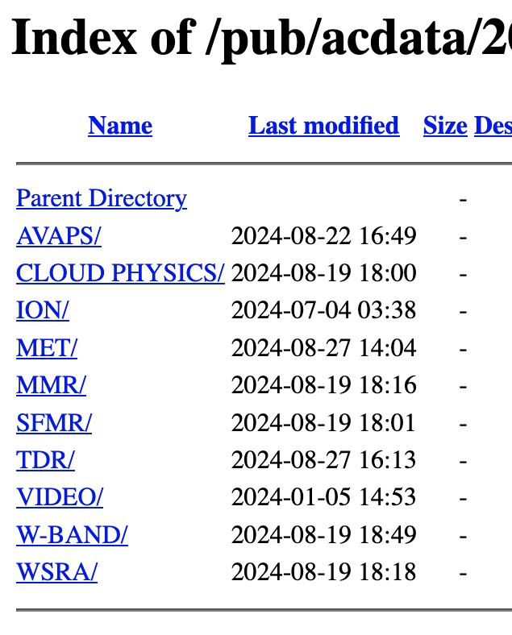




How to Access NOAA Flight Data – Dropsondes
NOAA AOC Aircraft Data Page: https://seb.omao.noaa.gov/pub/acdata/
Year → AVAPS → Mission ID (YYYYMMDDA#) → ASPEN_DATA or RAW_DATA
DYYYYMMDD_HHMMSS*
  ASPEN_DATA (research quality, QCed with ASPEN software)
    QCed, full vertical resolution dropsonde data: NetCDF (.nc), BUFR (.bfr), ASCII (.frd)
    TEMPDROP messages (ASCII) that are transmitted to the GTS in near real-time (WMO.txt)
    Skew-Ts (skewt.png)
  RAW_DATA (not QCed, used as input to ASPEN)
    Last digit in filename is AVAPS channel used on the aircraft (Ch 1-8)
    “_P” raw dropsonde files are cleaned up and easier to work with

Slide 15
G-IV Data Availability Timeline
Dropsondes
  Raw data on AOC server
  Missing most of ASPEN data for 20240815N1 and 20240816N1 flights
  Working with AOC to get ASPEN data uploaded ASAP
Tail Doppler radar
  Research-quality data available ~March 2025
Email will be sent out via listserv when all datasets become available, along with reminder about how to access data
Questions: Brittany.Dahl@noaa.gov

