Slide 1


Estimating Current Tropical Cyclone Intensity with 183-GHz TROPICS observations
Sarah M. Griffin sarah.griffin@ssec.wisc.edu
Tony Wimmers, Derrick Herndon, Chris Velden, Jeff Hawkins
University of Wisconsin-Madison
Cooperative Institute for Meteorological Satellite Studies

Slide 2
D-MINT183
Background

Slide 3
D-MINT183
Background
D-MINT183 is our third attempt at estimating current TC intensity with a convolutional neural network (CNN).
First two are:
Deep learning - Multispectral INtensity of TCs (D-MINT) which uses 37-GHz, 89-GHz, IR imagery, and scalar predictors
DeeP learning - IR INtensity of TCs (D-PRINT) which is D-MINT without the 37-GHz and 89-GHz imagery
D-MINT is more skillful than D-PRINT.

Slide 4
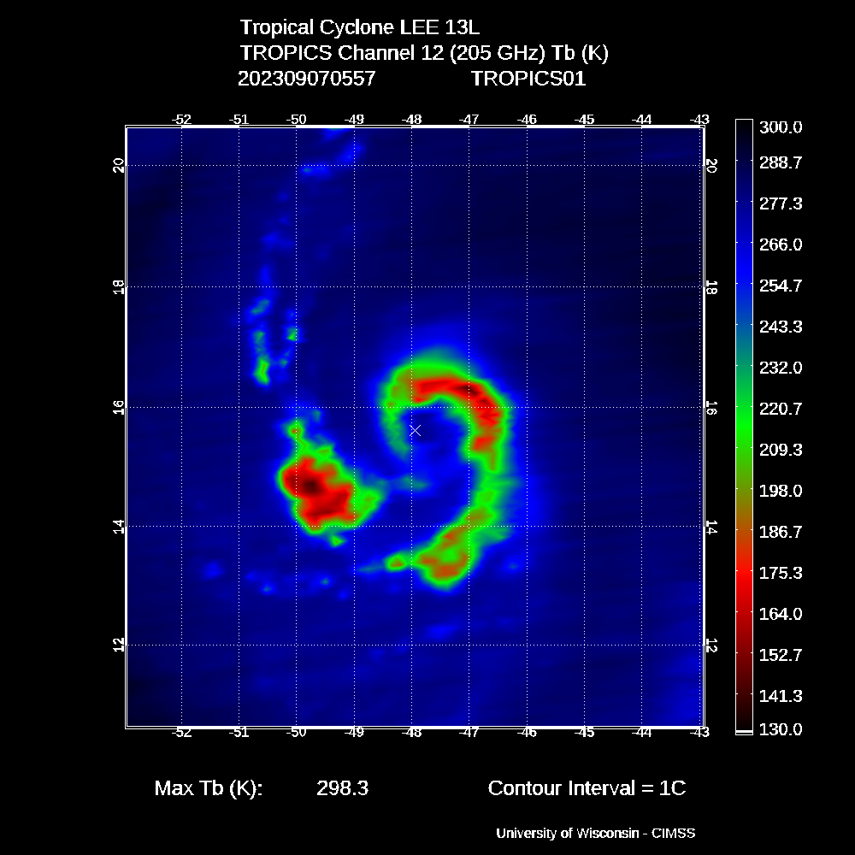
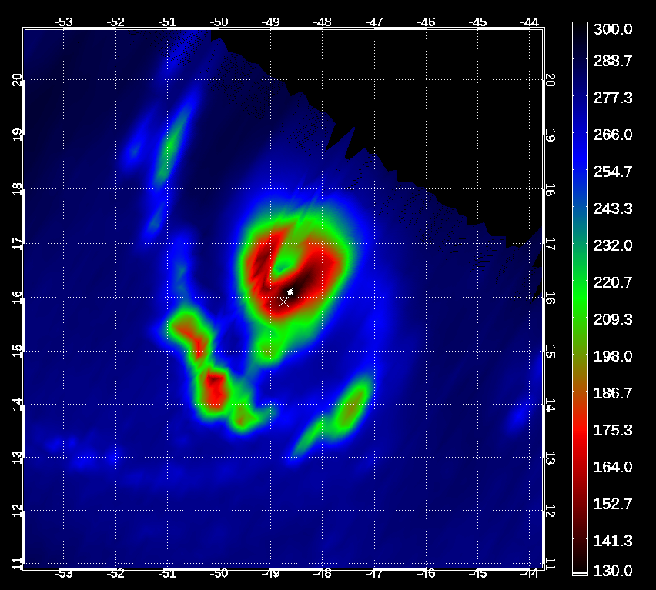
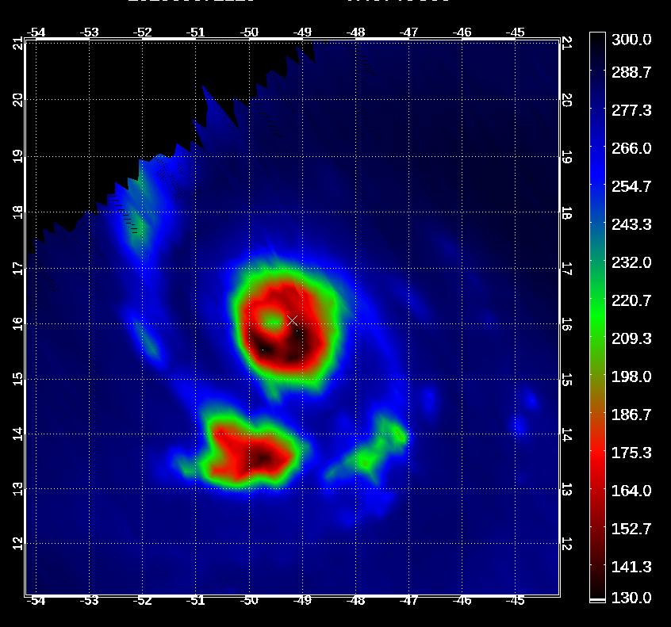
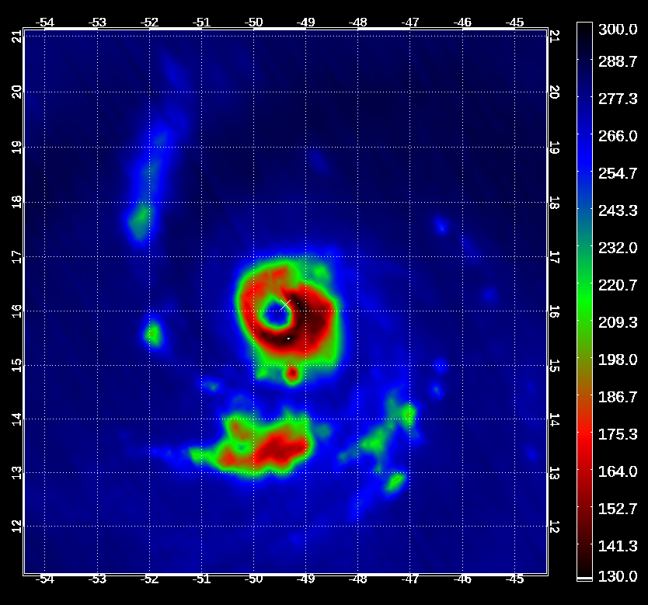
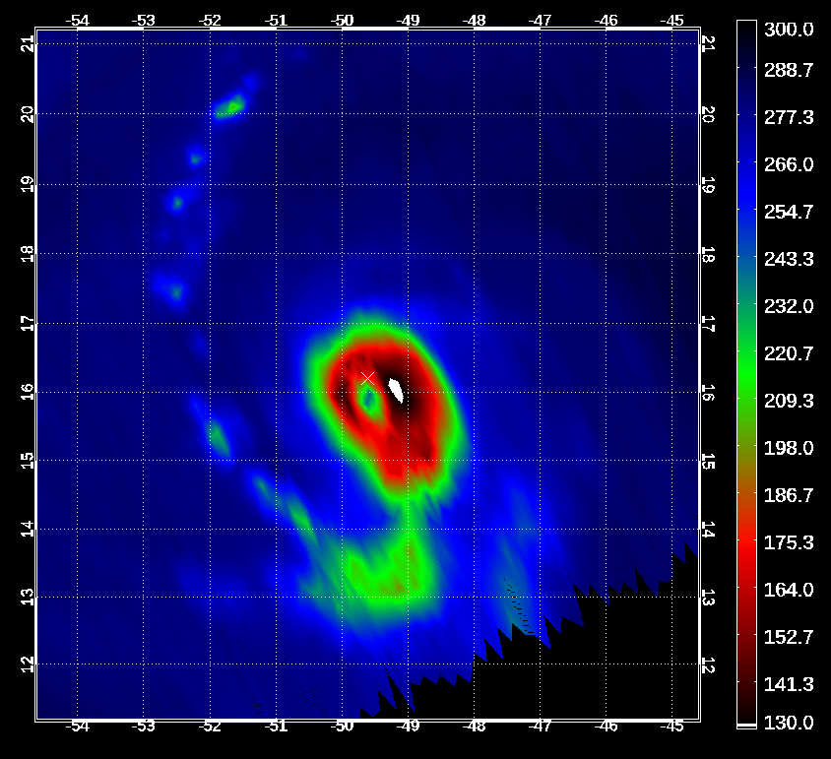
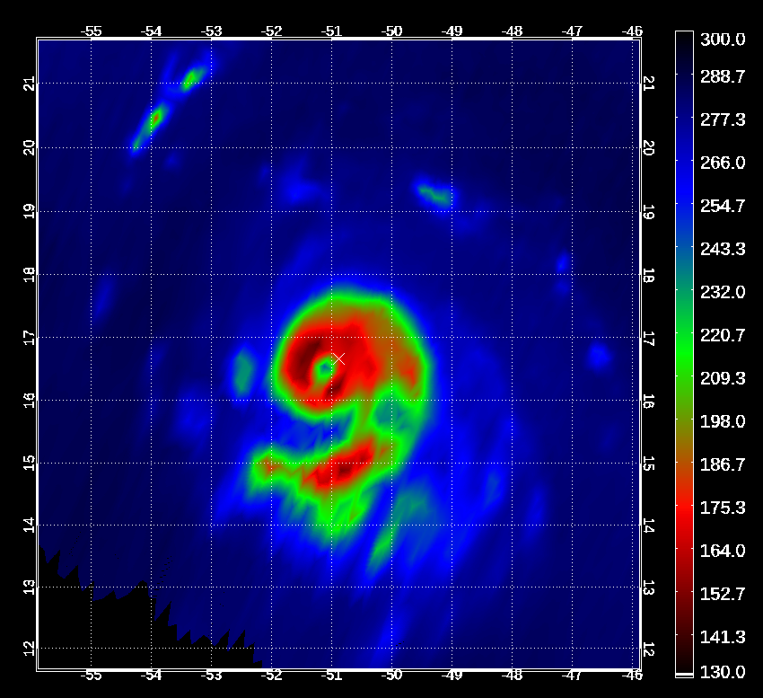
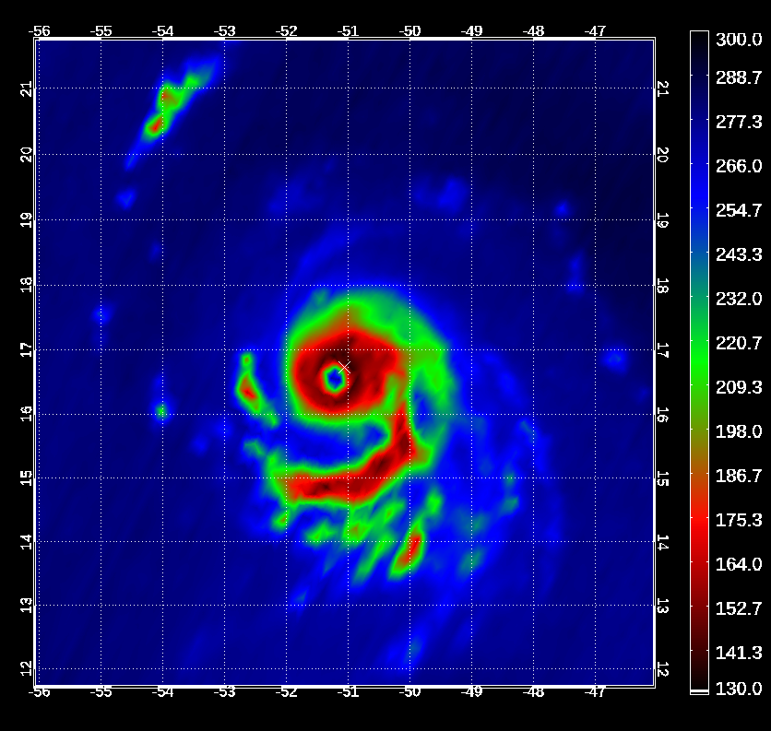
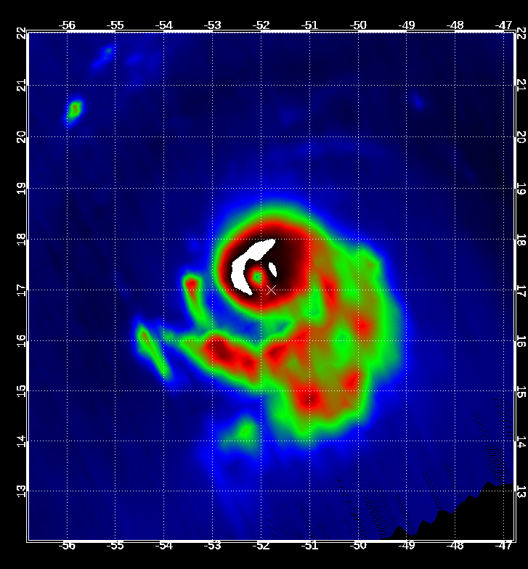
D-MINT183
Background
D-MINT183 is our third attempt at estimating current TC intensity with a convolutional neural network (CNN).
First two are:
Deep learning - Multispectral INtensity of TCs (D-MINT) which uses 37-GHz, 89-GHz, IR imagery, and scalar predictors
DeeP learning - IR INtensity of TCs (D-PRINT) which is D-MINT without the 37-GHz and 89-GHz imagery
Since D-MINT is more skillful than D-PRINT.
Can we use the abundance of TROPICS imagery to estimate current TC intensity?
Example: Hurricane Lee (2023) sequence of TROPICS 183 GHz (Ch. 9) images
07/0557Z T1
07/0917Z T3
07/1129Z T6
07/1207Z T5
07/1310Z T6
07/1956Z T6
07/2035Z T5
08/0039Z T3
70kts
135 kts

Slide 5
D-MINT183
Model Diagram

Slide 6
D-MINT183
Model Diagram

Slide 7
D-MINT183
Model Diagram
Input Features:
IR data: 128x128 grid over ~6 X 6° area centered on TC, normalized.
6 convolution layers where the scale gradually increases and more feature maps are added.
D-MINT183 needs one additional IR image at t-15h for intensity estimation.

Slide 8
D-MINT183
Model Diagram
Input Features:
IR data: 128x128 grid over ~6 X 6° area centered on TC, normalized.
6 convolution layers where the scale gradually increases and more feature maps are added.
D-MINT183 needs one additional IR image at t-15h for intensity estimation.
Input Features
MW data: 64 x 64 grid over ~3.2 X 3.2° area centered on TC, normalized.
5 convolution layers

Slide 9
D-MINT183
Model Diagram
Input Features:
IR data: 128x128 grid over ~6 X 6° area centered on TC, normalized.
6 convolution layers where the scale gradually increases and more feature maps are added.
D-MINT183 needs one additional IR image at t-15h for intensity estimation.
Input Features
MW data: 64 x 64 grid over ~3.2 X 3.2° area centered on TC, normalized.
5 convolution layers
(not included in D-PRINT)
Input Features:
Add normalized scalar location and environmental features.

Slide 10
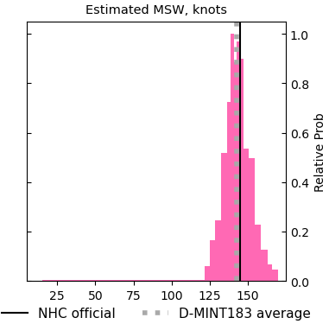
D-MINT183
Model Diagram
Input Features:
IR data: 128x128 grid over ~6 X 6° area centered on TC, normalized.
6 convolution layers where the scale gradually increases and more feature maps are added.
D-MINT183 needs one additional IR image at t-15h for intensity estimation.
Input Features
MW data: 64 x 64 grid over ~3.2 X 3.2° area centered on TC, normalized.
5 convolution layers
(not included in D-PRINT)
Input Features:
Add normalized scalar location and environmental features.
Output:
15 quantiles of TC intensity probabilities

Slide 11

D-MINT183
Training and Validation dataset
Training dataset: What D-MINT183 is trained on.
Validation dataset: What is used to make sure D-MINT183 is not overfitted and also used to determine optimal for D-MINT183.
 | SSMIS | ATMS | MHS | AMSU-B | GMI | TMS
Training (1998-2015, 2018) | 13334 | 1052 | 5687 | 4920 | 911 | 0
Validation (2016-2017) | 3211 | 227 | 1206 | 0 | 555 | 0
No TROPICS data was used in the training or validation of D-MINT183.
D-MINT183 is trained using 183$±$1 GHz and 183$±$3 GHz imagery.
TROPICS has 184.41 GHz and 186.51 GHz imagery, which is used as a proxy for the 183$±$1 GHz and 183$±$3 GHz imagery.

Slide 12
D-MINT183
TROPICS results
D-MINT183 is only run on the inner 50% of the swath to avoid edge effects.
Example: Hurricane Lee (2023) sequence of TROPICS 183 GHz (Ch. 9) images
07/0557Z T1
07/0917Z T3
07/1129Z T6
07/1207Z T5
07/1310Z T6
07/1956Z T6
07/2035Z T5
08/0039Z T3
70kts
135 kts

Slide 13
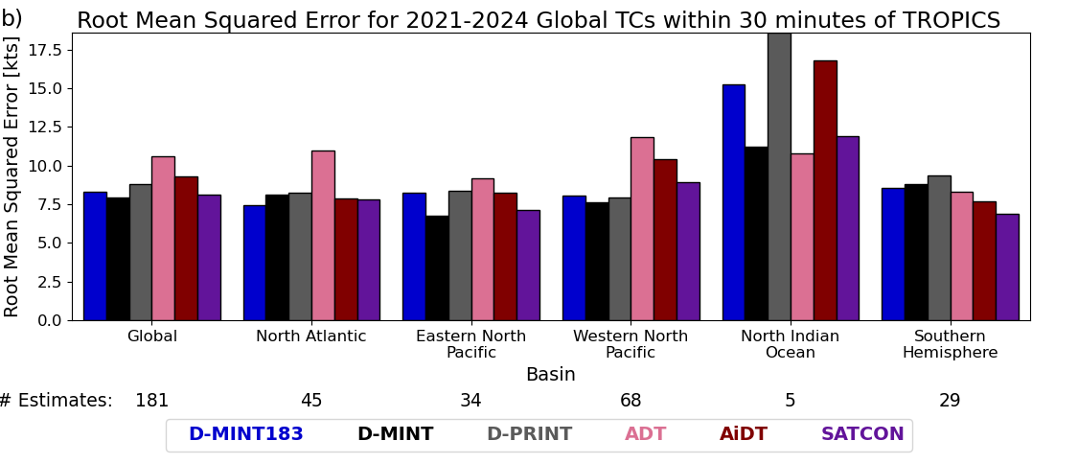
D-MINT183
TROPICS intensity estimate results – Max Sustained Winds
better
TROPICS
Deep Multispectral
INtensity of TCs
DeeP IR
INtensity of
TCs (IR-only)
Advanced Dvorak Technique
Ai-Enhanced ADT
SATellite CONsensus
D-MINT183 is generally slightly less skillful than D-MINT, but is more skillful than D-PRINT, which is our baseline since D-PRINT runs with any IR image. D-MINT183 more skillful than ADT and AiDT, but less skillful than SATCON.

Slide 14
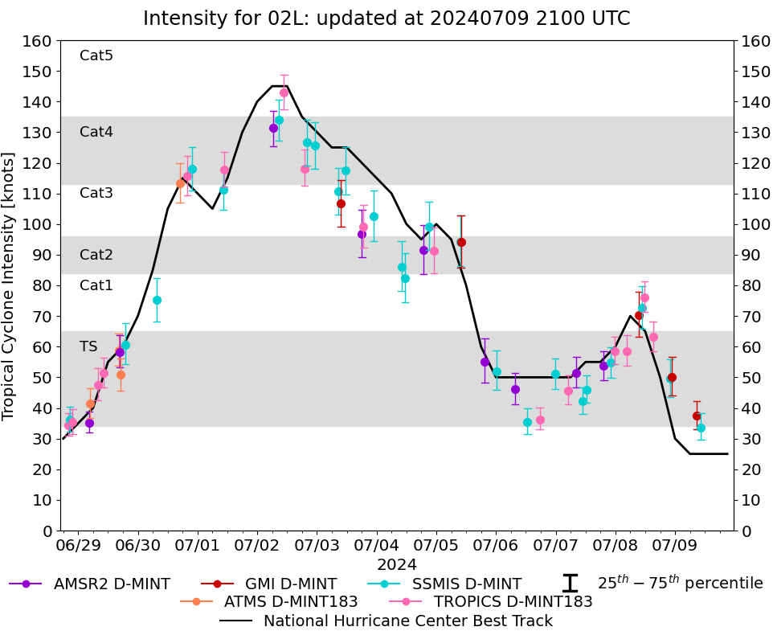
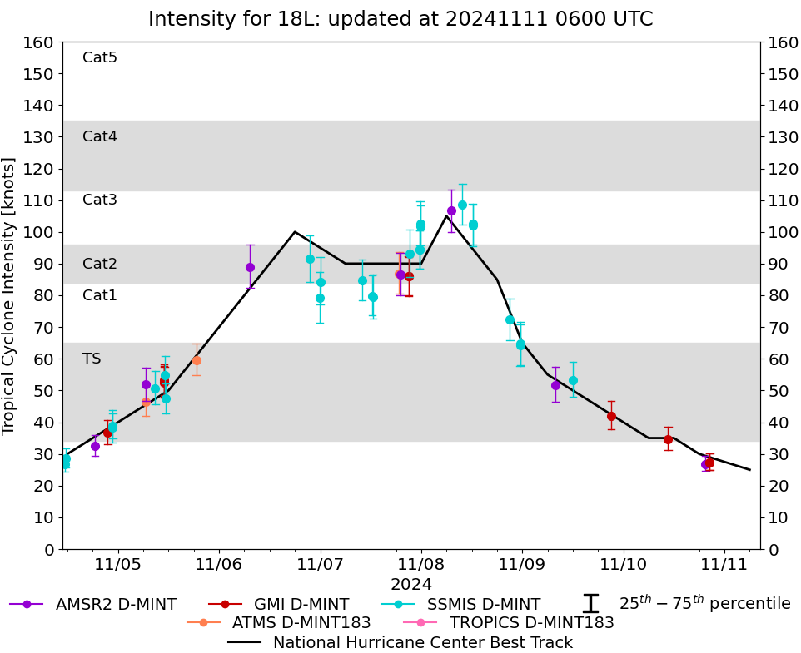
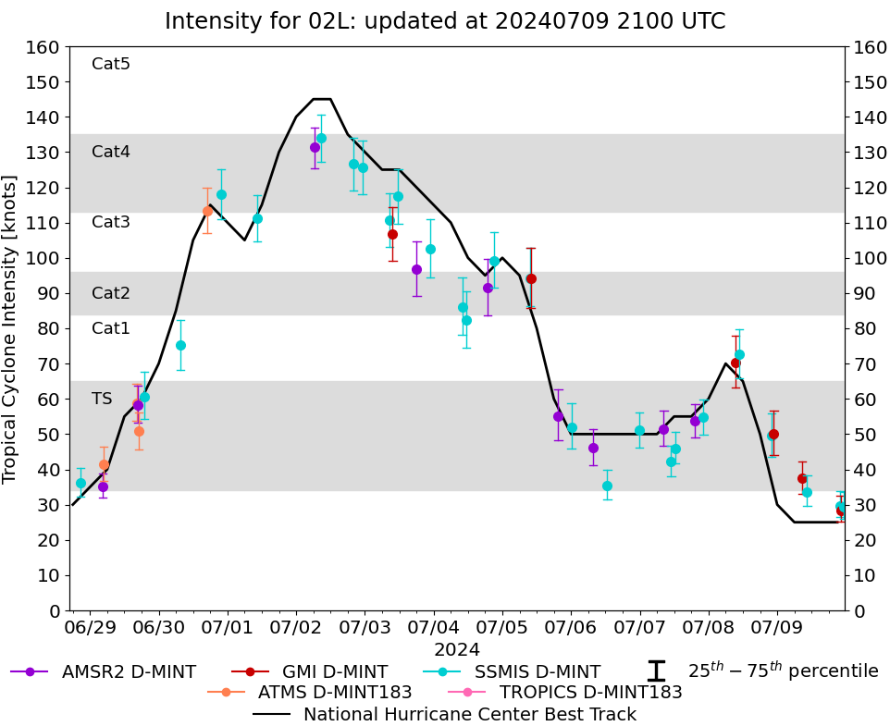
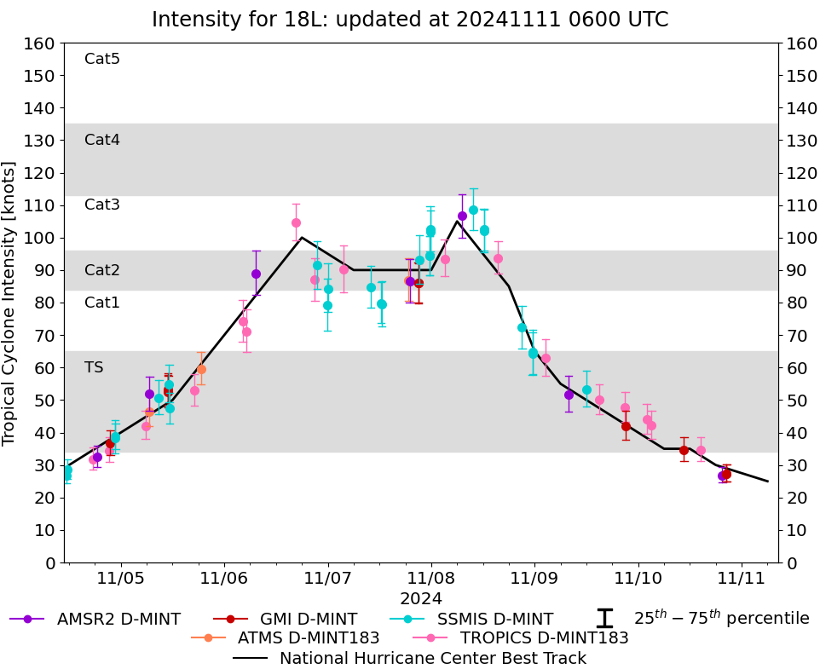
D-MINT183
Real-time TROPICS results
TROPICS intensity estimates with D-MINT183 are displayed on the D-MINT page (https://tropic.ssec.wisc.edu/real-time/DMINT/) with other intensity estimates and help fill in missing gaps.
These intensity estimates can have a latency of about 1-3 hours, similar to D-MINT.

Slide 15
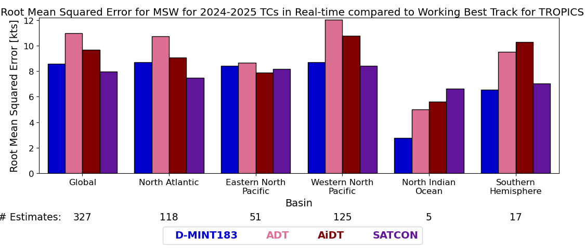
D-MINT183
Real-time TROPICS results – Max Sustained Winds
better
TROPICS
Advanced Dvorak Technique
Ai-Enhanced ADT
SATellite CONsensus
(D-PRINT ran hourly in real-time and thus not available for comparison.)
D-MINT183 more skillful than ADT and AiDT, but less skillful than SATCON.

Slide 16
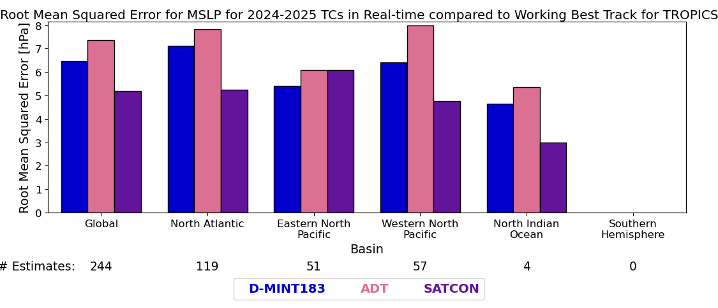
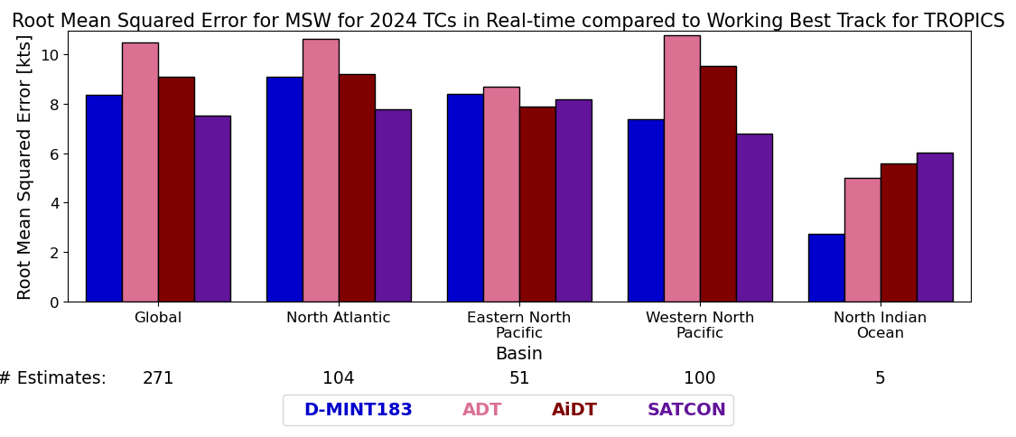
D-MINT183
Real-time TROPICS results – Minimum Sea Level Pressure
better
Missing scalar predictors from JTWC, so D-MINT183 will not estimate MSLP.
TROPICS
Advanced Dvorak Technique
SATellite CONsensus
D-MINT183 was also trained to estimate the pressure difference from the pressure of the outer closed isobar.
D-MINT183 is more skillful than ADT (which uses the Courtney-Knaff equations) but less skillful than SATCON.

Slide 17
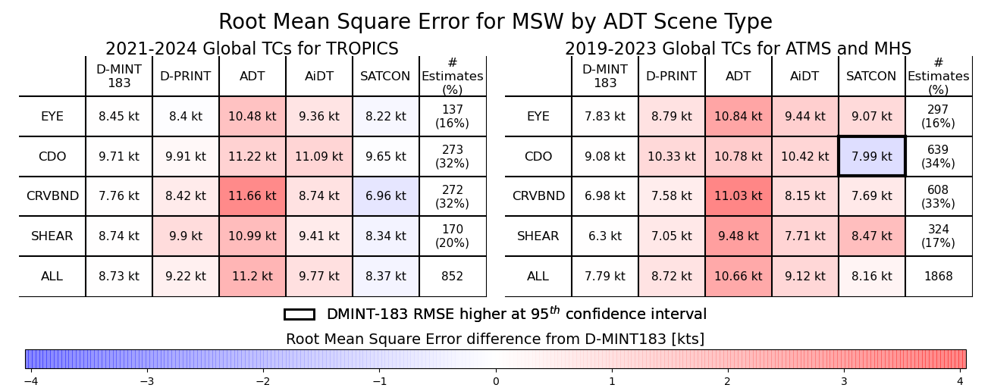
D-MINT183
Possible Issues
D-MINT183 is slightly less skillful than D-PRINT for ADT EYE scene types, but is more skillful for all other scene types.

Slide 18
D-MINT183
Possible Issues
D-MINT183 is slightly less skillful than D-PRINT for ADT EYE scene types, but is more skillful for all other scene types.
However, this is large disparity compared to what is observed with ATMS and MHS satellites, where D-MINT183 is more skillful than D-PRINT for EYE scene types. Why is this?

Slide 19
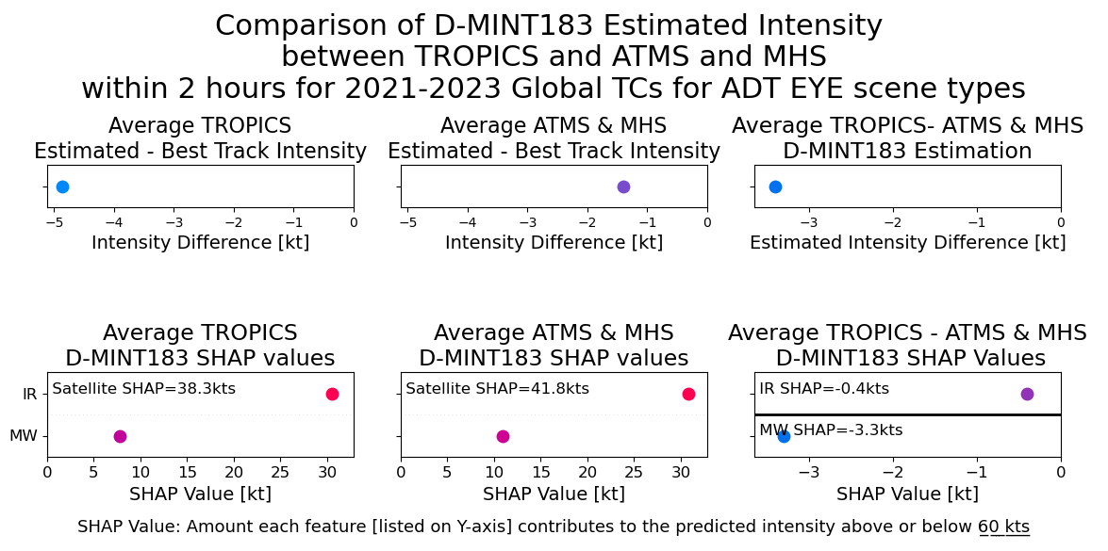
D-MINT183
Possible Issues
The average estimated TC intensity from TROPICS for ADT EYE scenes is over 3 kt lower than from ATMS and MHS.

Slide 20
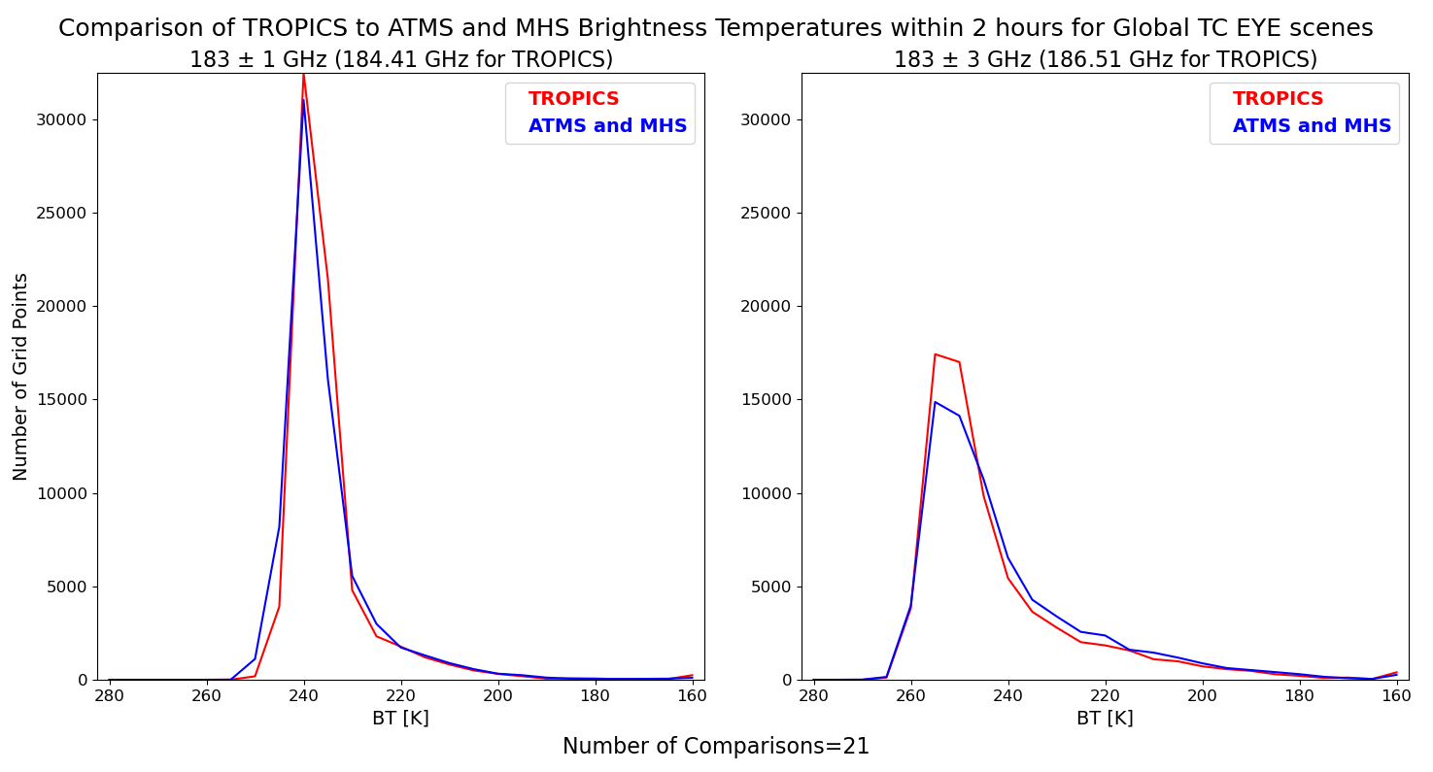
D-MINT183
Possible Issues

Slide 21
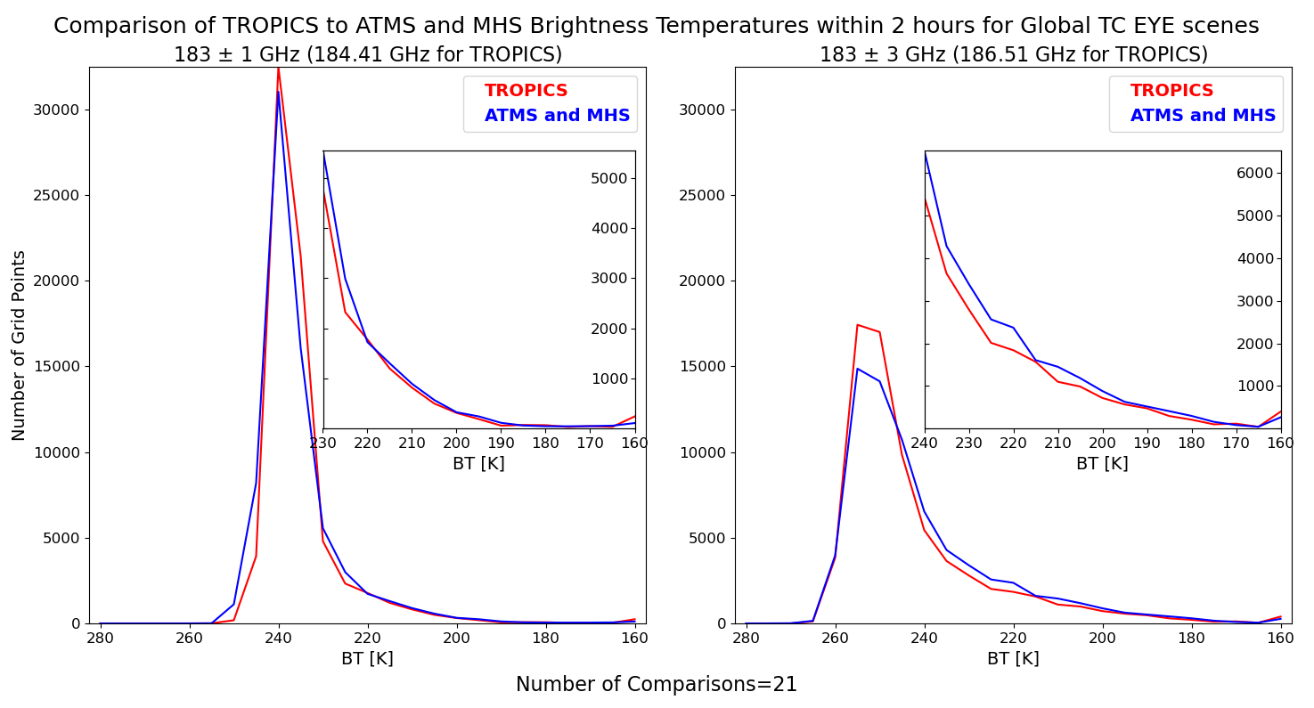


D-MINT183
Possible Issues
TROPICS has fewer grid points with BTs $≤$ 230 K compared to ATMS and MHS satellites.
TROPICS has fewer grid points with BTs $≤$ 240 K compared to ATMS and MHS satellites.

Slide 22
D-MINT183
Possible Issues
SHAP values indicate the amount an individual feature increases or decreases the estimated TC intensity from 60 kt.

Slide 23
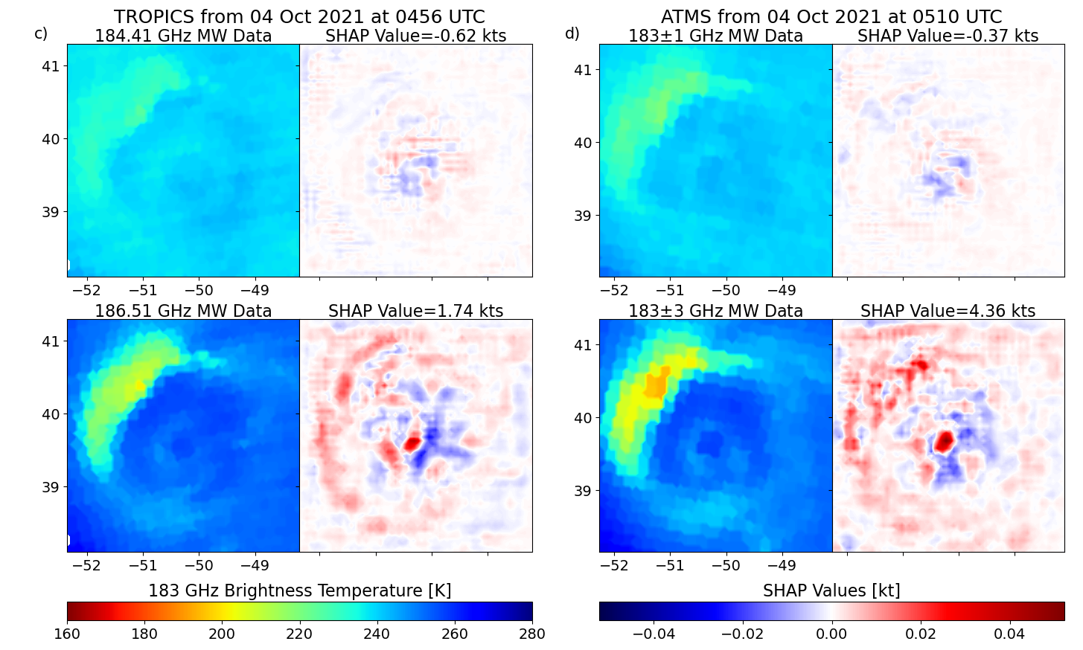


D-MINT183
Possible Issues
SHAP values indicate the amount an individual feature increases or decreases the estimated TC intensity from 60 kt.
The SHAP values for the TROPICS 184.41 GHz image is more negative than ATMS 183$±$1 GHz image, and thus the TROPICS estimated TC intensity is reduced more than ATMS estimated TC intensity.
The SHAP values for the TROPICS 186.51 GHz image is less positive than ATMS 183$±$1 GHz image, and again the TROPICS estimated TC intensity is reduced compared to the ATMS estimated TC intensity.
In both instances, lower BTs are associated with higher SHAP values.

Slide 24
D-MINT183
Possible Issues
The average estimated TC intensity from TROPICS for ADT EYE scenes is over 3 kt lower than from ATMS and MHS.

Slide 25
D-MINT183
Possible Issues
SHAP values indicate the amount an individual feature increases or decreases the estimated TC intensity from 60 kt.
The average estimated TC intensity from TROPICS for ADT EYE scenes is over 3 kt lower than from ATMS and MHS.

Slide 26
D-MINT183
Possible Issues
SHAP values indicate the amount an individual feature increases or decreases the estimated TC intensity from 60 kt.
The average estimated TC intensity from TROPICS for ADT EYE scenes is over 3 kt lower than from ATMS and MHS. That estimated difference is from the MW imagery, as evident by the SHAP values.

Slide 27
Conclusions
The CIMSS D-MINT model for estimating TC intensity has been re-trained with 183 GHz data, coined D-MINT183. Real-time global TC intensity estimates using ATMS and TROPICS are now available on the CIMSS TC site and in ATCF.
TROPICS data to-date is too limited for adequate training and optimizing of D-MINT183, however the 184 and 186 GHz data can be used as proxies for NRT estimates (expected latency: ~2-4 hours).
  Exploring options to retrain now that we have even more cases.
Currently, D-MINT183 on TROPICS only uses imagery from 3 satellites (3, 5, 6) inside the middle 50% of a TC overpass swath (limb data more challenging due to broader frequency bandwidths, lower footprint spatial resolution).
  This curtails # of TC ‘hits’; efforts underway to expand (e.g., limb darkening corrections).
Results indicate TC intensity estimates from TROPICS with D-MINT183 is a little less skillful than D-MINT, but still very competitive with existing satellite-based objective intensity estimates produced by CIMSS.
Plans are for D-MINT183 to employ TROPICS data for NRT intensity estimates during 2025 and possibly 2026 TC seasons (depending on spacecraft health).
  Hoping to expand to other satellites, such as Tomorrow.io.

Slide 28

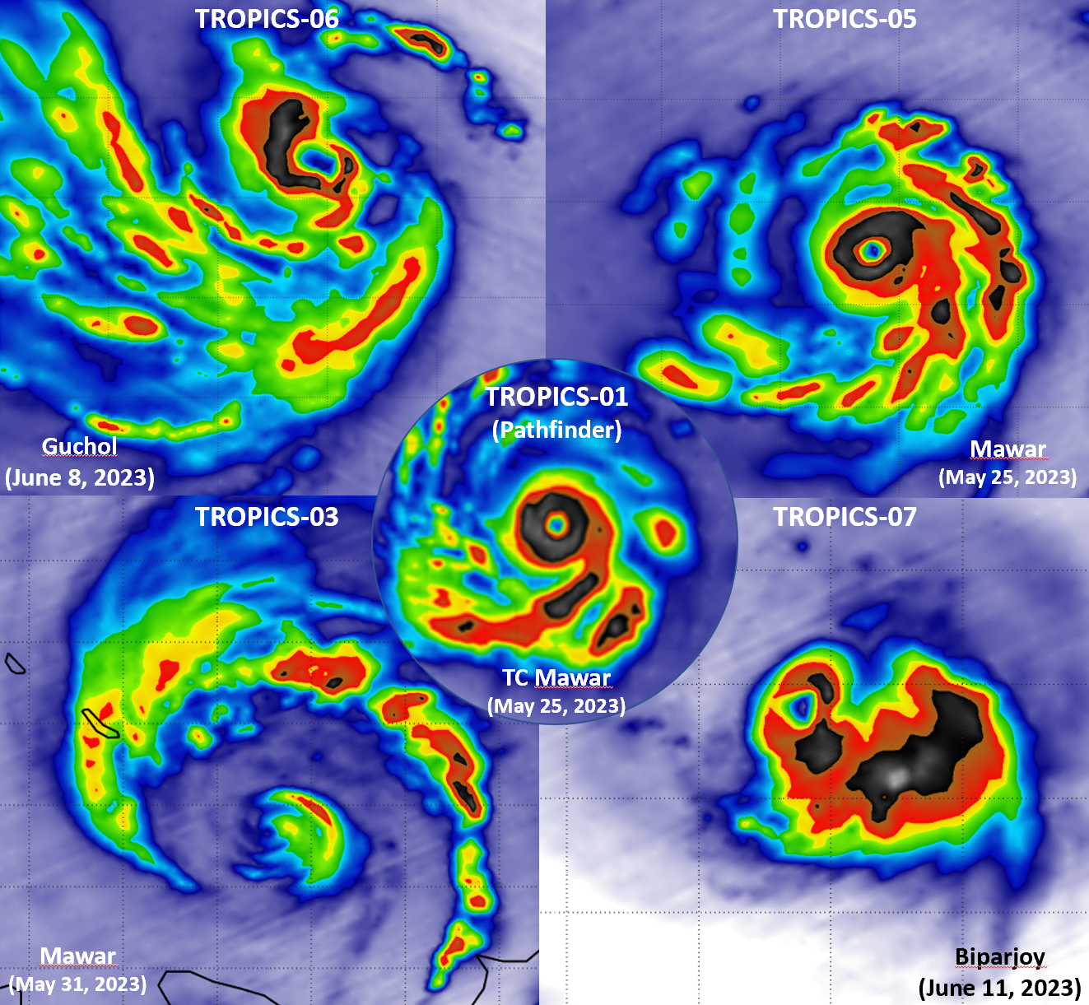

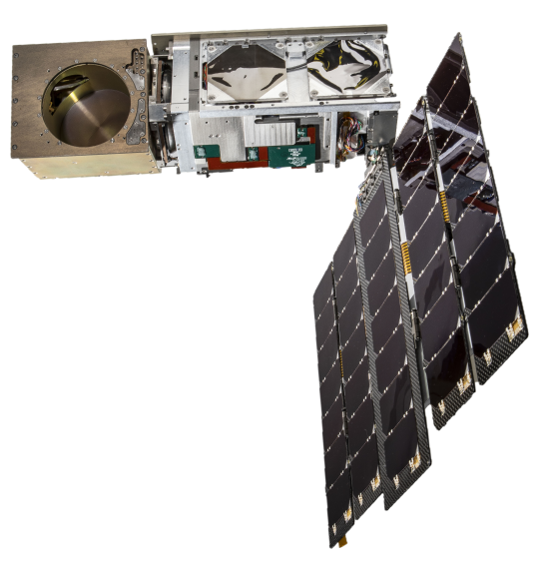
Conclusions
QUESTIONS?

