Slide 1
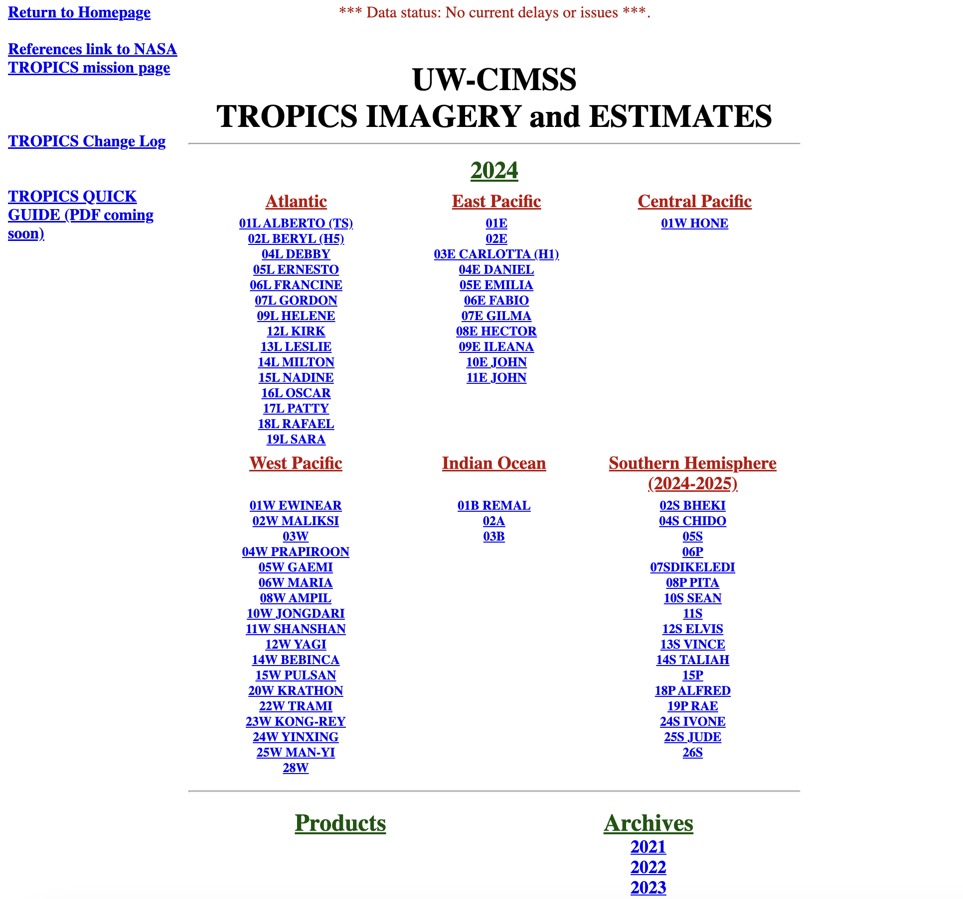
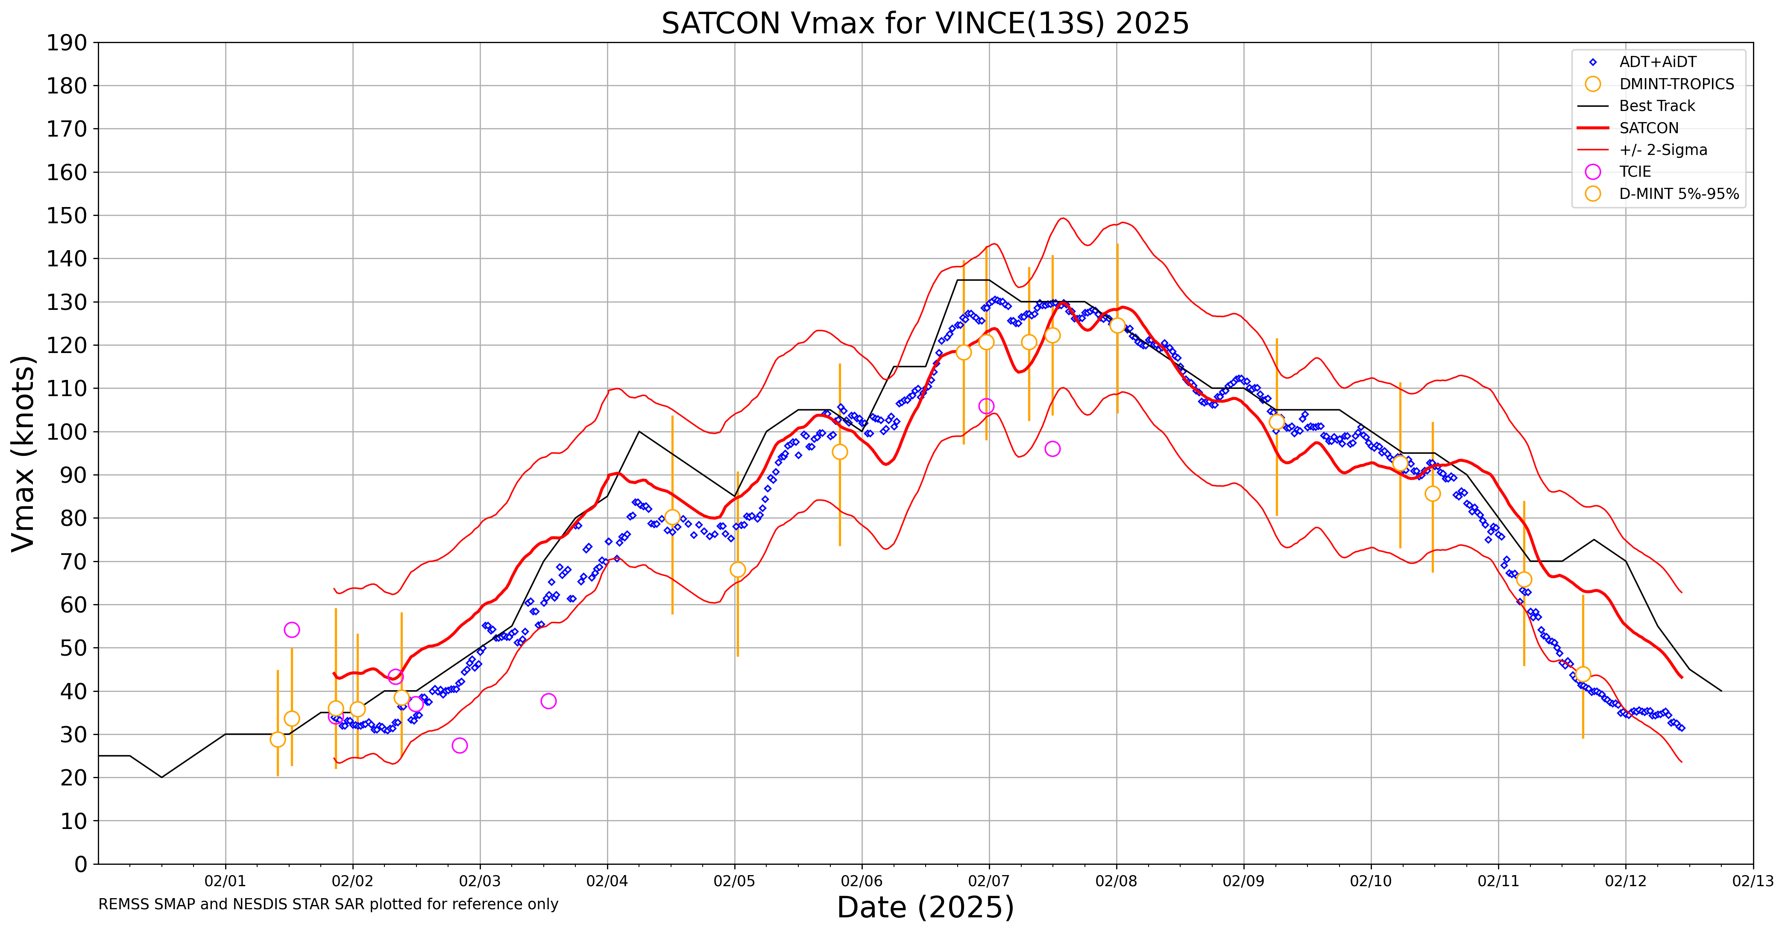
TROPICS Tropical Cyclone Intensity Efforts
TROPICS Applications Telecon March 24, 2025
Updates to TCIE page and a recent storm example
DMNT -183 rollout progress
Tomorrow.io comparisons with TROPICS underway
AMS Satellite Conference in San Diego abstract submission

Slide 2
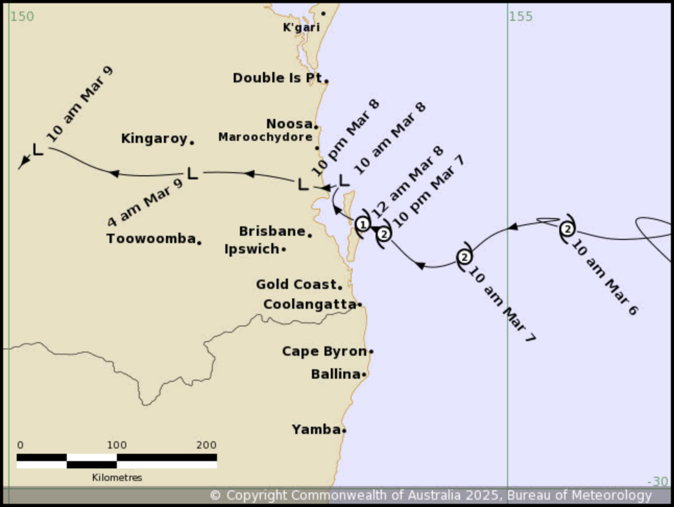
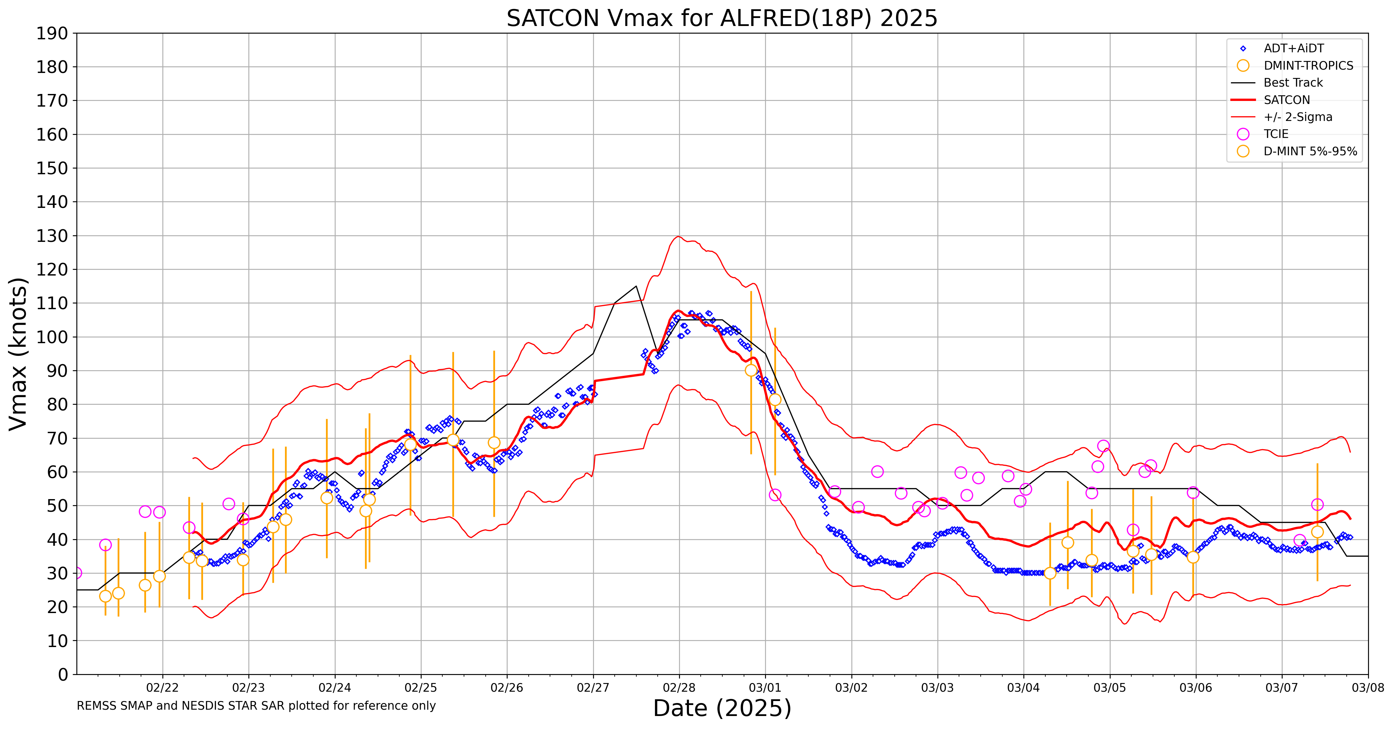
Tropical Cyclone Alfred landfall in Australia
“Alfred caused significant damage to southeast Queensland and northeastern New South Wales through damaging wind gusts, heavy rainfall with subsequent flooding impacts and severe coastal erosion of beaches.”
89
205
183

Slide 3
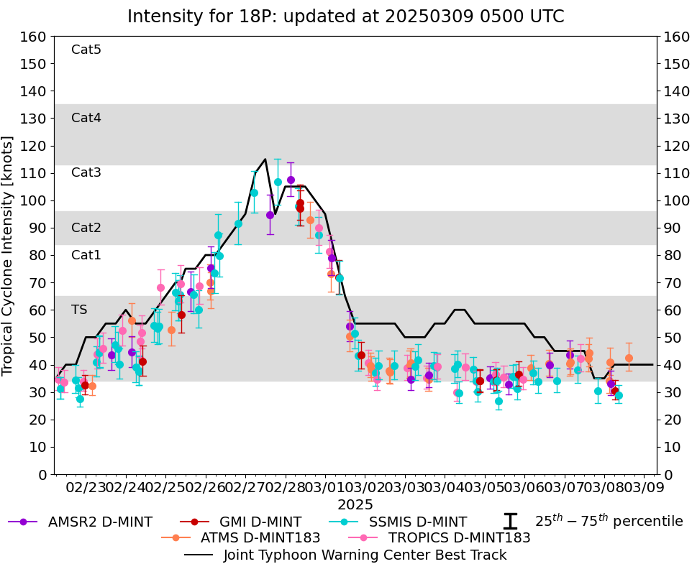
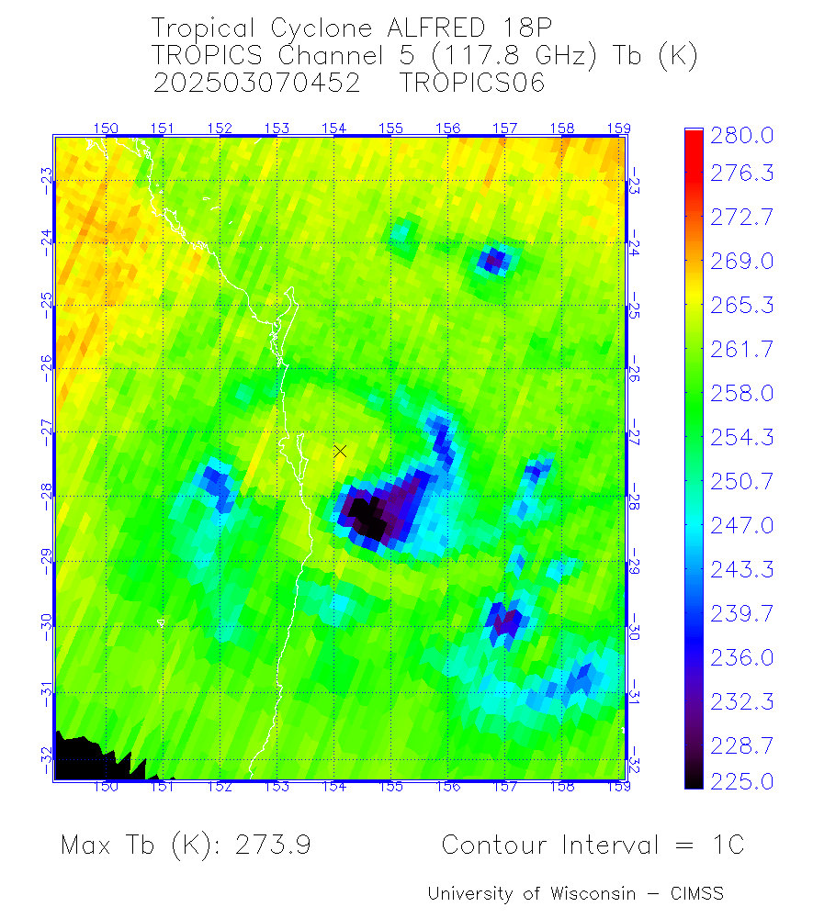
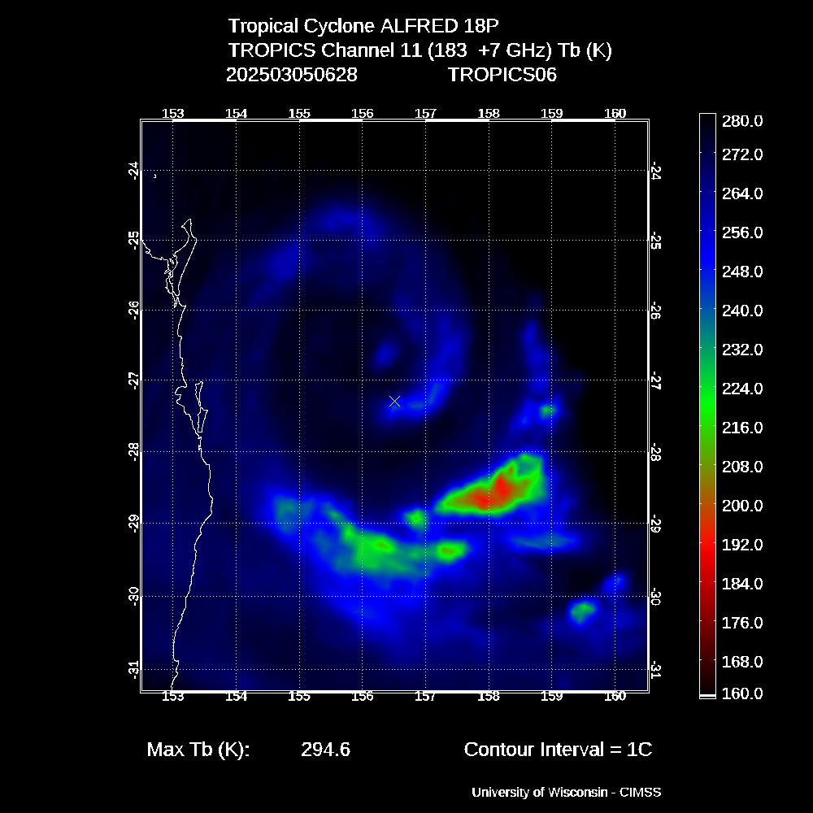
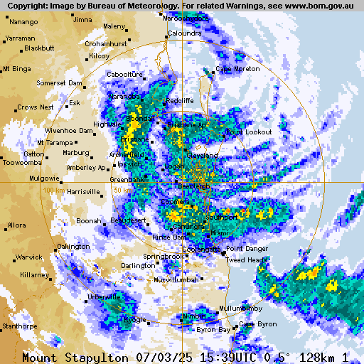
Tropical Cyclone Alfred landfall in Australia
D-MINT183 weak
due to lack of deep
convection
Discussion at BoM concerning
The phase of Alfred at landfall.
Tropical vs Subtropical.
Convection near core was weak
however sounders still showed
a broad weak warm core
Weak warm core CH5

Slide 4
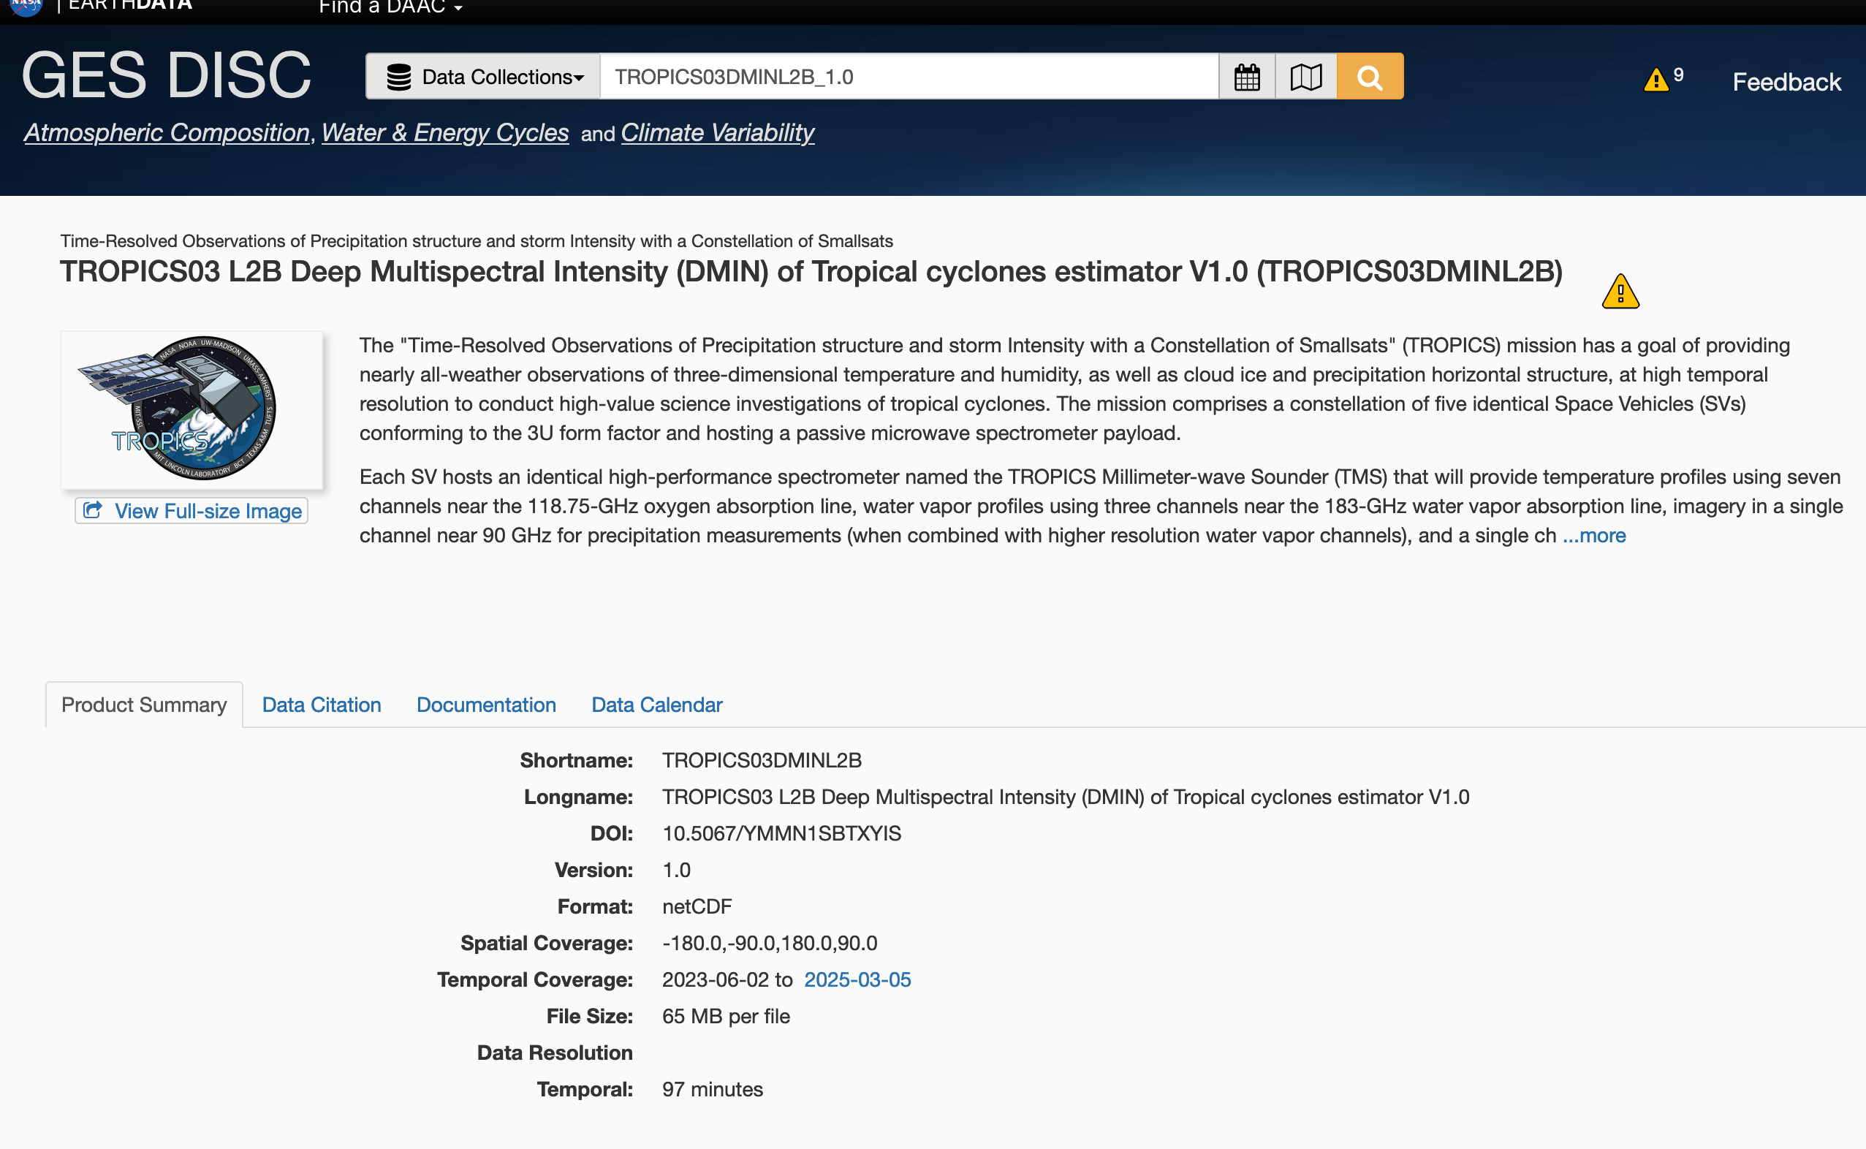
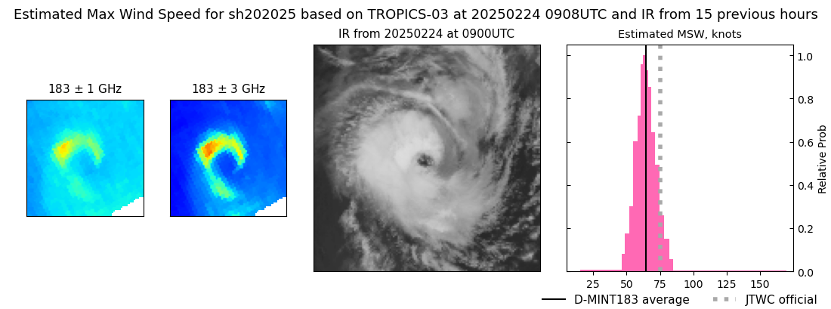
TROPICS Tropical Cyclone Intensity Efforts
TROPICS Applications Telecon March 24, 2025
D-MINT183 TC Intensity Estimates
Code updated to create NetCDF output
ATBD update to include D-MINT183
Now live at GES DISC
D-MINT183 is primary TC intensity tool
D-MINT183 output from GES DISC Archive (Bianca 20S)

